Slide 1
CSC 322 Operating Systems Concepts
Lecture - 11:
by
Ahmed Mumtaz Mustehsan
Special Thanks To:
Tanenbaum, Modern Operating Systems 3 e, (c) 2008 Prentice-Hall, Inc. (Chapter-2)
http://www.ibm.com/developerworks/linux/library/l-completely-fair-scheduler
Notes:
1

Slide 2
Scheduling in Interactive Systems
Round robin
Priority
Multiple Queues
Shortest Process Next
Guaranteed Scheduling
Lottery Scheduling
Fair Share Scheduling

Slide 3
Priority Scheduling
Run jobs according to their priority
Priority can be static or can be changed dynamically
Typically combine RR with priority.
Each priority class uses RR inside

Slide 4
Priority Scheduling
Have to decide on a priority number (o to n)
    0 can be highest or lowest
Priorities can be:
    Internal: Set according to O/S factors (e.g., memory requirements or other resources )
    External: Set as a user policy; e.g., User importance, proposed by administerator
    Static: Fixed for the duration of the process
    Dynamic: Changing during processing
        e.g., as a function of amount of CPU usage, or length of time waiting (a solution to starvation)
Notes:
Increasing the time quantum of of higher-priority tasks:
http://forum.soft32.com/linux2/Linux-Scheduler-Time-Quantum-ftopict16457.html

Slide 5
Starvation Problem
Priority scheduling algorithms can suffer from starvation (indefinite waiting for CPU access)
In a heavily loaded system, a steady stream of higher priority processes can result in a low priority process never receiving CPU time, i.e., it can starve for CPU time
One solution: aging: Gradually increasing the priority of a process that waits for a long time
Notes:
You see starvation not only in CPU scheduling but also in various other contexts in operating systems. Resource starvation in general is an issue. CPU starvation can also occur in receive livelock where you have a steady stream of incoming network traffic. E.g., denial of service.

Slide 6
Multiple Queues with Priority Scheduling
Highest priority gets one quantum, second highest gets 2, next highest gets 4………
  If highest finishes during quantum, great. Otherwise bump it to second highest priority and so on into the night
Consequently, shortest (high priority) jobs finishes first
They announce themselves; no previous knowledge assumed!

Slide 7
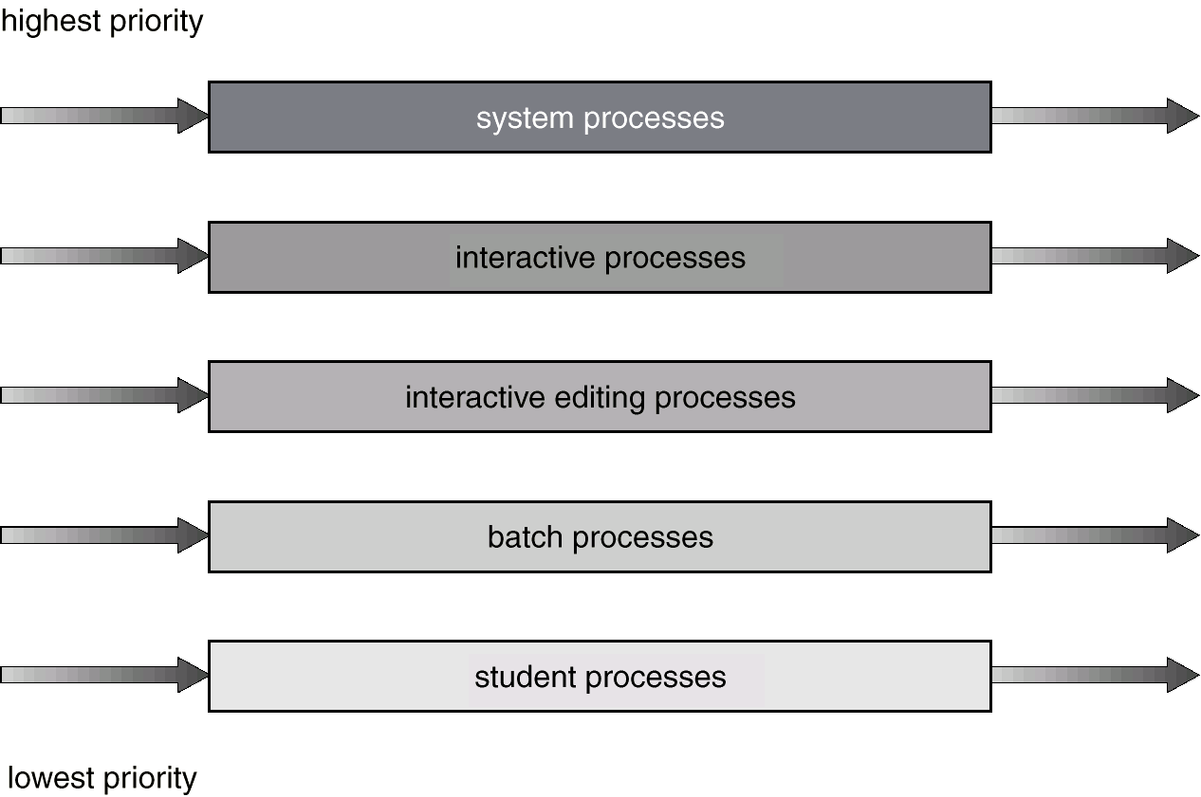
Multilevel Queue Scheduling

Slide 8
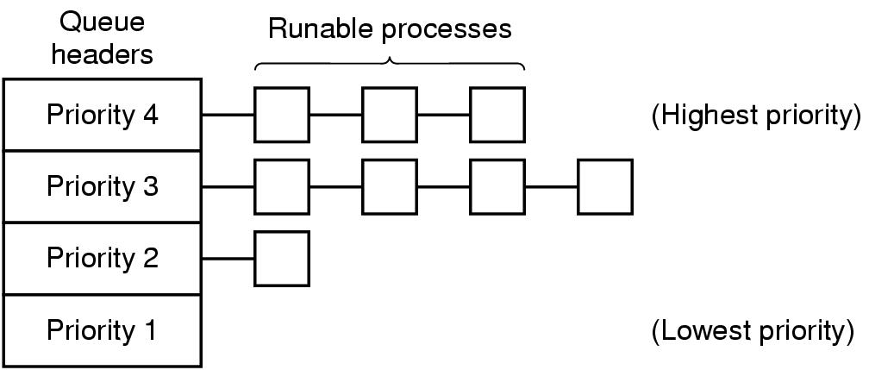
Priority Scheduling with Multiple Queues

Slide 9
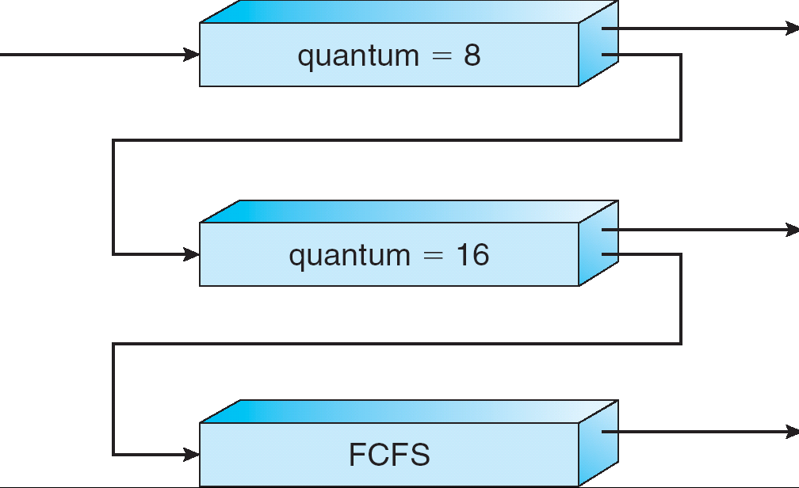
Multi-level Feedback Queues

Slide 10
Multi-level Ready Queues
Multiple ready queues
  For different types of processes (e.g., system, user)
  For different priority processes
Each queue can
  Have a different scheduling algorithm
  Receive a different amount of CPU time
  Have movement of processes to another queue (feedback)
if a process uses too much CPU time, put in a lower priority queue
If a process is getting too little CPU time, put it in a higher priority queue

Slide 11
Shortest Running Time Next
Pick job with shortest time to execute next
Pre-emptive: compare running time of new job to remaining time of existing job
  Need to know the run times of jobs in advance
  exponential smoothing can be used to estimate a jobs’ run time
  aT0 + (1-a)T1 where T0 and T1 are successive runs of the same job

Slide 12
Shortest Running Time Next
How to estimate or predict the future?
Use history to predict duration of next CPU burst
    E.g., base on duration of last CPU burst and a number summarizing duration of prior CPU bursts
  T_{n+1} = α * T₀ + (1 - α) * T_{n}
  Where:
    T_{n} is the actual duration of nth CPU burst value for the process.
    α is a constant indicating how much to base estimate on last CPU burst, and
    Τ_{n+`1} is the estimate of CPU burst duration for time n
Notes:
Show them the formula with a specific value plugged in for alpha
Write down this formula on the board

Slide 13
Shortest Running Time Next
Example Estimate
Say, α = 0.5
T₀ = 10 (last estimate)
  Will just give some reasonable guess for first τ
Current (measured) CPU burst, t = 6
What is estimate of next CPU burst?
  T₂ = α * T₀ + (1 - α) * T₁
  T₂ = 0.5 * 10 + 0.5 * 6 = 8

Slide 14
Shortest Running Time Next
Implementation
Need to keep ready ‘queue’ ordered
Process with the shortest estimated next CPU burst must be kept at the beginning of the ‘queue’

Slide 15
Guaranteed Scheduling
Make real promises to the users about performance and then live up to those promises.
Example: If there are n processes each one should get 1/n of the CPU cycles
Computes the amount of CPU each one is entitled to, the time since creation divided by n.
Compute the ratio of actual CPU time consumed to CPU time entitled, 0.5 means that a process had half of what it should have, and a ratio of 2.0 means that a process has had twice as much as it was entitled to.
Run the process with the lowest ratio until its ratio has moved above its closest competitor.

Slide 16
Lottery Scheduling
Yet another alternative: Lottery Scheduling
  Give each job some number of lottery tickets
  On each time slice, randomly pick a winning ticket
  On average, CPU time is proportional to number of tickets given to each job over time
How to assign tickets?
  To approximate SRTF, short-running jobs get more, long running jobs get fewer
  To avoid starvation, every job gets at least one ticket (everyone makes progress)

Slide 17
Lottery Scheduling
Advantage over strict priority scheduling: behaves gracefully as load changes
Hold lottery for CPU time; several times a second
Can enforce priorities by allowing more tickets for “more important” processes

Slide 18
Example: Lottery Scheduling
Assume short jobs get 10 tickets, long jobs get 1 ticket
What percentage of time does each long job get? Each short job?
# short jobs / # long jobs | % of CPU each short job gets | % of CPU each long job gets
1/1 | 91% | 9%
0/2 | N/A | 50%
2/0 | 50% | N/A
10/1 | 9.9% | 0.99%
1/10 | 50% | 5%

Slide 19
Example: Lottery Scheduling
What if there are too many short jobs to give reasonable response time
  In UNIX, if load average is 100%, it’s hard to make progress
  Log a user out or swap a process out of the ready queue (long term scheduler)

Slide 20
Real Time Scheduling
Hard real time vs soft real time
  Hard: robot control in a factory
  Soft: CD player
Events can be periodic (occurring after regular interval) or aperiodic ( occurring after irregular inertial)
Algorithms can be static (know run times in advance) or dynamic (run time decisions)

Slide 21
Fair-Share Scheduling
Consider who owns a process before scheduling it
if user-1 starts up 9 processes and user-2 starts up 1 process, with RR or equal priorities, user-1 will get 90% of the CPU and user-2 will get only 10% of it.
Example:
Consider two users are promised 50% of the CPU. User-1 has four processes, A, B, C, and D, and user 2 has only 1 process, E. with RR:
  A E B E C E D E A E B E C E D E . . .
On the other hand, if user-1 i s entitled to twice as much CPU time as user-2, we might get
  A B E C D E A B E C D E ...

Slide 22
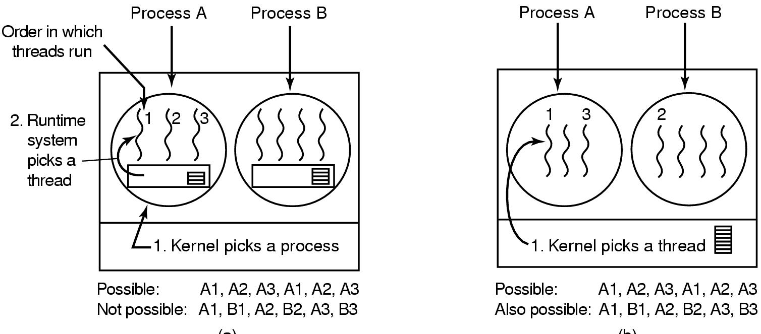
Thread Scheduling
Kernel picks process (left)
Kernel picks thread (right)

Slide 23
Multiprocessor Scheduling
Load sharing
  Scheduling processes on different CPU’s or cores
Types of ready queues
  Local: dispatch to a specific processor
  Global: dispatch to any processor
Processor/process relationship
  Run on only a specific processor (e.g., due to device or caching issues; hard affinity). Why?
  Run on any processor
Symmetric (SMP): Each processor does own scheduling
  Same operating system runs on each processor
Master/slave (Asymmetric)
  Master processor dispatches processes to slaves

Slide 24
Symmetric Multiprocessing: Synchronization Issues
Involves synchronization of access to global ready queue
  only one processor must execute a job at one time
Processors: CPU1, CPU2, CPU3, …
When a processor (e.g., CPU1) accesses the ready queue
  If they attempt access to the ready queue, all other processors (CPU2, CPU3, …) must wait; denied access
  Accessing processor (e.g., CPU1) removes a process from ready queue, and dispatch’s process on itself
  Just before dispatch, that processor makes ready queue again available for use by the other CPU’s (CPU2, CPU3, …)

Slide 25
CPU Scheduling in Existing Systems: Windows XP
Priority based, preemptive scheduling
Scheduling on the basis of threads
Highest priority thread always be dispatched, and runs until:
  preempted by a higher priority thread
  it terminates
  its time quantum ends
  it makes a blocking system call (e.g., I/O)
32 priorities, each with own queue:
  memory. mgmt.: 0; variable: 1 to 15;
  real-time; 16 to 31

Slide 26
Scheduling in Existing Systems: Linux 2.5 kernel
Priority-based, preemptive
Two priority ranges (real time and nice)
Time quantum longer for higher priority processes (ranges from 10ms to 200ms)
Tasks are runnable while they have time remaining in their time quantum; once exhausted, must wait until others have exhausted their time quantum

Slide 27
Which Scheduling Algorithms Can be Preemptive?
FCFS (First Come First Served)
    Non-preemptive
SJF (Shortest Job First, Shortest job Next)
    Can be either
    Choice when a new (shorter) job arrives
    Can preempt current job or not
Priority
    Can be either
    Choice when a processes priority changes or when a higher priority process arrives
Notes:
Review: What does preemptive mean? Just considering, in principle, which of these can be preemptive

Slide 28
Which Scheduling Algorithms Can be Preemptive?
Round robin,
Guaranteed Scheduling,
Lottery Scheduling,
Fair Share Scheduling:
  All the above are scheduling are preemptive.
Notes:
Review: What does preemptive mean? Just considering, in principle, which of these can be preemptive

Slide 29
RR (Round Robin) Scheduling: Example
CPU job burst times & order in queue
  P1: 20
  P2: 12
  P3: 8
  P4: 16
  P5: 4
Draw Gantt chart, and compute average wait time
    Time quantum of 4
    Like our previous examples, assume 0 context switch time
Notes:
Designed for time sharing
Textbook:

Slide 30
Solution
completes
completes
completes
completes
completes
P1
P2
P3
P4
P5
P1
P2
P3
P4
P1
P2
P4
P1
P4
P1
0
4
8
12
16
20
24
28
32
36
40
44
48
52
56
60
Waiting times:
    P1: 60 - 20 = 40
    P2: 44 - 12 = 32
    P3: 32 - 8 = 24
    P4: 56 - 16 = 40
    P5: 20 - 4 = 16
Average wait time: 30.4
  P1: 20
  P2: 12
  P3: 8
  P4: 16
  P5: 4
  (40+32+24+40+16)/5
= 152/5= 30.2
Notes:
This assumes a zero context switch time.

Slide 31
Other Performance Criteria
Response time:
  a). Time from job submission to time to first CPU response.
  b). Assume all jobs submitted at same time, in order given.
Turnaround time
  a). Time interval from submission of process until completion of process
  b). Assume all jobs submitted at same time
FCFS
P1
P2
P3
P4
P5
20
32
40
56
60
SJF
P5
P3
P2
P4
P1
4
12
24
40
60
RR
P1
P2
P3
P4
P5
P1
P2
P3
P4
P1
P2
P4
P1
P4
P1
4
8
12
16
20
24
28
32
36
40
44
48
52
56
60
Notes:
This assumes a zero context switch time.

Slide 32
Response Time Calculations
Job | FCFS | SJF | RR
P1 | 0 | 40 | 0
P2 | 20 | 12 | 4
P3 | 32 | 4 | 8
P4 | 40 | 24 | 12
P5 | 56 | 0 | 16
Average | 29.6 | 16 | 8
Notes:
This assumes a zero context switch time.

Slide 33
Turnaround Time Calculations
Job | FCFS | SJF | RR
P1 | 20 | 60 | 60
P2 | 32 | 24 | 44
P3 | 40 | 12 | 32
P4 | 56 | 40 | 56
P5 | 60 | 4 | 20
Average | 41.6 | 28 | 42.4
Notes:
This assumes a zero context switch time.

Slide 34
Performance Characteristics of Scheduling Algorithms
Different scheduling algorithms will have different performance characteristics
RR (Round Robin)
  Average waiting time often high
  Good average response time
    Important for interactive or timesharing systems
SJF
  Best average waiting time
  Some overhead with respect to estimates of CPU burst length & ordering ready ‘queue’

Slide 35
Context Switching Issues
This analysis has not taken context switch duration into account
    In general, the context switch will take time
    Just like the CPU burst of a process takes time
    Response time, wait time etc. will be affected by context switch time
RR (Round Robin) & quantum duration
      To reduce response times, want smaller time quantum
      But, smaller time quantum increases system overhead
Notes:
Throughput
Number of jobs completed per unit time
Turnaround time
Time interval from submission of a process until completion of the process

Slide 36
Example
Calculate average waiting time for RR (round robin) scheduling, for
Processes:
    P1: 24
    P2: 4
    P3: 4
  Assume above order in ready queue; P1 at head of ready queue
  Quantum = 4; context switch time = 1

Slide 37
Solution: Average Wait Time With
Context Switch Time
P1
P2
P3
P1
P1
P1
P1
P1
4
5
9
10
14
15
19
20
24
25
29
30
34
35
39
P1: 0 + 11 + 4 = 15
P2: 5
P3:10
Average: 10
(This is also a reason to dynamically vary the time quantum. e.g., Linux 2.5 scheduler, and Mach O/S.)

