Slide 1
CSC 322 Operating Systems Concepts
Lecture - 10:
by
Ahmed Mumtaz Mustehsan
Special Thanks To:
Tanenbaum, Modern Operating Systems 3 e, (c) 2008 Prentice-Hall, Inc. (Chapter-2)
http://www.ibm.com/developerworks/linux/library/l-completely-fair-scheduler
Notes:
1

Slide 2
CPU Scheduling
One CPU and many process to run (Multiprogramming) A choice is to be made that which process to run next!
Usually many processes in ready state
  Ready to run on CPU
  Focus on a single CPU here
Need strategies for
  Allocating CPU time (time quantum)
  Selecting next process to run
  Deciding what happens after a process completes a system call, or completes I/O
Short-term scheduling
  Must not take much CPU time to do the scheduling
Notes:
Draw this Figure on the board so that we can use it on slide #3 when I’m talking about when process scheduling occurs.

Slide 3
Scheduler and Scheduling Algorithms
The part of the operating system that makes the choice that which process to run next is called the scheduler.
The algorithm used by scheduler is called the scheduling algorithm.
Note: Generally the issues that apply to process scheduling also apply to thread scheduling.

Slide 4
Scheduling algorithm – Does not Matter For
Personal Computer User
  One user who only competes with himself for the CPU
  Computers have gotten so much faster over the years that the CPU is not a limited resource any more.
  Hardly any scheduling is required.

Slide 5
Scheduling algorithms – Do Matter For
Batch servers; Carry out background processing computing insurance claim
Time sharing machines; serving interactive users
Networked servers; sharing resources
You care if you have a bunch of users and/or if the demands of the jobs differ from process to process (I/O bound jobs and CPU bound jobs)

Slide 6
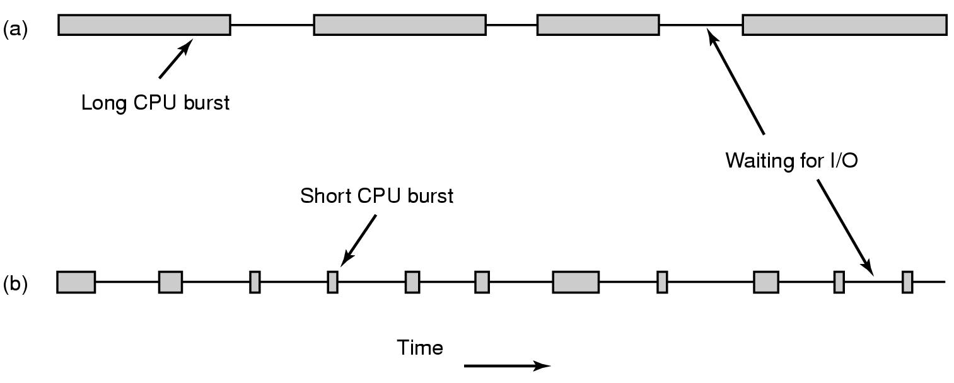
Scheduling – Process Behavior
Bursts of CPU usage alternate with periods waiting for I/O.
A CPU-bound or compute-bound process
An I/O-bound process. (enters the bocked state waiting for an external device to complete its work.)

Slide 7
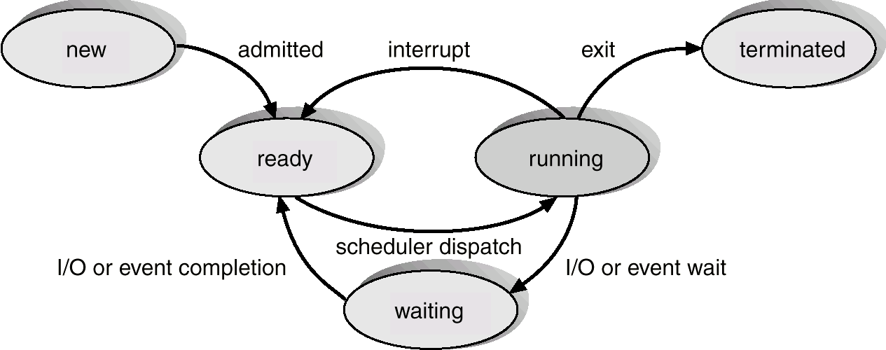
Scheduler to observe the Process states

Slide 8
When to make scheduling decisions
When to Schedule:
  New process creation (run parent or child; both are in ready state)
  A process exits (if no process is ready, a system supplied idle process is executed).
  A process blocks (e.g. on a semaphore, but scheduler does not have the dependency information)
  I/O interrupt happens (should the blocked process or some other process to run?)

Slide 9
Preemptive and non-preemptive scheduling
non-preemptive scheduling; Picks up a process to run and then just lets it run until:
it blocks on I/O or waiting for another process or it voluntarily releases the CPU.
not suspended forcefully
no scheduling decisions made during clock interrupts
preemptive scheduling; picks a process and lets it run
for an allocated time quantum.
If still running at the end of the time quantum it is suspended and the scheduler picks another process
preemptive scheduling requires a clock interrupt that gives control of the CPU back to the scheduler
If no clock interrupt then no preemptive scheduling.

Slide 10
Categories of Scheduling Algorithms
In different environments different scheduling algorithms are needed:
  Batch (payroll, inventory, accounts receivable payable, interest calculation, claims processing)
  Interactive ( users are in big hurry)
  Real time (Hard and soft deadlines)

Slide 11
When do Batch, Multiprogramming & Multitasking System do Scheduling?
When a process terminates
When a process switches from running to waiting state
    e.g., when it does an I/O request
When a process switches from running to ready state
    e.g., when a timer interrupt occurs
When a process switches from waiting state to ready state
    e.g., completion of I/O
Batch
Multiprogramming
Multi-tasking or time-sharing
Notes:
Case #1 is for batch systems
Case #1 and #2 are for multiprogramming systems

Slide 12
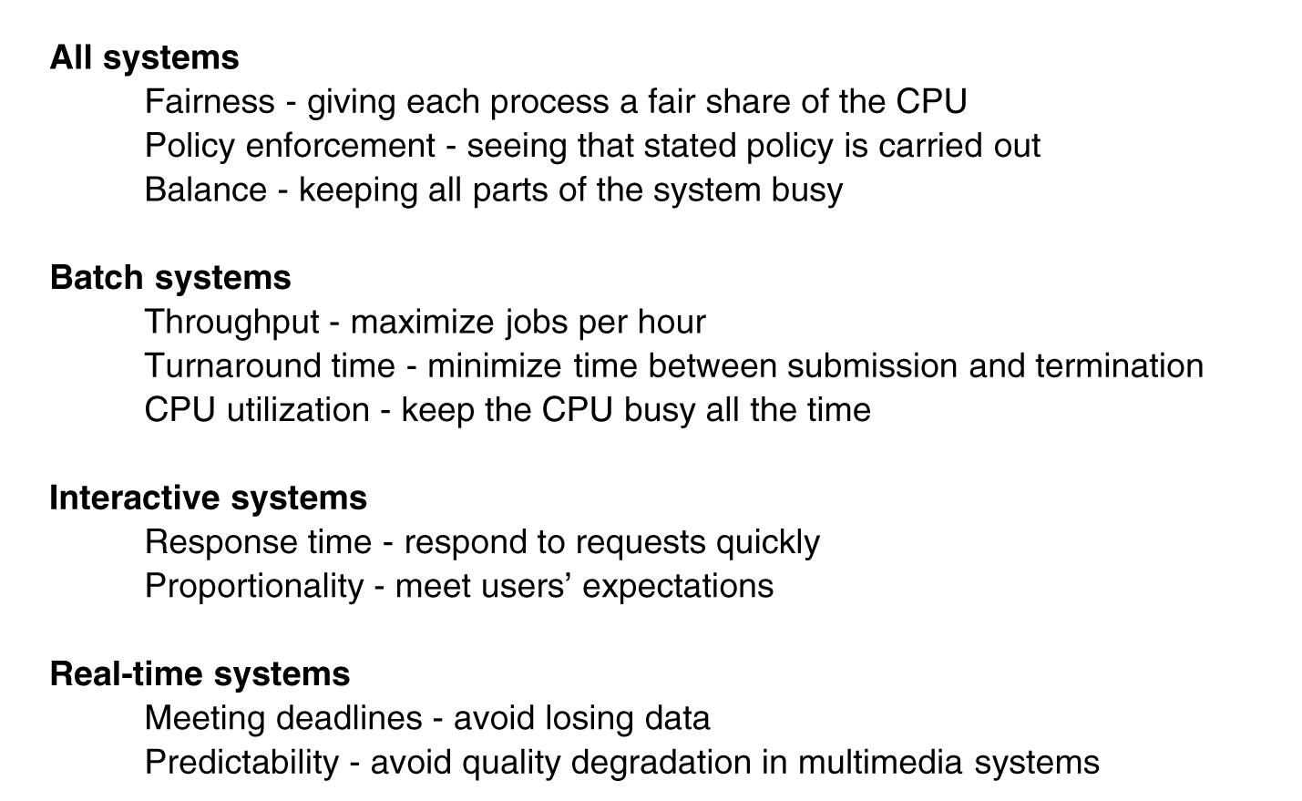
Scheduling Algorithm Goals

Slide 13
Scheduling in Batch Systems
First-come first-served
Shortest job first
Shortest remaining time next

Slide 14
FCFS: First-Come First-Served
Ready queue data structure: a FIFO queue
  Assuming we have (at least) a multi-programmed system
Example
  Draw Gantt chart
  Compute the average waiting time for processes with the following next CPU burst times and ready queue order:
    P1: 20
    P2: 12
    P3: 8
    P4: 16
    P5: 4
  Waiting time:
    Time period spent in the ready queue (assume processes terminate)
    Also calculate average waiting time across processes
  Assume 0 context switch time
CPU burst times
e.g., Time units are milliseconds
Notes:
Need to make sure they are understanding what CPU burst time is.

Slide 15
Solution: Gantt Chart Method
FCFS: First-Come First-Served
P1
P2
P3
P4
P5
0
20
32
40
56
60
Waiting times?
  P1: 0
  P2: 20
  P3: 32
  P4: 40
  P5: 56
Average wait time: 148/5 = 29.6

Slide 16
FCFS: First-Come First-Served
Advantage: Relatively simple algorithm
Disadvantage: long waiting times

Slide 17
Shortest Job First
Need to know run times in advance
Non pre-emptive algorithm
Provably optimal
eg 4 jobs with runs times of a,b,c,d
First finishes at a, second at a+b, third at a+b+c, last at a+b+c+d
(a + a+b + a+ b+c + a+b+c+d )
Mean turnaround time is (4a+3b+2c+d)/4
  smallest time has to come first to minimize the mean turnaround time

Slide 18
SJF: Shortest Job First
The job with the shortest next CPU burst time is selected
Example (from before):
  CPU job burst times and ready queue order:
    P1: 20
    P2: 12
    P3: 8
    P4: 16
    P5: 4
  Draw Gantt chart and compute the average waiting time given SJF CPU scheduling
  Assume 0 context switch time

Slide 19
SJF Solution
P5
P3
P2
P4
P1
0
4
12
24
40
60
Waiting times (how long did process wait before being scheduled on the CPU?):
  P1: 40
  P2: 12
  P3: 4
  P4: 24
  P5: 0
Average wait time: 16
(Recall: FCFS scheduling had average wait time of 29.6)

Slide 20
SJF
Provably shortest average wait time
BUT: But how do you know the execution time?
Will discuss in detail under Shortest Job Next !!!
Notes:
Need to keep the ready queue sorted in terms of the next burst requirement
Need to estimate the next burst requirement

Slide 21
Scheduling in Interactive Systems
Round robin
Priority
Multiple Queues
Shortest Process Next
Guaranteed Scheduling
Lottery Scheduling
Fair Share Scheduling

Slide 22
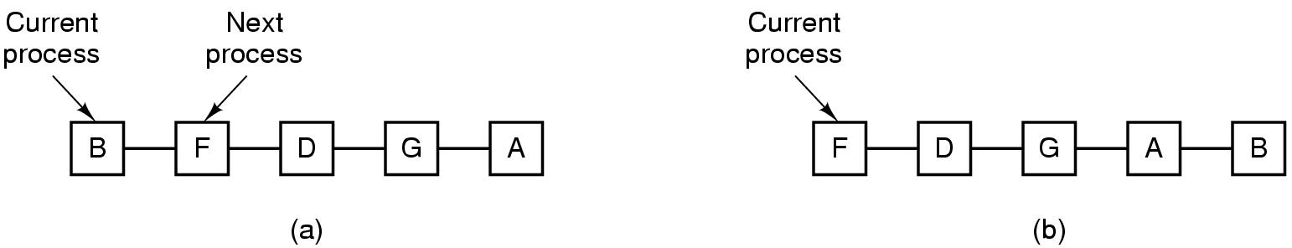
Round-Robin Scheduling
Process list-before and after

Slide 23
Round robin
Quantum too short => too many process switches
Quantum too long => wasted CPU time
Don’t need to know run times in advance

Slide 24
RR (Round Robin) Scheduling
Used in time-sharing or multi-tasking systems
    typical kind of scheduling algorithm in a contemporary general purpose operating system
Method
    Give each process a unit of time (time slice, quantum) of execution on CPU
    Then move to next process in ready queue
    Continue until all processes completed
Necessarily preemptive
    Requires use of timer interrupt
Time Quantum typically between 10 and 100 milliseconds
    Linux default TQ is 100ms
Notes:
Apparently duration of a timeslice on linux is 10ms
http://www.linux.org/docs/ldp/howto/KernelAnalysis-HOWTO-6.html
But in 2.6.36 kernel, in kernel/sched.c, default for SCHED_RR tasks is 100 msec (assuming that is milliseconds)
sched_rr_get_interval system call returns the time quantum of a SCHED_RR process on Linux (e.g., around 2.6.35 kernel)
I haven’t been able to get this to work.
Similar to FCFS, but context switch with timer also

Slide 25
RR (Round Robin) Scheduling: Example
CPU job burst times & order in queue
  P1: 20
  P2: 12
  P3: 8
  P4: 16
  P5: 4
Draw Gantt chart, and compute average wait time
    Time quantum of 4
    Like our previous examples, assume 0 context switch time
Notes:
Designed for time sharing
Textbook:

Slide 26
Solution
completes
completes
completes
completes
completes
P1
P2
P3
P4
P5
P1
P2
P3
P4
P1
P2
P4
P1
P4
P1
0
4
8
12
16
20
24
28
32
36
40
44
48
52
56
60
Waiting times:
    P1: 60 - 20 = 40
    P2: 44 - 12 = 32
    P3: 32 - 8 = 24
    P4: 56 - 16 = 40
    P5: 20 - 4 = 16
Average wait time: 30.4
  P1: 20
  P2: 12
  P3: 8
  P4: 16
  P5: 4
  (40+32+24+40+16)/5
= 152/5= 30.2
Notes:
This assumes a zero context switch time.

Slide 27
Priority Scheduling
Run jobs according to their priority
Priority can be static or can be changed dynamically
Typically combine RR with priority.
Each priority class uses RR inside

