Slide 1
CSC 322 Operating Systems Concepts
Teacher
Ahmed Mumtaz Mustehsan
Notes:
1

Slide 2
Personal Profile
Master Of Computer Sciences (1979-81) from Quaid-e-Azam university Islamabad.
Specialization :
Satellite Image Processing and GIS, Paris, France 1987:1988
More than 30 years of experience in the field of IT industry and Education , Research and development.
Served on different reputable posts at middle and top management at National and International organizations.
Hands on experience in ; System programming, Computer Interfacing, Cryptography using , Assembly , FORTRAN, and C languages.
Contributed in the Development of Projects of National interest.
Ahmed Mumtaz Mustehsan, CIIT, Islamabad

Slide 3
CSC322- Operating Systems Concepts
Course Objective and Outline:
In this course students will be taught the fundamentals of operating systems. Different models of operating systems will be introduced. References and examples will be quoted and explained from UNIX, WINDOWS and MULTICS Operating environments.
More focused on the most modern concept of Operating Systems as a creator of abstraction e.g. abstraction of CPU into multiple processes, abstraction of memory into virtual address space or abstraction of disk into files will be explained.
The students will be familiarized with different OS structure models and their components.

Slide 4
CSC322- Operating System Concepts
Course Objectives and outline:
The functionalities and responsibilities of different modules of operating systems such as Process Management, Memory Management, I/O Management and File management will be explained and discussed in detail.
The security and protection mechanism available in Operating systems will be introduced.
Few case studies will be undertaken to explain and study the features of UNIX, Windows and Embedded operating systems
A detailed outline of Lectures is provided at course portal

Slide 5

Recommended books:
Modern Operating System Third edition by, Andrew S. Tanenbaum

Slide 6
Recommended Books:
Operating Systems Design and Implementation, Andrew S. Tanenbaum, Albert S. Woodhull
An Introduction to Operating systems, by H. M. Deitel (Including Case studies in UNIX, OS/2, MS-DOS, VM, Open Systems
Other Reference: Lecture slides material
Official website of our text book Modern Operating Systems by Tanenbaum, 3 e, (c) 2008 Prentice-Hall, Inc.

Slide 7
Delivery:
32 lectures including hands on demonstrations
4 Quizzes
4 Assignment
Midterm Examination
Terminal Examination
Practice:
Exercises, Quizzes, Assignments

Slide 8
CSC 322 Operating Systems Concepts
Lecture -1
Ahmed Mumtaz Mustehsan
Special Thanks To:
Tanenbaum, Modern Operating Systems 3 e, (c) 2008 Prentice-Hall, Inc. (Chapter-1)
Notes:
8

Slide 9
What Is An Operating System?
Computer System ! Lots of hardware !!
One or more processors
Main memory
Disks
Printers
Various input/output devices
Managing all these components requires a layer of software – the operating system
!! A Challenging Job of OS

Slide 10
Operating System
Organization:
  In the form of layers of software
Abstraction:
  It provides user programs with a better, simpler, cleaner, model of the computer and to handle managing all the resources by itself.
Interface:
  shell when it is text based
  GUI (Graphical User Interface)—which is pronounced ‘‘gooey’’
Examples:
  Windows, Linux, FreeBSD, VMS, System V, Solaris

Slide 11
How it works!
Hardware ; at the bottom
  The hardware consists of chips, boards, disks, a keyboard, a monitor, and similar physical objects.
Software; It splits up in 2 modes
  kernel mode (also called supervisor mode). In this mode a complete access to all the hardware allowed and can execute any instruction the machine is capable of executing.
  User mode, only a subset of the machine instructions are available. The instructions that affect control of the machine (I/O) are forbidden to user-mode programs.

Slide 12
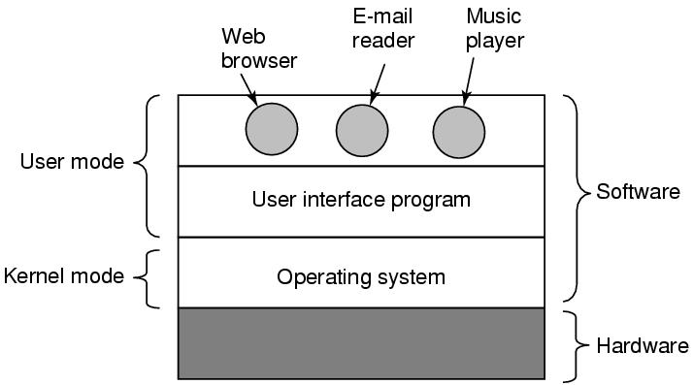
Where is the software?
Where the operating system fits in.

Slide 13
How it works!
Difference between OS and User Software
  If a user does not like a particular piece of program like e-mail may get a different one or write his own
  However, a user does not free to write his own clock interrupt handler,.
Boundary between kernel and user mode is not clear
  Everything running in kernel mode is part of the OS, but some programs running outside it are also part of it, or at least closely associated with it. e.g. Password reset and file systems in some OS
Size of Operating System
  Of the order of 5 to 10 millions lines of code!

Slide 14
Functions of operating system
OS performs two functions:
  Abstraction;
    Providing application programmers (and application programs) a clean abstract set of resources instead of complex hardware
  Resource Management;
    Managing the hardware resources

Slide 15
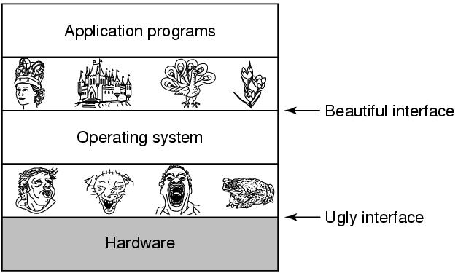
The Operating System as an Extended Machine
  ( An Abstraction ? );
Abstraction is the key to manage complexity. An abstraction turns a nearly impossible task into two manageable tasks.
Defining and implementing the abstractions.
Using these abstractions to solve the problem at hand.

Slide 16
The Operating System as an Extended Machine
An Abstraction ?
Operating system hides the hardware and present programs (and their programmers) with nice, clean, elegant, consistent, abstractions to work.
Operating systems turn the ugly interface into the beautiful interface
Example;
Windows GUI and Command line both running on the Windows operating system and use the abstractions
Linux Gnome or KDE sees a very different interface than a Linux user working on (text-oriented) X Window System, but the abstractions are the same in both cases.

Slide 17
Functions of OS
The Operating System as an Extended Machine
The Operating System as a Resource Manager

Slide 18
Functions of OS ; as an Extended Machine
The architecture of a computer system (instruction set, memory organization, I/O, and bus structure) of most computers is difficult to program at the machine language level, especially for I/O
Example I/O Of Floppy Read Write Command
  Requires 13 parameters, packed into 9 bytes.
  When the operation is completed, the controller chip returns 23 status and error fields packed into 7 bytes.
  Status of Motor (On or Off) should also be considered
  What is Abstraction? User performs File I/O not disk I/O

Slide 19
The Operating System as a Resource Manager
The Abstraction is Top-down approach
The resource Management is Bottom-up approach.
Resources
Consist of processors, memories, timers, disks, mice, network interfaces, printers, and a wide variety of other devices.
All modern OS to provide controlled allocation of the these resources to multiple programs run at the same time.
Problem: Shared Printer; Mess-up output by all programs
Solution: Buffering

Slide 20
The Operating System as a Resource Manager
With multiple simultaneous users, the need for managing and protecting the memory, I/O devices, and other resources is even greater.
users need to share not only hardware, but information (files, databases, etc.) as well.
Primary task of OS is to keep track of programs/users re using resource, grant resource to users, account for the usage, and to mediate conflicting requests from different programs and users.

Slide 21
The Operating System as a Resource Manager
Resource management includes :
Multiplexes (shares) resources in two different ways:
  Time Multiplexing; When a resource is time multiplexed, different programs or users take turns using it. Who goes next and for how long is the task of the operating system.
  Examples: one CPU and multiple programs. One printers among many users
  Space Multiplexing; Instead of exclusive allocation of resource, each one gets part of the resource.
  Examples: Main memory among several programs more programs in memory. Hard disk space for multiple users.

Slide 22
The Operating System as a Resource Manager
  Objectives of the operating system
  Fairness;
    All users should get fair share of CPU, Memory, and I/O devices without waiting unnecessarily.
  Security;
    Users not interfering with each other data and their private data/ information.
  Optimal Utilization of resources
    The resources of a computer system should be utilized Optimally.

Slide 23
History of Operating Systems
History:
The first true digital computer was designed by the English mathematician Charles Babbage (1792–1871).
Purely Mechanical, called “Analytical Engine”
Never got it working as the required Precision was not supported by the technology
Did not have an operating system but Charles Babbage identified the need of supporting Software.
Hired Ada Lovelace, the daughter of British poet Lord Byron to develop software for AE.
The programming language Ada® is named after her.

Slide 24
History of Operating Systems
Generations:
(1945–55) Vacuum Tubes
(1955–65) Transistors and Batch Systems
(1965–1980) ICs and Multiprogramming
(1980–Present) Personal Computers, Tablets, Phones

Slide 25
The First Generation (1945–55) Vacuum Tubes
Prof. John Atanasoff built first functioning digital computer at Iowa State University. It used 300 vacuum tubes.
Same time, Konrad Zuse in Berlin built the Z3 computer with relays.
In 1944, the Colossus was built by a group at Bletchley Park, England.
Mark I was built by Howard Aiken at Harvard.
The ENIAC was built by William Mauchley and his graduate student J. Presper Eckert at the University of Pennsylvania.

Slide 26
The First Generation (1945–55) Vacuum Tubes
Features:
A single team designed, built, programmed, operated, and maintained each machine.
All programming was done in machine language, or by wiring up electrical circuits (Plug boards)
OS and Programming languages were unknown
Programmer to sign up for some time, insert their plug board into the computer, and spend hours hoping that none of the 20,000 vacuum tubes would burn out.
Early 1950s; punched cards were introduced. It was possible to write programs on cards and read them in instead of plug boards.

Slide 27
Transistors and Batch Systems (1955–65)
2nd Generation;
Computers became reliable and could be manufactured and sold.
There was a clear separation between designers, builders, operators, programmers, and maintenance personnel.
These machines, now called mainframes, operated by professional operators . Only big corporations or universities could afford the multimillion $ price.

Slide 28
Transistors and Batch Systems (1955–65)
2nd Generation;
To run a job (i.e., a program):
Write the program on paper, punch it on cards, submit card deck to input room., when the computer finished the job an operator would tear off the output, put it over to the output room, for the programmer.
If the FORTRAN compiler was needed, the operator would have to get it from a file cabinet and read it in.
Much computer time was wasted that was to be optimized

Slide 29
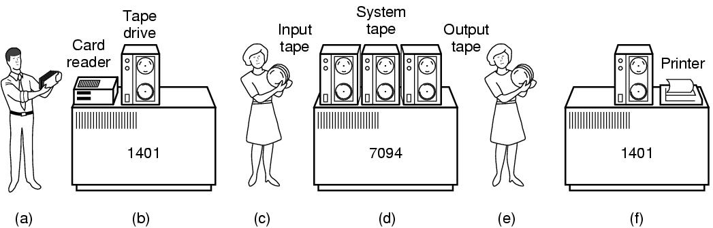
Transistors and Batch Systems (1955–65)
2nd Generation;
How an early Batch System worked:
(a) Programmers bring cards to 1401. (b)1401 reads batch of jobs onto tape. (c) Operator carries input tape to 7094. (d) 7094 does computing. (e) Operator carries output tape to 1401. (f) 1401 prints output.

Slide 30
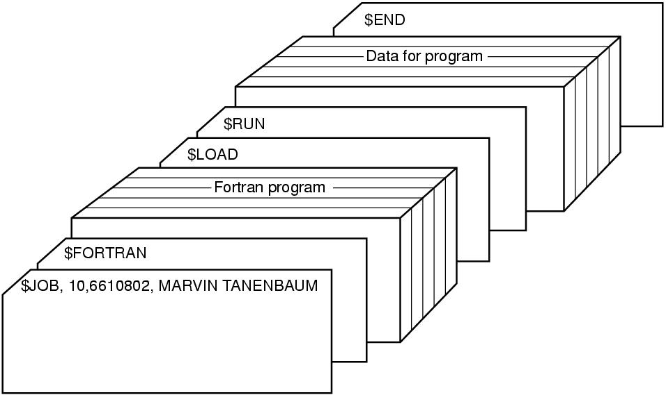
Transistors and Batch Systems (1955–65)
2nd Generation;
Structure of a typical File Management system (FMS) job.

Slide 31
Transistors and Batch Systems (1955–65)
2nd Generation;
Structure of a typical File Management system (FMS) job.
A $JOB card; Specifying the maximum run time, the account number to be charged, and the user name.
$FORTRAN card: Tells the operating system to load the FORTRAN compiler from the system tape.
A $LOAD card: Directing the operating system to load the object program just compiled.
$RUN card: Telling the operating system to run the program with the data following it.
The $END card: Marked the end of the job.

Slide 32
ICs and Multiprogramming (1965–1980)
3rd Generation
Early 1960s, There were 2 incompatible products:
7094: Word oriented, large-scale scientific computers.
1401: tape sorting, printing by banks and insurance Co.
IBM introduced
IBM360 series of software compatible machines had the compatibility with both 1401 and 7094
The360 was the first major computer line to use (small scale) Integrated Circuits( ICs), providing a major Price/performance advantage over the second generation machines.
Notes:
MULTICS
Timesharing CTSS (MIT)
Multics
UNix

Slide 33
ICs and Multiprogramming (1965–1980)
3rd Generation
All machines had same architecture and instruction set, hence programs written for one machine could run on all the others.
360 was designed to handle both scientific and commercial computing.
In subsequent years, IBM introduced compatible successors to the 360 lines, such as the 370, 4300, 3080, and 3090
The descendants of these machines are still in use for managing huge databases (e.g., for airline reservation systems) or as servers for World Wide Web sites that must process thousands of requests per second.
Notes:
MULTICS
Timesharing CTSS (MIT)
Multics
UNix

Slide 34
ICs and Multiprogramming (1965–1980)
3rd Generation
The greatest strength of the “one family” idea was simultaneously its greatest weakness. OS Compatibility the attempt failed miserable.
There was no way that IBM (or anybody else) could write a piece of software to meet all those conflicting requirements.
The result was an enormous and extraordinarily complex operating system, probably two to three orders of magnitude larger than FMS.
Each new release fixed some bugs and introduced new ones.
Notes:
MULTICS
Timesharing CTSS (MIT)
Multics
UNix

Slide 35
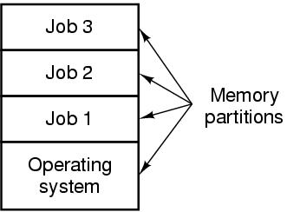
Third Generation: Major Achievements
Multiprogramming
This generation introduced a popular key techniques Called multiprogramming, which was absent in Second generation operating systems.
Partition memory into several pieces
Notes:
MULTICS
Timesharing CTSS (MIT)
Multics
UNix

Slide 36
Third Generation: Multiprogramming
A different job in each partition, while one job is waiting for I/O completion, CPU is allocated to another job.
If enough jobs are held in the main memory at one time, the CPU utilization could be 100 percent.
The system required special hardware to protect each job from the others.
Spooling : The ability of the system to read the jobs from cards to the disk, called (Simultaneous Peripheral Operation On Line)
Notes:
MULTICS
Timesharing CTSS (MIT)
Multics
UNix

Slide 37
Third generation: Timesharing
Timesharing; A variant of multiprogramming called timesharing, in which each user has an online terminal.
(Interactive users).
Timesharing system, CTSS (Compatible Time Sharing System), was developed at M.I.T. on a specially modified 7094 but did not become popular until the necessary protection hardware made available during the third generation.
After the success of the CTSS system, major computer manufacturer decided to develop a computer as a utility, a machine that should support hundreds of simultaneous timesharing users.
Notes:
MULTICS
Timesharing CTSS (MIT)
Multics
UNix

Slide 38
Third generation: MULTICS
Another system, introduced in that era was MULTICS (MULTiplexed Information and Computing Service), one huge machine for everyone in the Boston.
It was a mixed success. There were many reasons that MULTICS did not take over the world. (It was enormously ambitious, written in PL/I, size was too big, High price )
MULTICS introduced many ideas into the computer literature, despite its lack of commercial success, MULTICS had a huge influence on subsequent operating systems.
The concept of a computer utility had fizzled out but came back in the form of massive centralized Internet servers.
Notes:
MULTICS
Timesharing CTSS (MIT)
Multics
UNix

Slide 39
Third generation: UNIX and LINUX
Ken Thompson, found a small PDP-7 minicomputer wrote a stripped-down, single-user version of MULTICS.
That work later developed into the UNIX operating system, which became popular in the academic world, with government agencies, and with many companies.
The source code was widely available, various organizations developed their own (incompatible) versions, which led to chaos.
Two major versions developed, System V , from AT&T, and BSD, (Berkeley Software Distribution) from the University of California at Berkeley.
Notes:
MULTICS
Timesharing CTSS (MIT)
Multics
UNix

Slide 40
Third generation: UNIX and LINUX
To make a compatible UNIX system, IEEE developed a standard for UNIX, called POSIX, that most versions of UNIX now support.
POSIX defines a minimal system call interface conformant to UNIX systems must follow that. In fact, some other operating systems now also support the POSIX interface.
A student, Linus Torvalds, to write Linux. This system was developed on MINIX and originally supported various MINIX features (e.g., the MINIX file system).
LINUX is now owned by world called GNU (Gnu is Not UNIX) but highly compatible with UNIX.
Notes:
MULTICS
Timesharing CTSS (MIT)
Multics
UNix

