Slide 1
Lecture # 31
Theory Of Automata
By
Dr. MM Alam

Slide 2
Lecture 30 at a glance…
Using JFLAP for PDA
PDA Conversion to CFG
Chomsky Normal Form Conversion in JFLAP

Slide 3
What are Non-Context-Free languages
All languages are not CFL.
Languages which are not Context-Free, are called Non-CFL.
This chapter is about proving that all languages are not Context-Free
We will also use the Pumping Lemma with and without JFLAP for the proof of the aforementioned fact.

Slide 4
Live Production VS Dead Production
Definition
A production of the form
nonterminal → string of two nonterminals
is called a live production.
A production of the form nonterminal → terminal
is called a dead production.
Please keep in mind that every CFG in CNF has only aforementioned types of productions.
  Guess what, are the rules of CNF?

Slide 5
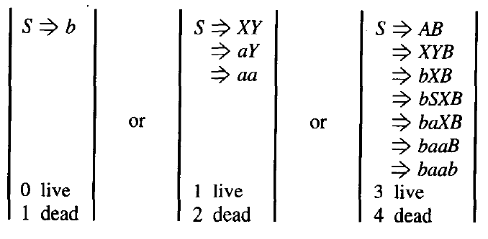
Live Productions Example
Thanks to Daniel I Cohen. The above excerpts have been taken from his Book: Automata Theory, Chapter Non Context Free Languages.

Slide 6
Finite many words can be generated if a CFG is in CNF and if there is restriction to use the live production at most once each.
It may be noted that every time a live production is applied during the derivation of a word it increases the number of non-terminals by one, similarly, dead productions are applied, it decreases the number of non-terminals by one.

Slide 7
Self Embedded Nonterminal
A nonterminal is said to be self-embedded, if in
a given derivation of a word, it ever occurs as a
tree descendant of itself

Slide 8
Theorem (33)
Statement:
If a CFG is in CNF with p live and q dead productions
and if w is a word generated by the CFG, having more than 2^{p} letters then any derivation tree for w has a nonterminal z which is used twice, where the second z is the descended from the first z.

Slide 9
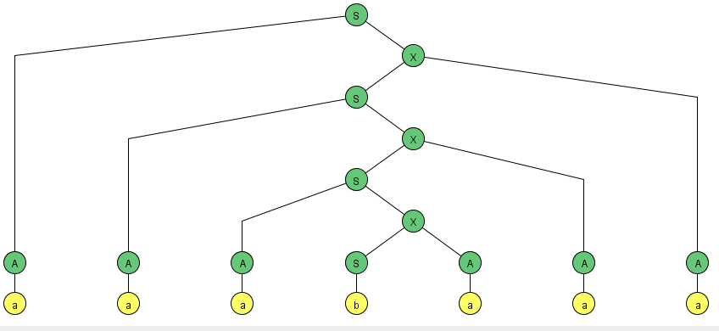
The nonterminal X is self-embedded

Slide 10
Example Grammar:
S | → | AX
X | → | SA
S | → | BY
Y | → | SB
S | → | a
S | → | b
S | → | AA
S | → | BB
A | → | a
B | → | b

Slide 11
 | S
S→AX | AX
X→SA | ASA
S→AX | AAXA
X→SA | AASAA
S→AX | AAAXAA
X→SA | AAASAAA
A→a | aAASAAA
A→a | aaASAAA
A→a | aaaSAAA
S→b | aaabAAA
A→a | aaabaAA
A→a | aaabaaA
A→a | aaabaaa

Slide 12
Consider the following CFG in CNF
and the derivation tree of the word bbabbb
S | → | AB
A | → | BC
C | → | AB
A | → | a
B | → | b

Slide 13
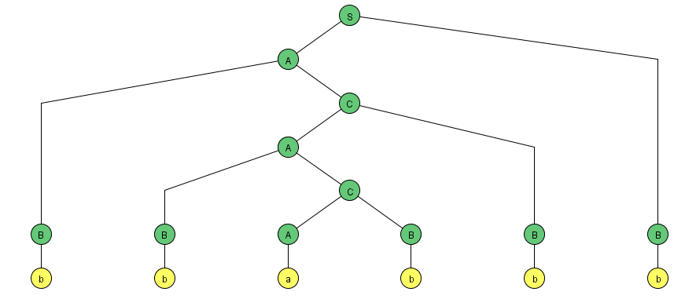
S | → | AB
A | → | BC
C | → | AB
A | → | a
B | → | b

Slide 14
S
Non-terminal A is self embedded
Look at the triangle – upper one and lower one identified in the lower.
Guess what – Pumping Lemma for CFG in CNF?
A
B
B
C
b
A
B
b
B
C
b
A
B
b
a
b

Slide 15
Pumping lemma for CFL in CNF
If G is any CFG in CNF with p live productions, then every word w of length more than 2^{p} , then we can break substrings as w=uvxyz, where x is not null string and v and y are both not null string.
Thus, all the words of the form uv^{n}xy^{n}z, n=1,2,3,… can also be generated by G.

Slide 16
Pumping Lemma Example
Consider the following CFG in CNF:
S → PQ
Q →QS|b
P →a
we derive the word abab as follows:

Slide 17
Pumping Lemma for CFG Example
w=uvxyz where u=a, v= ʎ, x=b, y=ab, z= ʎ
Left most is u, within the triangle, the left most is x and remaining part is y, since the v part can also be null.
S
P
Q
a
Q
S
u
P
Q
b
x
a
b
y

Slide 18
S
uvvxyyz=a ʎ ʎ babab ʎ =ababab belongs to the language generated by the given CFG.
uv^{n}xy^{n}z, n=1,2,3,… belong to the language generated by the given CFG.
P
S
Q
S
a
u
Q
S
P
Q
P
Q
b
x
a
b
a
b
y
y

Slide 19
Example
Consider the language
L={a^{n}b^{n}c^{n} :n=1,2,3,…}, let the language L be Context Free language
Let the word w=a²⁰⁰b²⁰⁰c²⁰⁰ of length more than 2^{p}, where p is the number of live productions of its CFG in CNF.
Please follow the observations given on the next slide:

Slide 20
Observations:
Substrings u,v,x,y and z. uv²xy²z can’t belong to L, as all the words in a^{n}b^{n}c^{n} have: Think on a³b³c³
Only one substring ab
Only one substring bc
No substring ac
No substring ba
No substring ca
No substring cb
For any n=1,2,3,…
It may be noted that the pumping lemma is satisfied by all CFLs and the languages which don’t hold this pumping lemma, can’t be Context Free languages. Such languages are non-CFLs. Following are the examples of non-CFL.

Slide 21
“If w is a large enough word (2^{P}) in a CF: then, w can be decomposed into w=uvxyz such that all words of the form uv^{n}xy^{n}z belong to L”

Slide 22
JFLAP For Non Context Free Languages
Pumping Lemma in JFLAP
How to list cases
Playing game
  You go first
  Computer go first

Slide 23
Lecture 31 Summary
Non Context Free Languages
How to determine Non Context Free languages
Pumping Lemma for Non Context Free Languages
JFLAP For Pumping Lemma for Non Context Free Languages

