Slide 1
Lecture # 30
Theory Of Automata
By
Dr. MM Alam

Slide 2
Lecture# 29 Recap
PDA = CFG
PDA to CFG conversion Examples

Slide 3
At every stage we have the following equivalence:
Working string = (letters cancelled from TAPE) (string of nonterminals from STACK
At the beginning this means:
working string = S
letters cancelled = none
string of nonterminals in STACK = ∆

Slide 4
At the end this means:
    working string = the whole word
    letters cancelled = all
    STACK= ∆
Notes:
Till here

Slide 5
PDA Examples in JFLAP
How to simulate PDA in JFLAP
Deterministic PDA Example
Non Deterministic PDA Example

Slide 6
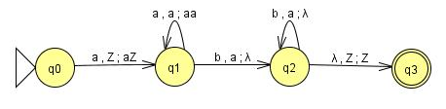
PDA Example
All Push, Pop and Tape read symbols in one diagram.
How to run Deterministic PDA in JFLAP
How to run Non Deterministic PDA Example in JFLAP

Slide 7
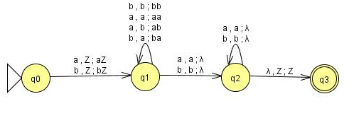
Even Palindrome

Slide 8
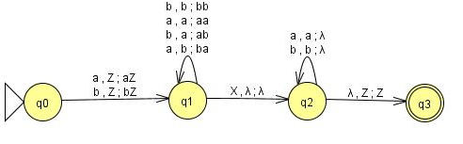
Palindrome with X

Slide 9
Chomsky Normal Form in JFLAP Repeat

Slide 10
Lecture 30 Summary
PDA to CFG formulas
Chomsky Normal Form in JFLAP Repeat
PDA Example in JFLAP
Even Palindrome Example in JFLAP

