Slide 1
Lecture # 29
Theory Of Automata
By
Dr. MM Alam

Slide 2
Lecture 28 at a Glance…
Push Down Automata Definition
PDA Symbols
Deterministic PDA Examples
Non-Deterministic PDA Examples

Slide 3
Pushdown Automata
Example
Consider the language generated by the CFG:
S → S + S I S * S | 4
The terminals are +, *, and 4 and the only nonterminal is S.

Slide 4
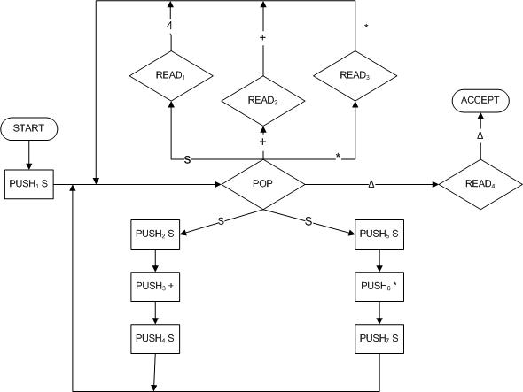
Pushdown Automata
The following PDA accepts this language:

Slide 5
Pushdown Automata
Example
Trace the acceptance of 4 + 4 * 4
STATE | STACK | TAPE
START | Δ | 4 +4 * 4
PUSH₁ S | S | 4 +4 * 4
POP | Δ | 4 +4 * 4
PUSH₂ S | S | 4 +4 * 4
PUSH₃ + | + S | 4 +4 * 4
PUSH₄ S | S + S | 4 +4 * 4

Slide 6
Pushdown Automata
Example
Trace the acceptance of 4 + 4 * 4 (continued)
STATE | STACK | TAPE
POP | +S | 4 +4 * 4
READ₁ | +S | 4 * 4
POP | S | 4 * 4
READ₂ | S | 4 * 4
POP | Δ | 4 * 4
PUSH₅ S | S | 4 * 4
PUSH₆ * | *S | 4 * 4
PUSH₇ S | S*S | 4 * 4
POP | *S | 4 * 4
READ₁ | *S | * 4

Slide 7
Pushdown Automata
Example
Trace the acceptance of 4 + 4 * 4 (continued)
POP | S | * 4
READ₃ | S | 4
POP | Δ | 4
READ₁ | Δ | Δ
POP | Δ | Δ
READ₄ | Δ | Δ
ACCEPT | Δ | Δ

Slide 8
Theorem
Statement:
Given a language L generated by a particular CFG, there is a PDA that accepts exactly L.
Notes:
∆

Slide 9
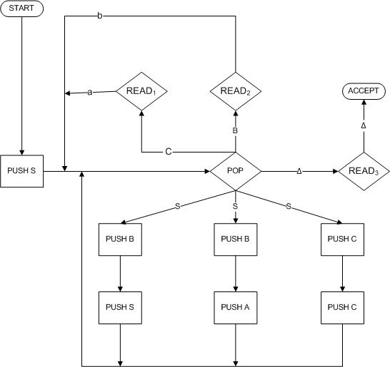
PDA Conversion to CFG
STACK alphabet :
Γ = {S, A, B, C}
TAPE alphabet:
S = {a, b}
Let us consider the following CFG in CNF
S → SB
S → AB
A → CC
B → b
C → a.
The nondeterministic PDA.

Slide 10
PDA Conversion to CFG
The word aab can be generated by most derivation in this grammar as follows:
Working-String Generation Production Used
S => AB S → AB Step I
=>CCB A → CC Step 2
=>aCB C → a Step 3
=>aaB C → a Step 4
=> aab B → b Step 5
Notes:
∆

Slide 11
PDA Conversion to CFG
We start with
Immediately we push the symbol S onto the STACK.
We pop the S and then we PUSH B, PUSH
STACK | TAPE
∆ | aab
STACK | TAPE
S | aab
STACK | TAPE
AB | aab
Notes:
∆

Slide 12
PDA Conversion to CFG
We again feed back into the central POP. The production we must now simulate is a A → CC. This is done by popping the A and following the path PUSH C, PUSH C.
Again we feed back into the central POP. This time we must simulate the reduction C → a. POP C and then read the a from the TAPE.
STACK | TAPE
CCB | aab
STACK | TAPE
CB | aab
Notes:
∆

Slide 13
PDA Conversion to CFG
We again feed back into the central POP. The production we must now simulate is a A → CC. This is done by popping the A and following the path PUSH C, PUSH C.
Again we feed back into the central POP. This time we must simulate the reduction C → a. POP C and then read the a from the TAPE.
STACK | TAPE
CCB | aab
STACK | TAPE
CB | aab
Notes:
∆

Slide 14
PDA Conversion to CFG
The next production we must simulate is another C → a. Again we POP C and READ a.
This time when we enter the central POP we simulate the last production in the derivation, B → b. We pop the B and read the b.
STACK | TAPE
B | aab
STACK | TAPE
∆ | aab
Notes:
∆

Slide 15
PDA Conversion to CFG
We now reenter the POP, and we must make sure that both STACK and TAPE are empty.
POP ∆ → READ₃ → ACCEPT
To accept a word we must follow its left- most derivation from the CFG. If the word is ababbbaab
and at some point in its left-most Chomsky derivation we have the working string ababbZWV.
Notes:
∆

Slide 16
PDA Conversion to CFG
Then at this point in the corresponding PDA-processing the status of the STACK and TAPE should be
This process continues until we have derived the entire word. We then have
STACK | TAPE
ZWV | ababbbaab
STACK | TAPE
∆ | ababbbaab
Notes:
∆

Slide 17
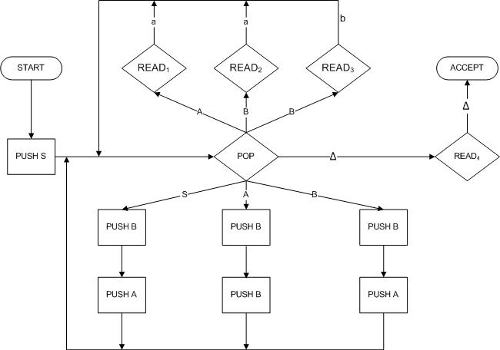
PDA Conversion to CFG
Example
S → AB
B → AB
B → a
A → BB
A → a
B → b
Notes:
∆

Slide 18
Left-most derivation | State | STACK | TAPE
 | START | ∆ | baaab
S | PUSH S | S | baaab
 | POP | ∆ | baaab
 | PUSH B | B | baaab
=> AB | PUSHA | AB | baaab
 | POP | B | baaab
 | PUSH B | BB | baaab
BBB | PUSH B | BBB | baaab
 | POP | BB | baaab
=>bBB | READ₃ | BB | baaab
 | POP | B | baaab
 | PUSH B | BB | baaab

Slide 19
Babb | READ₃ | BB | baaab
 | POP | B | baaab
 | PUSH B | BB | baaab
BaBB | Push A | ABB | baaab
 | POP | BB | baaab
BaBB | READ₁ | B | baaab
 | POP | B | baaab
bAAB | READ₂ | B | baaab
 | POP | ∆ | baaab
 | _{PUSH B} | B | baaab
baaAB | PUSH A | AB | baaab
 | Pop | B | baaab

Slide 20
baaAB | READ₁ | B | baaab
 | POP | ∆ | baaab
baaab | READ₃ | ∆ | baaab
 | POP | ∆ | baaab
 | READ₄ | ∆ | baaab
 | ACCEPT | ∆ | baaab

Slide 21
At every stage we have the following equivalence:
Working string = (letters cancelled from TAPE) (string of nonterminals from STACK
At the beginning this means:
working string = S
letters cancelled = none
string of nonterminals in STACK = ∆

Slide 22
At the end this means:
    working string = the whole word
    letters cancelled = all
    STACK= ∆
Notes:
Till here

Slide 23
Lecture 29 Summary
PDA = CFG
PDA to CFG conversion Examples

