Slide 1
Lecture # 28
Theory Of Automata
By
Dr. MM Alam

Slide 2
Lecture 27 recap
Chomsky Normal Form conversion in JFLAP
Push Down Automata Definition
PDA Symbols

Slide 3
Adding A Pushdown Stack
A PUSHDOWN STACK is a place where input letters can be stored until we want to refer to them again.
It holds the letters it has been fed in a long line. The operation PUSH adds a new letter to the line.
The new letter is placed on top of the STACK, and all the other letters are pushed back (or down) accordingly.
Before the machine begins to process an input string the STACK is presumed to be empty, which means that every storage location in it initially contains a blank.

Slide 4
Adding A Pushdown Stack
If the STACK is then fed the letters a, b, c, d by this sequence of instructions:
PUSH a
PUSH b
PUSH c
PUSH d
Then top letter in the STACK is d, the second is c, the third is b, and the fourth is a.
If we now execute the instruction:
PUSH b the letter b will be added to the STACK on the top. The d will be pushed down to position 2, the c to position 3, the other b to position 4, and the bottom a to position 5.

Slide 5
Adding A Pushdown Stack
One pictorial representation of a STACK with these letters in it is shown below.
Beneath the bottom a we presume that the rest of the STACK, which, like the INPUT TAPE, has infinitely many storage locations, holds only blanks.
b
d
c
b
a
Δ

Slide 6
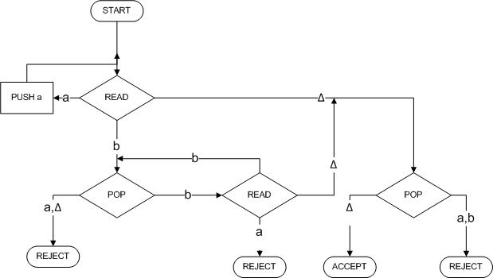
Adding A Pushdown Stack
How the following PDA is working:
a
b

Slide 7
Adding A Pushdown Stack
Its operation on the
input string aaabbb.
We begin by assuming
that this string has
been put on the TAPE.
STACK
Δ
a | a | a | b | b | b | Δ
TAPE

Slide 8
Adding A Pushdown Stack
Its operation on the
input string aaabbb.
We begin by assuming
that this string has been
put on the TAPE.
STACK
a
Δ
a | a | a | b | b | b | Δ
TAPE

Slide 9
Adding A Pushdown Stack
We now read another a
and proceed as before along
the a edge to push it into
the STACK.
Again we are returned
to the READ box.
Again we read an a (our third),
and again this a is pushed onto the STACK.
STACK
a
a
a
Δ
a | a | a | b | b | b | Δ
TAPE

Slide 10
Adding A Pushdown Stack
After the third PUSH a,
we are routed back to
the same READ state again.
This time, we read the letter b.
This means that we take the
b edge out of this state down
to the lower left POP.
STACK
a
a
Δ
a | a | a | b | b | b | Δ
TAPE

Slide 11
Adding A Pushdown Stack
The b road from the second
READ state now takes us
back to the edge feeding
into the POP state.
So we pop the STACK
again and get another a.
The STACK is now
down to only one a.
The a line from POP
takes us again to this same READ.
There is only one letter left on the input TAPE, a b.
a
Δ
a | a | a | b | b | b | Δ
TAPE
STACK

Slide 12
Adding A Pushdown Stack
We read it and
leave the TAPE empty,
that is, all blanks.
However, the machine does
not yet know that the TAPE
is empty.
It will discover this only when
it next tries to read the TAPE
and finds Δ.
Δ
a | a | a | b | b | b | Δ
TAPE

Slide 13
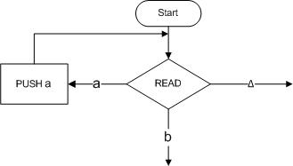
Adding A Pushdown Stack
Let

Slide 14
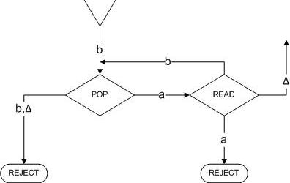
Adding A Pushdown Stack

Slide 15
Example
Example
The PALINDROMEX, language of all words of the form s X reverse(s) where s is any string in (a + b)*.
The words in this language are
{ X aXa bXb aaXaa abXba baXab bbXbb aaaXaaa aabXbaa . . . }
They all contain exactly one X, and this X marks the middle ofthe word.
We can build a deterministic PDA that accepts the language PALINDROMEX.
It has the same basic structure as the PDA we had for the language {a^{n}b^{n}}.

Slide 16
Adding A Pushdown Stack
Example
In the first part of the machine the STACK is loaded with the letters from the input string just as the initial a's from a^{n}b^{n} were pushed onto the STACK.
The letters go into the STACK first letter on the bottom, second letter on top of it, and so on till the last letter pushed in ends up on top.
When we read the X we know we have reached the middle of the input.

Slide 17
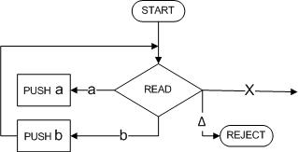
Adding A Pushdown Stack
Example
We can then begin to compare the front half of the word (which is reversed in the STACK) with the back half (still on the TAPE) to see that they match.
We begin by storing the front half of the input string in the STACK with this part of the machine.

Slide 18
Adding A Pushdown Stack
Example
If we READ an a, we PUSH an a. If we READ a b, we PUSH a b, and on and on until we encounter the X on the TAPE.
After we take the first half of the word and stick it into the STACK, we have reversed the order of the letters and it looks exactly like the second half of the word.
For example, if we begin with the input string
abbXbba

Slide 19
Adding A Pushdown Stack
Example
At the moment we are just about to read the X we have:
b
b
a
Δ
a | b | b | X | b | b | a | Δ

Slide 20
Adding A Pushdown Stack
Example
When we read the X we do not put it into the STACK. It is used up the process of transferring us to phase two.
In order to reach ACCEP these two should be the same letter for letter, down to the blanks.:

Slide 21
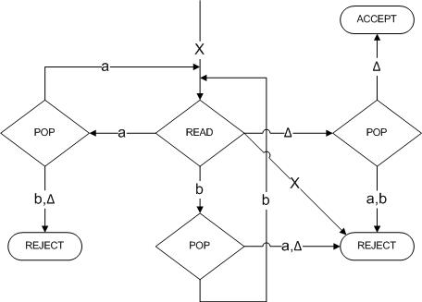
Adding A Pushdown Stack
Example

Slide 22
Adding A Pushdown Stack
Example 2
Consider the language:
EVENPALINDROME = {s reverse(s), where s is in (a + b)*}
= { A aa bb aaaa abba baab bbbbaaaaaa... }
This is the language of all palindromes with an even number of letters.
One machine to accept this language is shown on next slide:

Slide 23
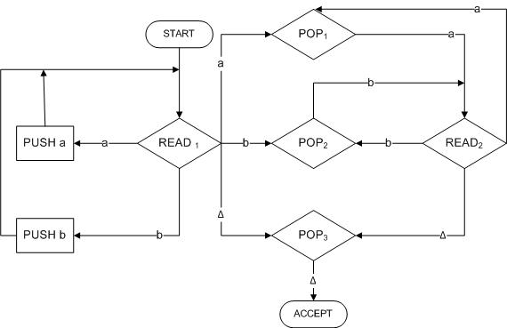
Adding A Pushdown Stack
Example 2

Slide 24
Adding A Pushdown Stack
The first letter of the second half of the word is read in READ₁ ,
Then we immediately go to the POP that compares the character read with what is on top of the STACK. After this we cycle READ₂-->POP-READ₂-->POP---> ....
Δ
b | a | b | b | a | b | Δ

Slide 25
Adding A Pushdown Stack
We can trace the path by which this input
STATE | STACK | TAPE
START | Δ . . . | babbabΔ ...
READ₁ | Δ . . . | babbabΔ …
PUSH_{b} | bΔ . . . | babbabΔ …
READ₁ | bΔ . . . | babbabΔ …
PUSH_{a} | abΔ . . . | babbabΔ …
READ₁ | abΔ . . | babbabΔ …
PUSH_{b} | babΔ . . | babbabΔ …
READ₁ | babΔ | babbabΔ …

Slide 26
Adding A Pushdown Stack
If we are going to accept this input string this is where we must make the jump out of the left circuit into the right circuit. The trace continues:
STATE | STACK | TAPE
POP₂ | abΔ . . . | babbabΔ ...
READ₂ | abΔ . . . | babbabΔ …
POP₁ | bΔ . . . | babbabΔ …
READ₂ | bΔ . . . | babbabΔ …
POP₂ | Δ . . . | babbabΔ …
READ₂ | Δ . . . | babbabΔ …

Slide 27
Adding A Pushdown Stack
If we are going to accept this input string this is where we must make the jump out of the left circuit into the right circuit. The trace continues:
STATE | STACK | TAPE
POP₂ | abREAD₁ . . . | babbabΔ ...
READ₂ | abΔ . . . | babbabΔ …
POP₁ | bΔ . . . | babbabΔ …
READ₂ | bΔ . . . | babbabΔ …
POP₂ | Δ . . . | babbabΔ …
READ₂ | Δ . . . | babbabΔ …

Slide 28
Adding A Pushdown Stack
We have just read the first of the infinitely many blanks on the TAPE.):
STATE | STACK | TAPE
POP₃ | Δ . . . (Popping a blank from an empty stack still leaves blanks) | babbabΔ ... (Reading a blank from from an empty an empty tape still stack still leaves leaves blanks)
ACCEPT | Δ . . . | babbabΔ …

Slide 29
Pushdown Automata
A pushdown automaton, PDA, is a collection of eight things
An alphabet Σ of input letters.
An input TAPE (infinite in one direction). Initially the letters is placed on the TAPE starting in cell i. The rest is blank.
3. An alphabet F of STACK characters.

Slide 30
Pushdown Automata
4. A pushdown STACK (infinite in one direction). Initially empty (contains all blanks).
5. One START state that has only out-edges, no in-edges.
Start

Slide 31
Pushdown Automata
Halt states of two kinds: some ACCEPT and some REJECT.
They have in-edges and no out-edge
7. Finitely many nonbranching PUSH states that introduce characters onto the top of the STACK. They are of the form
Accept
Reject
PUSH X

Slide 32
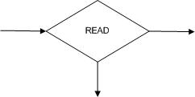
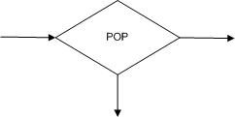
Pushdown Automata
8. Finitely many branching states of two kinds:
(i) States that read the next unused letter from the TAPE
(ii) States that read the top character of the STACK

Slide 33
Pushdown Automata
Example
Consider the language generated by the CFG:
S → S + S I S * S | 4
The terminals are +, *, and 4 and the only nonterminal is S.

Slide 34
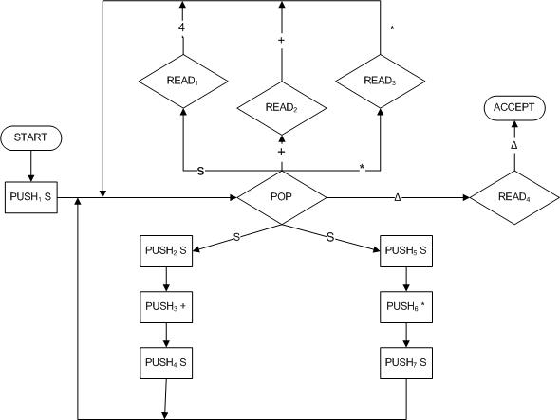
Pushdown Automata
The following PDA accepts this language:

Slide 35
Pushdown Automata
Example
Trace the acceptance of 4 + 4 * 4
STATE | STACK | TAPE
START | Δ | 4 +4 * 4
PUSH₁ S | S | 4 +4 * 4
POP | Δ | 4 +4 * 4
PUSH₂ S | S | 4 +4 * 4
PUSH₃ + | + S | 4 +4 * 4
PUSH₄ S | S + S | 4 +4 * 4

Slide 36
Pushdown Automata
Example
Trace the acceptance of 4 + 4 * 4 (continued)
STATE | STACK | TAPE
POP | +S | 4 +4 * 4
READ₁ | +S | 4 * 4
POP | S | 4 * 4
READ₂ | S | 4 * 4
POP | Δ | 4 * 4
PUSH₅ S | S | 4 * 4
PUSH₆ * | *S | 4 * 4
PUSH₇ S | S*S | 4 * 4
POP | *S | 4 * 4
READ₁ | *S | * 4

Slide 37
Pushdown Automata
Example
Trace the acceptance of 4 + 4 * 4 (continued)
POP | S | * 4
READ₃ | S | 4
POP | Δ | 4
READ₁ | Δ | Δ
POP | Δ | Δ
READ₄ | Δ | Δ
ACCEPT | Δ | Δ

Slide 38
Lecture 28 Summary
Deterministic PDA Examples
Non-Deterministic PDA Examples
Thanks to Daniel I.A. cohen. The material for these slides has been taken from his book Automata Theory

