Slide 1
Lecture # 27
Theory Of Automata
By
Dr. MM Alam

Slide 2
Lecture 26 RECAP..
Unit Production Elimination
Chomsky Normal Form
JFLAP practical for CNF

Slide 3
Chomsky NORMAL Form in JFLAP
Practical Demonstration

Slide 4
A new Format for FAs
We will start with our old FA's and throw in some new diagrams that will augment them and make them more powerful.
In this chapter complete new designs will be created for modeling FA’s.

Slide 5
New terminologies
We call it INPUT TAPE to the part of the FA where the input string lives while it is being run.
The INPUT TAPE must be long enough for any possible input, and since any word in a* is a possible input, the TAPE must be infinitely long.
The TAPE has a first location for the first letter of the input, then a second location, and so on.
Therefore, we say that the TAPE is infinite in one direction only.

Slide 6
A new Format for FAs
The locations into which put the input letters are called cells. (See table below)
Name the cells with lowercase Roman numerals.
The Δ used to indicate the blank
Input string is aab
a | a | b | Δ | Δ

Slide 7
Input tape parsing
As TAPE is processed, on the machine we read one letter at a time and eliminate each as it is used.
When we reach the first blank cell we stop.
We always presume that once the first blank is encountered the rest of the TAPE is also blank.
We read from left to right and never go back to a cell that was read before.

Slide 8
New symbols for FA
To streamline the design of the machine, some symbols are used.
The arrows (directed edges) into or out of these states can be drawn at any angle. The START state is like a state connected to another state in a TG by a ʎ edge.
We begin the process there, but we read no input letter. We just proceed immediately to the next state.

Slide 9
A new Symbol for FAs
A start state has no arrows coming into it.
An ACCEPT state is a shorthand notation for a dead-end final state-once entered, it cannot be left, shown on next slide :
Start
Accept
Reject

Slide 10
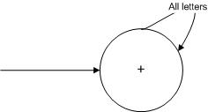

A new Format for FAs
A REJECT state is a dead-end state that is not final.

Slide 11
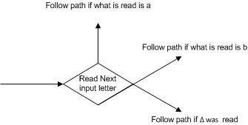
A new Format for FAs
READ states are introduced.
These are depicted as diamond shaped boxes

Slide 12
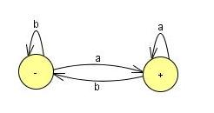
A new Format for FAs
The FA that is used to be drawn
The FA that accepts all words ending in the letter a becomes, in the new symbolism,

Slide 13
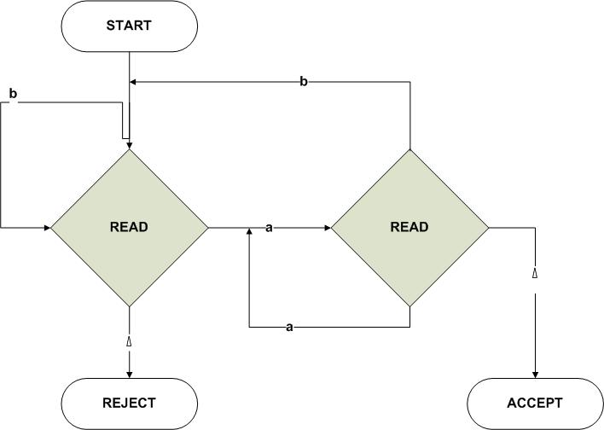
A new Format for FAs

Slide 14
A new Format for FAs
We have also used the electronic diagram notation for wires flowing into each other.

Slide 15
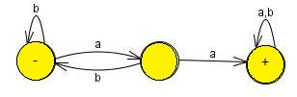
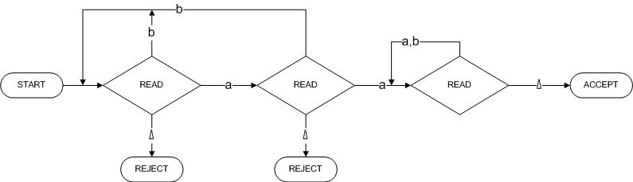
A new Format for FAs
We have also used the electronic diagram notation for wires flowing into each other.
Becomes

Slide 16
Lecture 27 Summary
Chomsky Normal Form conversion in JFLAP
Push Down Automata Definition
PDA Symbols
Deterministic PDA Examples
Non-Deterministic PDA Examples
Thanks to Daniel I.A. cohen. The material for these slides has been taken from his book Automata Theory

