Slide 1
Lecture # 26
Theory Of Automata
By
Dr. MM Alam

Slide 2
Lecture 25 Summary
Regular Grammar conversion to FA
JFLAP Practical demonstration
Elimination of NULL Productions
Elimination of UNIT Productions

Slide 3
Eliminate Unit Productions
EXAMPLE
Consider
S → A Ibb
A → B Ib
B → S | a
Separate the units from the nonunits:.
Unit Production Other ones
S → A S → bb
A → B A → b
B → S B → a

Slide 4
Killing Unit Productions
S → A Ibb
A → B Ib
B → S | a
S → A gives S → b
S → A → B gives S → a
A → B gives A → a
A → B → S gives A → bb
B → S gives B → bb
B → S → A gives B → b

Slide 5
Introduction to Chomsky Normal form
If L is a language generated by some CFG, then there is another CFG that generates all the non-ʎ words of L, all of whose productions are of one of two basic forms:
Nonterminal.-- string of only Nonterminals
or
Nonterminal - one terminal

Slide 6
Introduction to Chomsky Normal form
Example 1
Let start with the CFG:
S → X I X₂aX₂ aSb I b
X_{l} → X₂X₂ I b
X₂ → aX₂ I aaX₁
After the conversion we have:
S → X₁ X₁ → X ₂X ₂
S → X₂AX ₂ X₁ → B
S → ASB X₂ → AX ₂
S → B X₂ → AAX₁
A → a
B → b

Slide 7
Introduction to Chomsky Normal form
Example 1
We have not employed the disjunction slash I but instead have written out all the productions separately so that we may observe eight of the form:
Nonterminal → string of Nonterminals
and two of the form:
Nonterminal → one terminal

Slide 8
Introduction to Chomsky Normal form
EXAMPLE 2
Why not simply replace all a's in long strings by this Nonterminal? For instance, why cannot
S → Na
N → alb
become
S → NN
N → a l b
What do you think?

Slide 9
EXAMPLE 2
The answer is that bb is not generated by the first grammar but it is by the second.
The correct modified form is
S → NA
N → alb
A → a

Slide 10
Introduction to Chomsky Normal form
EXAMPLE 3
The CFG
S → XY
X → XX
Y → YY
Y → a
Y → b
(which generates aa*bb*),

Slide 11
Introduction to Chomsky Normal form
EXAMPLE 3
With our algorithm, become:
S → XY
X → XX
y → yy
X → A
Y → B
A → a
B → b

Slide 12
Introduction to Chomsky Normal form
EXAMPLE
With our algorithm, become:
S → XY
X → XX
Y → yy
X → A
Y → B
A → a Needless Unit Productions, wastage of time
B → b

Slide 13
What is Chomsky Normal form?
Definition
If a CFG has only production of the form
Nonterminal → strings of exactly two nonterminals
Or of the form
Noneterminal → one terminal
It is called Chomsky Normal Form

Slide 14
Chomsky Normal form
Example 4
Let us convert
S---> aSa I bSb I a | b I aa I bb
First separate the terminals from the nonterminal as in T
S → ASA
S → >BSB
S → AA
S → BB
S → a
S → b
A → a
B → b

Slide 15
Chomsky Normal form Conversion
Example 4
We are careful not to introduce the needless unit productions
S → A and S → B.
Now we introduce the R's:
S → AR ₁ S → AA
R ₁ → SA S → BB
S → BR₂ S → a
R₂ → SB S → b
A → a
B → b

Slide 16
Chomsky Normal form
Example 5
Convert the CFG into CNF.
S → bA I aB
A → bAA | aS | a
B → aBB | bS | b
The grammar becomes:
S → YA B → XBB
S → XB B → YS
A → YAA B → b
A → XS X → a
A → a Y → b

Slide 17
Chomsky Normal form
Example 5
We have left well enough alone in two instances:
A → a and B → b
We need to simplify only two productions:
A → YAA becomes {A → YR_{1,} R₁ →AA}
and
B → XBB becomes { B → XR₂,R₂ → BB}

Slide 18
Chomsky Normal form
Example 5
The CFG has now become:
S → YA I XB
A → YR₁ | XS | a
B → XR₂ | YS | b
X → a
Y → b
R₁ → AA
R₂ → BB

Slide 19
Chomsky Normal form
Example 6
Consider the CFG
S → aaaaS I aaaa
Which generates the language
a^{4n} for n = 1 2 3....= {a ⁴ , a⁸, a ¹² ... }
Convert this to CNF as follows:
S → AAAAS
S → AAAA
A → a

Slide 20
Chomsky Normal form
Example 6
Which in turn becomes
S → AR₁
R₁ → AR₂
R₂ → AR₃
R₃ → AS
S → AR₄
R₄ → AR₅
R₅ → AA
A → a

Slide 21
Left Most Derivation
If a word w is generated by a CFG by a certain derivation and at each step in the derivation a rule of production is applied to the leftmost nonterminal in the working string, then this derivation is called a leftmost derivation.

Slide 22
Chomsky Normal form
Example
Consider the CFG:
S → aSX I b
X → Xb Ia
Left most derivation is
S => aSX
=>aaSXX
=>aabXX
=> aabXbX
=> aababX
=> aababa

Slide 23
Chomsky NORMAL Form in JFLAP
Practical Demonstration

Slide 24
Lecture 26 Summary
Chomsky Normal Form
JFLAP practical for CNF
Thanks to Daniel I.A. cohen. The material for these slides has been taken from his book Automata Theory

Slide 25
A new Format for FAs
We will start with our old FA's and throw in some new diagrams that will augment them and make them more powerful.
In this chapter complete new designs will be created for modeling FA’s.

Slide 26
New terminologies
We call it INPUT TAPE to the part of the FA where the input string lives while it is being run.
The INPUT TAPE must be long enough for any possible input, and since any word in a* is a possible input, the TAPE must be infinitely long.
The TAPE has a first location for the first letter of the input, then a second location, and so on.
Therefore, we say that the TAPE is infinite in one direction only.

Slide 27
A new Format for FAs
The locations into which put the input letters are called cells. (See table below)
Name the cells with lowercase Roman numerals.
The Δ used to indicate the blank
Input string is aab
a | a | b | Δ | Δ

Slide 28
Input tape parsing
As TAPE is processed, on the machine we read one letter at a time and eliminate each as it is used.
When we reach the first blank cell we stop.
We always presume that once the first blank is encountered the rest of the TAPE is also blank.
We read from left to right and never go back to a cell that was read before.

Slide 29
New symbols for FA
To streamline the design of the machine, some symbols are used.
The arrows (directed edges) into or out of these states can be drawn at any angle. The START state is like a state connected to another state in a TG by a ʎ edge.
We begin the process there, but we read no input letter. We just proceed immediately to the next state.

Slide 30
A new Symbol for FAs
A start state has no arrows coming into it.
An ACCEPT state is a shorthand notation for a dead-end final state-once entered, it cannot be left, shown on next slide :
Start
Accept
Reject

Slide 31
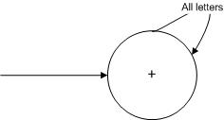

A new Format for FAs
A REJECT state is a dead-end state that is not final.

Slide 32
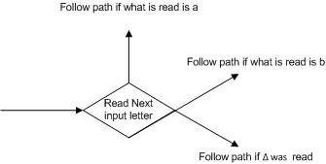
A new Format for FAs
READ states are introduced.
These are depicted as diamond shaped boxes

Slide 33
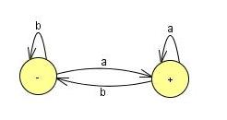
A new Format for FAs
The FA that is used to be drawn
The FA that accepts all words ending in the letter a becomes, in the new symbolism,

Slide 34
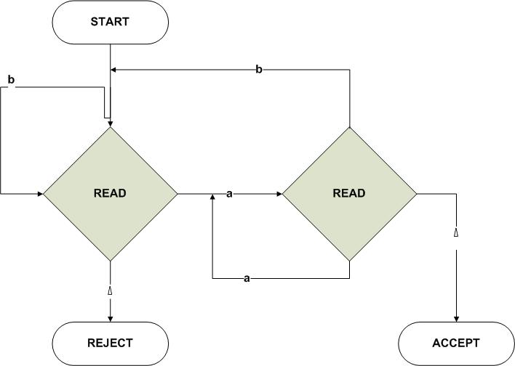
A new Format for FAs

Slide 35
A new Format for FAs
We have also used the electronic diagram notation for wires flowing into each other.

Slide 36
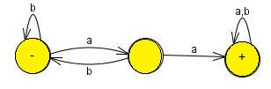
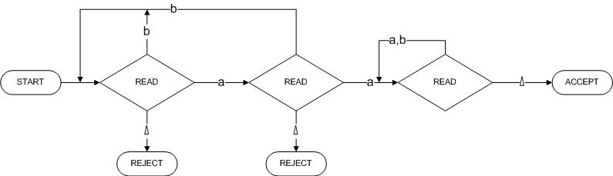
A new Format for FAs
We have also used the electronic diagram notation for wires flowing into each other.
Becomes

Slide 37
Adding A Pushdown Stack
A PUSHDOWN STACK is a place where input letters can be stored until we want to refer to them again.
It holds the letters it has been fed in a long line. The operation PUSH adds a new letter to the line.
The new letter is placed on top of the STACK, and all the other letters are pushed back (or down) accordingly.
Before the machine begins to process an input string the STACK is presumed to be empty, which means that every storage location in it initially contains a blank.

Slide 38
Adding A Pushdown Stack
If the STACK is then fed the letters a, b, c, d by this sequence of instructions:
PUSH a
PUSH b
PUSH c
PUSH d
Then top letter in the STACK is d, the second is c, the third is b, and the fourth is a.
If we now execute the instruction:
PUSH b the letter b will be added to the STACK on the top. The d will be pushed down to position 2, the c to position 3, the other b to position 4, and the bottom a to position 5.

Slide 39
Adding A Pushdown Stack
One pictorial representation of a STACK with these letters in it is shown below.
Beneath the bottom a we presume that the rest of the STACK, which, like the INPUT TAPE, has infinitely many storage locations, holds only blanks.
b
d
c
b
a
Δ

Slide 40
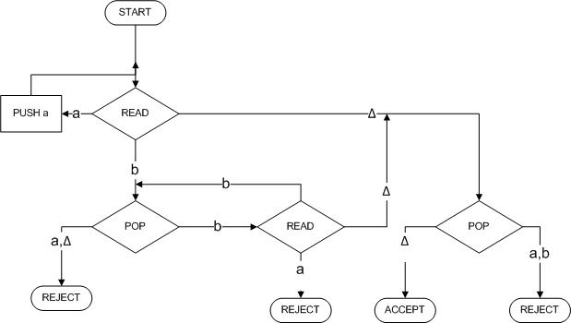
Adding A Pushdown Stack
How the following PDA is working:
a
b

Slide 41
Adding A Pushdown Stack
Its operation on the
input string aaabbb.
We begin by assuming
that this string has
been put on the TAPE.
STACK
Δ
a | a | a | b | b | b | Δ
TAPE

Slide 42
Adding A Pushdown Stack
Its operation on the
input string aaabbb.
We begin by assuming
that this string has been
put on the TAPE.
STACK
a
Δ
a | a | a | b | b | b | Δ
TAPE

Slide 43
Adding A Pushdown Stack
We now read another a
and proceed as before along
the a edge to push it into
the STACK.
Again we are returned
to the READ box.
Again we read an a (our third),
and again this a is pushed onto the STACK.
STACK
a
a
a
Δ
a | a | a | b | b | b | Δ
TAPE

Slide 44
Adding A Pushdown Stack
After the third PUSH a,
we are routed back to
the same READ state again.
This time, we read the letter b.
This means that we take the
b edge out of this state down
to the lower left POP.
STACK
a
a
Δ
a | a | a | b | b | b | Δ
TAPE

Slide 45
Adding A Pushdown Stack
The b road from the second
READ state now takes us
back to the edge feeding
into the POP state.
So we pop the STACK
again and get another a.
The STACK is now
down to only one a.
The a line from POP
takes us again to this same READ.
There is only one letter left on the input TAPE, a b.
a
Δ
a | a | a | b | b | b | Δ
TAPE
STACK

Slide 46
Adding A Pushdown Stack
We read it and
leave the TAPE empty,
that is, all blanks.
However, the machine does
not yet know that the TAPE
is empty.
It will discover this only when
it next tries to read the TAPE
and finds Δ.
Δ
a | a | a | b | b | b | Δ
TAPE

Slide 47
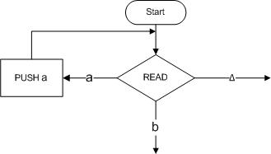
Adding A Pushdown Stack
Let

Slide 48
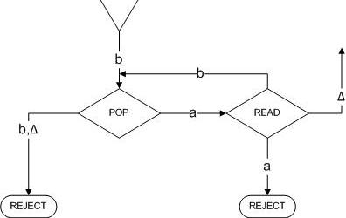
Adding A Pushdown Stack

Slide 49
Example
Example
The PALINDROMEX, language of all words of the form s X reverse(s) where s is any string in (a + b)*.
The words in this language are
{ X aXa bXb aaXaa abXba baXab bbXbb aaaXaaa aabXbaa . . . }
They all contain exactly one X, and this X marks the middle ofthe word.
We can build a deterministic PDA that accepts the language PALINDROMEX.
It has the same basic structure as the PDA we had for the language {a^{n}b^{n}}.

Slide 50
Adding A Pushdown Stack
Example
In the first part of the machine the STACK is loaded with the letters from the input string just as the initial a's from a^{n}b^{n} were pushed onto the STACK.
The letters go into the STACK first letter on the bottom, second letter on top of it, and so on till the last letter pushed in ends up on top.
When we read the X we know we have reached the middle of the input.

Slide 51
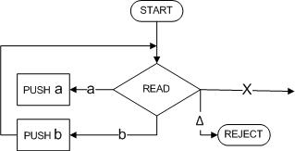
Adding A Pushdown Stack
Example
We can then begin to compare the front half of the word (which is reversed in the STACK) with the back half (still on the TAPE) to see that they match.
We begin by storing the front half of the input string in the STACK with this part of the machine.

Slide 52
Adding A Pushdown Stack
Example
If we READ an a, we PUSH an a. If we READ a b, we PUSH a b, and on and on until we encounter the X on the TAPE.
After we take the first half of the word and stick it into the STACK, we have reversed the order of the letters and it looks exactly like the second half of the word.
For example, if we begin with the input string
abbXbba

Slide 53
Adding A Pushdown Stack
Example
At the moment we are just about to read the X we have:
b
b
a
Δ
a | b | b | X | b | b | a | Δ

Slide 54
Adding A Pushdown Stack
Example
When we read the X we do not put it into the STACK. It is used up the process of transferring us to phase two.
In order to reach ACCEP these two should be the same letter for letter, down to the blanks.:

Slide 55
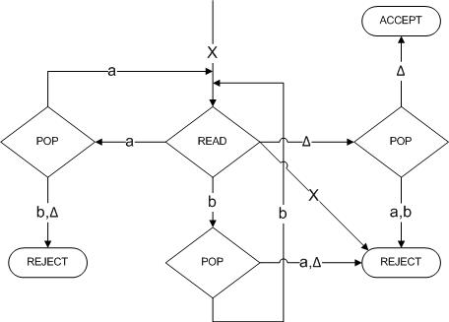
Adding A Pushdown Stack
Example

Slide 56
Adding A Pushdown Stack
Example 2
Consider the language:
EVENPALINDROME = {s reverse(s), where s is in (a + b)*}
= { A aa bb aaaa abba baab bbbbaaaaaa... }
This is the language of all palindromes with an even number of letters.
One machine to accept this language is shown on next slide:

Slide 57
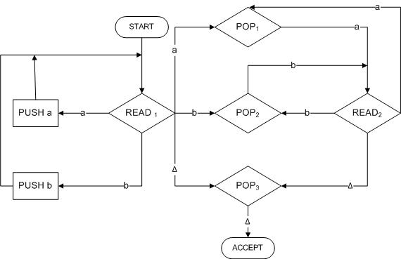
Adding A Pushdown Stack
Example 2

Slide 58
Adding A Pushdown Stack
The first letter of the second half of the word is read in READ₁ ,
Then we immediately go to the POP that compares the character read with what is on top of the STACK. After this we cycle READ₂-->POP-READ₂-->POP---> ....
Δ
b | a | b | b | a | b | Δ

Slide 59
Adding A Pushdown Stack
We can trace the path by which this input
STATE | STACK | TAPE
START | Δ . . . | babbabΔ ...
READ₁ | Δ . . . | babbabΔ …
PUSH_{b} | bΔ . . . | babbabΔ …
READ₁ | bΔ . . . | babbabΔ …
PUSH_{a} | abΔ . . . | babbabΔ …
READ₁ | abΔ . . | babbabΔ …
PUSH_{b} | babΔ . . | babbabΔ …
READ₁ | babΔ | babbabΔ …

Slide 60
Adding A Pushdown Stack
If we are going to accept this input string this is where we must make the jump out of the left circuit into the right circuit. The trace continues:
STATE | STACK | TAPE
POP₂ | abΔ . . . | babbabΔ ...
READ₂ | abΔ . . . | babbabΔ …
POP₁ | bΔ . . . | babbabΔ …
READ₂ | bΔ . . . | babbabΔ …
POP₂ | Δ . . . | babbabΔ …
READ₂ | Δ . . . | babbabΔ …

Slide 61
Adding A Pushdown Stack
If we are going to accept this input string this is where we must make the jump out of the left circuit into the right circuit. The trace continues:
STATE | STACK | TAPE
POP₂ | abREAD₁ . . . | babbabΔ ...
READ₂ | abΔ . . . | babbabΔ …
POP₁ | bΔ . . . | babbabΔ …
READ₂ | bΔ . . . | babbabΔ …
POP₂ | Δ . . . | babbabΔ …
READ₂ | Δ . . . | babbabΔ …

Slide 62
Adding A Pushdown Stack
We have just read the first of the infinitely many blanks on the TAPE.):
STATE | STACK | TAPE
POP₃ | Δ . . . (Popping a blank from an empty stack still leaves blanks) | babbabΔ ... (Reading a blank from from an empty an empty tape still stack still leaves leaves blanks)
ACCEPT | Δ . . . | babbabΔ …

Slide 63
Pushdown Automata
A pushdown automaton, PDA, is a collection of eight things
An alphabet Σ of input letters.
An input TAPE (infinite in one direction). Initially the letters is placed on the TAPE starting in cell i. The rest is blank.
3. An alphabet F of STACK characters.

Slide 64
Pushdown Automata
4. A pushdown STACK (infinite in one direction). Initially empty (contains all blanks).
5. One START state that has only out-edges, no in-edges.
Start

Slide 65
Pushdown Automata
Halt states of two kinds: some ACCEPT and some REJECT.
They have in-edges and no out-edge
7. Finitely many nonbranching PUSH states that introduce characters onto the top of the STACK. They are of the form
Accept
Reject
PUSH X

Slide 66
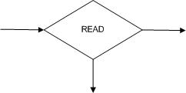
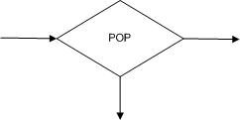
Pushdown Automata
8. Finitely many branching states of two kinds:
(i) States that read the next unused letter from the TAPE
(ii) States that read the top character of the STACK

Slide 67
Pushdown Automata
Example
Consider the language generated by the CFG:
S → S + S I S * S | 4
The terminals are +, *, and 4 and the only nonterminal is S.

Slide 68
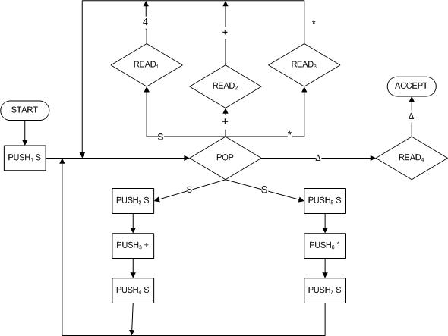
Pushdown Automata
The following PDA accepts this language:

Slide 69
Pushdown Automata
Example
Trace the acceptance of 4 + 4 * 4
STATE | STACK | TAPE
START | Δ | 4 +4 * 4
PUSH₁ S | S | 4 +4 * 4
POP | Δ | 4 +4 * 4
PUSH₂ S | S | 4 +4 * 4
PUSH₃ + | + S | 4 +4 * 4
PUSH₄ S | S + S | 4 +4 * 4

Slide 70
Pushdown Automata
Example
Trace the acceptance of 4 + 4 * 4 (continued)
STATE | STACK | TAPE
POP | +S | 4 +4 * 4
READ₁ | +S | 4 * 4
POP | S | 4 * 4
READ₂ | S | 4 * 4
POP | Δ | 4 * 4
PUSH₅ S | S | 4 * 4
PUSH₆ * | *S | 4 * 4
PUSH₇ S | S*S | 4 * 4
POP | *S | 4 * 4
READ₁ | *S | * 4

Slide 71
Pushdown Automata
Example
Trace the acceptance of 4 + 4 * 4 (continued)
POP | S | * 4
READ₃ | S | 4
POP | Δ | 4
READ₁ | Δ | Δ
POP | Δ | Δ
READ₄ | Δ | Δ
ACCEPT | Δ | Δ

Slide 72
Lecture 26 Summary
Push Down Automata Definition
PDA Symbols
Deterministic PDA Examples
Non-Deterministic PDA Examples
Thanks to Daniel I.A. cohen. The material for these slides has been taken from his book Automata Theory

