Slide 1
Lecture # 24
Theory Of Automata
By
Dr. MM Alam

Slide 2
Lecture#23 Summary
CFG Examples
Introduction to Trees
Ambiguity in CFGs
CFG in JFLAP

Slide 3
Unrestricted Grammars
Unrestricted Grammars:
  An unrestricted grammar is similar to a context-free grammar (CFG), except that the left side of a production may contain any nonempty string of terminals and variables, rather than just a single variable.
  In a CFG, the single variable on the left side of a production could be expanded in a derivation step. In an unrestricted grammar, multiple variables and/or terminals that match the left-side of a production can be expanded by the right-side of that production.

Slide 4
Unrestricted Grammar Example
S | → | AX
Db | → | bD
A | → | aAbc
DX | → | EXc
A | → | aBbc
BX | → | ʎ
Bb | → | bB
cE | → | Ec

Slide 5
CFG with JFLAP
Unrestricted Grammar with JFLAP
User Controlled Parsing with JFLAP

Slide 6
Semi words
Definition
For a given CFG a semiword is a string of terminals (maybe none) concatenated with exactly one nonterminal (on the right), for example,
(terminal) (terminal) . . . (terminal) (Nonterminal)

Slide 7
What are semi words?
DEFINITION
A CFG is called a regular grammar if each of its productions is of one of the two forms
Nonterminal → semiword
or
Nonterminal → word

Slide 8
Semiwords
Relationship between regular languages and context-free grammars?
    All regular languages can be generated by CFG's, and so can some nonregular languages but not all possible languages.
    Some regular languages can be generated by CFG's and some regular languages cannot be generated by CFG's. Some nonregular languages can be generated by CFG's and some nonregular languages cannot.

Slide 9
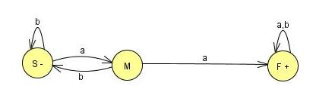
FA Conversion to Regular grammar
Accepts the language of all words with a double a:
S →aM
S →bS
M →aF
M →bS
F →aF
F →bF
F →ʎ

Slide 10
FA Conversion to Regular grammar
Example 1…
The word babbaaba is
Accepted by FA Through
sequence of this semi paths.
 | S
S→bS | bS
S→aM | baM
M→bS | babS
S→bS | babbS
S→aM | babbaM
M→aF | babbaaF
F→bF | babbaabF
F→aF | babbaabaF
F→λ | babbaaba

Slide 11
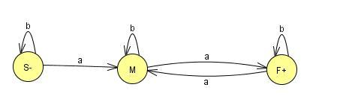
FA Conversion to Regular grammar
Example
The language of all words with an even number of a’s is accepted by the FA:
S → aM I bS
M → bS | aF
F → aF I bF | λ

Slide 12
FA Conversion to Regular grammar
EXAMPLE 2
Consider the CFG:
S → aaS I bbS I λ
There is only one nonterminal, S, so there will be only two states in the TG, - and the mandated +.

Slide 13
FA Conversion to Regular grammar
EXAMPLE 2
The only production of the form
  N_{p} → w_{q} (Nonterminal to word)
  is
  S → ʎ ,
So there is only one edge into + and that is labeled A.
The productions S - aaS and S → bbS are of the form N₁ → wN₂ where the N's are both S.

Slide 14
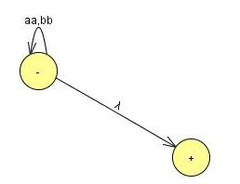
FA Conversion to Regular grammar
Since these are supposed to be made into paths from N, to N2 they become loops from S back to S.
These two productions will become two loops at one labeled aa and one labeled bb.

Slide 15
Lecture#24 Summary
Unrestricted Grammars Example
User controlled Parsing in JFLAP
Regular Grammar Conversion to FA
Regular Grammar Conversion to FA using JFLAP
Thanks to Daniel I.A. cohen. The material for these slides has been taken from his book Automata Theory.

