Slide 1
Lecture # 23
Theory Of Automata
By
Dr. MM Alam

Slide 2
Lecture#22 Recap….
Introduction to Context Free Grammars
How a High Level language is converted to low level instructions, that computer understand.
What are Production Rules and Derivations
What is a CFG
CFG Examples
JFLAP for CFG

Slide 3
Context Free Language
Example 3
Let the terminals be a and b, the only nonterminal be S, and
Productions
  PROD 1 S → aS
  PROD 2 S → bS
  PROD 3 S → a
  PROD 4 S →b

Slide 4
Context Free Language
Example 3
The word baab can be produced as follows:
S => bS (by PROD 2)
=> baS (by PROD 1)
=> baaS (by PROD 1)
=> baab (by PROD 4)

Slide 5
Context Free Language
Example 3
Productions 3 and 4 can be used only once and only one of them can be used.
E.g, to generate babb we apply in order Prods 2, 1, 2, 4, as below:
S => bS => baS => babS => babb

Slide 6
Context Free Language
Example 4
Let the terminals be a and b, nonterminals be S, X, and Y.
The productions are:
S → X
S → y
X → ʎ
Y→aY
Y → bY
Y → a
Y → b

Slide 7
Context Free Language
S → X
S → y
X → ʎ
Y→aY
Y → bY
Y → a
Y → b
All the words in this language are either of type X, if the first production in their derivation is S → X
or of type Y, if the first production in their derivation is S → Y
The only possible continuation for words of type X is the production X → ʎ
Therefore ʎ is the only word of type X.

Slide 8
Context Free Language
S → X
S → y
X → ʎ
Y→aY
Y → bY
Y → a
Y → b
The productions whose left side is Y form a collection identical to the productions in the previous example except that the start symbol S has been replaced by the symbol Y.
We can carry on from Y the same way we carried on from S before.
This does not change the language generated, which contains only strings of terminals.

Slide 9
Context Free Language
Example 5
Let the terminals be a and b. Let the only nonterminal be S.
Let the productions be
S → aS
S → bS
S → a
S → b
S → ʎ

Slide 10
Context Free Language
S → aS
S → bS
S → a
S → b
S → ʎ
The word ab can be generated by the derivation
S => aS
=> abS
=> ab ʎ
= ab

Slide 11
Context Free Language
Example 5
or by the derivation
S => aS
=> ab
The language of this CFG is also (a + b)*, but the sequence of productions that is used to generate a specific word is not unique.

Slide 12
Context Free Language
Example 6
Let the terminals be a and b, nonterminals be S and X, and the productions be
S → XaaX
X → aX
X → bX
X → a
X → b

Slide 13
Context Free Language
S → XaaX
X → aX
X → bX
X → a
X → b
If the nonterminal X appears in any working string we can apply productions to turn it into any word we want.
Therefore, the words generated from S have the form
anything aa anything
or
(a + b)*aa(a + b)*

Slide 14
Context Free Language
Example 7
Let the terminals be a and b, nonterminals be S, X, and Y the productions be
S → XY
X → aX
X → bX
X → a
Y → Ya
Y → Yb
Y → a

Slide 15
Context Free Language
Example 7
What can be derived from X? Let us look at the X productions alone.
X → aX
X → bX
X → a
X => bX => baX => babX => babbX => babba

Slide 16
Context Free Language
Example 7
Similarly, the words that can be derived from Y are exactly those that begin with an a.
To derive abbab,
Y => Yb => Yab => Ybab => Ybbab => abbab

Slide 17
Tree format for CFG
In old-fashioned English grammar courses students were often asked to diagram a sentence.
They were to draw a parse tree, which is a picture with the base line divided into subject and predicate.

Slide 18
Trees
Start with the symbol S.
Every time a production is used to replace a nonterminal by a string, draw downward lines from the nonterminal to each character in the string.
The CFG
S → AA
A → AAA I bA I Ab I a
Tree of this CFG is on next slide

Slide 19
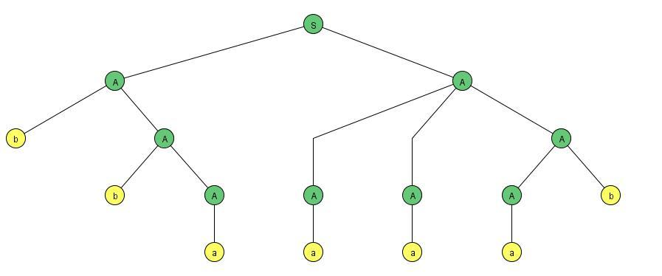
Trees
S → AA
A → AAA I bA I Ab I a

Slide 20
Trees
We begin with S and apply the production
S → AA.
To the left-hand A the production A → bA is applied.
To the right-hand A apply A → AAA is applied.
The b that we have on the bottom line is a terminal, so it does not descend further.
In the terminology of trees it is called a terminal node.

Slide 21
Ambiguity
DEFINITION
A CFG is called ambiguous if for at least one word in the language that it generates there are two possible derivations of the word that correspond to different syntax trees.

Slide 22
CFG
Example 1
Consider the language generated by the CFG:
PROD I S→ AB
PROD 2 A → a
PROD 3 B → b
There are two different sequences of applications of the productions that generate the word ab. One is PROD 1, PROD 2, PROD 3.
The other is PROD 1, PROD 3, PROD 2.
S => AB => aB => ab or
S => AB => Ab => ab

Slide 23
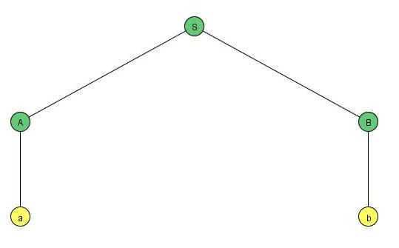
CFG
Example 1
When a corresponding syntax trees is drawn we see that the two derivations are essentially the same:

Slide 24
CFG
Example 2
Consider the language PALINDROME, define by
the CFG below:
S → aSa I bSb a I b| ʎ
At every stage in the generation of a word by this grammar the working string contains only the one nonterminal S smack dab in the middle.
The word grows like a tree from the center out.

Slide 25
CFG
Example 2….
... baSab => babSbab== babbSbbab => babbaSabbab ...
When we finally replace S by a center letter (or A if the word has no center letter) we have completed the production of a palindrome.
The word aabaa has only one possible generation:
S => aSa
=> aaSaa
=> aabaa

Slide 26
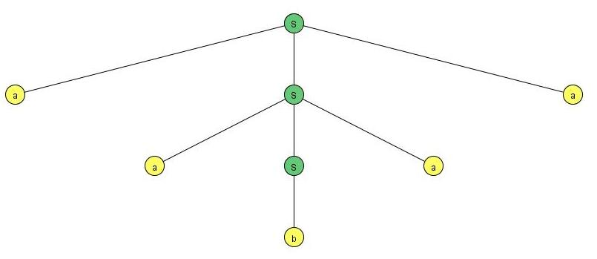
CFG
Example 2….

Slide 27
CFG
EXAMPLE 3
The language of all not-null strings of a's can be defined by a CFG as follows:
S → aS I Sa I a
In this case the word a³ can be generated by four different trees Shown on next slide

Slide 28
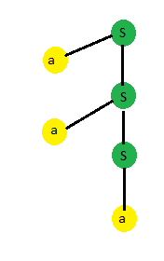
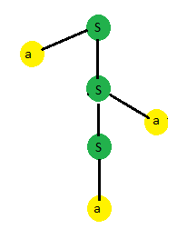
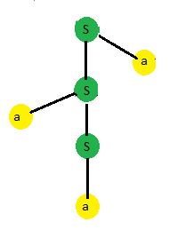
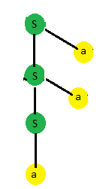
CFG Ambiguity
This CFG is therefore ambiguous.

Slide 29
CFG
However the same language can also be defined by the CFG:
  S → aS I a

Slide 30
Introduction to CFG in JFLAP
JFLAP GRAMMAR Menu

Slide 31
Lecture#23 Summary
CFG Examples
Introduction to Trees
Ambiguity in CFGs
CFG in JFLAP
Thanks to Daniel I cohen. The material for these slides has been taken from his book Automata Theory.

