Slide 1
Lecture # 21
Theory Of Automata
By
Dr. MM Alam

Slide 2
Lecture#20 Recap
Pumping Lemma 1 Examples
Need for Pumping Lemma Version II
JFLAP for Pumping Lemma Version II

Slide 3
PUMPING Lemma Version II using JFLAP

Slide 4
Pumping Lemma in JFLAP and in Daniel I. Cohen Book
M is not taken as a length of x and y but it other words, it is shown as xy<= m
Within the string decomposition, y cannot be null, but pumping 0 times, y cannot be empty. This fact is not very much obvious in the book.
However, the following example, make a clear note on it.

Slide 5
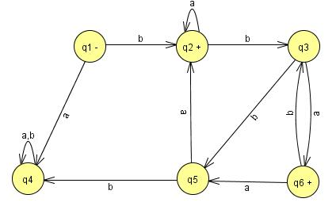
Pumping Lemma Example in Daniel I cohen Book
Example
Let us illustrate the action of the Pumping Lemma on a concrete example of a regular language.
The machine below accepts an infinite language and has only six states

Slide 6
Example
Any word with six or more letters must correspond to a path that includes a circuit.
Some words with fewer than six letters correspond to paths with circuits, such as baaa.
The word we will consider in detail is
w = bbbababa
Which has more than six letters and therefore includes a circuit.

Slide 7
Example
The path that this word generates through the FA can be decomposed into three stages:
The first part, the x-part, goes from the - state up to the first circuit.
This is only one edge and corresponds to the letter b alone.
The second stage is the circuit around states q2, q3, and q5.

Slide 8
Example
This corresponds to edges labeled b, b, and a.
We therefore say that the substring bba is the y-part of the word w.
After going around the circuit, the path proceeds to states q3, q6, q3, and q6.

Slide 9
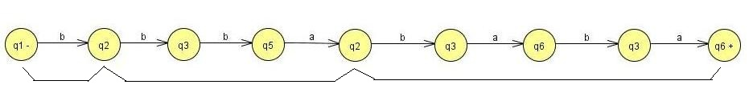
This corresponds to the substring baba of w, which constitutes the z-part.
w = b bba baba
x y z
what would happen to the input string xyyz.
x y y z = b bba bba baba
Clearly, the x-part (the letter b) would take this path from -- to the beginning of the circuit in the path of w.
Then the y-part would circle the circuit in the same way that the path for w does when it begins xy.

Slide 10
Pumping Lemma Version II from book
Let L be an infinite language accepted by a finite automaton with N states.
Then for all words w in L that have more than N letters there are strings x, y, and z
where y is not null and where length(x) + length(y) does not exceed N
such that
    W =xyz
    and all strings of the form
    xy^{n}z (for n =1 2 3 ... )
are in L.

Slide 11
Why we needed Pumping Lemma Version II?
Example
We shall show that the language PALINDROME is nonregular. We cannot use the first version of the Pumping Lemma to do this because the strings
x=a y=b z=a
satisfy the lemma and do not contradict the language. All words of the form
  xy^{n}z = ab^{n}a
  are in PALINDROME.

Slide 12
Lecture#20 Summary
Pumping Lemma version I Repeat
Need for Pumping Lemma Version II – Repeat
JFLAP for Pumping Lemma Version II
Thanks to Daniel I cohen. The material for these slides has been taken from his book Automata Theory.

