Slide 1
Lecture # 18
Theory Of Automata
By
Dr. MM Alam

Slide 2
Lecture 17 Recap….
Regular Languages Introduction – Repeat
Intersection with another language also results in a regular language

Slide 3
Theorem 12 – Repeat
  Statement
  The set of regular languages is closed under intersection.
  If L1 and L2 are regular languages then L₁∩ L₂ is also a regular language.

Slide 4
Theorem 12 – Repeat
PROOF: By Demorgan’s Law
For sets of any kind (regular or not)
L₁∩L₂ = (L₁' + L₂')‘
L₁∩L₂ consists of all words that are not in L1’ or L2’.
Because L1 is regular then L1’ is also regular (using Theorem 11) and so as L2’ is regular
Also L₁' + L₂' is regular, therefore (L₁' + L₂')‘ is also regular (using Theorem 11)

Slide 5
Theorem 12 – Repeat
Example
Two languages over Σ = {a,b}
    L₁ = all strings with a double a
    L₂ = all strings with an even number of a's.
L₁ and L₂ are not the same, since aaa is in L₁ but not in L₂ and aba in in L₂ but not in L₁

Slide 6
Theorem 12 – Repeat
Example
L₁ and L₂ are regular languages defined by the regular expressions below.
    r₁ = (a + b)*aa(a + b)*
    r₂ = b*(ab*ab*)*
A word in L₂ can have some b’s in the front
But whenever there is an a, it balanced by an other a (after some b’s).
Gives the factor of the form (ab*ab*)
The words can have as many factors of this from as it wants. It can end an a or ab.

Slide 7
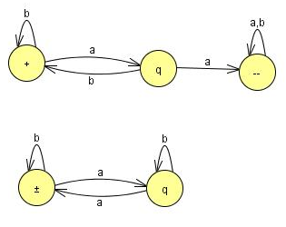
Theorem 12 – Repeat
Example
These two languages can also be defined by FA (Kleen’s theorem)
FA₁
FA₂

Slide 8
Theorem 12 – Repeat
In the proof of the theorem that the complement of a regular language is regular an algorithm is given for building the machines that accept these languages.
Now reverse what is a final state and what is not a final state.
The machines for these languages are then
(see the next slide →)

Slide 9
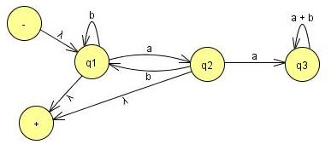
Theorem 12 – Repeat
Recall that how we go through stages of transition graphs with edges labeled by regular expressions. Thus, FA₁' becomes:

Slide 10
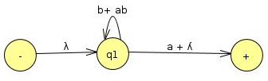
Theorem 12
State q₃ is part of no path from - to +, so it can be dropped.
We need to join incoming a edge with both outgoing edges(b to q1 and q2 to +).
When we add the two loops, we get b + ab and the sum of the two edges from q1 to + is a + ʎ so the machine looks like

Slide 11
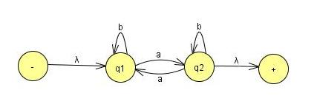
Theorem 12 – Repeat
The same thing for the language L₂
FA2 becomes
Simplify:
Eliminate state q₂
There is one incoming edge a loop, and two outgoing edges,
Now to replace them with only two edges:
The path q₁ – q₂ – q₂ – q₁ becomes a loop at q₁
The path q₁ – q₂ – q₂ – + becomes an edge from q1 to +.

Slide 12
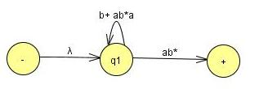

Theorem 12 – Repeat
When state q₂ is bypassed and adding the two loop labels we get,
We can eliminate state q₁ we get,

Slide 13
Theorem 12 – Repeat
As we have regular expression for L₁’ and L₂’
We can write the regular expression for L₁’+L₂’
r_{l}' + r ₂' = (b + ab)*(a + ʎ) + (b + ab*a)*ab*
Make this regular expression in to FA
so that we can take its complement to get the FA that defines L₁∩L₂.

Slide 14
Theorem 12
To build the FA that corresponds to a complicated regular expression is not easy job, as (from the proof of Kleene's Theorem).
Alternatively:
  Make the machine for L₁ ' + L ₂ ' directly from the machines for L₁ ' and L₂' without resorting to regular expressions.
  The method of building a machine that is the sum of two FA's is already developed .
  Also in the proof of Kleene's Theorem.

Slide 15
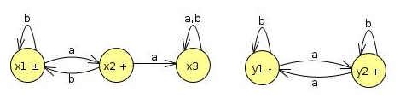
Theorem 12
Let us label the states in the two machines for FA₁' and FA₂‘.
FA₁’
FA₂’
The start states are x₁, and y₁ and the final states are x₁ , x₂, and y₂.

Slide 16
Theorem 12…
FA₁’
FA₂’
Old States | Reading at a | Reading at b
z1-+≡(x1,y1) | (x2,y2)≡z2 | (x1,y1)≡z1
Z2+≡(x2,y2) | (x3,y1)≡z3 | (x1,y2)≡z4
z3≡(x3,y1) | (x3,y2)≡z5 | (x3,y1)≡z3
Z4+≡(x1,y2) | (x2,y1)≡z6 | (x1,y2)≡z4
Z5+≡(x3,y2) | (x3,y1)≡z3 | (x3,y2)≡z5
Z6+≡(x2,y1) | (x3,y2)≡z5 | (x1,y1)≡z1

Slide 17
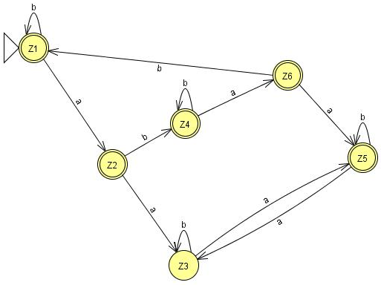
Theorem 12
The union machine

Slide 18
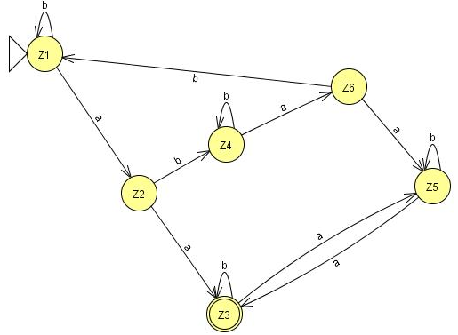
Theorem 12
This FA can accept the language L₁’+L₂’
Reverse the status of each state from final to non-final and vice versa, an FA is going to be produced for the language L₁∩L₂ after taking the complement again.

Slide 19
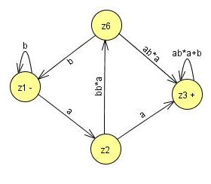
Theorem 12
Bypassing z₄ and z₅ gives

Slide 20
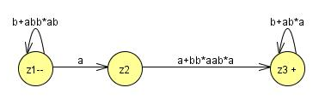
Theorem 12
Then bypassing z₃ gives
So the whole machine reduces to regular expression
(b + abb*ab)*a(a + bb*aab*a)(b + ab*a)*

Slide 21
Theorem 12
(b + abb*ab)*a(a + bb*aab*a)(b + ab*a)*
As it stands, there are four factors (the second is just an a and the first and fourth are starred).
Every time we use one of the options from the two end factors we incorporate an even number of a's into the word (either none or two).
The second factor gives us an odd number of a's (exactly one).

Slide 22
Theorem 12
(b + abb*ab)*a(a + bb*aab*a)(b + ab*a)*
The third factor gives us the option of taking either one or three a's. In total, the number of a's must be even.
So all the words in this language are in L₂.

Slide 23
(b + abb*ab)*a(a + bb*aab*a)(b + ab*a)*
The second factor gives us an a, and then we must immediately concatenate this with one of the choices from the third factor.
If we choose the other expression, bb*aab*a,
then we have formed a double a in a different way.
By either choice the words in this language all have a double a and are therefore in L₁.
This means that all the words in the language of this regular expression are contained in the language L₁∩L₂.

Slide 24
Theorem 12
Are all the words in L₁∩L₂ included in the language of this expression?
  YES
  Look at any word that is in L₁∩L₂
  It has an even number a’s and a double a somewhere

Slide 25
Theorem 12
Two possibilities, to consider separately
  Before the first double a there are an even number of a's.
  Before the first double a there are an odd number of a's.
Words of type 1 come from expression
    (even number of a's but not doubled) (first aa)
    (even number of a's may be doubled)
    = (b + abb*ab)* (aa)(b + ab*a)*
    = type 1

Slide 26
Theorem 12
Notice that
  the third factor defines the language L, and is a shorter expression than the r₁, used in previous slide.
Words of type 2 come from the expression:
    (odd number of not doubled a's) (first aa)
    (odd number of a's may be doubled)

Slide 27
Theorem 12
Notice that
  The first factor must end in b, since none of its a's is part of a double a.
      = [(b + abb*ab)*abb*] aa [b*a(b + ab*a)*]
      = (b + abb*ab)*(a)(bb* aab*a)(b + ab*a)*
      = type 2

Slide 28
Non-regular languages
Many Languages can be defined using FA’s.
These languages have had many different structures, they took only a few basic forms: languages with required substrings, languages that forbid some substrings, languages that begin or end with certain strings,
languages with certain even/odd properties, and so on.

Slide 29
Non-regular languages
Lets take a look to some new forms, such as the language PALINDROME or the language PRIME of all words a^{P} where p is a prime number.
Neither of these is a regular language.
They can be described in English, but they cannot be defined by an FA.
Conclusion: More powerful machines are needed to define them

Slide 30
Non-regular languages
  Definition
  A language that cannot be defined by a regular expression is called a non-regular language.

Slide 31
Non-regular languages
Cannot be accepted by any FA or TG.
(Kleene's theorem, )
All languages are either regular or nonregular, but not both of them.

Slide 32
Non-regular languages
Consider a simple case. Let us define the language L.
L = {a, ab, aabb, aaabbb, aaaabbbb, aaaaabbbbb . ..}
We could also define this language by the formula
L = {a^{n}b^{n} for n = 0 1 2 3 4 5 ... }
Or short for
L = {a^{n}b^{n}}

Slide 33
Non-regular languages
Please not that when the range of the abstract exponent n is unspecified we mean to imply that it is 0,1,2,3, ...
Lets show that this language is nonregular.
It is a subset of many regular languages, such as a*b*, which, however, also includes such strings as aab and bb that {a^{n}b^{n}} does not.

Slide 34
Non-regular languages
Suppose this language is regular and some FA must be developed that accepts it.
Let us picture one of these FA's .This FA might have many states.
Say that it has 95 states, just for the sake of argument.
Yet we know it accepts the word a⁹⁶b⁹⁶ . The first 96 letters of this input string are all a's and they trace a path through this hypothetical machine.

Slide 35
Non-regular languages
Because there are only 95 states ,The path cannot visit a new state with each input letter read.
The path returns to a state that it has already visited at some point.
The first time it was in that state it left by the a-road.
The second time it is in that state it leaves by the a-road again.

Slide 36
Non-regular languages
Even if it only returns once we say that the path contains a circuit in it.
  (A circuit is a loop that can be made of several edges.)
The path goes up to the circuit and then it starts to loop around the circuit, maybe 0 or more times.
It cannot leave the circuit until, b is read in.

Slide 37
Non-regular languages
Then the path can take a different turn. In this hypothetical example the path could make 30 loops around a three-state circuit before the first b is read.
After the first b is read, the path goes off and does some other stuff following b edges and eventually winds up at a final state where the word a⁹⁶b⁹ ⁶ is accepted.
Let us, say that the circuit that the a-edge path loops 'around has seven states in it. The path enters the circuit, loops around it continuously and then goes off on the b-line to a final state.

Slide 38
Non-regular languages
What will happen to the input string a⁹⁶⁺⁷ b⁹⁶ ? Just as in the case of the input string a⁹⁶ b⁹⁶ ,
This string would produce a path through the machine that would walk up to the same circuit (reading in only a's) and begin to loop around it in exactly the same way.
However, the path for a⁹⁶⁺⁷ b⁹⁶ loops around this circuit one more time than the path for a⁹⁶ b⁹⁶ --precisely one extra time.

Slide 39
Nonregular language
Both paths, at exactly the same state in the circuit, begin to branch off on the b-road.
Once on the b-road, they both go the same 96 b-steps and arrive at the same final state.
But this would mean that the input string a¹⁰³ b⁹⁶ is accepted by this machine.
But that string is not in the language L = {a^{n}b^{n}}.

Slide 40
Non-regular languages
This is a contradiction. We assumed that we were talking about an FA that accepts exactly the words in L and then we were able to prove that the same machine accepts some word that is not in L.
This contradiction means that the machine that accepts exactly the words in L does not exist.
In other words, L is nonregular.

Slide 41
Non-regular languages
Let us review what happened.
We chose a word in L that was so large (had so many letters) that its path through the FA had to contain a circuit.
Once we found that some path with a circuit could reach a final state, we asked ourselves what happens to a path that is just like the first one,
But that loops around the circuit one extra time and then proceeds identically through the machine.

Slide 42
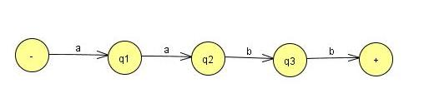
Non-regular languages
Suppose the following FA for a²b²
Only those used in the path of a²b^{2.}

Slide 43

Non-regular languages
Consider the following FA with Circuit….
However, the path for a¹³ b⁹ still has four more a-steps to take, which is one more time around the circuit, and then it follows the nine b-steps.

