Slide 1
Lecture # 17
Theory Of Automata
By
Dr. MM Alam

Slide 2
Lecture 16 Recap….
Transducers Example 2
Regular Languages Introduction
Regular Languages Union, Concatenation, Closure also results in a regular language
Complement of a regular language and Intersection with another language also results in a regular language

Slide 3
Theorem 12
Example
Two languages over Σ = {a,b}
    L₁ = all strings with a double a
    L₂ = all strings with an even number of a's.
L₁ and L₂ are not the same, since aaa is in L₁ but not in L₂ and aba in in L₂ but not in L₁

Slide 4
Theorem 12
Example
L₁ and L₂ are regular languages defined by the regular expressions below.
    r₁ = (a + b)*aa(a + b)*
    r₂ = b*(ab*ab*)*
A word in L₂ can have some b’s in the front
But whenever there is an a, it balanced by an other a (after some b’s).
Gives the factor of the form (ab*ab*)
The words can have as many factors of this from as it wants. It can end an a or ab.

Slide 5
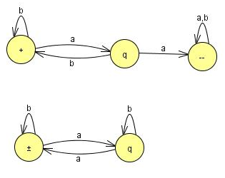
Theorem 12
Example
These two languages can also be defined by FA (Kleen’s theorem)
FA₁
FA₂

Slide 6
Theorem 12
Example
In the first machine we stay in the start state until we read our first a.
Then we move to the middle state.
Here we can find a double a.
If we read another a from the input string while in the middle state, we move to the final state where we remain.
If we read a b, we go back to -. If we never get past the middle state, the word has no double a and is rejected.

Slide 7
Theorem 12
Example
The second machine switches from left state to right state or from right state to left state every time it reads an a.
It ignores all b's. If the string begins on the left and ends on the left, it must have made an even number of left/right switches.
Therefore, the strings this machine accepts are exactly those in L₂ .

Slide 8
Theorem 12
The first step in building the machine (and regular expression) for L₁∩L₂ is to find the machines that accept the complementary languages L₁' and L₂'.
The English description of these languages is:
    L₁' = all strings that do not contain the substring a
    L₂' = all strings having an odd number of a's

Slide 9
Theorem 12
In the proof of the theorem that the complement of a regular language is regular an algorithm is given for building the machines that accept these languages.
Now reverse what is a final state and what is not a final state.
The machines for these languages are then
(see the next slide →)

Slide 10
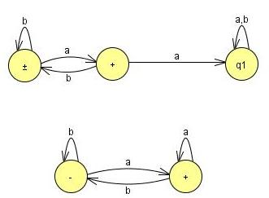
Theorem 12
The machines for these languages are
FA₁’
FA₂’

Slide 11
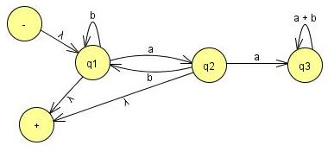
Theorem 12
Recall that how we go through stages of transition graphs with edges labeled by regular expressions. Thus, FA₁' becomes:

Slide 12
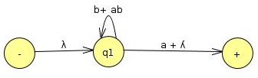
Theorem 12
State q₃ is part of no path from - to +, so it can be dropped.
We need to join incoming a edge with both outgoing edges(b to q1 and q2 to +).
When we add the two loops, we get b + ab and the sum of the two edges from q1 to + is a + ʎ so the machine looks like

Slide 13
Theorem 12
The last step is to bypass state q₁.
Concentrate the incoming ʎ label with the loop label starred (b + ab)*
Concentrated with outgoing (a + ʎ) to produce one edge from – to + with the regular expression for L₁’
  r₁’ = (b +ab)*(a + ʎ)

Slide 14
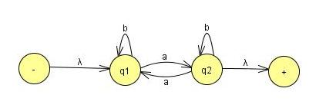
Theorem 12
Lets do the same thing for the language L₂
FA2 becomes
Simplify:
Eliminate state q₂
There is one incoming edge a loop, and two outgoing edges,
Now to replace them with only two edges:
The path q₁ – q₂ – q₂ – q₁ becomes a loop at q₁
The path q₁ – q₂ – q₂ – + becomes an edge from q1 to +.

Slide 15
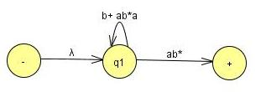

Theorem 12
When state q₂ is bypassed and adding the two loop labels we get,
We can eliminate state q₁ we get,

Slide 16
Theorem 12
It gives the regular expression
r₂’ = (b + ab*a)*ab*
This is one of the regular expression that define the language of all words with an odd number of a’s.
Another expression that define the same language
Add b*a in the front of regular expression for L1
We get
b*ab*(ab*ab*)*

Slide 17
Theorem 12
This works because words with an odd number of a's can be interpreted as b*a in front of words with an even number of a's.
The fact that these two different regular expressions define the same language is not obvious.

Slide 18
Theorem 12
As we have regular expression for L₁’ and L₂’
We can write the regular expression for L₁’+L₂’
r_{l}' + r ₂' = (b + ab)*(a + ʎ) + (b + ab*a)*ab*
Make this regular expression in to FA
so that we can take its complement to get the FA that defines L₁∩L₂.

Slide 19
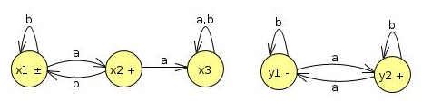
Theorem 12
Let us label the states in the two machines for FA₁' and FA₂‘.
FA₁’
FA₂’
The start states are x₁, and y₁ and the final states are x₁ , x₂, and y₂.

Slide 20
Theorem 12…
FA₁’
FA₂’
Old States | Reading at a | Reading at b
z1-+≡(x1,y1) | (x2,y2)≡z2 | (x1,y1)≡z1
Z2+≡(x2,y2) | (x3,y1)≡z3 | (x1,y2)≡z4
z3≡(x3,y1) | (x3,y2)≡z5 | (x3,y1)≡z3
Z4+≡(x1,y2) | (x2,y1)≡z6 | (x1,y2)≡z4
Z5+≡(x3,y2) | (x3,y1)≡z3 | (x3,y2)≡z5
Z6+≡(x2,y1) | (x3,y2)≡z5 | (x1,y1)≡z1

Slide 21
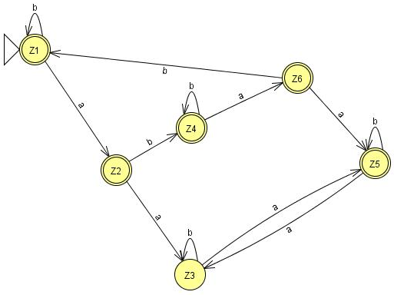
Theorem 12
The union machine

Slide 22
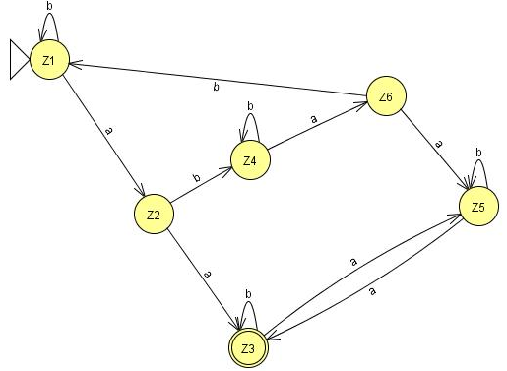
Theorem 12
This FA can accept the language L₁’+L₂’
Reverse the status of each state from final to non-final and vice versa, an FA is going to be produced for the language L₁∩L₂ after taking the complement again.

Slide 23
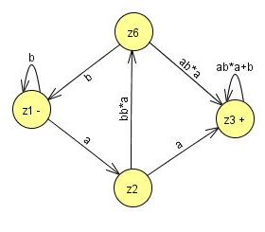
Theorem 12
Bypassing z₄ and z₅ gives

Slide 24
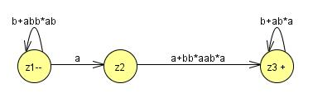
Theorem 12
Then bypassing z₃ gives
So the whole machine reduces to regular expression
(b + abb*ab)*a(a + bb*aab*a)(b + ab*a)*

Slide 25
Theorem 12
(b + abb*ab)*a(a + bb*aab*a)(b + ab*a)*
As it stands, there are four factors (the second is just an a and the first and fourth are starred).
Every time we use one of the options from the two end factors we incorporate an even number of a's into the word (either none or two).
The second factor gives us an odd number of a's (exactly one).

Slide 26
Theorem 12
(b + abb*ab)*a(a + bb*aab*a)(b + ab*a)*
The third factor gives us the option of taking either one or three a's. In total, the number of a's must be even.
So all the words in this language are in L₂.

Slide 27
(b + abb*ab)*a(a + bb*aab*a)(b + ab*a)*
The second factor gives us an a, and then we must immediately concatenate this with one of the choices from the third factor.
If we choose the other expression, bb*aab*a,
then we have formed a double a in a different way.
By either choice the words in this language all have a double a and are therefore in L₁.
This means that all the words in the language of this regular expression are contained in the language L₁∩L₂.

Slide 28
Theorem 12
Are all the words in L₁∩L₂ included in the language of this expression?
  YES
  Look at any word that is in L₁∩L₂
  It has an even number a’s and a double a somewhere

Slide 29
Theorem 12
Two possibilities, to consider separately
  Before the first double a there are an even number of a's.
  Before the first double a there are an odd number of a's.
Words of type 1 come from expression
    (even number of a's but not doubled) (first aa)
    (even number of a's may be doubled)
    = (b + abb*ab)* (aa)(b + ab*a)*
    = type 1

Slide 30
Theorem 12
Notice that
  the third factor defines the language L, and is a shorter expression than the r₁, used in previous slide.
Words of type 2 come from the expression:
    (odd number of not doubled a's) (first aa)
    (odd number of a's may be doubled)

Slide 31
Theorem 12
Notice that
  The first factor must end in b, since none of its a's is part of a double a.
      = [(b + abb*ab)*abb*] aa [b*a(b + ab*a)*]
      = (b + abb*ab)*(a)(bb* aab*a)(b + ab*a)*
      = type 2
Adding type 1 and type 2 together (and factoring out like terms using the distributive law), we obtain the same expression we got from the algorithm.
We now have two proofs that this is indeed a regular expression for the language L₁ ∩ L₂

Slide 32
Non-regular languages
Many Languages can be defined using FA’s.
These languages have had many different structures, they took only a few basic forms: languages with required substrings, languages that forbid some substrings, languages that begin or end with certain strings,
languages with certain even/odd properties, and so on.

Slide 33
Non-regular languages
Lets take a look to some new forms, such as the language PALINDROME or the language PRIME of all words a^{P} where p is a prime number.
Neither of these is a regular language.
They can be described in English, but they cannot be defined by an FA.
Conclusion: More powerful machines are needed to define them

Slide 34
Non-regular languages
  Definition
  A language that cannot be defined by a regular expression is called a non-regular language.

Slide 35
Non-regular languages
Cannot be accepted by any FA or TG.
(Kleene's theorem, )
All languages are either regular or nonregular, but not both of them.

Slide 36
Non-regular languages
Consider a simple case. Let us define the language L.
L = {a, ab, aabb, aaabbb, aaaabbbb, aaaaabbbbb . ..}
We could also define this language by the formula
L = {a^{n}b^{n} for n = 0 1 2 3 4 5 ... }
Or short for
L = {a^{n}b^{n}}

Slide 37
Non-regular languages
Please not that when the range of the abstract exponent n is unspecified we mean to imply that it is 0,1,2,3, ...
Lets show that this language is nonregular.
It is a subset of many regular languages, such as a*b*, which, however, also includes such strings as aab and bb that {a^{n}b^{n}} does not.

Slide 38
Non-regular languages
Suppose this language is regular and some FA must be developed that accepts it.
Let us picture one of these FA's .This FA might have many states.
Say that it has 95 states, just for the sake of argument.
Yet we know it accepts the word a⁹⁶b⁹⁶ . The first 96 letters of this input string are all a's and they trace a path through this hypothetical machine.

Slide 39
Non-regular languages
Because there are only 95 states ,The path cannot visit a new state with each input letter read.
The path returns to a state that it has already visited at some point.
The first time it was in that state it left by the a-road.
The second time it is in that state it leaves by the a-road again.

Slide 40
Non-regular languages
Even if it only returns once we say that the path contains a circuit in it.
  (A circuit is a loop that can be made of several edges.)
The path goes up to the circuit and then it starts to loop around the circuit, maybe 0 or more times.
It cannot leave the circuit until, b is read in.

Slide 41
Non-regular languages
Then the path can take a different turn. In this hypothetical example the path could make 30 loops around a three-state circuit before the first b is read.
After the first b is read, the path goes off and does some other stuff following b edges and eventually winds up at a final state where the word a⁹⁶b⁹ ⁶ is accepted.
Let us, say that the circuit that the a-edge path loops 'around has seven states in it. The path enters the circuit, loops around it continuously and then goes off on the b-line to a final state.

Slide 42
Non-regular languages
What will happen to the input string a⁹⁶⁺⁷ b⁹⁶ ? Just as in the case of the input string a⁹⁶ b⁹⁶ ,
This string would produce a path through the machine that would walk up to the same circuit (reading in only a's) and begin to loop around it in exactly the same way.
However, the path for a⁹⁶⁺⁷ b⁹⁶ loops around this circuit one more time than the path for a⁹⁶ b⁹⁶ --precisely one extra time.

Slide 43
Nonregular language
Both paths, at exactly the same state in the circuit, begin to branch off on the b-road.
Once on the b-road, they both go the same 96 b-steps and arrive at the same final state.
But this would mean that the input string a¹⁰³ b⁹⁶ is accepted by this machine.
But that string is not in the language L = {a^{n}b^{n}}.

Slide 44
Non-regular languages
This is a contradiction. We assumed that we were talking about an FA that accepts exactly the words in L and then we were able to prove that the same machine accepts some word that is not in L.
This contradiction means that the machine that accepts exactly the words in L does not exist.
In other words, L is nonregular.

Slide 45
Non-regular languages
Let us review what happened.
We chose a word in L that was so large (had so many letters) that its path through the FA had to contain a circuit.
Once we found that some path with a circuit could reach a final state, we asked ourselves what happens to a path that is just like the first one,
But that loops around the circuit one extra time and then proceeds identically through the machine.

Slide 46
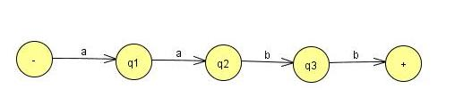
Non-regular languages
Suppose the following FA for a²b²
Only those used in the path of a²b^{2.}

Slide 47

Non-regular languages
Consider the following FA with Circuit….
However, the path for a¹³ b⁹ still has four more a-steps to take, which is one more time around the circuit, and then it follows the nine b-steps.

Slide 48
Non-regular languages
Let us return to.
With our first assumptions we made above (that there were 95 states and that the circuit was 7 states long), we could also say that a¹¹⁰b⁹⁶ , a¹¹⁷b⁹⁶, a¹²⁴b⁹⁶ ... are also accepted by this machine.
All can be written the form
  a⁹⁶(a⁷)^{m}b⁹⁶
where m is any integer 0,1,2,3 ..... If m is 0, the path through this machine is the path for the word a⁹⁶b^{96 .}

Slide 49
Non-regular languages
If m is (1, that looks the same, but it loops the circuit one more time.
If m 2, the path loops the circuit two more times.
In general, a⁹⁶(a⁷)^{m}b⁹⁶ loops the circuit exactly m more times.
After doing this looping it gets off the circuit at exactly the same place a⁹⁶b⁹⁶ does and proceeds along exactly the same route to the final state.
All these words, though not in L, must be accepted.

Slide 50
Non-regular languages
Suppose that we had considered a different machine to accept the language L, a machine that has 732 states.
When we input the word a⁷³³ b⁷³³ ,
the path that the a's take must contain a circuit.
The word a⁹⁹⁹⁹b⁹⁹⁹⁹ also must loop around a circuit in its a-part of the path.

Slide 51
Nonregular language
Suppose the circuit that the a-part follows has 101 states.
Then a⁷³³⁺¹⁰¹ b⁷³³ would also have to be accepted by this machine, because
its path is the same in every detail except that it loops the circuit one more time.
This second machine must also accept some strings, that are not in L:
  a⁸³⁴ b⁷³³ a⁹³⁵ b⁷³³ a¹⁰³⁶ b⁷³³ ……
  = a⁷³³ (a¹⁰¹ )^{m} b⁷³³

Slide 52
PUMPING LEMMA (Version I)
Let L be any regular language that has infinitely many words. Then there exist some three strings x, y, and z (where y is not the null string) such that all the strings of the form xy^{n}z for n = 1 2 3 ...

Slide 53
Theorem 13
PROOF
If L is a regular language, then there is an FA that accepts exactly the words in L.
Let us focus on one such machine.
Like all FA's, this machine has only finitely many states. But L has infinitely many words in it.
This means that there are arbitrarily long' words in L. (If there were some maximum on the length of all the words in L, then L could have only finitely many words in total.)

Slide 54
Theorem 13
PROOF
Let w be some word in L that has more letters in it than there are states in the machine we are considering.
When this word generates a path through the machine, the path cannot visit a new state for each letter because there are more letters than states.
Therefore, it must at some point revisit a state that it has been to before.

Slide 55
Theorem 13
Part 1
All the letters of w starting at the beginning that lead up to the first state that is revisited. Call this part x. Notice that x may be the null string if the path for w revisits the start state as its first revisit.
Part 2
Starting at the letter after the substring x, let y denote the substring of w that travels around the circuit coming back to the same state the circuit began with.
Since there must be a circuit, y cannot be the null string. y contains the letters of w for exactly one loop around this circuit.

Slide 56
Theorem 13
Part 3
Let z be the rest of w starting with the letter after the substring y and going to the end of the string w. This z could be null.
The path for z could also possibly loop around the y circuit or any other. What z does is arbitrary.
From the definition of these three substrings
    w = xyz
w is accepted by this machine.

Slide 57
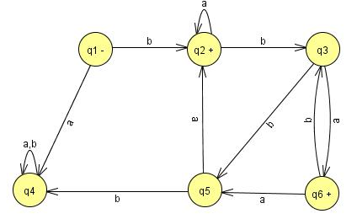
Theorem 13
Example
Let us illustrate the action of the Pumping Lemma on a concrete example of a regular language.
The machine below accepts an infinite language and has only six states

Slide 58
Example
Any word with six or more letters must correspond to a path that includes a circuit.
Some words with fewer than six letters correspond to paths with circuits, such as baaa.
The word we will consider in detail is
w = bbbababa
Which has more than six letters and therefore includes a circuit.

Slide 59
Example
The path that this word generates through the FA can be decomposed into three stages:
The first part, the x-part, goes from the - state up to the first circuit.
This is only one edge and corresponds to the letter b alone.
The second stage is the circuit around states q2, q3, and q5.

Slide 60
Example
This corresponds to edges labeled b, b, and a.
We therefore say that the substring bba is the y-part of the word w.
After going around the circuit, the path proceeds to states q3, q6, q3, and q6.

Slide 61
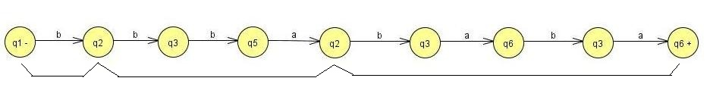
This corresponds to the substring baba of w, which constitutes the z-part.
w = b bba baba
x y z
what would happen to the input string xyyz.
x y y z = b bba bba baba
Clearly, the x-part (the letter b) would take this path from -- to the beginning of the circuit in the path of w.
Then the y-part would circle the circuit in the same way that the path for w does when it begins xy.

Slide 62
Theorem 13
At this point, we are back at the beginning of the circuit. We mark off the circuit starting at the first repeated state, which in this case is state q2.
Consider it to be made up of exactly as many edges as it takes to get back there (in this case 3 edges).
In the original path for w we proceed again from state q2 to state q3 as in the circuit, this is not part of the first simple- looping and so not part of y.

Slide 63
Theorem 13
so, we can string two y-parts together since the second y begins in the state in which the first leaves us.
The second y-part circles the circuit again and leaves us in the correct state to resume the path of the word w.
We can continue after xyy with the z path exactly as we continued w with the z path after its y-part.

Slide 64
Lecture 17 Summary
Theorem 12 Revision
Theorem 12 Proof using Kleen’s theorem (UNION)
Analysis of generated regular expressions
Thanks to Daniel I cohen. The material for these slides has been taken from his book Automata Theory.

