Slide 1
Lecture # 16
Theory Of Automata
By
Dr. MM Alam

Slide 2
Summary Lecture#15
Equivalence of Mealy and Moore Machines – Repeat
Transducers (NAND,OR,AND,NOT)
Transducers Example 1

Slide 3
Example2 Taken from the Book Exercises
Circuit Diagram
input
Output
A
B
OR
DELAY
AND
OR
  New B = old A
  New A = input OR(old A OR old B)
  output = old B AND input

Slide 4
Example2…
  A = 0, B = 0 q₀
  A = 0, B = 1 q₁
  A = 1, B = 0 q₂
  A = 1, B = 1 q₃
  New B = old A
  New A = input OR(old A OR old B)
  output = old B AND input

Slide 5
Example2…
  State q₀ /input = 0 / A = 0, B = 0
  New B = old A = 0
  New A = input OR (old A OR old B)
  = 0 OR (0 OR 0)
  = 0 OR 0 = 0
  Output = input AND old B
  = 0 AND 0 = 0

Slide 6
Example2…
State q_{o} / input = 1 / A =0, B = 0
new B = old A = 0
new A = input OR (old A OR old B)
= 1 OR (0 OR 0)
= 1 OR 0 = 1
output = input AND old B
= 1 AND 0 = 0

Slide 7
Example2…
state q₁ / input = 0 /A = 0, B= 1
new B = old A = 0
new A = input OR (old A OR old B)
    = 0 OR (0 OR 1)
    = 0 OR 1 = 1
output = old B AND input = 1 AND 0 = 0

Slide 8
Example2…
state q₁/ input = 1 /A = 0 , B = 1
new B = old A = 0
new A = input OR (old A OR old B)
= 1 OR (0 OR 1)
= 1 OR 1 = 1
output = old B AND input = 1 AND 1 = 1

Slide 9
Example2…
state q₂/ input = 0/ A = 1, B= 0
new B = old A = 1
new A = input OR (old A OR old B)
= 0 OR (1 OR 0)
= 0 OR 1 =1
output = old B AND input = 0 AND 0 = 0

Slide 10
Example2…
state q₂ / input = 1 / A= 1/ B= 0
new B = old A = 1
new A = input OR (old A OR old B)
= 1 OR (1 OR 1)
= 1 OR 1= 1
output = old B AND input = 0 AND 1 = 0

Slide 11
Example2…
state q₃ / input = 0 / A= 1/ B= 1
new B = old A = 1
new A = input OR (old A OR old B)
= 0 OR (1 OR 1)
= 0 OR 1= 1
output = old B AND input = 1 AND 0 = 0

Slide 12
Example2…
state q3 / input = 1 / A= 1/ B= 1
new B = old A = 1
new A = input OR (old A OR old B)
= 1 OR (1 OR 1)
= 1 OR 1= 1
output = old B AND input = 1 AND 1 = 1

Slide 13
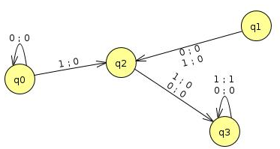
 | After input 0 |  | After input 1
Old State | New State | Output | New State | Output
q₀(A=0,B=0) | q₀ | 0 | q₂ | 0
q₁(A=0,B=1) | q₂ | 0 | q₂ | 0
q₂(A=1,B=0) | q₃ | 0 | q₃ | 0
q₃(A=1,B=1) | q₃ | 0 | q₃ | 1

Slide 14
Regular Languages
Defined by Regular Expression
Properties:
  Closure Properties
  Complements and intersection
  See chapter 9 of the Daniel Book. (All theorems are referred from the book)

Slide 15
Theorem 10
  Statement
  If L₁ and L₂ are regular languages then
  L₁ + L₂, L₁L₂, L₁* are also regular languages

Slide 16
Theorem 10
PROOF: By Regular Expressions
This proof uses the fact that if L₁ and L₂ are regular languages, they must be definable by some regular expressions.
if L₁ and L₂ are regular languages then there are regular expressions r₁, r₂ that define these languages.
  (r₁ + r₂) defines L₁ + L₂
  r₁r₂ defines L₁L₂
  (r₁)* defines L₁*

Slide 17
Theorem 10
PROOF: By Machines
Let there are two TGs that accept L₁ and L₂
TG₁ accepts L₁
TG₂ accepts L₂
Each TG has a unique start state and unique separate final state .

Slide 18
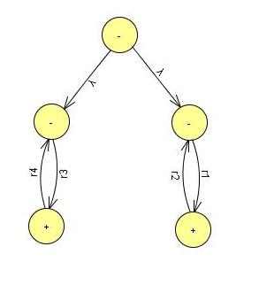
Theorem 10
PROOF: By Machines
TG Accepts L₁ + L₂
Starting at the start state of TG₁ , can only follow a path on TG₁
Starting at the start state of TG₂, can only follow a path on TG2

Slide 19
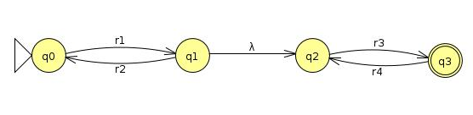
Theorem 10
PROOF: By Machines
TG Accepts L₁L₂
Can stop and accept the string or jump back at no cost,
and run another segment of input string back down to +

Slide 20
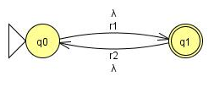
Theorem 10
PROOF: By Machines
TG Accepts L₁*
Can stop and accept the string or jump back at no cost
and run another segment of input string back down to +

Slide 21
Theorem 10
Proof Example
Let the alphabet be Σ = {a,b}
  L₁ = all words of two ore more letters that begin and end with the same letter
  L₂ = all words contain the substring aba
The regular Expressions are:
  a(a + b )*a + b(a + b)*b
  (a + b)*aba(a + b)*

Slide 22
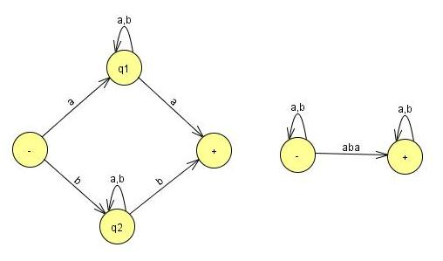
Theorem 10
Proof Example
Σ = {a,b} L₁ + L₂
  L₁ = all words of two ore more
  letters that begin and end
  with the same letter.
  L₂ = all words contain
  the substring aba.

Slide 23
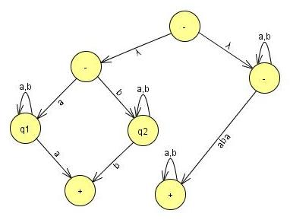
Theorem 10
Example Σ = {a,b}
Σ = {a,b} , L₁L₂
  L₁ = all words of two ore more
  letters that begin and end
  with the same letter.
  L₂ = all words contain the substring aba.
The language L₁ + L₂ is regular because it can be defined by regular expression [a(a + b )*a + b(a + b)*b] + [(a + b)*aba(a + b)*]

Slide 24
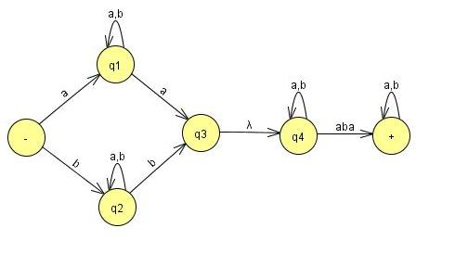
Theorem 10
Example Σ = {a,b}
Σ = {a,b} , L₁*
  L₁ = all words of two ore more
  letters that begin and end
  with the same letter.
  L₂ = all words contain the substring aba.
The language L₁L₂ is regular because it can be defined by regular expression [a(a + b )*a + b(a + b)*b] [(a + b)*aba(a + b)*]
Accepted by TG

Slide 25
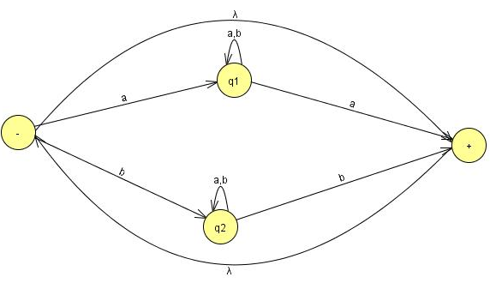
Theorem 10
Example Σ = {a,b}
Σ = {a,b} , L₁*
  L₁ = all words of two ore more letters that begin and end with the same letter.
The language L₁* is regular because it can be defined by regular expression [a(a + b )*a + b(a + b)*b]*
Accepted by TG

Slide 26
Complements and Intersections
  If L is a language over Σ , its complement is defined L’, the language of all strings of letters from Σ that are not words in L

Slide 27
Example
  If L is a language over = (a,b) of all words that have a double a in them, then L’ is the language of all words that donot have a double a.
The complement of a language L’ is the language L
  i.e. (L’)’ = L

Slide 28
Theorem 11
  Statement
  The set of regular languages is closed under complement
  If L is a regular language then L’ is also a regular language

Slide 29
Theorem 11
PROOF:
If L is a regular language then there is some FA that accepts L. (Kleen’s theorem)
Make final state nonfinal state.
Make nonfinal state final state.
The input string now ends in nonfinal state and vice versa.
Make Initial state both initial and final.

Slide 30
Theorem 11
PROOF:
Accepts words of L’.
Rejects words in L.
This machine accepts exactly words in L’.
So L’ is regular. (Kleen’s theorem)

Slide 31
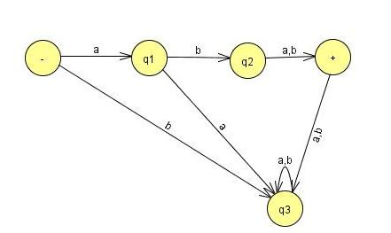
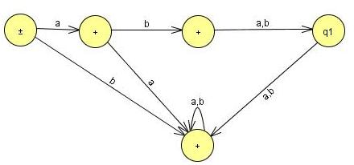
Theorem 11
Example:
A FA that accepts only the string aba and abb.
A FA that accepts all strings but not aba and abb.

Slide 32
Theorem 12
  Statement
  The set of regular languages is closed under intersection.
  If L1 and L2 are regular languages then L₁∩ L₂ is also a regular language.

Slide 33
Theorem 12 (Regular Languages Intersection Theorem)
PROOF: By Demorgan’s Law
For sets of any kind (regular or not)
L₁∩L₂ = (L₁' + L₂')‘
L₁∩L₂ consists of all words that are not in L1’ or L2’.
Because L1 is regular then L1’ is also regular (using Theorem 11) and so as L2’ is regular
Also L₁' + L₂' is regular, therefore (L₁' + L₂')‘ is also regular (using Theorem 11)

Slide 34
Lecture 16 Summary
Transducers Example 2
Regular Languages Introduction
Regular Languages Union, Concatenation, Closure also results in a regular language
Complement of a regular language and Intersection with another language also results in a regular language
Thanks to Daniel I cohen. The material of these slides has been taken from his book Automata Theory.

