Slide 1
Lecture # 15
Theory Of Automata
By
Dr. MM Alam

Slide 2
Lecture 14 at a glance…
Example Moore and Mealy Machines Repeat
Incrementing Mealy machines
Overflow state.

Slide 3
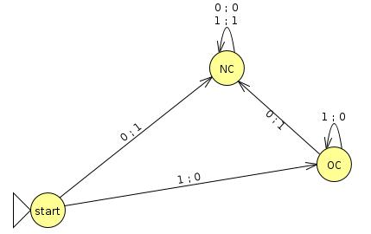
Constructing the incrementing machine continued …
The Mealy machine have the states
q₀, q₁, q₂ , where q₀ is the start state and
Σ = {0,1},
Г={0,1}

Slide 4
Overflow state
Due to typical property of Mealy machines of having input bits equals to outputs, if string 1111 is run as input, the output will be 0000 and not 10000. This is called overflow state.

Slide 5
Relationship between input and output
Generally, a Mealy machine does not accept or reject an input string, there is an implicit relationship between the input and output string.
Consider the following example Mealy machine taken from Daniel A Cohen book, in which whenever a double letter such as aa or bb appears, the output string places 1 as indication.

Slide 6
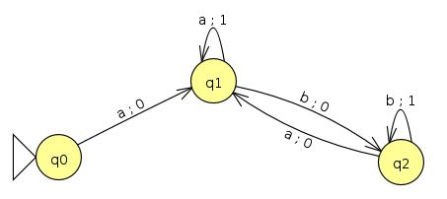

Slide 7
Theorem
Statement:
For every Moore machine there is a Mealy machine that is equivalent to it (ignoring the extra character printed the Moore machine).
Proof: see the following example…

Slide 8
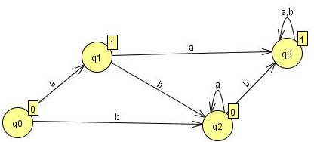
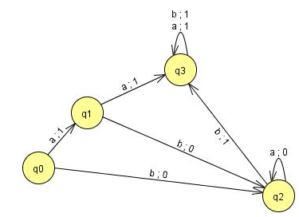

Slide 9
Theorem
Statement:
For every Mealy machine there is a Moore machine that is equivalent to it (ignoring the extra character printed the Moore machine).
Proof: Let M be a Mealy machine. At each state there are two possibilities for incoming transitions
  All incoming transitions have the same output.
  All incoming transitions have different output.

Slide 10
Proof continued …
If all the transitions have same output characters, handling it is very easy.
If all the transitions have different output characters, then the corresponding state will be divided in to the number of outputs generated by incoming transitions.
Please note that the divided state shall behave like the undivided one, that is the output should be same.

Slide 11
Continued…
Initial state conversion….
No output on a set of transitions….

Slide 12
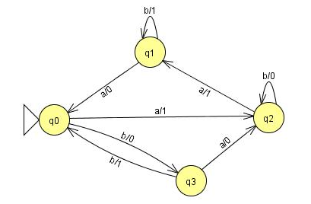
Example
Consider the following Mealy machine

Slide 13
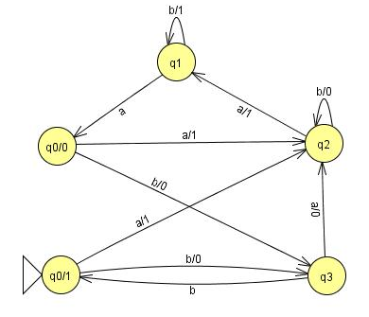
Example continued ...
Dividing the state q0 into q0/0 and q0/1

Slide 14
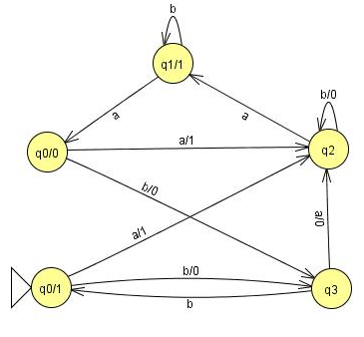
Example continued ...
Shifting the output character 1 of transition a to q₁

Slide 15
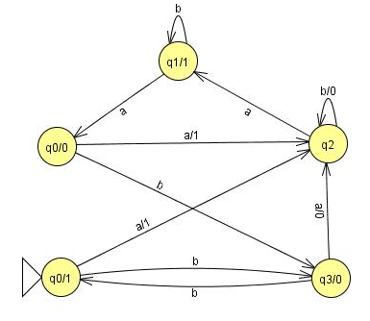
Example continued ...
Shifting the output character 0 of transition b to q₃

Slide 16
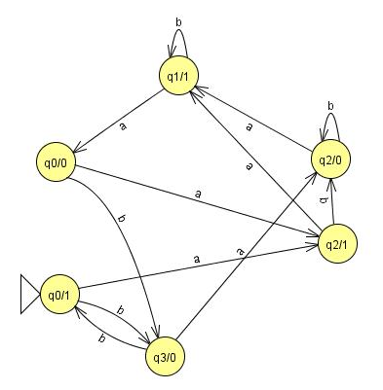
Example continued ...
Dividing the state q2 into q2/0 and q2/1

Slide 17
Finite Automata as Sequential Circuits
How the state machines that we have studied so far, can be used as sequential circuits.
We have already seen these systems working in our computer logic and architecture course.
Automata that we have studied so far, is called transducers because of their similarity to digital circuits.

Slide 18
Example Taken from Daniel I Cohen Book
Let us consider an example of a simple sequential circuit. The box labeled NAND means "not and.“. Its output wire carries the complement of the Boolean AND of its input wires.
The output of the box labeled DELAY is the same as its previous input. It delays transmission of the signal along the wire by

Slide 19
Example1 ..
one step (clock pulse).
The DELAY is sometimes called a D flip-flop. The AND and OR are as usual. Current in a wire is denoted by the value 1, no current by 0.

Slide 20
Example1 ..
input
Output
A
B
NAND
DELAY
OR
OR

Slide 21
Example1 ..
We identify four states based on whether or not there is current at points
A and B in the circuit.
q_{o} is A = 0 B = 0
q₁, is A = 0 B = 1
q₂ is A = 1 B = 0
q₃ is A = 1 B = 1

Slide 22
Example1 ..
The operation of this circuit is such that after an input of 0 or 1 the state changes according to the following rules:
    new B = old A
    new A = (input) NAND (old A OR old B)
    output = (input) OR (old B)
At various discrete pulses of a time clock input is received, the state changes, and output is generated.

Slide 23
Example1 ..
Suppose we are in state q₀ and we receive the input 0:
    new B = old A = 0
    new A = (input) NAND (old A OR old B)
      = (0) NAND (0 OR 0)
      = 0 NAND 0
      = 1
    output = 0 OR 0 = 0

Slide 24
Example1 ..
The new state is q₂ (since new A = 1,
new B = 0).
If we are in state q₀ and we receive the input 1:
    new B = old A = 0
    new A = 1 NAND (0 OR 0) = I
output = 1 OR0 = 1
The new state is q₂ (since the new A = 1 and the new B = 0).

Slide 25
Example1 ..
If we are in q₁, and we receive the input 0:
    new B = old A = 0
    new A = 0 NAND (0 OR 1) = I
    output = 0 OR 1 = I
The new state is q₂.
If we are in q₁, and we receive the input 1:
    new B = old A = 0
    New A = 1 NAND (0 OR 1) = 0
    output = I OR 1 = 1
The new state is q_{o}

Slide 26
Example1 ..
If we are in state q₂ and we receive the input 0:
    new B = old A = 1
    new A = 0 NAND (1 OR0) = 1
    output = 0OR0 = 0
The new state is q₃ (since new A = 1,new B = 1).
If we are in q₂ and we receive the input 1:
    New B = old A = 1
    new A = 1 NAND (1 OR 0) = 0
    output = I OR0 = I
The new state is q₁ .

Slide 27
Example1 ..
If we are in q₃ and we receive the input 0:
    newB = oldA = 1
    new A = 0 NAND (1 OR 1) =
    output = 0 OR 1 = 1
The new state is q₃.
If we are in q₃ and we receive the input 1:
    new B = old A = I
    new A = 1 NAND (1 OR 1) =
    output = I OR 1 = I
The new state is q₁ .

Slide 28
Example1 ..
If we are in q₃ and we receive the input 0:
    newB = oldA = 1
    new A = 0 NAND (1 OR 1) =
    output = 0 OR 1 = 1
The new state is q₃.
If we are in q₃ and we receive the input 1:
    new B = old A = I
    new A = 1 NAND (1 OR 1) =
    output = I OR 1 = I
The new state is q₁ .

Slide 29
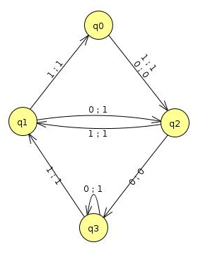
 | After input 0 |  | After input 1
Old State | New State | Output | New State | Output
q₀ | q₂ | 0 | q₂ | 1
q₁ | q₂ | 1 | q₀ | 1
q₂ | q₃ | 0 | q₁ | 1
q₃ | q₃ | 1 | q₁ | 1

Slide 30
Example2 Taken from the Exercises.
Circuit
input
Output
A
B
OR
DELAY
AND
OR

Slide 31
Example2…
  A = 0, B = 0 q₀
  A = 0, B = 1 q₁
  A = 1, B = 0 q₂
  A = 1, B = 1 q₃
  New B = old A
  New A = input OR(old A OR old B)
  output = old B AND input

Slide 32
Example2…
  State q₀ /input = 0 / A = 0, B = 0
  New B = old A = 0
  New A = input OR (old A OR old B)
  = 0 OR (0 OR 0)
  = 0 OR 0 = 0
  Output = input AND old B
  = 0 AND 0 = 0

Slide 33
Example2…
State q_{o} / input = 1 / A =0, B = 0
new B = old A = 0
new A = input OR (old A OR old B)
= 1 OR (0 OR 0)
= 1 OR 0 = 1
output = input AND old B
= 1 AND 0 = 0

Slide 34
Example2…
state q₁ / input = 0 /A = 0, B= 1
new B = old A = 0
new A = input OR (old A OR old B)
    = 0 OR (0 OR 1)
    = 0 OR 1 = 1
output = old B AND input = 1 AND 0 = 0

Slide 35
Example2…
state q₁/ input = 1 /A = 0 , B = 1
new B = old A = 0
new A = input OR (old A OR old B)
= 1 OR (0 OR 1)
= 1 OR 1 = 1
output = old B AND input = 1 AND 1 = 1

Slide 36
Example2…
state q₂/ input = 0/ A = 1, B= 0
new B = old A = 1
new A = input OR (old A OR old B)
= 0 OR (1 OR 0)
= 0 OR 1 =1
output = old B AND input = 0 AND 0 = 0

Slide 37
Example2…
state q₂ / input = 1 / A= 1/ B= 0
new B = old A = 1
new A = input OR (old A OR old B)
= 1 OR (1 OR 1)
= 1 OR 1= 1
output = old B AND input = 0 AND 1 = 0

Slide 38
Example2…
state q₃ / input = 0 / A= 1/ B= 1
new B = old A = 1
new A = input OR (old A OR old B)
= 0 OR (1 OR 1)
= 0 OR 1= 1
output = old B AND input = 1 AND 0 = 0

Slide 39
Example2…
state q3 / input = 1 / A= 1/ B= 1
new B = old A = 1
new A = input OR (old A OR old B)
= 1 OR (1 OR 1)
= 1 OR 1= 1
output = old B AND input = 1 AND 1 = 1

Slide 40
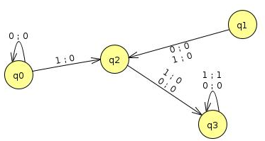
 | After input 0 |  | After input 1
Old State | New State | Output | New State | Output
Q₀(A=0,B=0) | q₀ | 0 | q₂ | 0
q₁(A=0,B=1) | q₂ | 0 | q₂ | 0
q₂(A=1,B=0) | q₃ | 0 | q₃ | 0
q₃(A=1,B=1) | q₃ | 0 | q₃ | 1

Slide 41
Summary Lecture#15
Equivalence of Mealy and Moore Machines – Repeat
Transducers (NAND,OR,AND,NOT)
Transducers Example 1
Transducers Example 2

