Slide 1
Lecture # 14
Theory Of Automata
By
Dr. MM Alam

Slide 2
Lecture 13 at a glance…
NFA conversion – Repeat
Closure Task Solution

Slide 3
Finite Automata with output
In Finite Automata, the input string represents the input data to a computer program. Reading the input letters is very much similar to how a computer program performs various instructions.
The concept of states tell us that what we are printing and what we have printed so far.

Slide 4
Our goal in this chapter is to prove that the mathematical models that we have studied so far can be represented as machines.
We will study two machines created by G.H Mealy (1955) and by E.F Moore (1956).
Initially both models were intended for sequential circuit design.

Slide 5
Moore machine Definition
A Moore machine consists of the following
  A finite set of states q₀, q₁, q₂, … where q₀ is the initial state.
  An alphabet of letters Σ = {a,b,c,…} from which the input strings are formed.
  An alphabet Г={x,y,z,…} of output characters from which output strings are generated.

Slide 6
Moore machine continued …
4. A transition table that shows for each state and each input letter what state is entered the next.
5. No final state, so no question of acceptance of input strings.

Slide 7
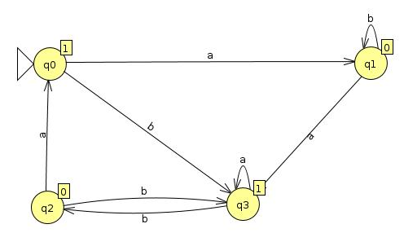
Moore Machine with JFLAP

Slide 8
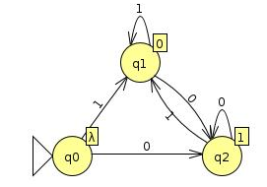
Example: Moore NOT machine

Slide 9
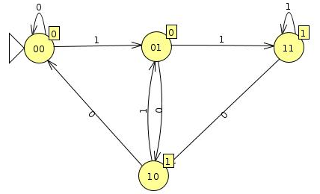
Example: Divide an Input in to half

Slide 10
Mealy machine
A Mealy machine consists of the following
  A finite set of states q₀, q₁, q₂, … where q₀ is the initial state.
  An alphabet of letters Σ = {a,b,c,…} from which the input strings are formed.
  An alphabet Г={x,y,z,…} of output characters from which output strings are generated.

Slide 11
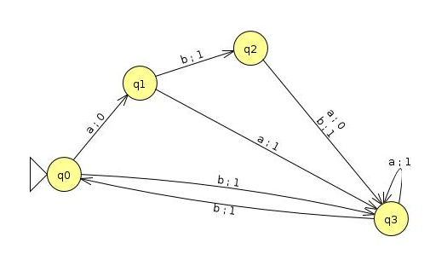
Example Mealy machine

Slide 12
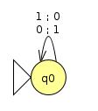
Complementing Mealy Machine

Slide 13
Incrementing Mealy Machine
  Consider the following additions
  a) 100101100 b) 1001111111
  + 1 + 1
  100101101 1010000000
  If the right most bit is 0 then…
  If the right most bit is 1 then…

Slide 14
Incrementing Mealy Machine
The machine will have three states: start, owe-carry (OC), and no-carry(NC). Owe-carry state will output 0 when two 1 bits are added.
The concept of states tell us that what we are printing and what we have printed so far.

Slide 15
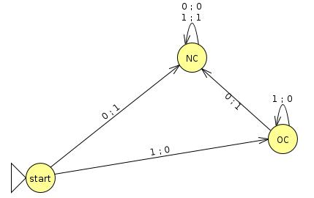
Constructing the incrementing machine continued …
The Mealy machine have the states
q₀, q₁, q₂ , where q₀ is the start state and
Σ = {0,1},
Г={0,1}

Slide 16
Overflow state
Due to typical property of Mealy machines of having input bits equals to outputs, if string 1111 is run as input, the output will be 0000 and not 10000. This is called overflow state.

Slide 17
Summing Up
Example of Moore machine,
Two halves Moore machine
Mealy machine, Examples
Example Moore and Mealy Machines Repeat
Incrementing Mealy machines
Overflow state.

