Slide 1
Lecture # 13
Theory Of Automata
By
Dr. MM Alam

Slide 2
Lecture 12 at a glance…
NFA with NULL to FA Conversion using transition tables
Examples

Slide 3
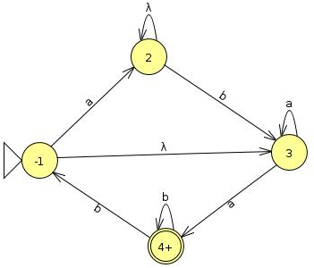
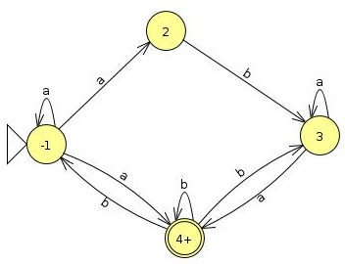
NFA with NULL conversion – Repeat

Slide 4
 | a | b
z₁ ≡ 1 | (1,2,4) ≡ z₂ | ᵩ ≡ Z₅
Z₂⁺ ≡ (1,2,4) | (1,2,4) ≡ z₂ | (1,3,4) ≡ z₃
Z₃⁺ ≡ (1,3,4) | (1,2,4,3) ≡ z₄ | (1,3,4) ≡ z₃
Z₄⁺ ≡ (1,2,3,4) | (1,2,4,3 )≡ z₄ | (1,3,4) ≡ z₃

Slide 5
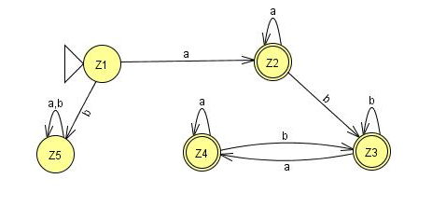
 | a | b
Z₁ ≡ 1 | (1,2,4) ≡ Z₂ | ᵩ ≡ Z₅
Z₂⁺ ≡ (1,2,4) | (1,2,4) ≡ z₂ | (1,3,4) ≡ z₃
Z₃⁺ ≡ (1,3,4) | (1,2,4,3) ≡ z₄ | (1,3,4) ≡ z₃
Z₄⁺ ≡ (1,2,3,4) | (1,2,4,3 )≡ z₄ | (1,3,4) ≡ z₃

Slide 6
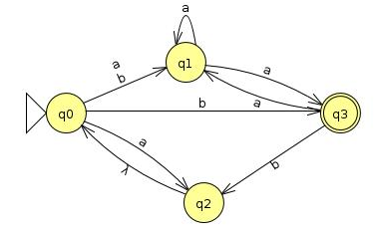
Convert the following NFA with NULL transition to FA.

Slide 7
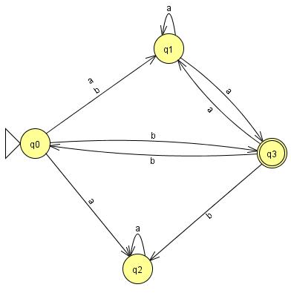
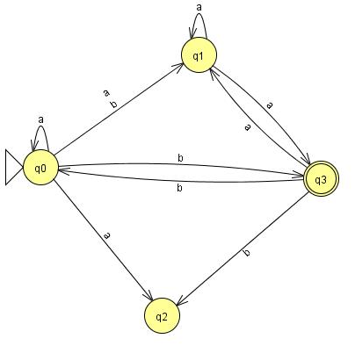
Question:
Which conversion from NFA-with NULL to NFA is OK?
a
b

Slide 8
 | a | b
q_{o} ≡ z₁ | (q_{o,} q_{1,} q₂) ≡ Z₂ | ( q_{1,} q₃) ≡ Z₃
Z₂ ≡ (q_{o,} q_{1,} q₂) | (q_{o,} q_{1,} q_{2,} q₃) ≡ Z₄ | ( q_{1,} q₃) ≡ Z₃
Z₃⁺ ≡ ( q_{1,} q₃) | ( q_{1,} q₃) ≡ Z₃ | ( q_{0,} q₂) ≡Z₅
Z₄⁺ ≡ (q_{o,} q_{1,} q_{2,} q₃) | (q_{o,} q_{1,} q_{2,} q₃) ≡ Z₄ | (q_{1,} q_{3,} q_{2,} q₀) ≡ Z₄
Z₅ ≡ (q_{o,} q₂) | (q_{o,} q_{1,} q₂) ≡ Z₂ | ( q_{1,} q₃) ≡ Z₃

Slide 9
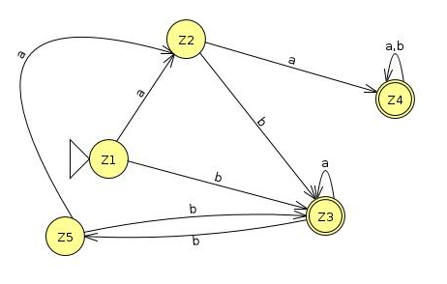
 | a | b
q_{o} ≡ z₁ | (q_{o,} q_{1,} q₂) ≡ Z₂ | ( q_{1,} q₃) ≡ Z₃
Z₂ ≡ (q_{o,} q_{1,} q₂) | (q_{o,} q_{1,} q_{2,} q₃) ≡ Z₄ | ( q_{1,} q₃) ≡ Z₃
Z₃⁺ ≡ ( q_{1,} q₃) | ( q_{1,} q₃) ≡ Z₃ | ( q_{0,} q₂) ≡Z₅
Z₄⁺ ≡ (q_{o,} q_{1,} q_{2,} q₃) | (q_{o,} q_{1,} q_{2,} q₃) ≡ Z₄ | (q_{1,} q_{3,} q_{2,} q₀) ≡ Z₄
Z₅ ≡ (q_{o,} q₂) | (q_{o,} q_{1,} q₂) ≡ Z₂ | ( q_{1,} q₃) ≡ Z₃

Slide 10
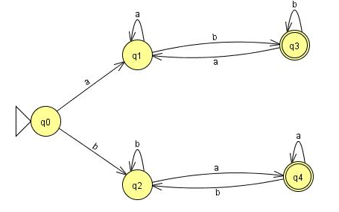
Task Solution for FA Closure
Old States | Reading at a | Reading at b
z1±≡q0 | q1≡z2 | q2≡z3
z2 ≡q1 | q1≡z2 | (q3, q0)≡z4
z3 ≡q2 | (q4, q0)≡z5 | q2≡z3
z4+≡ (q3, q0) | (q1,q1)≡q1≡z2 | (q3, q0,q2)≡z6
z5+≡ (q4, q0) | (q1,q4,q0)≡z7 | (q2,q2)≡q2≡z3
z6+≡ (q3, q0,q2) | (q1,q1,q4,q0)≡(q1,q4,q0)≡z7 | (q3, q0,q2,q2)≡ (q3, q0,q2)≡z6
z7+≡ (q1,q4,q0) | (q1,q4,q0,q1)≡(q1,q4,q0)≡z7 | (q3, q0,q2,q2)≡ (q3, q0,q2)≡z6

Slide 11
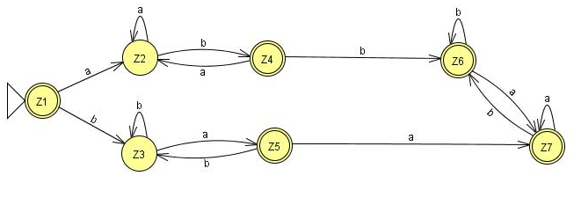
Verification: ( a(a+b)*b + b(a+b)*a)*
A,b,abba,baab,aaaabbbbba,

Slide 12
Finite Automata with output
In Finite Automata, the input string represents the input data to a computer program. Reading the input letters is very much similar to how a computer program performs various instructions.
The concept of states tell us that what we are printing and what we have printed so far.

Slide 13
Summary Lecture#13
NFA conversion – Repeat
Closure Task Solution

