Slide 1
Lecture # 12
Theory Of Automata
By
Dr. MM Alam

Slide 2
Lecture 11 at a glance…
Kleene Theorem Part III (Concatenation)
Examples of Kleene Theorem Concatenation part.
Closure and its Examples

Slide 3
NFA & FA at a glance..
FA | NFA
Single Start State and multiple end states (may be none) | Single Start State and multiple end states (may be none)
Finite set of input symbols | Same
Finite set of transitions | Same
Deterministic | Non-Deterministic
Distinguishing Rule | No such rule

Slide 4
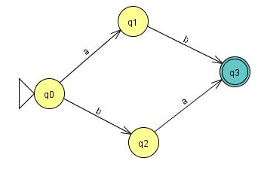
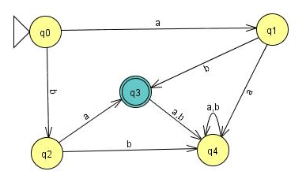
Example
Consider the following NFA

Slide 5
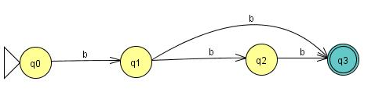
Example
A simple NFA that accepts the language of strings defined over ={a,b}, consists of bb and bbb
The above NFA can be converted to the following FA
b

Slide 6
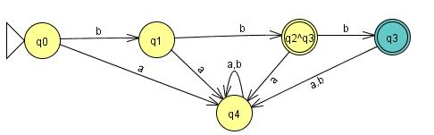
Example Continued ...

Slide 7
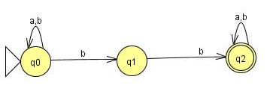
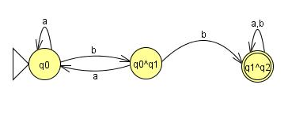

Slide 8
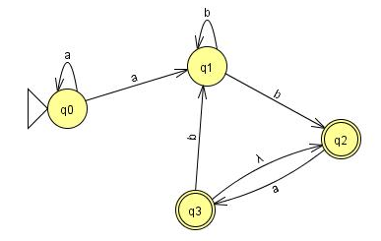
NFA with Null Transition
Convert the following NFA with NULL transition to FA.

Slide 9
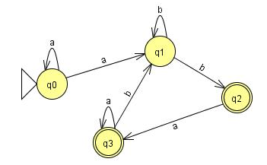

Slide 10
 | a | b
z₁ ≡ q_{o} | (q_{o}, q₁) ≡ z₂ | ᵩ ≡ z₃
z₂ ≡ (q_{o}, q₁) | (q_{o}, q₁) ≡ z₂ | (q₁, q₂) ≡ z₄
z₄⁺≡ (q₁, q₂) | q₃ ≡ z₅ | (q₁, q₂) ≡ z₄
z₅⁺≡ q₃ | q₃ ≡ z₅ | q₁ ≡ z₆
z₆≡ q₁ | ᵩ ≡ z₃ | (q₁, q₂) ≡ z₄

Slide 11
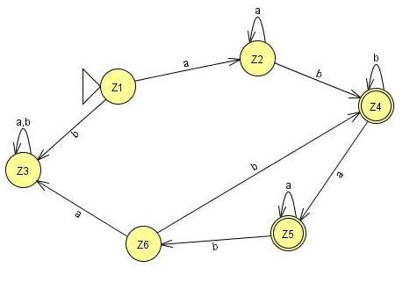
 | a | b
z₁ ≡ q_{o} | (q_{o}, q₁) ≡ z₂ | ᵩ ≡ z₃
z₂ ≡ (q_{o}, q₁) | (q_{o}, q₁) ≡ z₂ | (q₁, q₂) ≡ z₄
z₄⁺≡ (q₁, q₂) | q₃ ≡ z₅ | (q₁, q₂) ≡ z₄
z₅⁺≡ q₃ | q₃ ≡ z₅ | q₁ ≡ z₆
z₆≡ q₁ | ᵩ ≡ z₃ | (q₁, q₂) ≡ z₄

Slide 12
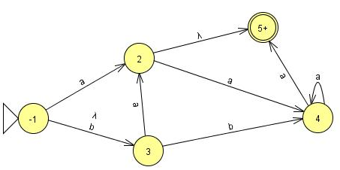
Convert the following NFA with NULL transition to FA.

Slide 13
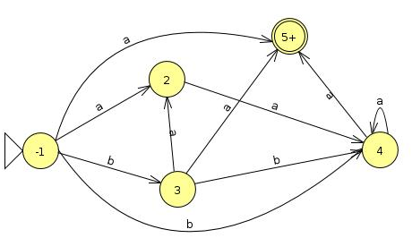

Slide 14
 | a | b
z₁⁻ ≡ 1 | (2,5) ≡ z₂ | 3,4 ≡ z₃
Z₂⁺ ≡ ( 2,5) | 4 ≡ z | ᵩ ≡ Z₅
Z₃ ≡ (3,4) | (2,5,4) ≡ z₆ | 4 ≡ z₄
Z₄ ≡ 4 | (4,5) ≡ z₇ | ᵩ ≡ Z₅
Z₅ ≡ ᵩ | Z₅ | Z₅
Z₆⁺ ≡ (2,5,4) | (4,4) ≡ z₄ | ᵩ ≡ Z₅
Z₇⁺ ≡ (4,5) | (4,5) ≡ z₇ | ᵩ ≡ Z₅

Slide 15
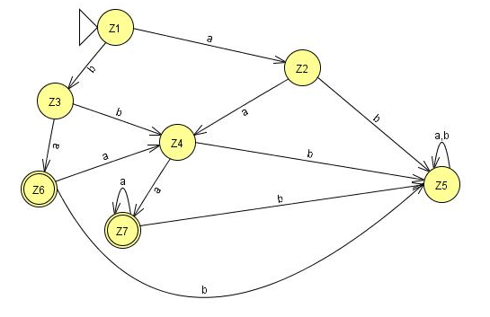

Slide 16
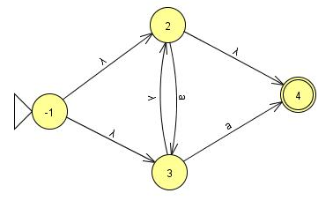
Convert the following NFA with NULL transition to FA.

Slide 17
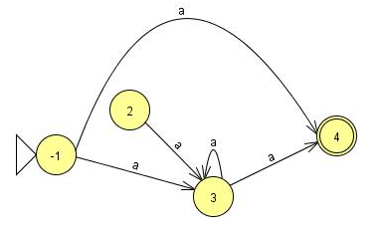

Slide 18
 | a | b
z₁⁺ ≡ 1 | (3,4) ≡ z₂ | ᵩ ≡ Z₃
Z₂⁺ ≡ (3,4) | (3,4) ≡ z₂ | ᵩ ≡ Z₃
Z₃ ≡ ᵩ | Z₃ | Z₃

Slide 19
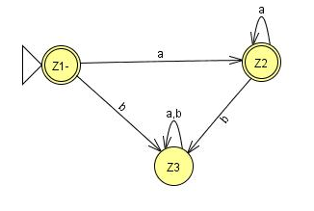

Slide 20
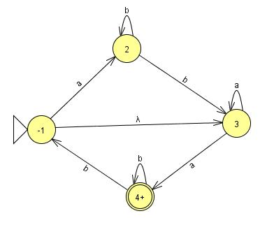

Slide 21
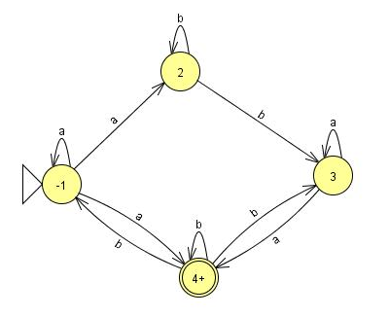

Slide 22
 | a | b
z₁ ≡ 1 | (1,2,4) ≡ z₂ | ᵩ ≡ Z₅
Z₂⁺ ≡ (1,2,4) | (1,2,4) ≡ z₂ | (1,3,4) ≡ z₃
Z₃⁺ ≡ (1,3,4) | (1,2,4,3) ≡ z₄ | (1,3,4) ≡ z₃
Z₄⁺ ≡ (1,2,3,4) | (1,2,4,3 )≡ z₄ | (1,3,4) ≡ z₃

Slide 23
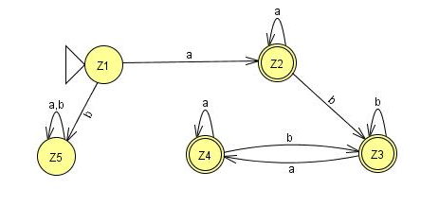
 | a | b
z₁ ≡ 1 | (1,2,4) ≡ z₂ | ᵩ ≡ Z₅
Z₂⁺ ≡ (1,2,4) | (1,2,4) ≡ z₂ | (1,3,4) ≡ z₃
Z₃⁺ ≡ (1,3,4) | (1,2,4,3) ≡ z₄ | (1,3,4) ≡ z₃
Z₄⁺ ≡ (1,2,3,4) | (1,2,4,3 )≡ z₄ | (1,3,4) ≡ z₃

Slide 24
Lecture#12 Summary
NFA to FA manual conversion
NFA with NULL to FA Conversion using transition tables
Examples

