Slide 1
Lecture # 11
Theory Of Automata
By
Dr. MM Alam

Slide 2
Lecture 10 at a glance…
Kleene Theorem Part III (Union) – Repeat
Kleene Theorem Part III (Union) – Example
Kleene Theorem Part III (Concatenation)
Kleene Theorem Part III Concatenation Examples

Slide 3
Kleene Theorem Part III (Concatenation) – Repeat
If r1r2 represents a regular expression r3, then FA1FA2 represents an FA3 that should correspond to r3.
Start by taking the first FA’s initial state and traversing on each input symbol in the respective FA.
Since one initial state is allowed in FA, therefore, only one state can be marked as initial state
During the process, any state encountered final of the second FA only, the resultant state will be final. Further, the second FA will be concatenated through first FA’s initial state.
However, if the final state of the second FA is encountered, it will not be combined with the first FA.

Slide 4
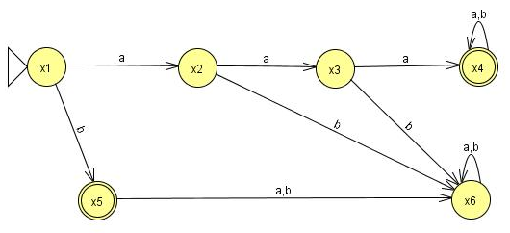
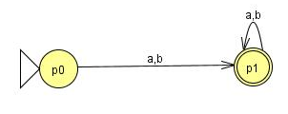
Question (concatenation)
Find FA3FA2 for the following:

Slide 5
Old States | Reading at a | Reading at b
z1- ≡x1 | x2≡ z2 | (x5,p0)≡ z3
z2 ≡x2 | x3≡ z4 | x6≡ z5
z3≡(x5,p0) | ( x6,p1)≡z6 | ( x6,p1)≡z6
z4 ≡x3 | ( x4,p0)≡z7 | x6≡z5
z5 ≡x6 | x6≡z5 | x6≡z5
z6+≡( x6,p1) | ( x6,p1)≡z6 | ( x6,p1)≡z6
z7≡( x4,p0) | ( x4,p0,p1)≡ z8 | ( x4,p0,p1)≡ z8
z8+≡( x4,p0,p1) | ( x4,p0,p1,p1)= ( x4,p0,p1)≡z8 | ( x4,p0,p1,p1)= (x4,p0,p1)≡z8

Slide 6
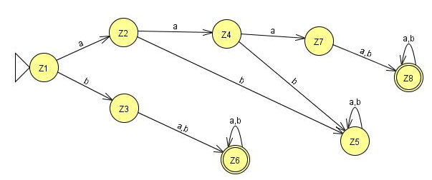

Slide 7
Kleene Theorem Part III (Closure)
If r1 represents a regular expression and r1* the closure of the r1. Similarly, if FA1 corresponds to r1 then FA1* should correspond to closure of r1.
Start by taking the first FA’s and traversing on each input symbol in the respective FA.
Since one initial state is allowed in FA, therefore, only one state can be marked as initial state. Further, the initial state is marked final by default, in order to accommodate NULL string.
During the process, any state found final, the resultant state will be final. Further, the FA’s initial state will be concatenated through its final state. The new state will be marked as final.
Note that, the final state of the FA will always be combined with the initial state of the FA.

Slide 8
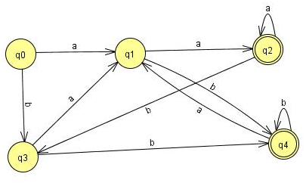
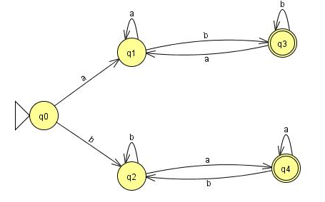
2 Questions for Closure
FA1: (a+b)*(aa+bb)
FA2: a(a+b)*b + b(a+b)*a

Slide 9
Old States | Reading at a | Reading at b
z1±≡q0 | q1≡z2 | q3≡z3
z2 ≡q1 | (q2, q0)≡z4 | (q4, q0)≡z5
z3 ≡q3 | q1≡z2 | (q4, q0)≡z5
z4+≡ (q2, q0) | (q2, q0,q1)≡z6 | (q3,q3)≡ q3≡z3

Slide 10
z5+≡ (q4, q0) | (q1,q1)≡ q1≡z2 | (q4,q0,q3)≡z7
z6+≡ (q2, q0,q1) | (q2, q0,q1,q2, q0)≡(q2, q0,q1)≡z6 | (q3,q3,q4,q0)≡(q4,q0,q3)≡z7
z7+≡ (q4,q0,q3) | (q1,q1q1)≡q1≡z2 | (q4,q0,q3,q4,q0,)≡(q4,q0,q3)≡z7

Slide 11
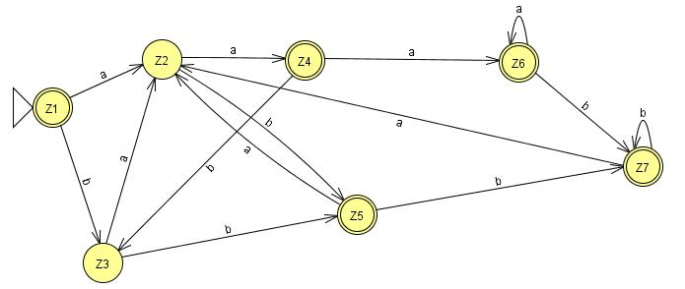
Verification: ( (a+b)*(aa+bb))*
aaaa

Slide 12
Task

Slide 13
FA Closure Special Note
One special requirement for FA’s having an initial state which has a loop or an in coming transition in the closure results in two different states: One non-final state and other one final. See the Next Example…

Slide 14
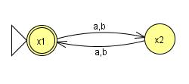
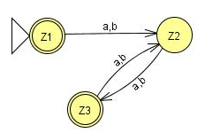
Final Z1≡ x1 | x2≡Z2 | x2≡Z2
Z2≡x2 | X1,x1=x1≡Z3 | X1,x1=x1≡Z3
Z3≡x1 | x2≡Z2 | x2≡Z2

Slide 15
NFA & FA at a glance..
FA | NFA
Single Start State and multiple end states (may be none) | Single Start State and multiple end states (may be none)
Finite set of input symbols | Same
Finite set of transitions | Same
Deterministic | Non-Deterministic
Distinguishing Rule | No such rule

Slide 16
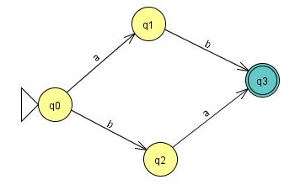
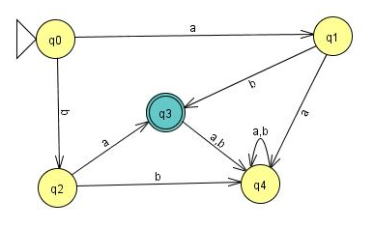
Example
Consider the following NFA

Slide 17
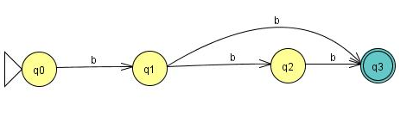
Example
A simple NFA that accepts the language of strings defined over ={a,b}, consists of bb and bbb
The above NFA can be converted to the following FA
b

Slide 18
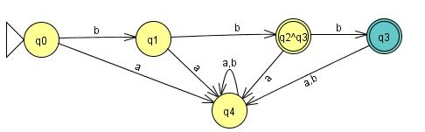
Example Continued ...

Slide 19
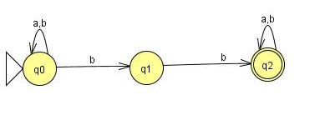
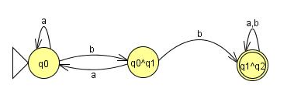

Slide 20
Lecture#11 Summary
Kleene Theorem Part III (Concatenation) – Repeat
Kleene Theorem Part III (Closure)
Kleene Theorem Part III (Examples)

