Slide 1
Lecture # 10
Theory Of Automata
By
Dr. MM Alam

Slide 2
Lecture 9 at a glance…
Kleene Theorem Part I and Part II
Kleene Theorem Part III (Union)

Slide 3
Repeat – Kleene Part III
Every Regular Expression can be represented by an FA
We already know that a regular expression has a corresponding FA. However, the difficult part is that a regular expression can be combined with other regular expression through union (sum), concatenation and closure of FA. Thus, we need to devise methods for FA1+FA2, FA1FA2, FA1 Closure.

Slide 4
Repeat – Kleene Theorem Part III (Union)
If r1+r2 represents a regular expression r3, then FA+FA2 represents an FA3 that correspond to r3.
Start by taking both FA’s initial state and traversing on each input symbol in the respective FA
Since one initial state is allowed in FA, therefore, only one state can be marked as initial state
During the process, any state encountered final, the resultant state will be final. This is due to the fact that multiple final states are allowed in FA.

Slide 5
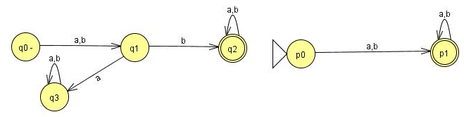
Old States | Reading at a | Reading at b
z1-≡(q0,p0) | (q1,p1)≡z2 | (q1,p1)≡z2
z2+≡(q1,p1) | (q3,p1)≡z3 | (q2,p1)≡z4
z3+≡(q3,p1) | (q3,p1)≡z3 | (q3,p1)≡z3
z4+≡(q2,p1) | (q2,p1)≡z4 | (q2,p1)≡z4

Slide 6
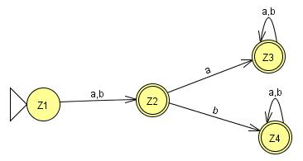

Slide 7
Kleene Theorem Part III (Concatenation)
If r1r2 represents a regular expression r3, then FA1FA2 represents an FA3 that should correspond to r3.
Start by taking the first FA’s initial state and traversing on each input symbol in the respective FA.
Since one initial state is allowed in FA, therefore, only one state can be marked as initial state
During the process, any state encountered final of the second FA only, the resultant state will be final. Further, the second FA will be concatenated through first FA’s initial state.
However, if the final state of the second FA is encountered, it will not be combined with the first FA.

Slide 8
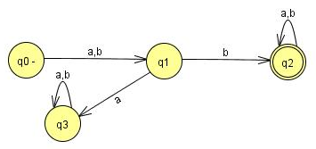
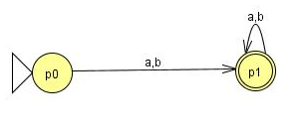
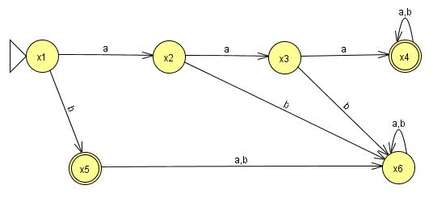
3 Questions for Concatenation
FA1: (a+b)b(a+b)*
FA2: (a+b)⁺
FA3: (aaa+b)+

Slide 9
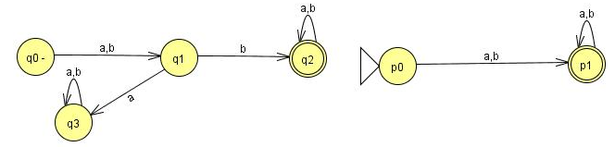
Question (concatenation)
Find FA1FA2 for the following:

Slide 11
Verification: (a+b)b(a+b)*(a+b)⁺
^{bba,}

Slide 12
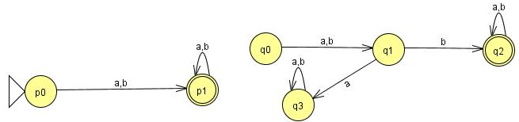
Question (concatenation)
Find FA2FA1 for the following:

Slide 13
Old States | Reading at a | Reading at b
z1-≡p0 | (p1, q0)≡ z2 | (p1, q0)≡ z2
z2≡(p1, q0) | (p1,q0,q1)≡ z3 | (p1,q0,q1)≡ z3
z3 ≡ (p1,q0,q1) | (p1,q0,q1,q3)≡ z4 | (p1,q0,q1,q2)≡z5
z4≡ (p1,q0,q1,q3) | (p1,q0,q1,q3,q3)= (p1,q0,q1,q3)≡z4 | (p1,q0,q1,q2,q3)≡z6
z5+≡(p1,q0,q1,q2) | (p1,q0,q1,q2,q3)≡z6 | (p1,q0,q1,q2,q2)= (p1,q0,q1,q2)≡z5
z6+≡(p1,q0,q1,q2,q3) | (p1,q0,q1,q3,q2,q3)= (p1,q0,q1,q2,q3)z6 | (p1,q0,q1,q2,q2,q3)= (p1,q0,q1,q2,q3)≡z6

Slide 14
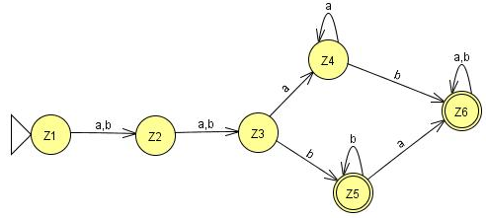
Verification: (a+b)⁺(a+b)b(a+b)*
^{aabaaa}

Slide 15
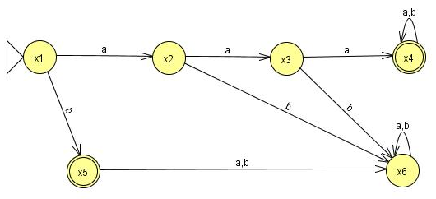
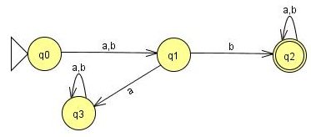
Question (concatenation)
Find FA3FA1 for the following:

Slide 16
Old States | Reading at a | Reading at b
z1- ≡x1 | x2≡ z2 | (x5,q0)≡z3
z2 ≡x2 | x3≡ z4 | x6≡ z5
z3 ≡(x5,q0) | (x6,q1)≡z6 | (x6,q1)≡z6
z4 ≡x3 | (x4,q0)≡z7 | x6≡ z5
z5 ≡x6 | x6≡z5 | x6≡z5
z6 ≡( x6,q1) | ( x6,q3)≡ z8 | ( x6,q2)≡ z9
z7≡( x4,q0) | ( x4,q0,q1)≡ z10 | ( x4,q0,q1)≡ z10
z8 ≡( x6,q3) | ( x6,q3)≡ z8 | ( x6,q3)≡ z8

Slide 17
z9+≡( x6,q2) | ( x6,q2)≡ z9 | ( x6,q2)≡ z9
z10 ≡( x4,q0,q1) | (x4,q0,q1,q3)≡ z11 | (x4,q0,q1,q2)≡ z12
z11≡( x4,q0,q1,q3) | (x4,q0,q1,q3,q3)= (x4,q0,q1,q3)≡ z11 | (x4,q0,q1,q2,q3)≡ z13
z12+≡( x4,q0,q1,q2) | (x4,q0,q1,q2,q3)≡ z13 | (x4,q0,q1,q2,q2)= (x4,q0,q1,q2)≡z12
z13+≡( x4,q0,q1,q2,q3) | (x4,q0,q1,q3,q2,q3)= (x4,q0,q1,q2,q3)≡z13 | (x4,q0,q1,q2,q2,q3)= (x4,q0,q1,q2,q3)≡z13

Slide 18
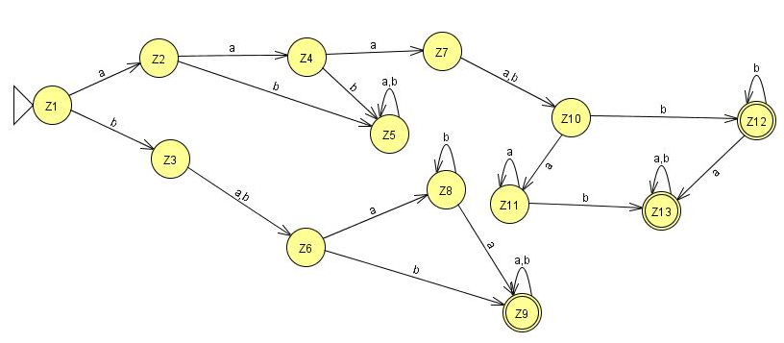
Verification: (aaa+b)⁺(a+b)b(a+b)*
bab

Slide 19
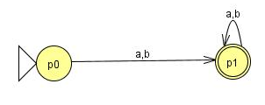
Question (concatenation)
Find FA3FA2 for the following:

Slide 20
Old States | Reading at a | Reading at b
z1- ≡x1 | x2≡ z2 | (x5,p0)≡ z3
z2 ≡x2 | x3≡ z4 | x6≡ z5
z3≡(x5,p0) | ( x6,p1)≡z6 | ( x6,p1)≡z6
z4 ≡x3 | ( x4,p0)≡z7 | x6≡z5
z5 ≡x6 | x6≡z5 | x6≡z5
z6+≡( x6,p1) | ( x6,p1)≡z6 | ( x6,p1)≡z6
z7≡( x4,p0) | ( x4,p0,p1)≡ z8 | ( x4,p0,p1)≡ z8
z8+≡( x4,p0,p1) | ( x4,p0,p1,p1)= ( x4,p0,p1)≡z8 | ( x4,p0,p1,p1)= (x4,p0,p1)≡z8

Slide 21
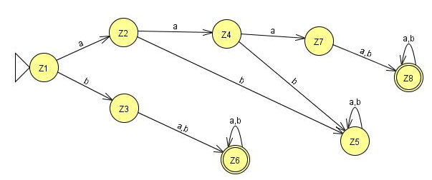
Verification: (aaa+b)⁺(a+b)⁺
aaabab

Slide 22
Lecture 10 Summary
Kleene Theorem Part III (Union) – Repeat
Kleene Theorem Part III (Concatenation)
Kleene Theorem Part III (Examples)

