Slide 1
Lecture # 9
Theory Of Automata
By
Dr. MM Alam

Slide 2
Lecture 8 at a glance…
How to define FA using Martin Method
Which FA’s cannot be modeled using Martin’s method
TG and GTG Definition and Examples
Kleene Theorem Introduction
Kleene Theorem Part I and Part II (Till State elimination)

Slide 3
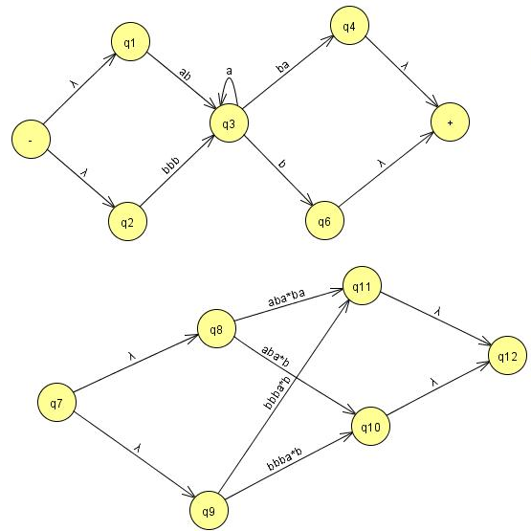
State
elimination
cont’d..

Slide 4
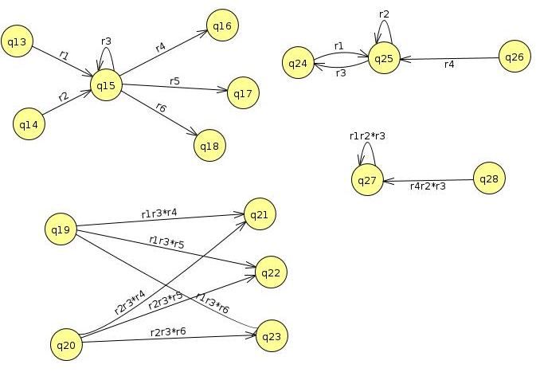

Slide 5
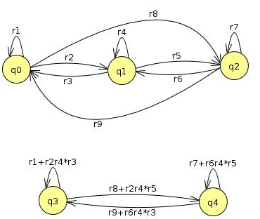

Slide 6
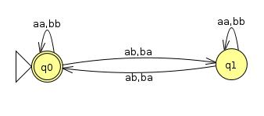

Slide 8
Kleene Part III
Every Regular Expression can be represented by an FA
We already know that a regular expression has a corresponding FA. However, the difficult part is that a regular expression can be combined with other regular expression through union (sum), concatenation and closure of FA. Thus, we need to devise methods for FA1+FA2, FA1FA2, FA1 Closure.

Slide 9
Kleene Theorem Part III (Union)
If r1+r2 represents a regular expression r3, then FA+FA2 represents an FA3 that correspond to r3.
Start by taking both FA’s initial state and traversing on each input symbol in the respective FA
Since one initial state is allowed in FA, therefore, only one state can be marked as initial state
During the process, any state encountered final, the resultant state will be final. This is due to the fact that multiple final states are allowed in FA.

Slide 10
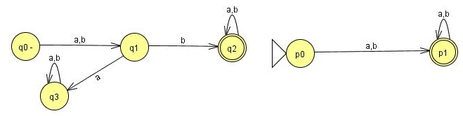
Question
Find FA1 U FA2 for the following:

Slide 13
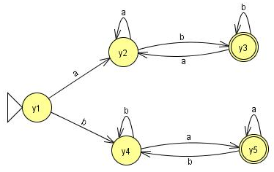
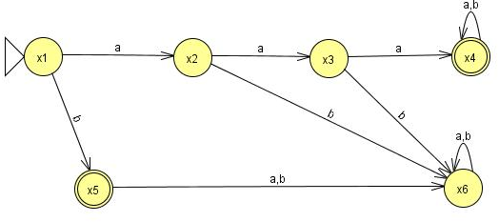
Question
Find FA1 U FA2 for the following:

Slide 14
Old States | Reading at a | Reading at b
z1-≡(x1,y1) | (x2,y2)≡z2 | (x5,y4)≡z3
z2≡(x2,y2) | (x3,y2)≡ z4 | (x6,y3)≡z5
z3+≡(x5,y4) | (x6,y5)≡ z6 | (x6,y4)≡z7
z4≡(x3,y2) | (x4,y2)≡ z8 | (x6,y3)≡z5
z5+≡(x6,y3) | (x6,y2)≡ z9 | (x6,y3)≡z5

Slide 15
Old States | Reading at a | Reading at b
z6+≡(x6,y5) | (x6,y5)≡ z6 | (x6,y4)≡z7
z7≡(x6,y4) | (x6,y5)≡ z6 | (x6,y4)≡z7
z8+≡(x4,y2) | (x4,y2)≡ z8 | (x4,y3)≡z10
z9≡(x6,y2) | (x6,y2)≡ z9 | (x6,y3)≡z5
z10+≡(x4,y3) | (x4,y2)≡ z8 | (x4,y3)≡z10

Slide 16
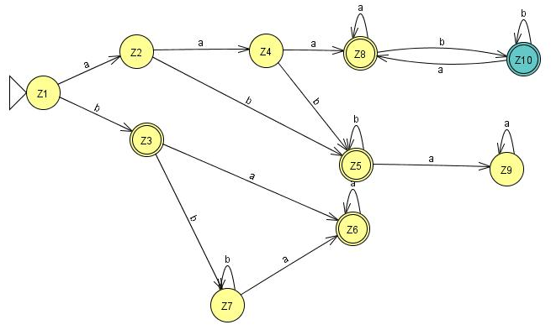

Slide 17
Lecture 9 Summary
Kleene Theorem Part I and Part II (Till State elimination)
Kleene Theorem Part III (Union)

Slide 18
Lecture # 10
Theory Of Automata
By
Dr. MM Alam

Slide 19
Lecture 9 at a glance…
Kleene Theorem Part I and Part II (Till State elimination)
Kleene Theorem Part III (Union)

Slide 20
Kleene Theorem Part III (Concatenation)
If r1r2 represents a regular expression r3, then FAFA2 represents an FA3 that should correspond to r3.
Start by taking the first FA’s and traversing on each input symbol in the respective FA.
Since one initial state is allowed in FA, therefore, only one state can be marked as initial state
During the process, any state encountered final, the resultant state will be final. Further, the second FA will be concatenated through its initial state. The new state will be marked as final.
However, if the final state of the second FA is encountered, it will not be combined with the first FA.

Slide 21
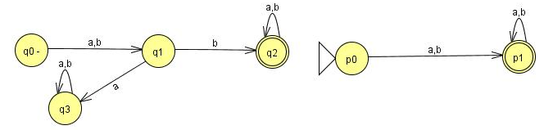
Question (concatenation)
Find FA1FA2 for the following:

Slide 22
Old States | Reading at a | Reading at b
z1-≡q0 | q1≡z2 | q1≡z2
z2≡q1 | q3≡z3 | (q2,p0)≡z4
z3≡q3 | q3≡z3 | q3≡z3
z4+ ≡ (q2,p0) | (q2,p0,p1)≡z5 | (q2,p0,p1)≡z5
z5+≡(q2,p0,p1) | (q2,p0,p1,p1)= (q2,p0,p1)≡z5 | (q2,p0,p1,p1)= (q2,p0,p1)≡z5

Slide 23
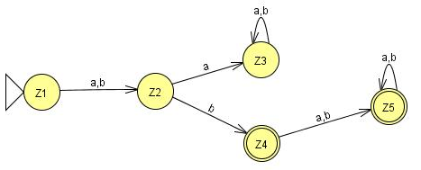

Slide 24
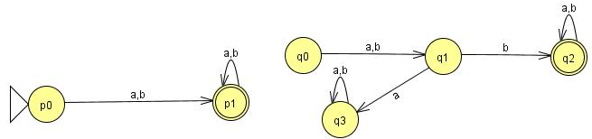
Question (concatenation)
Find FA2FA1 for the following:

Slide 25
Old States | Reading at a | Reading at b
z1-≡p0 | (p1, q0)≡ z2 | (p1, q0)≡ z2
z2+≡(p1, q0) | (p1,q0,q1)≡ z3 | (p1,q0,q1)≡ z3
z3+ ≡ (p1,q0,q1) | (p1,q0,q1,q3)≡ z4 | (p1,q0,q1,q2)≡z5
z4+≡ (p1,q0,q1,q3) | (p1,q0,q1,q3,q3)= (p1,q0,q1,q3)≡z4 | (p1,q0,q1,q2,q3)≡z6
z5+≡(p1,q0,q1,q2) | (p1,q0,q1,q2,q3)≡z6 | (p1,q0,q1,q2,q2)= (p1,q0,q1,q2)≡z5
z6+≡(p1,q0,q1,q2,q3) | (p1,q0,q1,q3,q2,q3)= (p1,q0,q1,q2,q3)z6 | (p1,q0,q1,q2,q2,q3)= (p1,q0,q1,q2,q3)≡z6

Slide 26
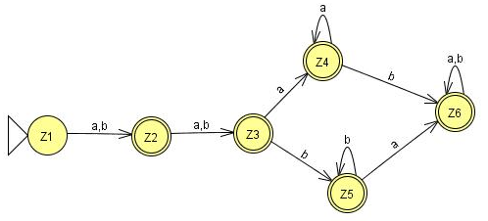

Slide 27
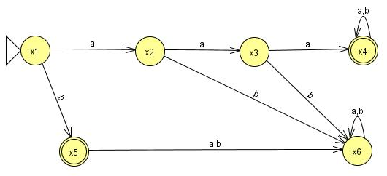
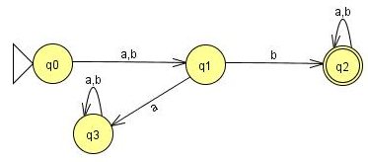
Question (concatenation)
Find FA3FA1 for the following:

Slide 28
Old States | Reading at a | Reading at b
z1- ≡x1 | x2≡ z2 | (x5,q0)≡z3
z2 ≡x2 | x3≡ z4 | x6≡ z5
z3+ ≡(x5,q0) | (x6,q1)≡z6 | (x6,q1)≡z6
z4 ≡x3 | (x4,q0)≡z7 | x6≡ z5
z5 ≡x6 | x6≡z5 | x6≡z5
z6 ≡( x6,q1) | ( x6,q3)≡ z8 | ( x6,q2)≡ z9
z7+≡( x4,q0) | ( x4,q0,q1)≡ z10 | ( x4,q0,q1)≡ z10
z8 ≡( x6,q3) | ( x6,q3)≡ z8 | ( x6,q3)≡ z8

Slide 29
z9+≡( x6,q2) | ( x6,q2)≡ z9 | ( x6,q2)≡ z9
z10+ ≡( x4,q0,q1) | (x4,q0,q1,q3)≡ z11 | (x4,q0,q1,q2)≡ z12
z11+≡( x4,q0,q1,q3) | (x4,q0,q1,q3,q3)= (x4,q0,q1,q3)≡ z11 | (x4,q0,q1,q2,q3)≡ z13
z12+≡( x4,q0,q1,q2) | (x4,q0,q1,q2,q3)≡ z13 | (x4,q0,q1,q2,q2)= (x4,q0,q1,q2)≡z12
z13+≡( x4,q0,q1,q2,q3) | (x4,q0,q1,q3,q2,q3)= (x4,q0,q1,q2,q3)≡z13 | (x4,q0,q1,q2,q2,q3)= (x4,q0,q1,q2,q3)≡z13

Slide 30
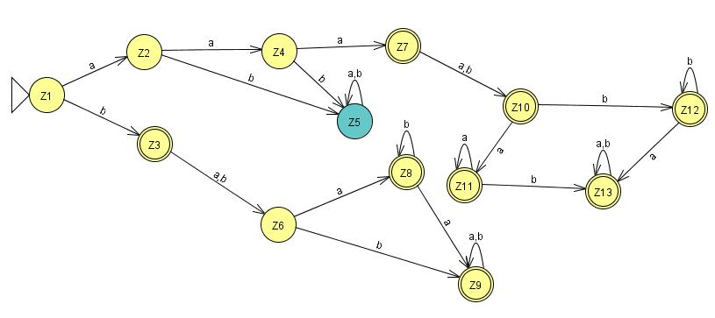

Slide 31
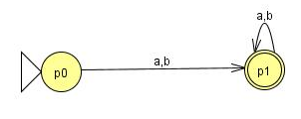
Question (concatenation)
Find FA3FA2 for the following:

Slide 32
Old States | Reading at a | Reading at b
z1- ≡x1 | x2≡ z2 | (x5,p0)≡ z3
z2 ≡x2 | x3≡ z4 | x6≡ z5
z3+≡(x5,p0) | ( x6,p1)≡z6 | ( x6,p1)≡z6
z4 ≡x3 | ( x4,p0)≡z7 | x6≡z5
z5 ≡x6 | x6≡z5 | x6≡z5
z6+≡( x6,p1) | ( x6,p1)≡z6 | ( x6,p1)≡z6
z7+≡( x4,p0) | ( x4,p0,p1)≡ z8 | ( x4,p0,p1)≡ z8
z8+≡( x4,p0,p1) | ( x4,p0,p1,p1)= ( x4,p0,p1)≡z8 | ( x4,p0,p1,p1)= ( x4,p0,p1)≡z8

Slide 33
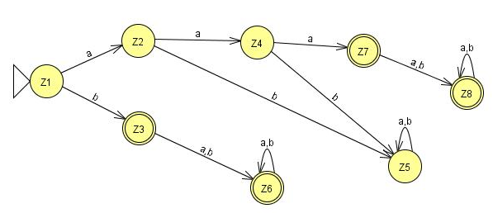

Slide 34
Lecture 10 Summary
Kleene Theorem Part III (Concatenation)
Kleene Theorem Part III (Examples)

Slide 35
Lecture # 11
Theory Of Automata
By
Dr. MM Alam

Slide 36
Lecture 10 at a glance…
Kleene Theorem Part III (Concatenation)
Examples of Kleene Theorem Concatenation part.

Slide 37
Kleene Theorem Part III (Closure)
If r1 represents a regular expression and r1* the closure of the r1. Similarly, if FA1 corresponds to r1 then FA1* should correspond to closure of r1.
Start by taking the first FA’s and traversing on each input symbol in the respective FA.
Since one initial state is allowed in FA, therefore, only one state can be marked as initial state. Further, the initial state is marked final by default, in order to accommodate NULL string.
During the process, any state found final, the resultant state will be final. Further, the same FA initial state will be concatenated through its final state. The new state will be marked as final.
The final state of the FA will always be combined with the initial state of the FA.

Slide 38
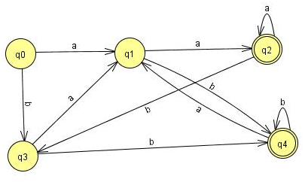
Old States | Reading at a | Reading at b
z1±≡q0 | q1≡z2 | q3≡z3
z2 ≡q1 | (q2, q0)≡z4 | (q4, q0)≡z5
z3 ≡q3 | (q1,q1)≡q1≡z2 | (q4, q0)≡z5
z4+≡ (q2, q0) | (q2, q0,q1)≡z6 | (q3,q3)≡ q3≡z3

Slide 39
z5+≡ (q4, q0) | (q1,q1)≡ q1≡z2 | (q4,q0,q3)≡z7
z6+≡ (q2, q0,q1) | (q2, q0,q1,q2, q0)≡(q2, q0,q1)≡z6 | (q3,q3,q4,q0)≡(q4,q0,q3)≡z7
z7+≡ (q4,q0,q3) | (q1,q1q1)≡q1≡z2 | (q4,q0,q3,q4,q0,)≡(q4,q0,q3)≡z7

Slide 40
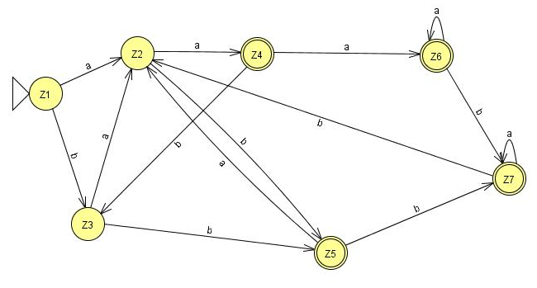

Slide 41
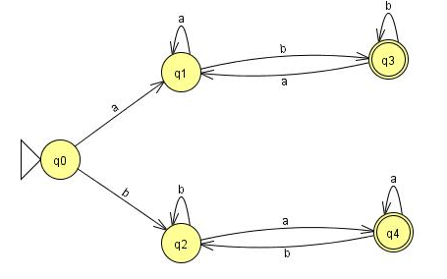
Old States | Reading at a | Reading at b
z1±≡q0 | q1≡z2 | (q3, q0)≡z3
z2 ≡q1 | (q2, q0)≡z4 | (q4, q0)≡z5
z3 ≡(q3, q0) | (q1,q1)≡q1≡z2 | (q4, q0,q1)≡z6
z4+≡ (q2, q0) | (q2, q0,q1)≡z6 | (q3,q3,q0)= (q3,q0)≡z3

Slide 42
z5+≡ (q4, q0) | (q1,q4,q0)≡z7 | (q2,q2)≡q2≡z3
z6+≡ (q3, q0,q2) | (q1,q1,q4,q0)≡(q1,q4,q0)≡z7 | (q3, q0,q2,q2)≡ (q3, q0,q2)≡z6
z7+≡ (q1,q4,q0) | (q1,q4,q0,q1)≡(q1,q4,q0)≡z7 | (q3, q0,q2,q2)≡ (q3, q0,q2)≡z6

Slide 43
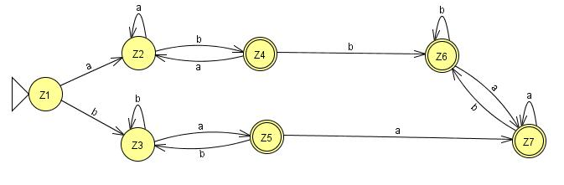

Slide 44
One special requirement for FA’s having an initial state which has a loop or an in coming transition in the closure results in two different states: One non-final state and other one final.

Slide 45
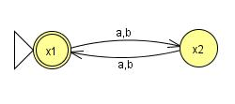
Final Z1≡ x1 | x2≡Z2 | x2≡Z2
x2≡Z2 | x1≡Z1 | x1≡Z1

Slide 46
Lecture#11 Summary
Kleene Theorem Part III (Closure)
Kleene Theorem Part III (Examples)

