Slide 1
Lecture # 8
Theory Of Automata
By
Dr. MM Alam

Slide 2
Lecture#7 Recap
FA definition RECAP
Wrong FA correction using Regular expressions different possibilities.
How to build an FA from scratch
What are Dead or Trap states in FA
Trap or dead state Example using JFLAP

Slide 3
How to avoid Dead States in FA
Martin method:
  Make each state label, as it progresses, based on the input strings.
  Based on the conditions of the Regular expressions or FA, only required states are marked final.
  Not every FA can be modeled in this way!

Slide 4
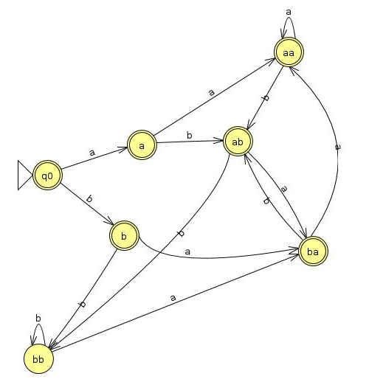
Example for FA that does not end at bb only.
  RE will be as :- Λ+a+b+(a+b)*(ab+ba+aa)

Slide 5
Example for FA that does not end at aba and abb. Also the length of each word >= 3
  RE will be as follows:-
  aab+ aaa+ bab+ baa+bbb+bba

Slide 7
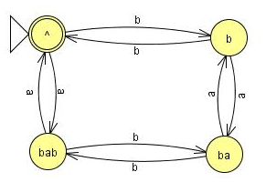
Even-Even Example
Even-Even Example cannot be modeled using Martin’s method.

Slide 8
Transition Graphs (TGs) and Generalized Transition Graphs (GTGs)
Transition Graphs | Generalized Transition Graphs
Finite number of states | same
Finite set of input strings | same
Finite set of transitions including NULL string | Finite set of transitions including NULL string and transitions can represent Regular expressions

Slide 9
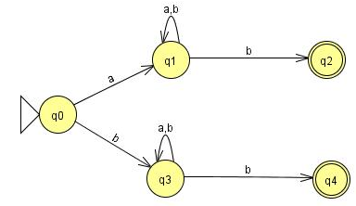
Starting and ending in different letters

Slide 10
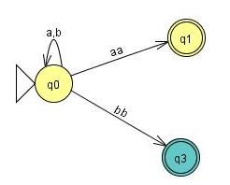
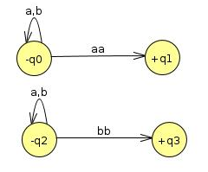
Ends at a double letter

Slide 11
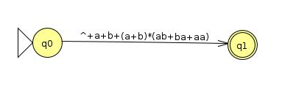
GTG Example

Slide 12
Kleene Theorem
Daniel I Cohen has divided Kleene Theorem in to three parts:
  Part I: Every FA is a TG
  Part II: Every TG has a regular expression
  Every Regular expression can be represented by a Finite Automata

Slide 13
Kleene Theorem Part I
Every FA is a TG as well.
  Please refer to Previous Slides.
FA | TG
Single Start State and multiple end states | Multiple State States and multiple end states
Finite set of input symbols | Same
Finite set of transitions | Same
Deterministic | Non-Deterministic
Distinguishing Rule | No such rule

Slide 14
Kleene Theorem Part II
Every TG has a regular expression.
  The prove of this Part requires a systematic algorithm through which a TG can be converted to a GTG, in which all transitions are actually regular expressions. Thus, we need to transform a TG to a GTG and eliminate its various states and convert it to a single state or single transition GTG, so that we can get the regular expression associated with the TG.

Slide 15
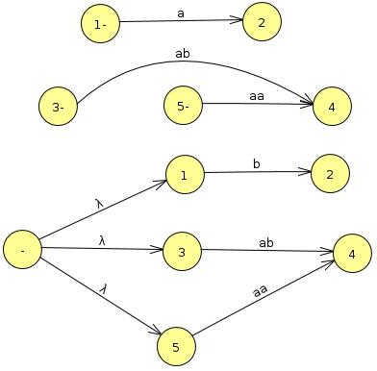
Steps involved in TG to GTG conversion
Examples taken from Daniel I Cohen Book
Step I: More than one Initial states conversion:

Slide 16
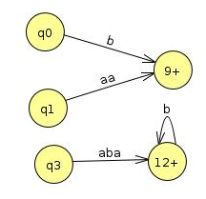
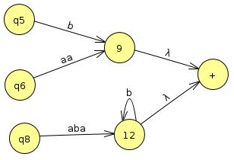
Step II: More than one Final states conversion:

Slide 17

Step III: Multiple Loops conversion:
r₃
5
r₄

Slide 18
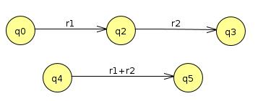
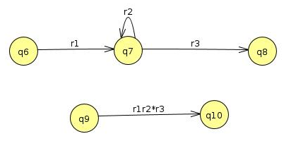
Step IV: State Elimination:

Slide 19
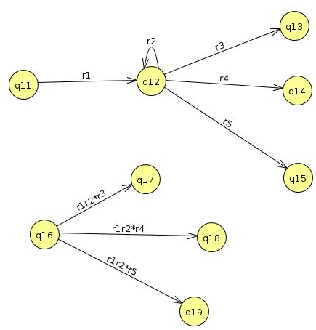

Slide 20
Lecture 8 Summary
Martin View of FA
Which FA’s cannot be modeled using Martin’s method
TG and GTG Definition and Examples
Kleene Theorem Introduction
Kleene Theorem Part I and Part II (Till State elimination)

Slide 21
Lecture # 9
Theory Of Automata
By
Dr. MM Alam

Slide 22
Lecture 8 at a glance…
How to define FA using Martin Method
Which FA’s cannot be modeled using Martin’s method
TG and GTG Definition and Examples
Kleene Theorem Introduction
Kleene Theorem Part I and Part II (Till State elimination)

Slide 23
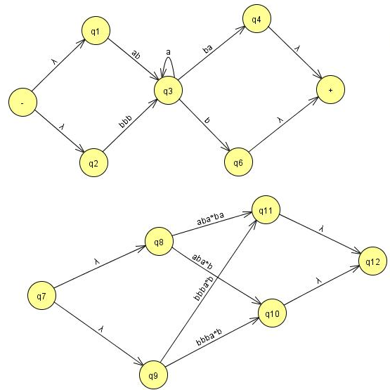
State
elimination
cont’d..

Slide 24
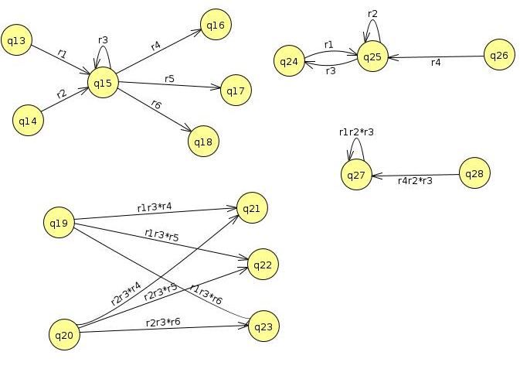

Slide 25
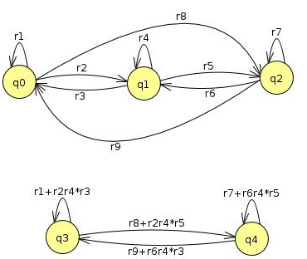

Slide 26
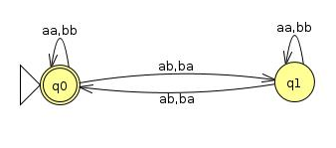

Slide 28
Kleene Part III
Every Regular Expression can be represented by an FA
We already know that a regular expression has a corresponding FA. However, the difficult part is that a regular expression can be combined with other regular expression through union (sum), concatenation and closure of FA. Thus, we need to devise methods for FA1+FA2, FA1FA2, FA1 Closure.

Slide 29
Kleene Theorem Part III (Union)
If r1+r2 represents a regular expression r3, then FA+FA2 represents an FA3 that correspond to r3.
Start by taking both FA’s initial state and traversing on each input symbol in the respective FA
Since one initial state is allowed in FA, therefore, only one state can be marked as initial state
During the process, any state encountered final, the resultant state will be final. This is due to the fact that multiple final states are allowed in FA.

Slide 30
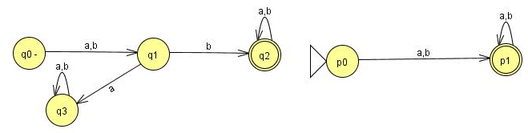
Question
Find FA1 U FA2 for the following:

Slide 31
Old States | Reading at a | Reading at b
z1-≡(q0,p0) | (q1,p1)≡z2 | (q1,p1)≡z2
z2+≡(q1,p1) | (q3,p1)≡z3 | (q2,p1)≡z4
z3+≡(q3,p1) | (q3,p1)≡z3 | (q3,p1)≡z3
z4+≡(q2,p1) | (q2,p1)≡z4 | (q2,p1)≡z4

Slide 32
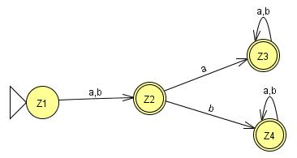

Slide 33
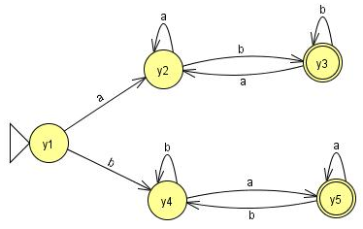
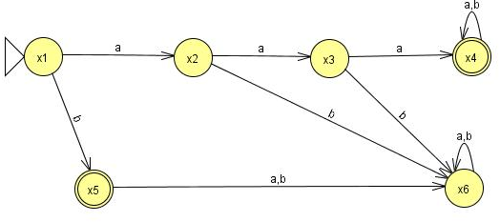
Question
Find FA1 U FA2 for the following:

Slide 34
Old States | Reading at a | Reading at b
z1-≡(x1,y1) | (x2,y2)≡z2 | (x5,y4)≡z3
z2≡(x2,y2) | (x3,y2)≡ z4 | (x6,y3)≡z5
z3+≡(x5,y4) | (x6,y5)≡ z6 | (x6,y4)≡z7
z4≡(x3,y2) | (x4,y2)≡ z8 | (x6,y3)≡z5
z5+≡(x6,y3) | (x6,y2)≡ z9 | (x6,y3)≡z5

Slide 35
Old States | Reading at a | Reading at b
z6+≡(x6,y5) | (x6,y5)≡ z6 | (x6,y4)≡z7
z7≡(x6,y4) | (x6,y5)≡ z6 | (x6,y4)≡z7
z8+≡(x4,y2) | (x4,y2)≡ z8 | (x4,y3)≡z10
z9≡(x6,y2) | (x6,y2)≡ z9 | (x6,y3)≡z5
z10+≡(x4,y3) | (x4,y2)≡ z8 | (x4,y3)≡z10

Slide 36
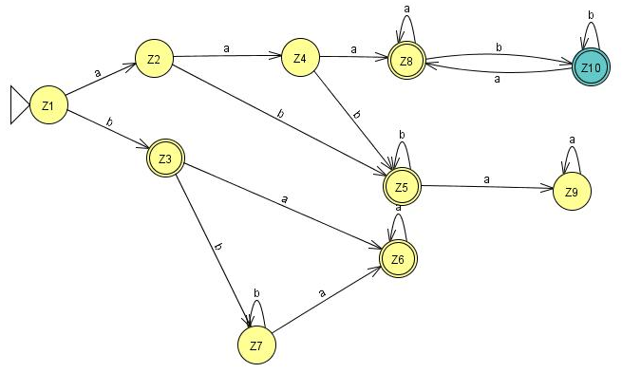

Slide 37
Lecture 9 Summary
Kleene Theorem Part I and Part II (Till State elimination)
Kleene Theorem Part III (Union)

Slide 38
Lecture # 10
Theory Of Automata
By
Dr. MM Alam

Slide 39
Lecture 9 at a glance…
Kleene Theorem Part I and Part II (Till State elimination)
Kleene Theorem Part III (Union)

Slide 40
Kleene Theorem Part III (Concatenation)
If r1r2 represents a regular expression r3, then FAFA2 represents an FA3 that should correspond to r3.
Start by taking the first FA’s and traversing on each input symbol in the respective FA.
Since one initial state is allowed in FA, therefore, only one state can be marked as initial state
During the process, any state encountered final, the resultant state will be final. Further, the second FA will be concatenated through its initial state. The new state will be marked as final.
However, if the final state of the second FA is encountered, it will not be combined with the first FA.

Slide 41
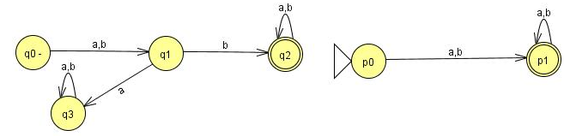
Question (concatenation)
Find FA1FA2 for the following:

Slide 42
Old States | Reading at a | Reading at b
z1-≡q0 | q1≡z2 | q1≡z2
z2≡q1 | q3≡z3 | (q2,p0)≡z4
z3≡q3 | q3≡z3 | q3≡z3
z4+ ≡ (q2,p0) | (q2,p0,p1)≡z5 | (q2,p0,p1)≡z5
z5+≡(q2,p0,p1) | (q2,p0,p1,p1)= (q2,p0,p1)≡z5 | (q2,p0,p1,p1)= (q2,p0,p1)≡z5

Slide 43
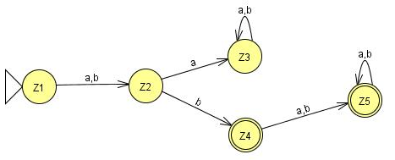

Slide 44
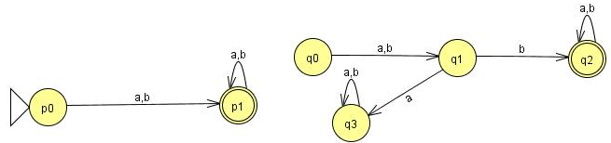
Question (concatenation)
Find FA2FA1 for the following:

Slide 45
Old States | Reading at a | Reading at b
z1-≡p0 | (p1, q0)≡ z2 | (p1, q0)≡ z2
z2+≡(p1, q0) | (p1,q0,q1)≡ z3 | (p1,q0,q1)≡ z3
z3+ ≡ (p1,q0,q1) | (p1,q0,q1,q3)≡ z4 | (p1,q0,q1,q2)≡z5
z4+≡ (p1,q0,q1,q3) | (p1,q0,q1,q3,q3)= (p1,q0,q1,q3)≡z4 | (p1,q0,q1,q2,q3)≡z6
z5+≡(p1,q0,q1,q2) | (p1,q0,q1,q2,q3)≡z6 | (p1,q0,q1,q2,q2)= (p1,q0,q1,q2)≡z5
z6+≡(p1,q0,q1,q2,q3) | (p1,q0,q1,q3,q2,q3)= (p1,q0,q1,q2,q3)z6 | (p1,q0,q1,q2,q2,q3)= (p1,q0,q1,q2,q3)≡z6

Slide 46
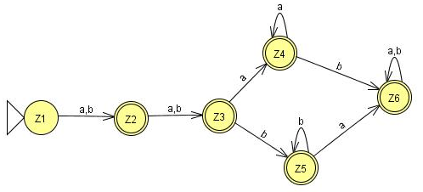

Slide 47
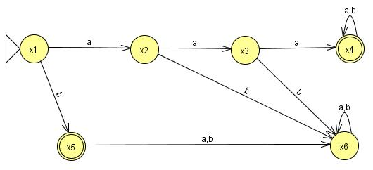
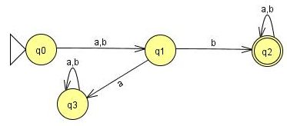
Question (concatenation)
Find FA3FA1 for the following:

Slide 48
Old States | Reading at a | Reading at b
z1- ≡x1 | x2≡ z2 | (x5,q0)≡z3
z2 ≡x2 | x3≡ z4 | x6≡ z5
z3+ ≡(x5,q0) | (x6,q1)≡z6 | (x6,q1)≡z6
z4 ≡x3 | (x4,q0)≡z7 | x6≡ z5
z5 ≡x6 | x6≡z5 | x6≡z5
z6 ≡( x6,q1) | ( x6,q3)≡ z8 | ( x6,q2)≡ z9
z7+≡( x4,q0) | ( x4,q0,q1)≡ z10 | ( x4,q0,q1)≡ z10
z8 ≡( x6,q3) | ( x6,q3)≡ z8 | ( x6,q3)≡ z8

Slide 49
z9+≡( x6,q2) | ( x6,q2)≡ z9 | ( x6,q2)≡ z9
z10+ ≡( x4,q0,q1) | (x4,q0,q1,q3)≡ z11 | (x4,q0,q1,q2)≡ z12
z11+≡( x4,q0,q1,q3) | (x4,q0,q1,q3,q3)= (x4,q0,q1,q3)≡ z11 | (x4,q0,q1,q2,q3)≡ z13
z12+≡( x4,q0,q1,q2) | (x4,q0,q1,q2,q3)≡ z13 | (x4,q0,q1,q2,q2)= (x4,q0,q1,q2)≡z12
z13+≡( x4,q0,q1,q2,q3) | (x4,q0,q1,q3,q2,q3)= (x4,q0,q1,q2,q3)≡z13 | (x4,q0,q1,q2,q2,q3)= (x4,q0,q1,q2,q3)≡z13

Slide 50
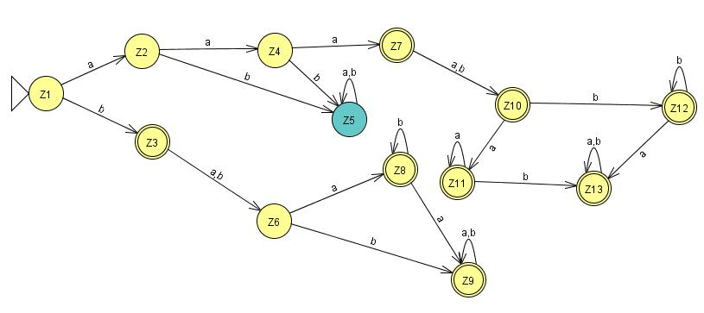

Slide 51
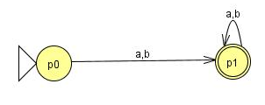
Question (concatenation)
Find FA3FA2 for the following:

Slide 52
Old States | Reading at a | Reading at b
z1- ≡x1 | x2≡ z2 | (x5,p0)≡ z3
z2 ≡x2 | x3≡ z4 | x6≡ z5
z3+≡(x5,p0) | ( x6,p1)≡z6 | ( x6,p1)≡z6
z4 ≡x3 | ( x4,p0)≡z7 | x6≡z5
z5 ≡x6 | x6≡z5 | x6≡z5
z6+≡( x6,p1) | ( x6,p1)≡z6 | ( x6,p1)≡z6
z7+≡( x4,p0) | ( x4,p0,p1)≡ z8 | ( x4,p0,p1)≡ z8
z8+≡( x4,p0,p1) | ( x4,p0,p1,p1)= ( x4,p0,p1)≡z8 | ( x4,p0,p1,p1)= ( x4,p0,p1)≡z8

Slide 53
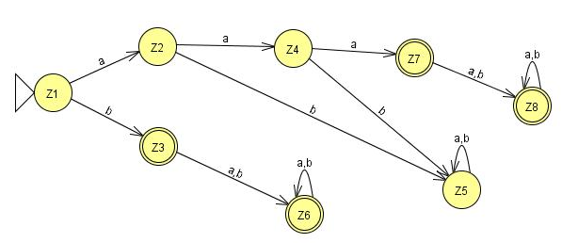

Slide 54
Lecture 10 Summary
Kleene Theorem Part III (Concatenation)
Kleene Theorem Part III (Examples)

Slide 55
Lecture # 11
Theory Of Automata
By
Dr. MM Alam

Slide 56
Lecture 10 at a glance…
Kleene Theorem Part III (Concatenation)
Examples of Kleene Theorem Concatenation part.

Slide 57
Kleene Theorem Part III (Closure)
If r1 represents a regular expression and r1* the closure of the r1. Similarly, if FA1 corresponds to r1 then FA1* should correspond to closure of r1.
Start by taking the first FA’s and traversing on each input symbol in the respective FA.
Since one initial state is allowed in FA, therefore, only one state can be marked as initial state. Further, the initial state is marked final by default, in order to accommodate NULL string.
During the process, any state found final, the resultant state will be final. Further, the same FA initial state will be concatenated through its final state. The new state will be marked as final.
The final state of the FA will always be combined with the initial state of the FA.

Slide 58
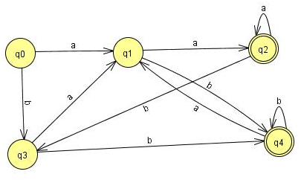
Old States | Reading at a | Reading at b
z1±≡q0 | q1≡z2 | q3≡z3
z2 ≡q1 | (q2, q0)≡z4 | (q4, q0)≡z5
z3 ≡q3 | (q1,q1)≡q1≡z2 | (q4, q0)≡z5
z4+≡ (q2, q0) | (q2, q0,q1)≡z6 | (q3,q3)≡ q3≡z3

Slide 59
z5+≡ (q4, q0) | (q1,q1)≡ q1≡z2 | (q4,q0,q3)≡z7
z6+≡ (q2, q0,q1) | (q2, q0,q1,q2, q0)≡(q2, q0,q1)≡z6 | (q3,q3,q4,q0)≡(q4,q0,q3)≡z7
z7+≡ (q4,q0,q3) | (q1,q1q1)≡q1≡z2 | (q4,q0,q3,q4,q0,)≡(q4,q0,q3)≡z7

Slide 60
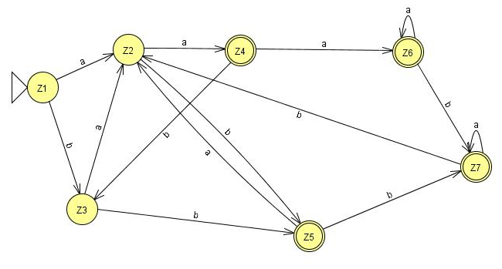

Slide 61
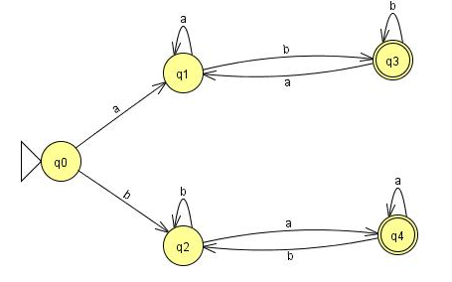
Old States | Reading at a | Reading at b
z1±≡q0 | q1≡z2 | (q3, q0)≡z3
z2 ≡q1 | (q2, q0)≡z4 | (q4, q0)≡z5
z3 ≡(q3, q0) | (q1,q1)≡q1≡z2 | (q4, q0,q1)≡z6
z4+≡ (q2, q0) | (q2, q0,q1)≡z6 | (q3,q3,q0)= (q3,q0)≡z3

Slide 62
z5+≡ (q4, q0) | (q1,q4,q0)≡z7 | (q2,q2)≡q2≡z3
z6+≡ (q3, q0,q2) | (q1,q1,q4,q0)≡(q1,q4,q0)≡z7 | (q3, q0,q2,q2)≡ (q3, q0,q2)≡z6
z7+≡ (q1,q4,q0) | (q1,q4,q0,q1)≡(q1,q4,q0)≡z7 | (q3, q0,q2,q2)≡ (q3, q0,q2)≡z6

Slide 63
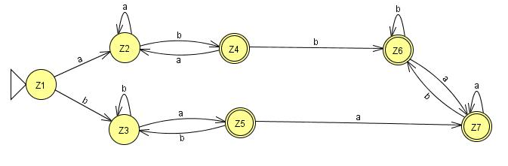

Slide 64
One special requirement for FA’s having an initial state which has a loop or an in coming transition in the closure results in two different states: One non-final state and other one final.

Slide 65
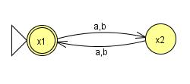
Final Z1≡ x1 | x2≡Z2 | x2≡Z2
x2≡Z2 | x1≡Z1 | x1≡Z1

Slide 66
Lecture#11 Summary
Kleene Theorem Part III (Closure)
Kleene Theorem Part III (Examples)

