Slide 1
Software Construction
Lecture 7
Java Implementation 2

Slide 2
Agenda
Topics:
  Interfaces in Java
  Reference data types
  Abstract classes in Java
  Overview of generics in Java
Reading
  In The Java Tutorials:
    What is an Interface?, in the Object-Oriented Programming Concepts Lesson
    The Interfaces and Inheritance Lesson
    Why Use Generics? in the Generics (Updated) Lesson.

Slide 3
Abstract Classes
Sometimes, it’s appropriate to partly-implement a class or interface.
  Abstract classes allow code to be reused in similar implementations.
Abstract classes may include some abstract methods.
  If there are no abstract methods, then the class is usually (but not always) implemented fully enough to be used by an application.
    Sometimes it’s helpful to have multiple implementations that differ only in their type, but this is quite an advanced concept in design.
public abstract class MyGraphicObject {
// declare fields – these may be non-static
private int x, y;
// declare non-abstract methods
// (none)
// declare methods which must be implemented later
abstract void draw();
}

Slide 4
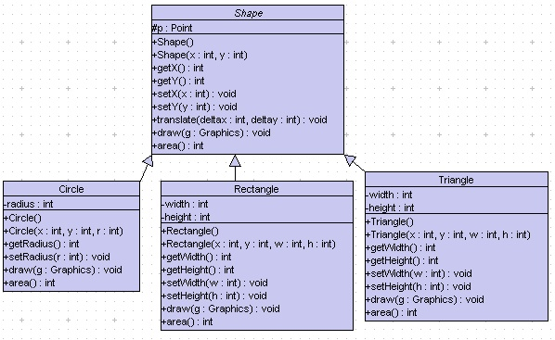
public abstract class Shape {
…
public abstract void draw(Graphics g);
public abstract int area();
}
The method signature is declared, but no implementation is provided.
Abstract methods
Provide implementation in subclasses
public class Rectangle extends Shape {
private int width, height;
public int area() {
return (width * height);
}
...
public class Circle extends Shape {
private int radius;
public int area() {
return (int) (Math.PI * radius * radius);
}
...
public class Triangle extends Shape {
private int width, height;
public int area() {
return (width * height) / 2;
}
...

Slide 5
Final
The final keyword can be applied to prevent the extension (over-riding) of a field, argument, method, or class.
  Final field: constant
  Final argument: cannot change the data within the called method
  Final method: cannot override method in subclasses
  Final class: cannot be subclassed (all of its methods are implicitly final as well)
class ChessAlgorithm {
. . .
final void nextMove(
ChessPiece pieceMoved, BoardLocation newLocation ) {
\\ body of nextMove – can’t be overriden
}
}

Slide 6
Super
If your method overrides one of its superclass's methods, you can invoke the overridden method through the use of the keyword super.
  You can also use super to refer to a hidden field (although hiding fields is discouraged).
Example below. (What is printed when main() is executed?)
public class Superclass {
public void printMethod() {
System.out.println("Printed in Superclass.");
} }
public class Subclass extends Superclass {
public void printMethod() {
super.printMethod();
System.out.println("Printed in Subclass");
} }
public static void main(String[] args) {
Subclass s = new Subclass();
s.printMethod();
} }
Printed in Superclass.
Printed in Subclass

Slide 7
Generics
“Generics are a powerful feature of the Java programming language.
  They improve the type safety of your code, making more of your bugs detectable at compile time.” [http://docs.oracle.com/javase/tutorial/java/index.html]
“In a nutshell, generics enable types (classes and interfaces) to be parameters when defining classes, interfaces and methods.
  Much like the more familiar formal parameters used in method declarations,
    type parameters provide a way for you to re-use the same code with different inputs.
  The difference is that the inputs to formal parameters are values,
    while the inputs to type parameters are types.” [http://docs.oracle.com/javase/tutorial/java/generics/why.html]

Slide 8
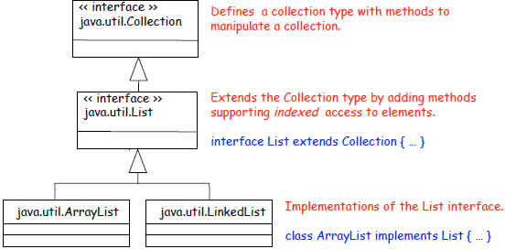
Collection (without using generics)
Collection Interface
  A collection represents a group of objects, known as its elements
List Interface
  An ordered collection. The user can access elements by their integer index (position in the list), and search for elements in the list.
ArrayList
  Resizable-array implementation of the List interface
  Implements the size, isEmpty, get, set, iterator, and listIterator methods
LinkedList
  Doubly-linked list implementation of the List interface
  Implements the size, isEmpty, get, set, iterator, and listIterator methods

Slide 9
List versus List<T>
Nice:
Nicer (because no typecasts, and better type-checking):
What will happen if you put different classes of objects in a List, then invoke findMax() on the objects in that list?
  You would get a runtime error if the isLargerThan() method for one class doesn’t accept objects in the other class as a parameter.
  List list = new ArrayList();
  list.add("hello");
  String s = (String) list.get(0);
  List<String> list = new ArrayList<String>();
  list.add("hello");
  String s = list.get(0); // no cast

Slide 10
Visibility Rules, from The Java Tutorial
Access Levels
Modifier | Class | Package | Subclass | World
public | Y | Y | Y | Y
protected | Y | Y | Y | N
no modifier | Y | Y | N | N
private | Y | N | N | N
“The first data column indicates whether the class itself has access to the member defined by the access level.
“The second column indicates whether [other] classes in the same package as the class (regardless of their parentage) have access to the member.
“The third column indicates whether subclasses of the class declared outside this package have access to the member.
“The fourth column indicates whether all classes have access to the member.”

Slide 11
Tips on Choosing an Access Level
“If other programmers use your class, you want to ensure that errors from misuse cannot happen.
  Access levels can help you do this.
“Use the most restrictive access level that makes sense for a particular member.
“Use private unless you have a good reason not to.
“Avoid public fields except for constants.
  (Many of the examples in the tutorial use public fields. This may help to illustrate some points concisely, but is not recommended for production code.)
  Public fields tend to link you to a particular implementation and limit your flexibility in changing your code.”
  [The Java Tutorials, Controlling Access to a Member or Class]

Slide 12
Packages
“Definition: A package is a grouping of related types providing access protection and name space management.
“Note that types refers to classes, interfaces, enumerations, and annotation types.
  Enumerations and annotation types are special kinds of classes and interfaces, respectively, so types are often referred to in this lesson simply as classes and interfaces.”
Purpose: “To make types easier to find and use, to avoid naming conflicts, and to control access, programmers bundle groups of related types into packages.”

Slide 13
Creating a Package
“To create a package, you
  choose a name for the package (naming conventions are discussed in the next section) and
  put a package statement with that name at the top of every source file that contains the types (classes, interfaces, enumerations, and annotation types) that you want to include in the package.
“The package statement (for example, package graphics;) must be the first line in the source file.
  There can be only one package statement in each source file, and it applies to all types in the file.”

Slide 14
One public type per file!
“If you put multiple types in a single source file, only one can be public, and it must have the same name as the source file.
  For example, you can
    define public class Circle in the file Circle.java,
    define public interface Draggable in the file Draggable.java,
    define public enum Day in the file Day.java, and so forth.
“You can include non-public types in the same file as a public type
  (this is strongly discouraged, unless the non-public types are small and closely related to the public type),
  but only the public type will be accessible from outside of the package.
  All the top-level, non-public types will be package private.”
This rule makes it easy for the class loader, and the human programmer, to find the definition for a public type.
  The name of a package determines the directory in which the files of this package should be stored.
  The name of a public type determines the name of the file in which the type’s definition must be found.

Slide 15
The default package
“If you do not use a package statement, your type ends up in an unnamed package.
  Generally speaking, an unnamed package is only for small or temporary applications or when you are just beginning the development process.
  Otherwise, classes and interfaces belong in named packages.”

Slide 16
Package naming conventions
“With programmers worldwide writing classes and interfaces using the Java programming language,
  it is likely that many programmers will use the same name for different types.
  [Because the fully-qualified name of each class includes the package name, e.g. java.awt.Rectangle,
  there is no naming conflict] unless two independent programmers use the same name for their packages.
  What prevents this problem [of name conflict]? Convention.
“Naming Conventions
  Package names are written in all lower case to avoid conflict with the names of classes or interfaces.
  Companies use their reversed Internet domain name to begin their package names
    for example, com.example.mypackage for a package named mypackage created by a programmer at example.com.
  Name collisions that occur within a single company need to be handled by convention within that company,
  Packages in the Java language itself begin with java. or javax.

Slide 17
External references
“To use a public package member from outside its package, you must do one of the following:
Refer to the member by its fully qualified name,
Import the package member, [or]
Import the member’s entire package.”
The fully qualified name for class C in package p is p.C
To import class C from package p, you write import p.C
To import an entire package p, you write import p.*
Java gives you a great deal of control over the “name space” of your program:
  You control the import of external names (by your import statements)
  You control the export of your names (by restricting visibility, in packages and in inheritances).

Slide 18
Keywords for Control of Inheritance
Every subclass will
  inherit all superclass members that are declared as public or protected .
By contrast,
  private members are not inherited (but may be accessible through super.)
  The default visibility is “package-private” – inherited by subclasses within the same package, but not inherited by subclasses that are declared outside the package.
No subclass can
  override static methods, or
  override final methods.
Any subclass may
  add new members (= fields or methods), or
  override any non-static, non-final method in the superclass.
We say a method is overridden in a subclass, if any of its superclasses has a method of the same signature (= name, plus the number and types of parameters) and return type.
  Note that overriding does not absolutely prevent access. A reference to the superclass member is still possible (e.g. with super) if this member is visible.

Slide 19
Review
Interfaces in Java
Types in Java
Abstract classes in Java
Overview of generics in Java
Packages

