Slide 1
Software Construction
Lecture 6
Java Implementation

Slide 2
Agenda
Topics:
  Interfaces in Java
  Reference data types
  Abstract classes in Java
  Overview of generics in Java
Reading
  In The Java Tutorials:
    What is an Interface?, in the Object-Oriented Programming Concepts Lesson
    The Interfaces and Inheritance Lesson
    Why Use Generics? in the Generics (Updated) Lesson.

Slide 3
Learning objectives for this week
Students will be competent at implementing OO designs in Java
  Interfaces, reference data types, abstract classes, intro to generics
The lectures will give you the basic “theory”, but they won’t give you a “working understanding” – you have to do the hard-yards of putting these ideas into practice.
  You won’t even understand the theory, if you listen passively to lectures. I’ll try to help you “learn how to learn” from the Java tutorials.
  You’ll get many chances to develop your understanding in your lab assignments for this course.

Slide 4
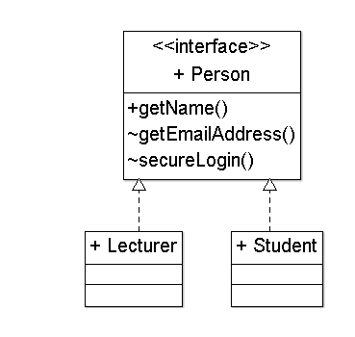
Interfaces, in UML (review)
Interfaces specify behaviour (a public contract), without data or implementation.
Interfaces are drawn like classes, but without attributes, and with the keyword <<Interface>>
A dotted open-triangle arrow, from a class to an interface, means that “the class implements this interface”.
  We also say that “the class fulfils the contract specified by this interface”, or that it “realizes the interface.”
Note that interfaces define methods but not attributes.
  A password allows a secureLogin().

Slide 5
Interfaces in Java
An Interface is like a Class, with no bodies in the methods. It may define constants (public static final) but no runtime variables.
  Usually, an Interface is public.
  An interface provides a standard way to access a class which could be implemented in many different ways.
The Java Tutorials:
  “There are a number of situations in software engineering when it is important for disparate groups of programmers to agree to a ‘contract’ that spells out how their software interacts.”
  “Each group should be able to write their code without any knowledge of how the other group's code is written.”
  “Generally speaking, interfaces are such contracts.”

Slide 6
Implementations, in Java
In Java, a class which implements an interface must provide an implementation of every method defined within the interface
  A class may implement some additional methods (but these extra methods aren’t accessible through this interface)
  Beware: adding another method to an existing Interface will “break” every current implementation of this Interface!
A class can implement many interfaces.
An Interface can extend other Interfaces.
  Extension is the preferred way to add new methods to an Interface.
    (Do you understand why?)
  In Java, classes are less extendible than interfaces, because a Class can extend at most one other Class (“single inheritance”).
    class MountainBike extends Bicycle { … }

Slide 7
Example 1
public interface Bicycle {
void changeCadence(int newValue);
void changeGear(int newValue);
void speedUp(int increment);
void applyBrakes(int decrement);
}
class ACMEBicycle implements Bicycle {
int cadence = 0;
void changeCadence(int newValue) {
cadence = newValue;
}
\\ an implementation may be incorrect!
void changeGear(int newValue) {}
void speedUp(int increment) {}
void applyBrakes(int decrement) {}
}
\\ an implementation usually has variables

Slide 8
Example 2
public interface GroupedInterface extends
Interface1, Interface2, Interface3 {
// constant declarations
// base of natural logarithms
double E = 2.718282;
// method signatures
void doSomething( int i, double x );
int doSomethingElse( String s );
}

Slide 9
Example 3
public interface EventListener {
// No constants
// No method signatures!
}
“A tagging interface that all event listener interfaces must extend.” [http://docs.oracle.com/javase/6/docs/api/java/util/EventListener.html]
Why?
  At first glance, this is worse than useless! One more name for the Java programmer to remember…
This interface allows programmers, and the Java compiler, to distinguish event-listeners from all other types of classes and interfaces.
  Event-listeners are important, and they behave quite differently to a regular class. (Later, you’ll learn about inversion of control…)

Slide 10
MouseListener in java.awt.event
public interface MouseListener extends EventListener
  The listener interface for receiving “interesting” mouse events (press, release, click, enter, and exit) on a component. (To track mouse moves and mouse drags, use the MouseMotionListener.)
All Known Subinterfaces:
  MouseInputListener
All Known Implementing Classes:
  AWTEventMulticaster, BasicButtonListener, BasicComboPopup.InvocationMouseHandler, BasicComboPopup.ListMouseHandler, BasicDesktopIconUI.MouseInputHandler, …
public interface MouseListener
extends EventListener {
mouseClicked( MouseEvent e );
mouseEntered( MouseEvent e );
mouseExited( MouseEvent e );
mousePressed( MouseEvent e );
mouseReleased( MouseEvent e );
}
public interface MouseMotionListener extends EventListener {
mouseDragged( MouseEvent e );
mouseMoved( MouseEvent e );
}
public interface MouseInputListener
extends MouseListener, MouseMotionListener {
// this interface has 7 method signatures, can you list them?
}

Slide 11
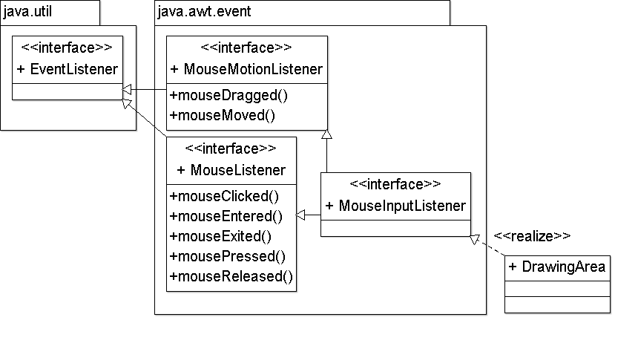
UML: Review of Interfaces. Packages.

Slide 12
Using an Interface as a Type
“When you define a new interface, you are defining a new reference data type.
  “You can use interface names anywhere you can use any other data type name.
  “If you define a reference variable whose type is an interface, any object you assign to it must be an instance of a class that implements the interface.” [http://docs.oracle.com/javase/tutorial/java/IandI/interfaceAsType.html]
Example on the next slide:
  A method for finding the largest object in a pair of objects, for any objects that are instantiated from a class that implements Relatable.
public interface Relatable {
public int isLargerThan( Relatable other );
}

Slide 13
Using an Interface as a Type
public Object findMax(Object object1, Object object2) {
Relatable obj1 = (Relatable)object1;
Relatable obj2 = (Relatable)object2;
if( (obj1).isLargerThan(obj2) > 0 )
return object1;
else
return object2;
}
If comparisons are important in your application, then you’ll be able to write very elegant code!
  You can write z.findMax(x, y), if x and y are instances of any class which extends Relatable.

Slide 14
Using an Interface as a Type: Dangers
public Object findMax( Object object1, Object object2 ) {
Relatable obj1 = (Relatable)object1;
Relatable obj2 = (Relatable)object2;
if( (obj1).isLargerThan(obj2) > 0 )
return object1;
else return object2;
}
Watch out for type mismatches!! We’d get a compile-time error if
  (object1).isLargerThan(object2) were in the body of this method,
  we invoked it as z.findMax(x,y), for any instance x of a class that doesn’t extend Relatable, or if
  we invoked it as x.findLargest(y,z), if y.isLargerThan() does not accept z as a parameter.
If it’s easy for a programmer (and a compiler) to determine the class of all arguments in every method-call, then you’ll avoid these dangers.

Slide 15
Typing Rules
The typing rules for interfaces are similar to those for classes.
  A reference variable of interface type T can refer to an instance of any class that implements interface T or a sub-interface of T.
  Through a reference variable of interface type T, methods defined by T and its super interfaces can be called.
«realize»
interface I1 {
public void m1();
public void m2();
}
class c1 implements I1 {
public void m1() {}
public void m2() {}
}
interface I2 extends I1 {
public void m3();
}
C1 a = new C1(); \\ a is a reference variable of type C1
C1 b = new C1();
I1 p = a; \\ p is a reference variable of type I1
p.m1();
C2 c = new C2();
I2 q = c; \\ q is a reference variable of type I2
q.m1();
q.m2();
«realize»
class c2 implements I2 {
public void m1() {}
public void m2() {}
public void m3() {}
}

Slide 16
instanceof
You can use the instanceof operator to test an object to see if it implements an interface, before you invoke a method in this interface.
  This might improve readability and correctness.
  This might be a hack.
    Where possible, you should extend classes and interfaces to obtain polymorphic behaviour, rather than making a runtime check.
if( b instanceof Bounceable ) {
b.hitWall( "Wall A" );
} else { \\ abort, with an error message to the console
throw new AssertionError( b );
}
Date somedate = new Date();
\\ throw an exception if somedate is not Relatable.
assert( Date instanceof Relatable );
    \\ See http://docs.oracle.com/javase/1.4.2/docs/guide/lang/assert.html

