Slide 1
Software Construction
Lecture 5
Class Diagrams

Slide 2
Agenda
Topics:
  Examples of class diagrams
  Navigation, visibility, named associations, and multiplicity in UML
  Interfaces and implementation, in UML
If you actually want to learn this material…
  Find your own examples of class diagrams on the web. Try to interpret them. Look for patterns.
  Talk about it within your study group.

Slide 3
Learning Objectives
Students will have a strong conceptual foundation for their future uses of the OO features of Java
  Interfaces
Students will be able to interpret a class diagram
  Worked examples in this lecture
Students will be competent at the basic OO design patterns
  Implementing interfaces, composing classes, extending classes

Slide 4
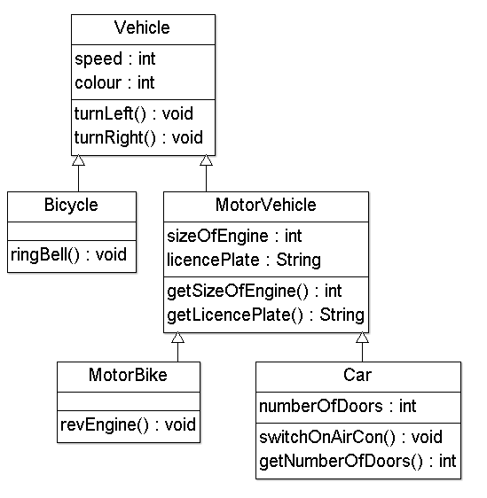
Example of Inheritance
Source: http://www.ldodds.com/lectures/intro2java/Lesson1.ppt

Slide 5
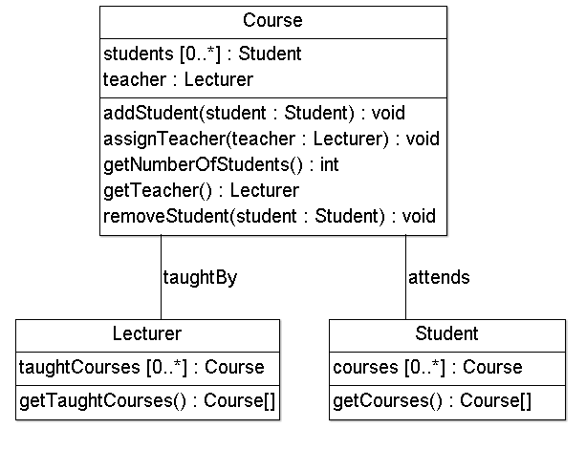
Too much detail?
Source: http://www.ldodds.com/lectures/intro2java/Lesson1.ppt

Slide 6
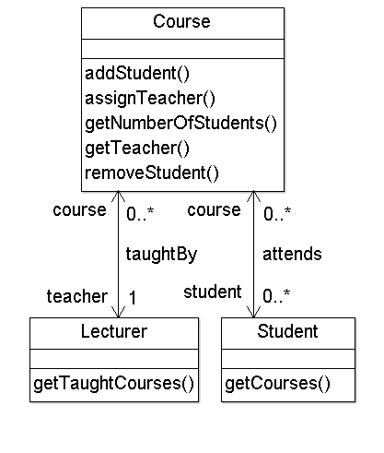
Simplify! (with a little more notation)
Multiplicity:
  There is exactly one teacher per course, as indicated by the 1.
  A lecturer can teach any number of courses, as indicated by 0..*.
  We can also write 1..* in a UML diagram.
The arrowheads indicate that the taughtBy association is navigable in both directions, telling us that
  Course has an instance variable teacher, of type Lecturer, and
  Lecturer has the instance variable Vector<Course> course.

Slide 7
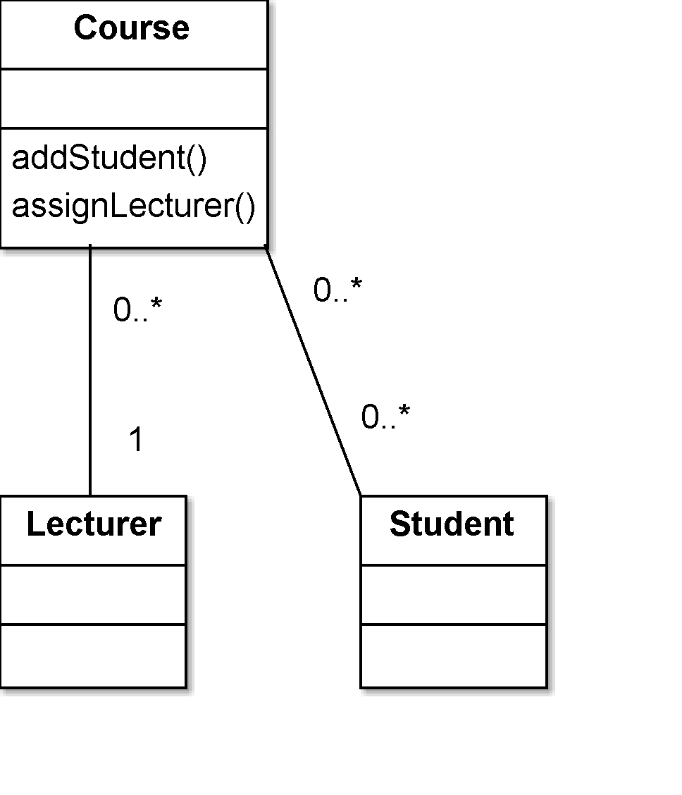
Simplify even more, with defaults
Associations have default multiplicity 1
Association endpoints have a default name.
  Course has an instance variable myLecturer of type Lecturer
  Lecturer has an instance variable myCourse of type Vector<Course>
Getters, setters may be implied.
  Unimportant members might not be shown.
Defaults may be well-defined by an organisation’s stylesheet, or (more commonly) by their UML-drawing software package.
  See e.g. http://msdn.microsoft.com/en-us/library/dd323861.aspx: “Properties of Attributes in UML Diagrams” for VS 2013.

Slide 8
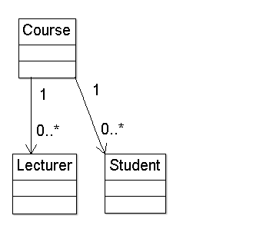
One-way Navigation
These courses have a Vector of their Lecturers and Students.
  (They might have a List; they might have an array; these are implementation decisions.)
These lecturers don’t know what they are teaching!
These students have no idea of what course they are taking!

Slide 9
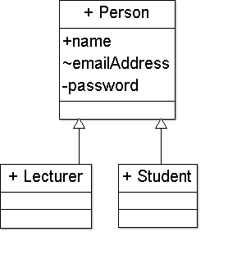
Creating new classes by generalising
Lecturers and students have some attributes in common.
  A public name
  An email address that is revealed to everyone in our University
  A secret password
We write these methods once for the Person class, and we can reuse them in the Lecturer and Student class.
  But we have complicated our design by adding another class.
  Do we really need so many classes?

Slide 10
Association Relationships (Cont’d)
We can model objects that contain other objects by way of special associations called aggregations and compositions.
An aggregation specifies a whole-part relationship between an aggregate (a whole) and a constituent part, where the part can exist independently from the aggregate. Aggregations are denoted by a hollow-diamond adornment on the association.
Car
Engine
Transmission

Slide 11
Association Relationships (Cont’d)
A composition indicates a strong ownership and coincident lifetime of parts by the whole (i.e., they live and die as a whole). Compositions are denoted by a filled-diamond adornment on the association.
Window
Scrollbar
1
1
Titlebar
1
1
Menu
1
1 .. *

Slide 12
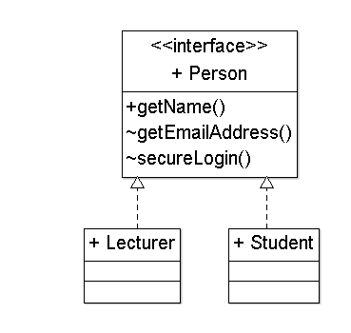
Interfaces
Interfaces are a way to specify behaviour (a public contract) without data or implementation.
Interfaces are classed with an extra label next to their name: <<Interface>>
A dotted open-triangle arrow, from a class to an interface means that “the class implements this interface”.
  We also say that “the class fulfils the contract specified by this interface”, or that it “realizes the interface.”
Note that interfaces define methods but not attributes.
  A password allows a secureLogin().

Slide 13
Interface Realization Relationship
<<interface>>
ControlPanel
A realization relationship connects a class with an interface that supplies its behavioral specification. It is rendered by a dashed line with a hollow triangle towards the specifier.
specifier
implementation
VendingMachine

Slide 14
Interfaces
inputStream
FileWriter
{file must not be locked}
A class’ interface can also be rendered by a circle connected to a class by a solid line.
File
FileReader
{file must exist}
outputStream

Slide 15
Parameterized Class
T
A parameterized class or template defines a family of potential elements.
To use it, the parameter must be bound.
LinkedList
T
1 .. *
A template is rendered by a small dashed rectangle superimposed on the upper-right corner of the class rectangle. The dashed rectangle contains a list of formal parameters for the class.

Slide 16
Parameterized Class (Cont’d)
T
LinkedList
Binding is done with the <<bind>> stereotype and a parameter to supply to the template. These are adornments to the dashed arrow denoting the realization relationship.
Here we create a linked-list of names for the Dean’s List.
T
1..*
<<bind>>(Name)
DeansList

Slide 17
Enumeration
<<enumeration>>
Boolean
An enumeration is a user-defined data type that consists of a name and an ordered list of enumeration literals.
false
true

Slide 18
Exceptions
<<exception>>
Exception
Exceptions can be modeled just like any other class.
Notice the <<exception>> stereotype in the name compartment.
getMessage()
printStackTrace()
<<exception>>
KeyException
<<exception>>
SQLException

Slide 19
Packages
A package is a container-like element for organizing other elements into groups.
A package can contain classes and other packages and diagrams.
Packages can be used to provide controlled access between classes in different packages.
Compiler

Slide 20
Packages (Cont’d)
Classes in the FrontEnd package and classes in the BackEnd package cannot access each other in this diagram.
Compiler
FrontEnd
BackEnd

Slide 21
Packages (Cont’d)
Classes in the BackEnd package now have access to the classes in the FrontEnd package.
Compiler
FrontEnd
BackEnd

Slide 22
Packages (Cont’d)
Compiler
We can model generalizations and dependencies between packages.
JavaCompiler
Java

Slide 23
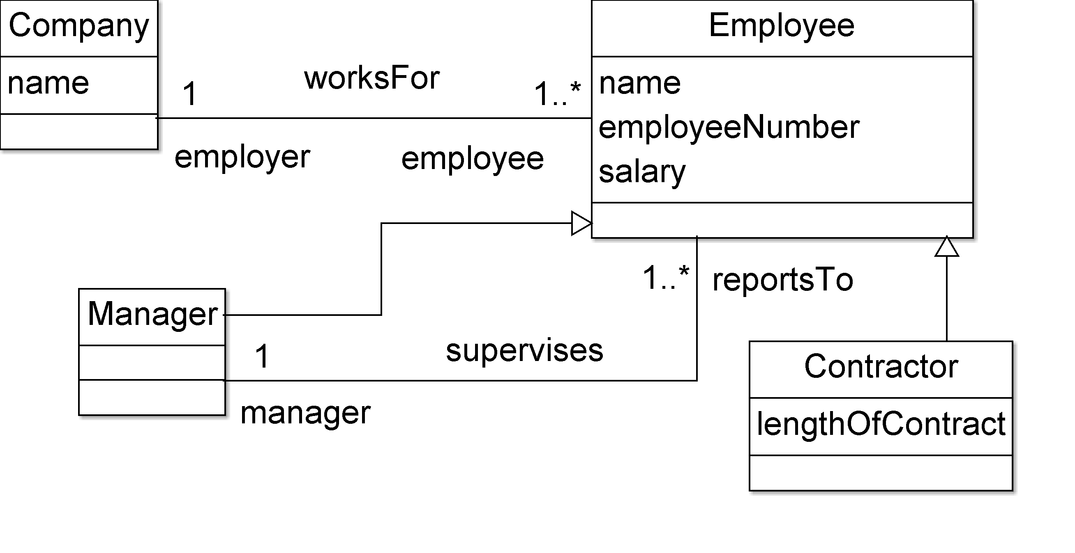
Can you understand this design?
Adapted from http://www.ldodds.com/lectures/intro2java/Lesson1.ppt

Slide 24
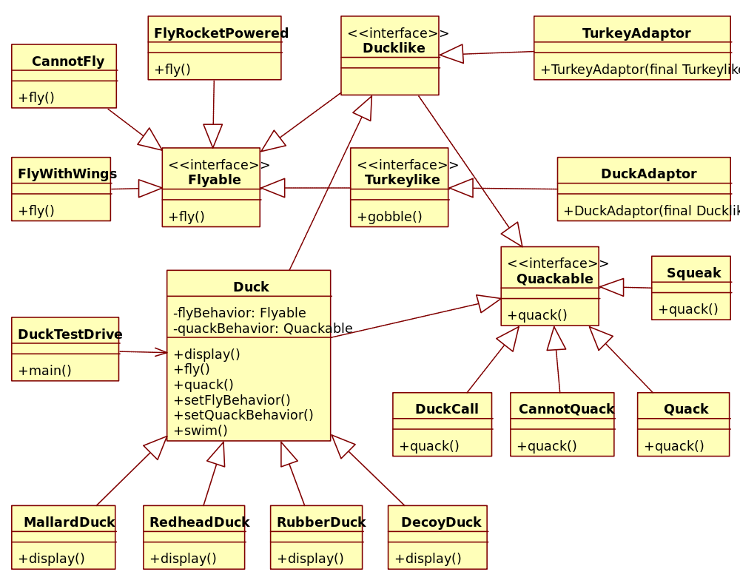
Can you understand this design?
Source: http://commons.wikimedia.org/wiki/File:UML_diagram_ of_composition_over_inheritance.svg, available 2014-03-12.

Slide 25
Learning Objectives (review)
Students will have a strong conceptual foundation for their future uses of the OO features of Java
  Interfaces
Students will be able to interpret a class diagram
  Worked examples in this lecture
Students will be competent at the basic OO design patterns
  Implementing interfaces, composing classes, extending classes

