Slide 1
Software Construction
Lecture 4
Object-Oriented Design – Key Concepts

Slide 2
Agenda & Reading
Topics:
  Abstraction and information hiding
  Inheritance, instantiation, and polymorphism
  Association, aggregation, and composition
Reading
  The Java Tutorial, on Inheritance
  Wikipedia, on Class Diagram

Slide 3
Learning Objectives
Students will have a strong conceptual foundation for their future uses of the OO features of Java
  Inheritance (is-a) vs composition/aggregation/association (has-a)
  Polymorphism
Students will be able to discuss the OO features of an existing design (as expressed in a Java program or a class diagram)
Students will be competent at basic OO design

Slide 4
Abstraction
An abstraction is a view or representation of an entity that includes only the attributes of significance in a particular context.
Abstraction is essential when working with complex systems.
Without abstraction, the programmer faces an overwhelming level of detail.
Ignore
Inessential Details
Instance Variables:
item: Vector
Complex
Object
Idealised
Model
Instance variables:
Names : String
DateOfBirth : Date
Stack
Methods:
push(object:Object): void
pop(): Object
Methods:
getSurname(): String
getFirstname (): String
getAge(): Integer
setSurname(name: String): void
Customer
Instance Variables:
topLeftCorner: Point
Width: Integer
Height: Integer
Rectangle
Methods:
paint(): void

Slide 5
Information Hiding: two definitions
A programming technique, in which the programmer
  uses language features (such as Interface, protected, private) to restrict access to implementation details.
  In the extreme case, other programmers are not allowed to “look inside” your model to see its implementation.
A design technique, in which the designer
  defines a model which is simple, useful, and unlikely to change.
  In the extreme case, other programmers can read your high-level design documents, but not your code.
It is usually undesirable for programmers to rely on “undocumented functions” in an implementation.
  Undocumented functions are subject to change with every release!
It is often undesirable, and usually infeasible, to absolutely prevent other programmers from learning about your implementation.
  Many non-functional requirements (e.g. for security) are not adequately disclosed in high-level design documents.
  The design documents may be incomplete, incorrect, or ambiguous.

Slide 6

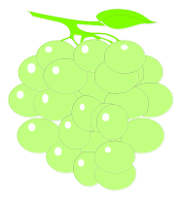


Inheritance and Instantiation
Inheritance: create new classes from existing classes.
  Instantiation: create new instances from existing classes.
  Inheritance is more powerful than instantiation.
  When a subclass is created by inheritance from a superclass, some of the methods and attributes in its superclass may be added or redefined.
Inheritance is an “is-a” relation.
  Example: “An orange is a fruit. An apple is a fruit.”
    Every instance of an Orange is a Fruit (= its superclass) , but it is more accurately described as being an instance of the Orange class (= its subclass).
    If there is no important difference between oranges and apples, you should simplify your design!

Slide 7
Polymorphism
Different objects can respond differently to the same message.
  Inheritance is the “obvious” way to obtain polymorphic behaviour in your OO design, but it may not be the best way.
  Instantiations are polymorphic, if the values in their attributes affect the behaviour of their methods.
Hmmm… if you have instantiated a million objects of a single Class, could they do anything useful? Hmmm….
    Worker ants are (nearly) identical, but they won’t reproduce without a Queen ant.
    Ants may be important members of an ecosystem, but only if the ecosystem contains other forms of life, some inanimate objects, and an energy source.
    One way to conceive of OOD is that you’re designing an ecosystem with multiple species (Classes) in an evolutionary tree.
    It is possible to write a useful program in a non-OO language!
    Polymorphism is not necessary in programming, but it is fundamental to OO design.

Slide 8
OO Analysis: Basic Questions
What classes and instances should be in my high-level design?
  To get started on answering this question, you should identify important entities, and look for commonalities among different entities.
    Similar entities might be instances of the same class… but maybe there are some “natural” subclasses?
How should my classes and instances be related to each other?
  We have seen the Inheritance (“is-a”) relationship.
  We have also seen the Instantiation (“instance-of”) relationship.
  We will now look at a few other relationships that are fundamental to OO design.

Slide 9

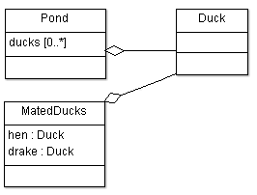
4. Composition and Aggregation
These relationships create a complex class from one or more existing classes (or instances), in a whole/part relationship.
Composition (“owns-a”, “has-a”):
  An object is a component of at most one composition.
  When a composition instance is destroyed, all objects belonging to this instance are destroyed as well.
  Example: SimCard has-a SIM
Aggregation (“has-a”):
  An object can be in many aggregations.
  Example: Pond has-a Duck

Slide 10

Association
In an association, an instance of one class is linked to an instance of another class.
  An aggregation is an association, because the aggregating class has instance variables which refer to objects of its parts.
  A composition is an association, because the “container” or “owner” has references to its parts,
An association may have no “container”, “owner”, or “whole”.
  Example: every teacher has 0 or more students, and every student has 0 or 1 teachers.

Slide 11

Multiplicities
The multiplicity of an association may be important enough to include in a high-level design document.
  The filled-diamond notation for compositions implies that the “whole” (Composite) class has a multiplicity of 1..1 or 0..1 – because each Part can belong to at most one whole.
  No department can exist unless it is part of a university, so the University’s multiplicity in this association is 1..1 (sometimes written “1”).
  A university must have at least one department.
Multiplicities of 0..* are not very informative.

Slide 12
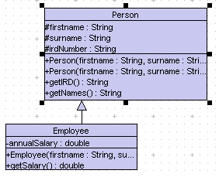
Inheritance
Example: Person.java & Employee.java
Generalisation
  Look for conceptual commonalities in the abstractions
    Common attributes/state
    Common methods or behaviour
“is-a” relationship
  Subclass “is-a” kind of Superclass
Superclass (base class) defines the general state and behaviour
Subclass (derived) class :
  Created from an existing class, by extending the existing class, rather than rewriting it
Examples
  Person
    Employee & Customer (Customer “is-a” Person)

Slide 13
Composition Vs Inheritance
Car
Engine
Cylinders
Crankshaft
Body
Wheels
Means of transportation
Wheeled vehicle
Packhorse
Bicycle
Automobile
Human body
Bone
Muscles
Nervous system
Skin
Component
Button
Label
TextComponent
TextField
TextArea

Slide 14
Composition Vs Inheritance
Suppose we want to create a class to represent circles:
  Composition or Inheritance?
    Circle is a point with a radius?
    Circle has a point with a radius?
General guideline
  Inheritance : Is-a
  Composition : has-a
But there is no rulebook - the objective is clean, understandable and maintainable code that can be implemented in reasonable time
Some more guidelines:
  Inheritance provides a means for constructing highly reusable components, but needs to be used very carefully
  Choose composition first when creating new classes from existing classes. You should only used inheritance if it is required by your design. If you use inheritance where composition will work, your designs will become needlessly complicated

Slide 15
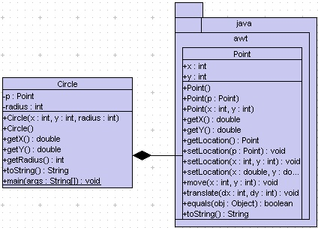
Composition
Example: Circle_a/Circle.java
import java.awt.Point;
public class Circle {
private Point p;
private int radius;
public Circle (int x, int y, int radius) {
p = new Point (x, y);
this.radius = radius;
}
public double getX() {
return p.getX ();
}
public double getY() {
return p.getY ();
}
public int getRadius () {
return radius;
}
// additional code
}
Circle c1 = new Circle();
System.out.println("x=" + c1.getX() + ", y=" + c1.getY());
System.out.println("radius=" + c1.getRadius());

Slide 16
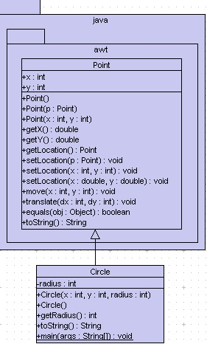
Inheritance
Example: Circle_i/Circle.java
We could reuse Point class since it already has code for representing a point position
import java.awt.Point;
public class Circle extends Point {
private int radius;
public Circle() {
}
public int getRadius () {
return radius;
}
// additional code
}
Instance variable: radius
Inherited from Point class
Circle c1 = new Circle();
System.out.println("x=" + c1.getX() + ", y=" + c1.getY());
System.out.println("radius=" + c1.getRadius());

Slide 17
Review
Abstraction
  The ability of a language (and a designer) to take a concept and create an abstract representation of that concept within a program
Information Hiding
  How well does this language, designer, and programmer hide an object’s internal implementation?
Inheritance
  The “is-a” relation: important for code reuse
Polymorphism
  How does this language let us treat related objects in a similar fashion?
Composition, Aggregation, Association
  Types of “has-a” relations: ways to build complex classes from simpler ones.

