Slide 1
Lecture 2
Introduction to Object-Orientation

Slide 2
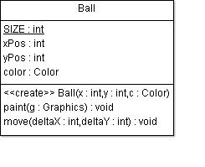
Message Passing
In a method call, a message is passed to a receiver object.
The receiver’s response to the message is determined by its class.
Ball b = new Ball(10, 20, Color.Red);
b.move(50, 100);
b: Ball
xPos =10
yPos = 20
Color = Red
b: Ball
xPos = 10 60
yPos = 20120
Color = Red
message
receiver
arguments
public class Ball {
...
public void move(int deltaX, int deltaY) {
xPos += deltaX;
yPos += deltaY;
}
}

Slide 3
Instance & Class Variables
Class variables are statically allocated, so they
  are shared by an entire Class of objects.
  The runtime system allocates class variables once per class, regardless of the number of instances created of that class.
  Static storage is allocated when the class is loaded.
  All instances share the same copy of the class variables.
Instance variables are dynamically allocated, so they
  may have different values in each instance of an object.
  When an object is instantiated, the runtime system allocates some memory to this instance – so that it can “remember” the values it stores in instance variables.
: Class
name = “Ball”
size = 10
b1: Ball
xPos=10
yPos = 20
Color = Red
b2: Ball
xPos =10
yPos = 10
Color = Blue

Slide 4
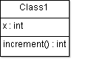
Instance & Class Methods
Instance methods operate on this object's instance variables.
  They also have read & write access to class variables.
Class methods are static.
  Class methods cannot access instance variables.
  Class methods are handled by the “class object” – they can be called even if there are no instances of this class.
  (Example on the next slide.)
public class Class1 {
private int x;
public int increment() {
++x;
}
}

Slide 5
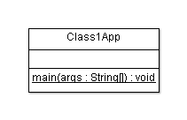
Class1App
public class Class1App {
public static void main( String[] args ) {
Class1 x = new Class1();
System.out.println(
"Without initialisation, ++x = "
+ x.increment()
);
System.out.println(
"After another incrementation, ++x = "
+ x.increment()
);
}
}

Slide 6
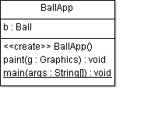
BallApp
import java.awt.*;
import java.awt.event.*;
public class BallApp extends Frame{
Ball b = new Ball( 20, 30, Color.blue );
public BallApp() {
addWindowListener(
new WindowAdapter() {
public void windowClosing(
WindowEvent e
) {
System.exit( 0 );
}
}
);
setSize( 300, 200 );
setVisible( true );
}
public void paint(Graphics g) {
b.paint( g );
}
public static void main(
String[] args
) {
new BallApp();
}
}

Slide 7
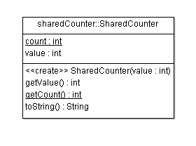
public class SharedCounter {
private static int count;
private int value;
public SharedCounter(int value) {
this.value = value;
count++;
}
public int getValue() {
return value;
}
public static int getCount() {
return count;
}
public String toString() {
return "value=" + value + " count=" + count;
}
}
: Class
name = “SharedCounter”
count = 0 1 2
: Class
name = “SharedCounter”
count = 0
: Class
name = “SharedCounter” count = 0 1 2 3
: Class
name = “SharedCounter”
count = 0 1
c1: SharedCounter
value = 10
c2: SharedCounter
value = 100
public static void main(String[] args) {
SharedCounter c1 = new SharedCounter(10);
SharedCounter c2 = new SharedCounter(100);
SharedCounter c3 = new SharedCounter(200);
System.out.println(c1 + " " + c2 + " " + c3);
}
c3: SharedCounter
value = 200

Slide 8
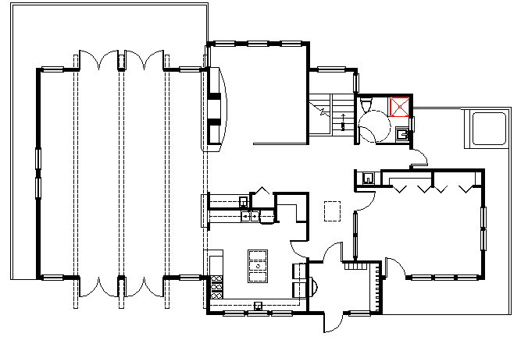
UML
Unified Modeling Language (UML)
  When creating complex OO systems, where do we start?
  When building complex systems, it might be worthwhile to plan things out before you start coding!
    When building a house, we usually have a set of plans.
UML is a language which allows us to graphically model an OO system in a standardised format.
  This helps us (and others!) understand the system.
There are many different UML diagrams, allowing us to model designs from many different viewpoints. Roughly, there are
  Structure diagrams (documenting the architecture), e.g. class diagrams
  Behaviour diagrams (documenting the functionality), e.g. use-case diagrams

Slide 9
Object Diagrams in UML
  In this lecture, I have drawn some object diagrams of instance models (using coloured boxes).
    An object diagram is a graphic representation of an instance model, showing the state of a system after some objects have been instantiated, and after some variables of these objects have been updated.
    Object diagrams are very helpful in tuition, but are not commonly used outside the classroom.
  Please focus on the basics.
    Understand the distinction between static variables and instance variables.
    Develop a working understanding of instantation – this is a crucial concept!
    Learn how to draw UML-standard class diagrams.
    Honours-level students might want to learn more about object diagrams. I recommend “Modelling instances of classifiers using UML object diagrams”, online Help resource for the IBM Rational Software Modeler, available 4 March 2014.

Slide 10
Tool Support: Eclipse & ArgoUML?
You may use any development environment for this class. I recommend…
  Eclipse
    The de-facto industry standard for Java developers. It’s FOSS: free and open-source software. Its codebase is robust and is under active development. Your tutors will help you learn this.
  DrJava
    Learning resources are available in COMPSCI 101 & 105 webareas.
  javac and a customisable text editor such as emacs
    I reckon every Java developer should know how to run javac from a console, but I won’t attempt to teach this!)
You’ll also have to draw some class diagrams and use-case diagrams. Options:
  By hand: during exams and tests, and maybe your best choice for homework
  ArgoUML
    FOSS, works ok (with some missing features e.g. no “undo” button – save your versions carefully!!)
    No longer under active development: v0.34 is dated 15 December 2011.
    No integration with current versions of Eclipse.
    I don’t know of any FOSS, nor of any inexpensive software package, which does a better job of forward- and reverse-engineering between UML and Java, and which supports both class and use-case diagrams.
  A general-purpose drawing package
    Warning: you’ll have trouble with the fancy arrowheads in UML!

Slide 11
Review
The OO approach is based on modeling the real world using interacting objects.
  OO design is a process of determining what the stakeholders require, designing a set of classes with objects which will meet these requirements, implementing, and delivering.
The statements in a class define what its objects remember and what they can do (the messages they can understand), that is, they define
  Instance variables, class variables, instance methods, and class methods
The hardest concept in this set of lecture slides: instantiation.
  Very important!
A UML class diagram shows the “bare bones” of an OO system design.
  It need not show all classes! (A diagram should not have irrelevant information.)

