Slide 1
Lecture 1
Introduction to Software Construction

Slide 2
Introducing myself
Dr. Saqib Iqbal
  PhD, Software Engineering
          University of Huddersfield, Huddersfield, UK
  MSc. Software Engineering
          Queen Mary University of London, UK
  MSc. Computer Science
          Punjab University, Lahore, Pakistan
  B.Sc. Mathematics & Physics
          Government College Lahore, Pakistan

Slide 3
Overview
In earlier courses, you learned how to write programs to solve small problems.
  In this course we teach programming “in the large”.
Large software systems have many stakeholders.
  What will its users want?
  Can we describe user requirements, accurately and succinctly?
Large software systems are very complex.
  Can we describe the design of a complex software system, accurately and succinctly?
  Can we be sure that a complex system will do what it is designed to do, and that it will not do anything unintended?
In this course you will learn some incomplete answers to these difficult questions.
  I will also attempt to teach you how to “learn how to learn” the technical skills you will need in the future – as a competent computer professional.

Slide 4
Syllabus
Four Themes:
  The object-oriented programming paradigm
    Object-orientation, object-oriented programming concepts and programming language constructs – because, for many important problems, OO design is a convenient way to express the problem and its solution in software.
  Frameworks
    Inversion of control, AWT/Swing and JUnit – because many important “sub-problems” have already been solved: these solutions should be re-used!
  Software quality
    Testing, inspection, documentation – because large teams are designing, implementing, debugging, maintaining, revising, and supporting complex software.
  Application-level concurrent programming
    Multithreading concepts, language primitives and abstractions – because even our laptops have multiple CPUs. Dual-core smartphones are now available...

Slide 5
Agenda & Reading
Topics:
  Review (or learn for the first time?)
    What is Object-Oriented Programming?
    Classes & Objects
    Variables & Methods
  Introduction to OO Design
    A process of determining what the stakeholders require, designing a set of classes with objects which will meet these requirements, implementing, and delivering.
    Structure Diagrams: high-level design
    Use Cases: high-level requirements
    Other concerns: implementation, quality assurance

Slide 6
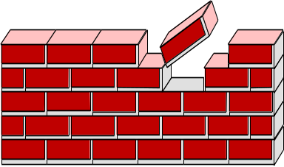
Software Design
Communication:
  identify stakeholders, find out what they want and need.
Planning:
  list tasks, identify risks, obtain resources, define milestones, estimate schedule.
Modeling:
  develop structure diagrams and use cases, maybe some other UML artifacts.
Construction:
  implement the software, with assured quality.
Deployment:
  deliver the software, then get feedback for possible revision.
To learn more:
  R. Pressman, Software Engineering: A Practitioner’s Approach, 7th Ed., 2010, pp. 14-15.

Slide 7
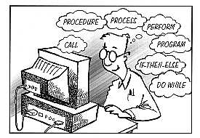
What is Object-Oriented Design?
In OO design, a system is a
  collection of interacting objects.
  Each object should have simple attributes and behaviours.
  Each object should have simple relations to other objects.
In procedural design, a system is a
  collection of basic blocks.
  Each basic block should have a simple effect on local and global variables.
  Basic blocks are linked by control-flow arcs: if/then/else, call/return, while/loop, for/loop, case, goto, …
In data architecture, a system is a
  collection of data structures, with access and update methods.
  Each data structure should have simple relations to other data structures.
Program
object 2
object 1
object 3
object 4

Slide 8







What is an Object?
A building block for OO development
  Like objects in the world around us
  Objects have state and behaviour
Examples:
  Dog
    State/field/attribute: name, colour, isHungry, …
    Behaviour: bark(), fetch(), eat(), …
  Bicycle
    State: gear, colour, …
    Behaviour: brake(), turn(), changeGear(), …
  VCR
    State: brand, colour, isOn …
    Behaviour: play(), stop(), rewind(), turnOn(), …

Slide 9



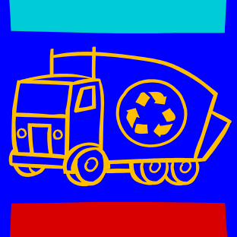

Classes & Objects
Class
  A set of objects with shared behaviour and individual state
  Individual state:
    Data is stored with each instance, as an instance variable.
  Shared behaviour:
    Code is stored with the class object, as a method.
  Shared state may be stored with the class object, as a class variable.
Object
  Objects are created from classes at runtime by instantiation
    usually with New.
  There may be zero, one, or many objects (instances) of a class.
  Instantiated objects are garbage-collected if no other
  user-defined object can reference them.

Slide 10
Imagine a world of communicating objects
Object
  An object remembers things (i.e. it has a memory): its state.
  An object responds to messages it gets from other objects.
    It performs the method with the given parameters, then sends a response.
    An object that receives a strange message may throw an exception. Be careful!
  An object’s method may “ask for help” from other objects.
    It sends a message to an object, and waits for a response.
    A method may send a message to itself! This is called recursion. Be careful.
Messages between objects
  Usually: method calls and method returns, sometimes exceptions.

Slide 11
Information Hiding
The implementation details of a method should be of no concern to the sender of the message.
  If a JavaKid tells a JavaDog to fetch(), the dog might run across a busy street during its fetch().
  Parameterised methods allow the senders to have more control over object behaviour. For example, a JavaDog might have a parameterised fetch() method:
  ball = dog.fetch(SAFELY);
Note: in these lecture slides, the word “should” indicates an element of style.
  You should write Java code that is understandable to other Java programmers.

Slide 12
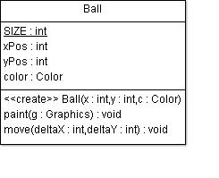

Example 1: Ball
Attributes
  Represent the internal state of an instance of this class.
Constructor
  Creates the object
Methods
  Implement the processing performed by or to an object, often updating its state.
  If there are read and write methods for an attribute x, these should be called getX() and setX().
    You should learn Java’s conventions for capitalisation and naming.
Example: Ball.java
public class Ball
{
public final static int SIZE = 20;
private int xPos;
private int yPos;
private Color color;
public Ball(int x, int y, Color c) {
xPos = x;
yPos = y;
color = c;
}
public void move(int deltaX, int deltaY) {
xPos += deltaX;
yPos += deltaY;
}
public void paint(Graphics g) {
g.setColor(color);
g.fillOval(xPos,yPos,SIZE,SIZE);
}
}

Slide 13
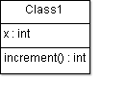
Object Instantiation
When a constructor method is called, a new instance is created.
If a class definition doesn’t include a constructor method, the Java compiler inserts a default constructor with default initialisations.
Ball b = new Ball( 10, 20, Color.Red );
Ball c = new Ball( 0, 10, Color.Blue );
b: Ball
xPos = 10
yPos = 20
Color = Red
c: Ball
xPos = 0
yPos = 10
Color = Blue
public class Class1 {
private int x;
// Note no explicit constructor
public int increment() {
++x;
}
}
Class1 d = new Class1();
d: Class1
x = 0
// is this good code?

