Slide 1
Requirement Engineering

Slide 2
Recap
Flow Based Modeling
  DFDs
  CFDs
  Processing narratives
Class-based Model
  How to select classes?
  How to find attributes and operations of a class?
  CRC modeling

Slide 3
Outline
Elaboration
  Behavioral Modeling
Negotiation
Specification
Validation
Requirements management

Slide 4
Behavioral Modeling

Slide 5
Creating a Behavioral Model
Identify events found within the use cases and implied by the attributes in the class diagrams
Build a state diagram for each class, and if useful, for the whole software system

Slide 6
Identifying Events in Use Cases
An event occurs whenever an actor and the system exchange information
An event is NOT the information that is exchanged, but rather the fact that information has been exchanged
Some events have an explicit impact on the flow of control, while others do not
  An example is the reading of a data item from the user versus comparing the data item to some possible value

Slide 7
Building a State Diagram
A state is represented by a rounded rectangle
A transition (i.e., event) is represented by a labeled arrow leading from one state to another
  Syntax: trigger-signature [guard]/activity
The active state of an object indicates the current overall status of the object as is goes through transformation or processing
  A state name represents one of the possible active states of an object
The passive state of an object is the current value of all of an object's attributes
  A guard in a transition may contain the checking of the passive state of an object

Slide 8
Identifying Events
A use-case is examined for points of information exchange.
The homeowner uses the keypad to key in a four-digit password. The password is compared with the valid password stored in the system. If the password in incorrect, the control panel will beep once and reset itself for additional input. If the password is correct, the control panel awaits further action.

Slide 9
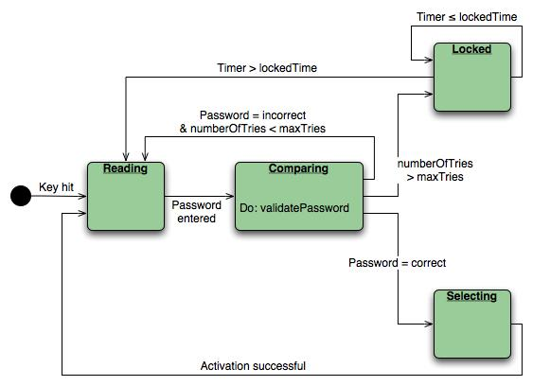
State Diagram
State diagram for the ControlPanel class

Slide 10
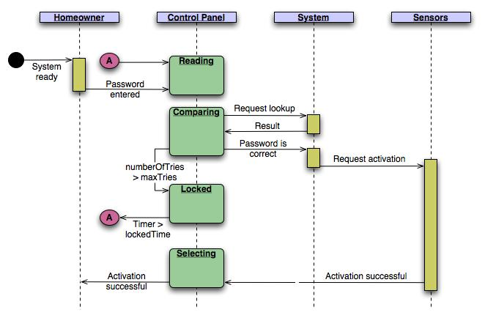
Sequence Diagram
Sequence diagram (partial) for the SafeHome security function

Slide 11
Inception
Elicitation
Elaboration
Negotiation
Specification
Validation
Requirements
Management

Slide 12
Negotiation Task
During negotiation, the software engineer reconciles the conflicts between what the customer wants and what can be achieved given limited business resources
Requirements are ranked (i.e., prioritized) by the customers, users, and other stakeholders
Risks associated with each requirement are identified and analyzed
Rough guesses of development effort are made and used to assess the impact of each requirement on project cost and delivery time
Using an iterative approach, requirements are eliminated, combined and/or modified so that each party achieves some measure of satisfaction

Slide 13
The Art of Negotiation
Recognize that it is not competition
Map out a strategy
Listen actively
Focus on the other party’s interests
Don’t let it get personal
Be creative
Be ready to commit

Slide 14
Inception
Elicitation
Elaboration
Negotiation
Specification
Validation
Requirements
Management

