Slide 1
Requirement Engineering
Lecture 7

Slide 2
Review
Analysis Modeling
  Structured analysis
  Object oriented analysis
Object Oriented Analysis
  Scenario Based Modeling (Use Cases, Swim lane Diagrams, Activity Diagrams)

Slide 3
Contents
Flow Oriented Modeling
Class Based Modeling

Slide 4
Flow-Oriented Modeling

Slide 5
Guidelines
Depict the system as single bubble in level 0.
Carefully note primary input and output.
Refine by isolating candidate processes and their associated data objects and data stores.
Label all elements with meaningful names.
Maintain information conformity between levels.
Refine one bubble at a time.

Slide 6
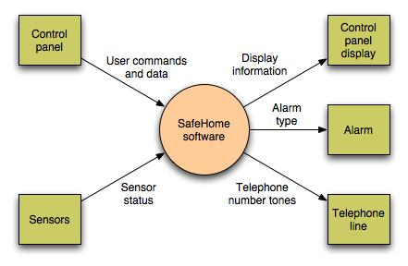
Data Flow Diagram
Context-level DFD for SafeHome security function

Slide 7
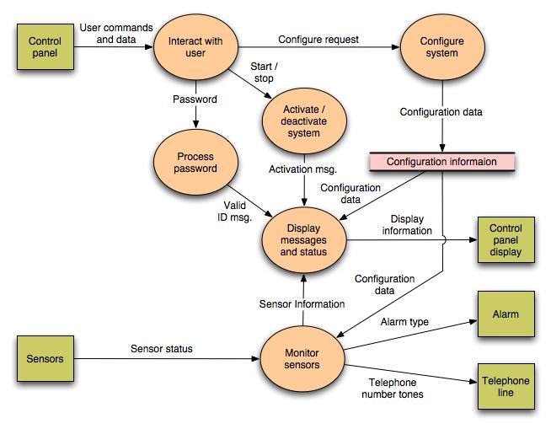

Slide 8
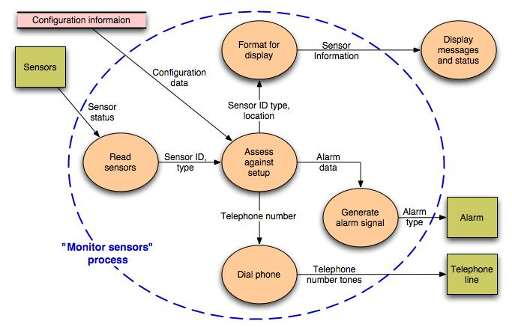
Level 2 DFD that refines the monitor sensors process

Slide 9
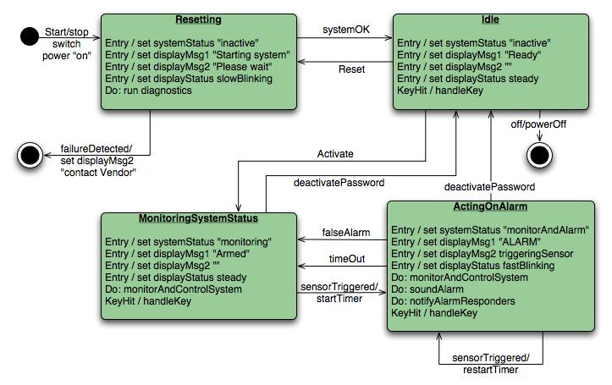
Control Flow Diagram
State diagram for SafeHome security function

Slide 10
Processing narrative
The SafeHome security function enables the homeowner to configure the security system when it is installed, monitors all sensors connected to the security system, and interacts with the homeowner through the Internet, a PC, or a control panel.
During installation, the SafeHome PC is used to program and configure the system. Each sensor is assigned a number and type, a master password is programmed for arming and disarming the system, and telephone number(s) are input for dialing when a sensor event occurs.
When a sensor event is recognized, the software invokes an audible alarm attached to the system. After a delay time that is specified by the homeowner during system configuration activities, the software dials a telephone number of a monitoring service, provides information about the location, reporting the nature of the event that has been detected. The telephone number will be redialed every 20 seconds until a telephone connection is obtained.
The homeowner receives security information via a control panel, the PC, or a browser, collectively called an interface. The interface displays prompting messages and system status information on the control panel, the PC, or the browser window. Homeowner interaction takes the following form…

Slide 11
Class-based Modeling

Slide 12
Identifying Analysis Classes
Perform a grammatical parse of the problem statement or use cases
Classes are determined by underlining each noun or noun clause
A class required to implement a solution is part of the solution space
A class necessary only to describe a solution is part of the problem space
A class should NOT have an imperative procedural name (i.e., a verb)
List the potential class names in a table and "classify" each class according to some taxonomy and class selection characteristics
A potential class should satisfy nearly all (or all) of the selection characteristics to be considered a legitimate problem domain class
Potential classes | General classification | Selection Characteristics
(More on next slide)

Slide 13
Grammatical Parse
The SafeHome security function enables the homeowner to configure the security system when it is installed, monitors all sensors connected to the security system, and interacts with the homeowner through the Internet, a PC, or a control panel.
During installation, the SafeHome PC is used to program and configure the system. Each sensor is assigned a number and type, a master password is programmed for arming and disarming the system, and telephone number(s) are input for dialing when a sensor event occurs.
When a sensor event is recognized, the software invokes an audible alarm attached to the system. After a delay time that is specified by the homeowner during system configuration activities, the software dials a telephone number of a monitoring service, provides information about the location, reporting the nature of the event that has been detected. The telephone number will be redialed every 20 seconds until a telephone connection is obtained.
The homeowner receives security information via a control panel, the PC, or a browser, collectively called an interface. The interface displays prompting messages and system status information on the control panel, the PC, or the browser window. Homeowner interaction takes the following form…

Slide 14
Grammatical Parse
The SafeHome security function enables the homeowner to configure the security system when it is installed, monitors all sensors connected to the security system, and interacts with the homeowner through the Internet, a PC, or a control panel.
During installation, the SafeHome PC is used to program and configure the system. Each sensor is assigned a number and type, a master password is programmed for arming and disarming the system, and telephone number(s) are input for dialing when a sensor event occurs.
When a sensor event is recognized, the software invokes an audible alarm attached to the system. After a delay time that is specified by the homeowner during system configuration activities, the software dials a telephone number of a monitoring service, provides information about the location, reporting the nature of the event that has been detected. The telephone number will be redialed every 20 seconds until a telephone connection is obtained.
The homeowner receives security information via a control panel, the PC, or a browser, collectively called an interface. The interface displays prompting messages and system status information on the control panel, the PC, or the browser window. Homeowner interaction takes the following form…

Slide 15
Identifying Analysis Classes
(continued)
General classifications for a potential class
  External entity (e.g., another system, a device, a person)
  Thing (e.g., report, screen display)
  Occurrence or event (e.g., movement, completion)
  Role (e.g., manager, engineer, salesperson)
  Organizational unit (e.g., division, group, team)
  Place (e.g., manufacturing floor, loading dock)
  Structure (e.g., sensor, vehicle, computer)
(More on next slide)

Slide 16
Class Selection Criteria
Retained information
Needed services
Multiple attributes
Common attributes
Common operations
Essential requirements

Slide 17
Identifying Classes
Potential class | Classification | Accept / Reject
homeowner | role; external entity | reject: 1, 2 fail
sensor | external entity | accept
control panel | external entity | accept
installation | occurrence | reject
(security) system | thing | accept
number, type | not objects, attributes | reject: 3 fails
master password | thing | reject: 3 fails
telephone number | thing | reject: 3 fails
sensor event | occurrence | accept
audible alarm | external entity | accept: 1 fails
monitoring service | organizational unit; ee | reject: 1, 2 fail

Slide 18
Defining Attributes of a Class
Attributes of a class are those nouns from the grammatical parse that reasonably belong to a class
Attributes hold the values that describe the current properties or state of a class
An attribute may also appear initially as a potential class that is later rejected because of the class selection criteria
In identifying attributes, the following question should be answered
  What data items (composite and/or elementary) will fully define a specific class in the context of the problem at hand?
Usually an item is not an attribute if more than one of them is to be associated with a class

Slide 19
Defining Operations of a Class
Operations define the behavior of an object
Four categories of operations
  Operations that manipulate data in some way to change the state of an object (e.g., add, delete, modify)
  Operations that perform a computation
  Operations that inquire about the state of an object
  Operations that monitor an object for the occurrence of a controlling event
An operation has knowledge about the state of a class and the nature of its associations
The action performed by an operation is based on the current values of the attributes of a class
Using a grammatical parse again, circle the verbs; then select the verbs that relate to the problem domain classes that were previously identified

Slide 20
Identifying operations
The SafeHome security function enables the homeowner to configure the security system when it is installed, monitors all sensors connected to the security system, and interacts with the homeowner through the Internet, a PC, or a control panel.
During installation, the SafeHome PC is used to program and configure the system. Each sensor is assigned a number and type, a master password is programmed for arming and disarming the system, and telephone number(s) are input for dialing when a sensor event occurs.
When a sensor event is recognized, the software invokes an audible alarm attached to the system. After a delay time that is specified by the homeowner during system configuration activities, the software dials a telephone number of a monitoring service, provides information about the location, reporting the nature of the event that has been detected. The telephone number will be redialed every 20 seconds until a telephone connection is obtained.
The homeowner receives security information via a control panel, the PC, or a browser, collectively called an interface. The interface displays prompting messages and system status information on the control panel, the PC, or the browser window. Homeowner interaction takes the following form…

Slide 21
Identifying operations
The SafeHome security function enables the homeowner to configure the security system when it is installed, monitors all sensors connected to the security system, and interacts with the homeowner through the Internet, a PC, or a control panel.
During installation, the SafeHome PC is used to program and configure the system. Each sensor is assigned a number and type, a master password is programmed for arming and disarming the system, and telephone number(s) are input for dialing when a sensor event occurs.
When a sensor event is recognized, the software invokes an audible alarm attached to the system. After a delay time that is specified by the homeowner during system configuration activities, the software dials a telephone number of a monitoring service, provides information about the location, reporting the nature of the event that has been detected. The telephone number will be redialed every 20 seconds until a telephone connection is obtained.
The homeowner receives security information via a control panel, the PC, or a browser, collectively called an interface. The interface displays prompting messages and system status information on the control panel, the PC, or the browser window. Homeowner interaction takes the following form…

Slide 22
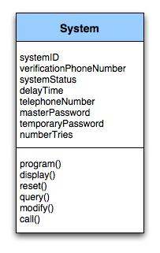
Class Diagram
Class diagram for the system class

Slide 23
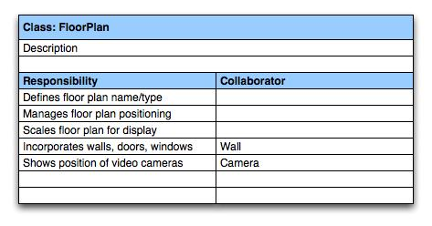
CRC Modeling
A CRC model index card for FloorPlan class

Slide 24
Example Class Box
Class Name
Component
+ componentID
- telephoneNumber
- componentStatus
- delayTime
- masterPassword
- numberOfTries
Attributes
+ program()
+ display()
+ reset()
+ query()
- modify()
+ call()
Operations

Slide 25
Summary
Flow Based Modeling
  DFDs
  CFDs
  Processing narratives
Class-based Model
  How to select classes?
  How to find attributes and operations of a class?
  CRC modeling

Slide 26
Behavioral Modeling

Slide 27
Creating a Behavioral Model
Identify events found within the use cases and implied by the attributes in the class diagrams
Build a state diagram for each class, and if useful, for the whole software system

Slide 28
Identifying Events in Use Cases
An event occurs whenever an actor and the system exchange information
An event is NOT the information that is exchanged, but rather the fact that information has been exchanged
Some events have an explicit impact on the flow of control, while others do not
  An example is the reading of a data item from the user versus comparing the data item to some possible value

Slide 29
Building a State Diagram
A state is represented by a rounded rectangle
A transition (i.e., event) is represented by a labeled arrow leading from one state to another
  Syntax: trigger-signature [guard]/activity
The active state of an object indicates the current overall status of the object as is goes through transformation or processing
  A state name represents one of the possible active states of an object
The passive state of an object is the current value of all of an object's attributes
  A guard in a transition may contain the checking of the passive state of an object

Slide 30
Identifying Events
A use-case is examined for points of information exchange.
The homeowner uses the keypad to key in a four-digit password. The password is compared with the valid password stored in the system. If the password in incorrect, the control panel will beep once and reset itself for additional input. If the password is correct, the control panel awaits further action.

Slide 31
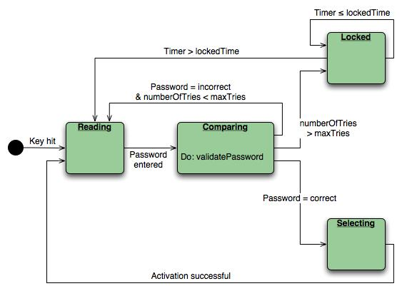
State Diagram
State diagram for the ControlPanel class

Slide 32
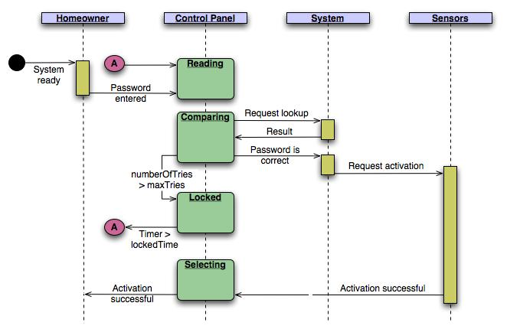
Sequence Diagram
Sequence diagram (partial) for the SafeHome security function

Slide 33
Inception
Elicitation
Elaboration
Negotiation
Specification
Validation
Requirements
Management

Slide 34
Negotiation Task
During negotiation, the software engineer reconciles the conflicts between what the customer wants and what can be achieved given limited business resources
Requirements are ranked (i.e., prioritized) by the customers, users, and other stakeholders
Risks associated with each requirement are identified and analyzed
Rough guesses of development effort are made and used to assess the impact of each requirement on project cost and delivery time
Using an iterative approach, requirements are eliminated, combined and/or modified so that each party achieves some measure of satisfaction

Slide 35
The Art of Negotiation
Recognize that it is not competition
Map out a strategy
Listen actively
Focus on the other party’s interests
Don’t let it get personal
Be creative
Be ready to commit

Slide 36
Inception
Elicitation
Elaboration
Negotiation
Specification
Validation
Requirements
Management

Slide 37
Specification Task
A specification is the final work product produced by the requirements engineer
It is normally in the form of a software requirements specification
It serves as the foundation for subsequent software engineering activities
It describes the function and performance of a computer-based system and the constraints that will govern its development
It formalizes the informational, functional, and behavioral requirements of the proposed software in both a graphical and textual format

Slide 38
Typical Contents of a Software Requirements Specification
Requirements
  Required states and modes
  Software requirements grouped by capabilities (i.e., functions, objects)
  Software external interface requirements
  Software internal interface requirements
  Software internal data requirements
  Other software requirements (safety, security, privacy, environment, hardware, software, communications, quality, personnel, training, logistics, etc.)
  Design and implementation constraints
Qualification provisions to ensure each requirement has been met
  Demonstration, test, analysis, inspection, etc.
Requirements traceability
  Trace back to the system or subsystem where each requirement applies

Slide 39
Software Requirements Specification (SRS) template
TABLE OF CONTENTS
1.0 Introduction
  1.1 Purpose
  1.2 Scope
  1.3 Definitions, Acronyms, and Abbreviations
  1.4 References
  1.5 Overview
2.0 General Description
  2.1 Product Perspective
  2.2 Product Functions
  2.3 User Characteristics
  2.4 General Constraints
  2.5 Assumptions and Dependencies

Slide 40
SRS template
3.0 Specific Requirements
  3.1 Functional Requirements
    3.1.1 Unit Registration
    3.1.2 Retrieving and Displaying Unit Information
    3.1.3 Report Generation
    3.1.4 Data Entry
  3.2 Design Constraints
  3.3 Non-Functional Requirements
    3.3.1 Security
Appendix A

Slide 41
SRS explained
1.0 INTRODUCTION
  This document specifies all the requirements for
  1.1 Purpose
    The purpose of the …is to ….
    The system should assist ….
    The intended audience for this document is …
    This specification describes …..
  1.2 Scope
    This document applies only to …...
    This specification is not concerned with …..

Slide 42
SRS explained
  1.3 Definitions, Acronyms, and Abbreviations
    SRS - Software Requirements Specifications
    IEEE - Institute of Electrical and Electronic Engineering
  1.4 Reference
    [1] IEEE 830-1993: IEEE Recommended Practice for Software Requirements Specifications" IEEE Standards Collection, IEEE, 1997.
  1.5 Overview
    In the following sections of this specification……will be presented.
    In Section 2, the general product and its functions will be introduced.

Slide 43
SRS explained
  In Section 3, all detailed requirements will be specified and grouped.
  In Appendix …….
2.0 GENERAL DESCRIPTION
  2.1 Product Perspective
    This system allows stakeholders to…..
    The system will display…..
    The system will help ……
    The system provides information about ….
  2.2 Product Functions
    The system provides the following functions:

Slide 44
SRS explained
  2.3 User Characteristics
  The users of the system are:
    Level of Users’ Computer Knowledge
    Level of Users’ Business Knowledge
    Frequency of Use
  2.4 General Constraints
    The system will support ….
    The system will not allow ……
  2.5 Assumption and Dependencies
    This system relies on ……
    The system must have a satisfactory interface and ……

Slide 45
Section 3 of SRS
3 SPECIFIC REQUIREMENTS
  3.1 Functional Requirements
    3.1.1 Unit Registration
      The unit registration requirements are concerned with functions regarding unit registration which includes students selecting, adding, dropping, and changing a unit.
      SRS-001 (3.1.1.1):
      The system shall allow the user to register a unit.
      SRS-002 (3.1.1.2):
      STS shall allow the user to delete a unit if the user has chosen to drop that unit.
      SRS-003 (3.1.1.3):
      STS shall check if a unit has been filled by enough registered students.

Slide 46
SRS functional egs
      SRS-004 (3.1.1.4):
      STS shall allow the user to add his/her name to the unit waiting list if the user wants to register in a unit which has been filled already with enough registered students.
      SRS-005 (3.1.1.5):
      STS shall automatically register the unit for the user who is the first one on the waiting list if a vacancy appears for that unit.
      SRS-006 (3.1.1.6):
      STS shall allow the user to change practical session(s) within a unit.
      SRS-007 (3.1.1.7):
      STS shall allow the user to change tutorial session(s) within a unit.

Slide 47
Functional parent reqs broken into many child-reqs.
    3.1.2 Retrieving and Displaying Unit Information
    The retrieving and displaying requirements are concerned with how information is retrieved and presented to the user.
      SRS-014 (3.1.2.1):
      The system shall allow users to enter the following selection criteria to retrieve unit information: by unit code, by unit number, by title of unit, by weight of unit (credit points).
      OR by unit code (3.1.2.1.1) , by unit number (3.1.2.1.2) , by title of unit (3.1.2.1.3) , by weight of unit (credit points) (3.1.2.1.4).

Slide 48
Design Constraints (3.2)
  3.2 Design Constraints
    SRS-031 (3.2.1):
    STS shall store and retrieve persistent data.
    SRS-032 (3.2.2):
    STS shall support PC and/or UNIX platforms.
    SRS-033 (3.2.3):
    STS shall be developed using the JAVA programming language

Slide 49
Non-functional requirements
  3.3 Non-Functional Requirements
    SRS-034 (3.3.1):
    STS shall respond to any retrieval in less than 5 seconds.
    SRS-035 (3.3.2):
    STS shall generate a report within 1 minute.
    SRS-036 (3.3.3):
    STS shall allow the user to remotely connect to the system.
    SRS-041 (3.3.8):
    The system will be accompanied by a comprehensive user manual.

Slide 50
Safety and security issues
  3.5.3 Security
  The security requirements are concerned with security and privacy issues.
SRS-029:
VSS shall provide staff ID and password verification protection to protect from unauthorised use of the system.
SRS-030:
VSS shall allow the store manager to add, remove and modify staff ID and passwords as required.

Slide 51
Other SRS template for section 3
3. Specific Requirements
  3.1 External Interface Requirements
    3.1.1 User Interfaces
    3.1.2 Hardware Interfaces
    3.1.3 Software Interfaces
    3.1.4 Communication Interfaces
  3.2 Functional Requirements
    3.2.1 Requirement 1
      3.2.1.1 Introduction
      3.2.1.2 Inputs
      3.2.1.3 Processing
      3.2.1.4 Outputs
    3.2.2 Requirement 2 …..

Slide 52
Other SRS template for section 3
  3.3 Performance Requirements
  3.4 Design Constraints
    3.4.1 Standards Compliance
    3.4.2 Hardware Limitations ……
  3.5 Software System Attributes
    3.5.1 Reliability
    3.5.2 Availability
    3.5.3 Security
    3.5.4 Maintainability
    3.5.5 Portability
    3.5.6 Reusability
    3.5.7 Usability 3.5.8 Other Factors …..
  3.6 Other Requirements
    3.6.1 Database
    3.6.2 Operations …..

Slide 53
Inception
Elicitation
Elaboration
Negotiation
Specification
Validation
Requirements
Management

Slide 54
Validation Task
During validation, the work products produced as a result of requirements engineering are assessed for quality
The specification is examined to ensure that
  all software requirements have been stated unambiguously
  inconsistencies, omissions, and errors have been detected and corrected
  the work products conform to the standards established for the process, the project, and the product
The formal technical review serves as the primary requirements validation mechanism
  Members include software engineers, customers, users, and other stakeholders

Slide 55
Questions to ask when Validating Requirements
Is each requirement consistent with the overall objective for the system/product?
Have all requirements been specified at the proper level of abstraction? That is, do some requirements provide a level of technical detail that is inappropriate at this stage?
Is the requirement really necessary or does it represent an add-on feature that may not be essential to the objective of the system?
Is each requirement bounded and unambiguous?
Does each requirement have attribution? That is, is a source (generally, a specific individual) noted for each requirement?
(more on next slide)

Slide 56
Questions to ask when Validating Requirements (continued)
Do any requirements conflict with other requirements?
Is each requirement achievable in the technical environment that will house the system or product?
Is each requirement testable, once implemented?
  Approaches: Demonstration, actual test, analysis, or inspection
Does the requirements model properly reflect the information, function, and behavior of the system to be built?
Has the requirements model been “partitioned” in a way that exposes progressively more detailed information about the system?

Slide 57
Inception
Elicitation
Elaboration
Negotiation
Specification
Validation
Requirements
Management

Slide 58
Requirements Management Task
During requirements management, the project team performs a set of activities to identify, control, and track requirements and changes to the requirements at any time as the project proceeds
Each requirement is assigned a unique identifier
The requirements are then placed into one or more traceability tables
These tables may be stored in a database that relate features, sources, dependencies, subsystems, and interfaces to the requirements
A requirements traceability table is also placed at the end of the software requirements specification

Slide 59
Summary
Inception
Elicitation
Elaboration
Negotiation
Specification
Validation
Requirements
Management
☺

