Slide 1
Software Quality Assurance (SQA)

Slide 2
Recap
SQA goal, attributes and metrics
SQA plan
Formal Technical Review (FTR)
Statistical SQA
  Six Sigma
  Identifying vital few causes
  Review efficiency

Slide 3
Effectiveness of Review
Development step
Defects
Detection
Errors passed through
Percent efficiency for error detection
Errors from previous steps
Errors passed to next step
Amplified errors 1:x
Newly identified errors

Slide 4
Example

Slide 5
Example

Slide 6
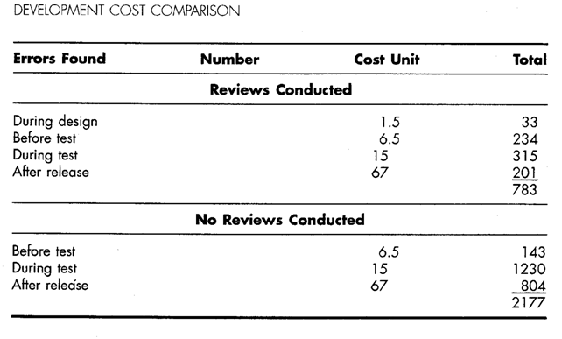
Cost of correcting errors

Slide 7
Review metrics and their use
Many metrics can be defined for technical reviews
The following can be calculated for each review conducted:
  Preparation effort (E_{p})
  Assessment effort (E_{a})
  Rework effort (E_{r})
  Work product size (WPS)
  Minor errors found (Err_{minor})
  Major errors found (Err_{major})

Slide 8
Analyzing review metrics
Total review effort (E_{review})
  E_{review} = E_{p} + E_{a} + E_{r}
Total number of errors (Err_{tot})
  Err_{tot} = Err_{minor} + Err_{major}
Error density represents the errors found per unit of work product reviewed
  Error density = Err_{tot} / WPS
Cost effectiveness of reviews
  Effort saved per error = E_{testing} – E_{reviews}

Slide 9
Software reliability
Defined as the probability of failure free operation of a computer program in a specified environment for a specified time.
Can be measured directly and estimated using historical and developmental data (unlike many other software quality factors)
Software reliability problems can usually be traced back to errors in design or implementation.
Reliability metrics are units of measure for system reliability
System reliability is measured by counting the number of operational failures and relating these to demands made on the system at the time of failure
A long-term measurement program is required to assess the reliability of critical systems

Slide 10
Measuring S/W reliability
A measure of software reliability is mean time between failures where
MTBF = MTTF + MTTR
MTTF = mean time to failure
MTTR = mean time to repair
Availability =MTTF/(MTTF + MTTR) * 100%
Software availability is the probability that a program is operating according to requirements at a given point in time

Slide 11
Software reliability -- Software safety
Processes that help reduce the probability that critical failures will occur due to SW
Hazard analyses
  Identify hazards that could call failure
  Develop fault tree
  Identify all possible causes of the hazard
  Formally review the remedy for each
Redundancy
Require a written software safety plan
Require independent verification & validation

Slide 12
Example Fault Tree -- Thermal
Loss of heat
...
Power failure
Computer failure
Incorrect
input
SW failed to throw switch
Computer failure
SW failed to throw switch
...
Logic reversed

Slide 13
Software Safety
Redundancy
  Replicated at the hardware level
  Similar vs.. dis-similar redundancy
Verification
  Assuring that the software specifications are met
Validation
  Assuring that the product functions as desired
Independence

Slide 14
ISO 9000 Quality Standards
ISO 9000 describes QA elements in generic terms
  Elements include organizational structure, procedures, processes and resources.
It treats an enterprise as a network of interconnected processes.
To be ISO-complaint processes should adhere to the standards described.
Ensures quality planning, quality control, quality assurance and quality improvement.
From S/W engineering view point: An international standard which provides broad guidance to software developers on how to Implement, maintain and improve a quality software system capable of ensuring high quality software
Consists of 20 requirements...
  Differs from country to country..
23

Slide 15
ISO 9001 … requirements
Management responsibility
Quality system
Contract review
Design Control
Document and data control
Purchasing
Control of customer supplied product
Product identification and traceability
Process control
Inspection and testing
Control of inspection, measuring and test equipment
Inspection and test status
Control of non-confirming product
Corrective and preventive action
Handling, storage, packaging, preservation and delivery
Control of quality records
Internal quality audits
Training
Servicing
Statistical techniques
25

Slide 16
Summary
SQA must be applied at each step
SQA might be complex
Software reviews are important SQA activities
Statistical SQA helps improve product quality and software process
SQA goal, attributes and metrics
SQA plan
Formal Technical Review (FTR)
Software Safety is essential for critical systems
ISO 9001 standardizes the SQA activities
27

