Slide 1
User interface design

Slide 2
Recap
User Interface
GUI Characteristics (Windows, Icons, Menus, Pointing, Graphics)
User Centered Design
User Interface Design Process
UI Design Principles
  User familiarity
  Consistency
  Minimal Surprise
  Recoverability
  User guidance
  User diversity
User System Interaction
  How users will interact with the software?
  How software will present information to the user?

Slide 3
Information presentation
Information presentation is concerned with presenting system information to system users
The information may be presented directly (e.g. text in a word processor) or may be transformed in some way for presentation (e.g. in some graphical form)

Slide 4
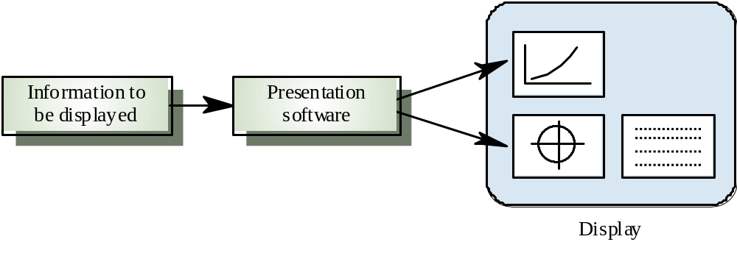
Information presentation

Slide 5
Information presentation
Static information
  Initialised at the beginning of a session. It does not change during the session
  May be either numeric or textual
Dynamic information
  Changes during a session and the changes must be communicated to the system user
  May be either numeric or textual

Slide 6
Information display factors
Is the user interested in precise information or
data relationships?
How quickly do information values change?
Must the change be indicated immediately?
Must the user take some action in response to
a change?
Is there a direct manipulation interface?
Is the information textual or numeric? Are relative values important?

Slide 7
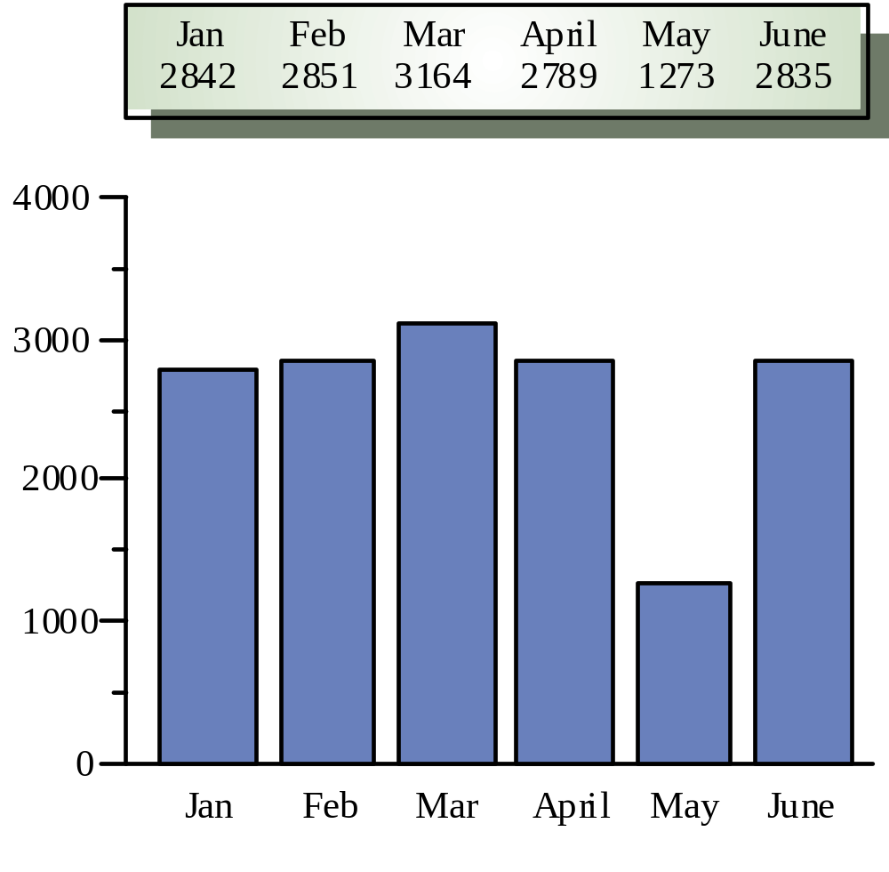
Alternative information presentations

Slide 8
Analogue vs. digital presentation
Digital presentation
  Compact - takes up little screen space
  Precise values can be communicated
Analogue presentation
  Easier to get an 'at a glance' impression of a value
  Possible to show relative values
  Easier to see exceptional data values

Slide 9
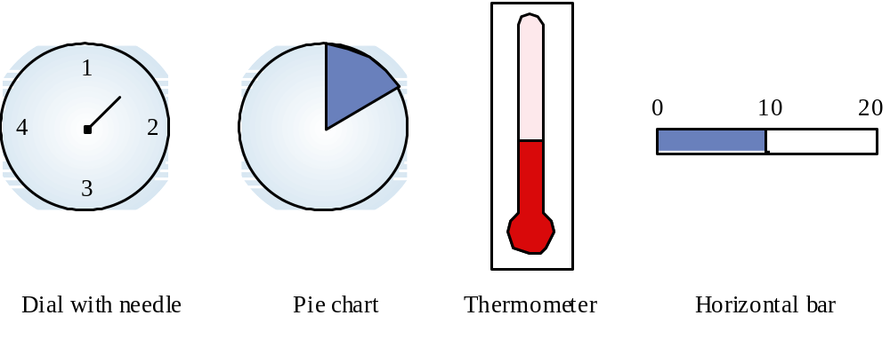
Dynamic information display

Slide 10
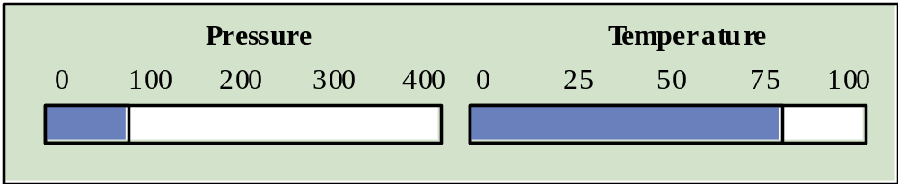
Displaying relative values

Slide 11
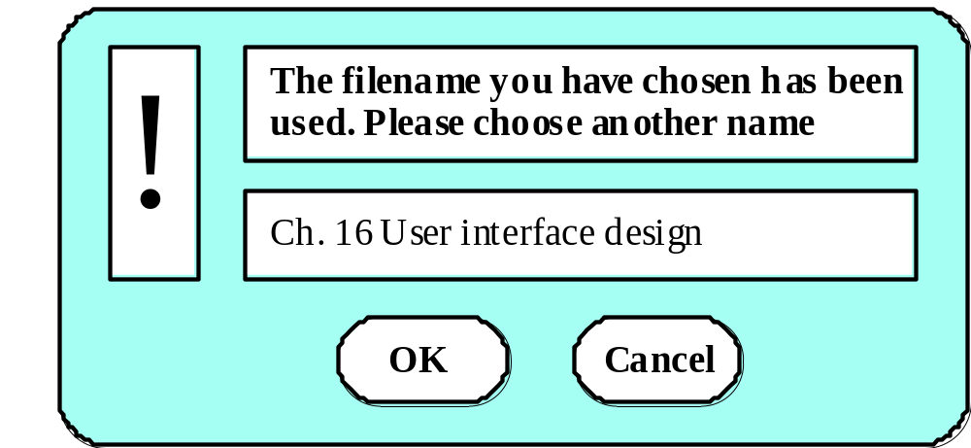
Textual highlighting

Slide 12
Data visualisation
Concerned with techniques for displaying large amounts of information
Visualisation can reveal relationships between entities and trends in the data
Possible data visualisations are:
  Weather information collected from a number of sources
  The state of a telephone network as a linked set of nodes
  Chemical plant visualised by showing pressures and temperatures in a linked set of tanks and pipes
  A model of a molecule displayed in 3 dimensions
  Web pages displayed as a hyperbolic tree

Slide 13
Colour displays
Colour adds an extra dimension to an interface
and can help the user understand complex
information structures
Can be used to highlight exceptional events
Common mistakes in the use of colour in
interface design include:
  The use of colour to communicate meaning
  Over-use of colour in the display

Slide 14
Colour use guidelines
Don't use too many colours
Use colour coding to support use tasks
Allow users to control colour coding
Design for monochrome then add colour
Use colour coding consistently
Avoid colour pairings which clash
Use colour change to show status change
Be aware that colour displays are usually lower
resolution

Slide 15
User support
User guidance covers all system facilities to support users including on-line help, error messages, manuals etc.
The user guidance system should be integrated with the user interface to help users when they need information about the system or when they make some kind of error
The help and message system should, if possible, be integrated

Slide 16
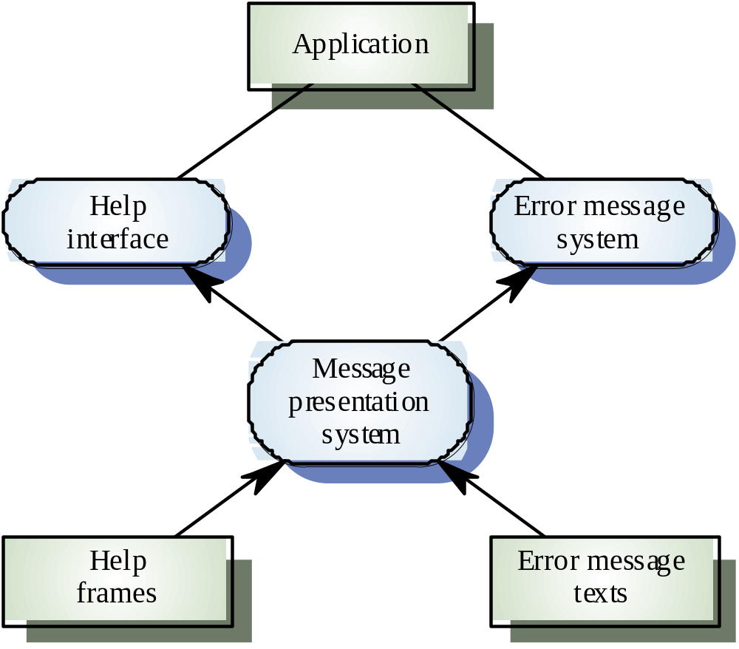
Help and message system

Slide 17
Error messages
Error message design is critically important.
Poor error messages can mean that a user
rejects rather than accepts a system
Messages should be polite, concise, consistent
and constructive
The background and experience of users
should be the determining factor in message
design

Slide 18
Design factors in message wording

Slide 19
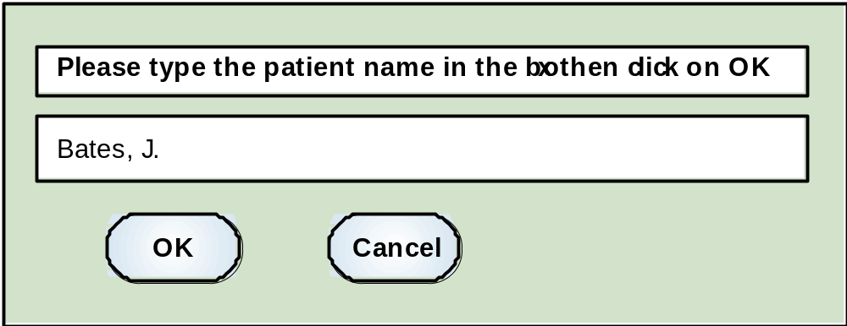
Nurse input of a patient’s name

Slide 20
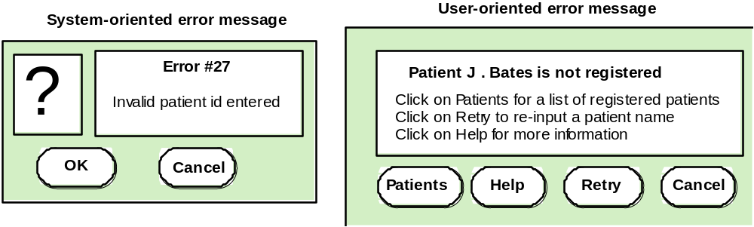
System and user-oriented error messages

Slide 21
Help system design
Help? means ‘help I want information”
Help! means “HELP. I'm in trouble”
Both of these requirements have to be taken
into account in help system design
Different facilities in the help system may be
required

Slide 22
Help information
Should not simply be an on-line manual
Screens or windows don't map well onto paper pages.
The dynamic characteristics of the display can
improve information presentation.
People are not so good at reading screen as
they are text.

Slide 23
Help system use
Multiple entry points should be provided so that the user can get into the help system from different places.
Some indication of where the user is positioned in the help system is valuable.
Facilities should be provided to allow the user
to navigate and traverse the help system.

Slide 24
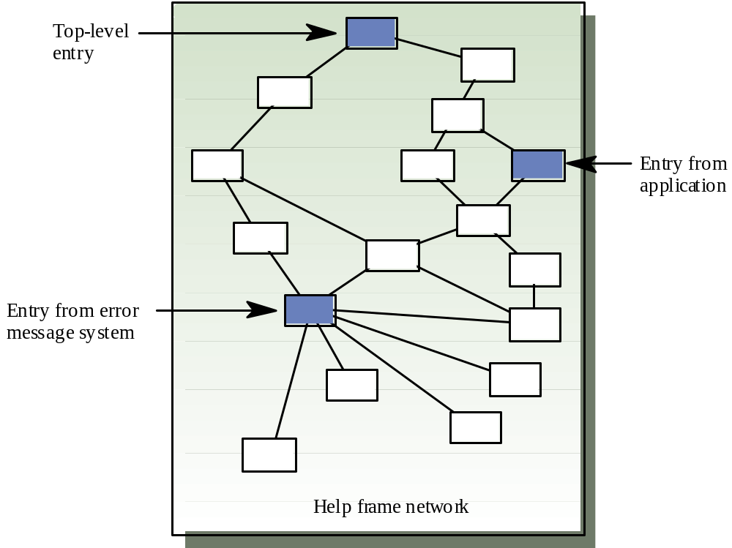
Entry points to a help system

Slide 25
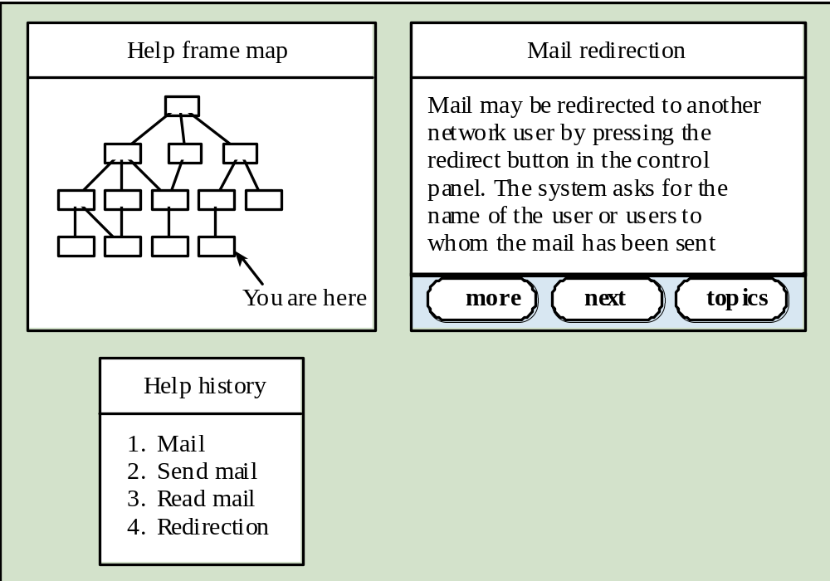
Help system windows

Slide 26
User documentation
As well as on-line information, paper documentation should be supplied with a system
Documentation should be designed for a range of users from inexperienced to experienced
As well as manuals, other easy-to-use documentation such as a quick reference card may be provided

Slide 27
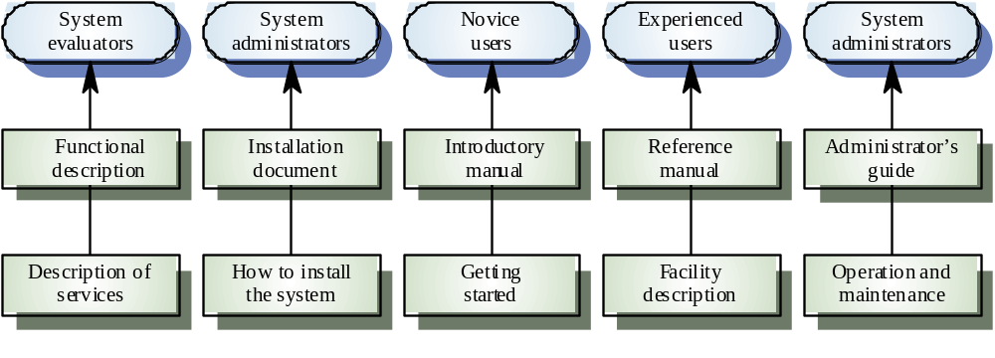
User document types

Slide 28
Document types
Functional description
  Brief description of what the system can do
Introductory manual
  Presents an informal introduction to the system
System reference manual
  Describes all system facilities in detail
System installation manual
  Describes how to install the system
System administrator’s manual
  Describes how to manage the system when it is in use

Slide 29
User interface evaluation
Some evaluation of a user interface design
should be carried out to assess its suitability
Full scale evaluation is very expensive and
impractical for most systems
Ideally, an interface should be evaluated against a usability specification. However, it is rare for such specifications to be produced

Slide 30
Usability attributes

Slide 31
Simple evaluation techniques
Questionnaires for user feedback
Video recording of system use and subsequent
tape evaluation.
Instrumentation of code to collect information
about facility use and user errors.
The provision of a grip button for on-line user
feedback.

Slide 32
Key points
Interface design should be user-centred. An interface should be logical and consistent and help users recover from errors
Interaction styles include direct manipulation, menu systems form fill-in, command languages and natural language
Graphical displays should be used to present trends and approximate values. Digital displays when precision is required
Colour should be used sparingly and consistently

Slide 33
Key points
Systems should provide on-line help. This should include “help, I’m in trouble” and “help, I want information”
Error messages should be positive rather than
negative.
A range of different types of user documents should be provided
Ideally, a user interface should be evaluated against a usability specification

Slide 34
Software Process Model
Analysis
Design
  Architectural Design
  Object / Class Design
  User Interface Design
Implementation
Testing
Deployment/Maintenance

Slide 35
Software Design
Analysis to Design
Design Quality Guidelines
Design Concepts
Component-level Design
(Class-based model, Flow-oriented model
Behavioural model)
Interface Design
(Scenario-based model, Flow-oriented model
Behavioural model)
Architectural Design
(Class-based model, Flow-oriented model)
Data/Class Design
(Class-based model, Behavioural model)

Slide 36
Architectural Design
System structuring
Control models
  Centralized control models (Call return model)
  Event-based models
Modular decomposition
  Object models
  Data flow models
Domain specific architectures

Slide 37
OOD / Class Design
Characteristics of OOD
Advantages of OOD
OOA, OOD, and OOP
Identifying Objects
Architectural design to OOD
Design Models

Slide 38
User Interface Design
User Interface
GUI Characteristics (Windows, Icons, Menus, Pointing, Graphics)
User Centered Design
User Interface Design Process
UI Design Principles
  User familiarity
  Consistency
  Minimal Surprise
  Recoverability
  User guidance
  User diversity
User System Interaction
  How users will interact with the software?
  How software will present information to the user?
Design Evaluation

Slide 39
Reference
Ian Sommerville, Software Engineering, Chapter 13, 6th Edition

