Slide 1
CRC Modeling

Slide 2
Recap
Class Modeling
  How to Identify classes, its attributes and functions?
  Class selection criteria
  Relationships
    Associations
    Generalization

Slide 3
Content
Class Modeling
  Relationships
    Dependency
    Realization
  Constraints, Notes
CRC Modeling

Slide 4
Associations (cont.)
Role name
Association name
instructor
StaffMember
Student
1..*
instructs
*
Role
Navigable
(uni-directional) association
Multiplicity
*
pre -
requisites
Courses
0..3
Reflexive association

Slide 5
Aggregation
A special form of association that models a whole-part relationship between an aggregate (the whole) and its parts.
  Models a “is a part-part of” relationship.
2..*
Door
1..*
Car
House
Whole
Part

Slide 6
Aggregation (cont.)
Aggregation tests:
  Is the phrase “part of” used to describe the relationship?
    A door is “part of” a car
  Are some operations on the whole automatically applied to its parts?
    Move the car, move the door.
  Are some attribute values propagated from the whole to all or some of its parts?
    The car is blue, therefore the door is blue.
  Is there an intrinsic asymmetry to the relationship where one class is subordinate to the other?
    A door is part of a car. A car is not part of a door.

Slide 7
Composition
A strong form of aggregation
  The whole is the sole owner of its part.
    The part object may belong to only one whole
  Multiplicity on the whole side must be zero or one.
  The life time of the part is dependent upon the whole.
    The composite must manage the creation and destruction of its parts.
Circle
1
Point
Circle
Point
Polygon
3..*

Slide 8
Generalization
Indicates that objects of the specialized class (subclass) are substitutable for objects of the generalized class (super-class).
  “is kind of” relationship.
{abstract} is a tagged value that indicates that the class is abstract.
The name of an abstract class should be italicized
An abstract class
Shape
{abstract}
Super Class
Generalization relationship
Sub Class
Circle

Slide 9
Generalization
A sub-class inherits from its super-class
  Attributes
  Operations
  Relationships
A sub-class may
  Add attributes and operations
  Add relationships
  Refine (override) inherited operations
A generalization relationship may not be used to model interface implementation.

Slide 10
Dependency
A dependency indicates a semantic relation between two or more classes in which a change in one may force changes in the other although there is no explicit association between them.
A stereotype may be used to denote the type of the dependency.
Iterator
<<friend>>
Vector

Slide 11
Realization
A realization relationship indicates that one class implements a behavior specified by another class (an interface or protocol).
An interface can be realized by many classes.
A class may realize many interfaces.
LinkedList
<<interface>>
List
LinkedList
List

Slide 12
Constraint Rules and Notes
Constraints and notes annotate among other things associations, attributes, operations and classes.
Constraints are semantic restrictions noted as Boolean expressions.
  UML offers many pre-defined constraints.
id: long { value > 0 }
Customer
1
*
Order
may be canceled
{ total < $50 }
Constraint
Note

Slide 13
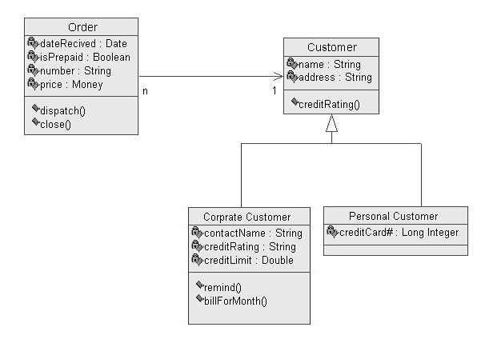
Examples

Slide 14
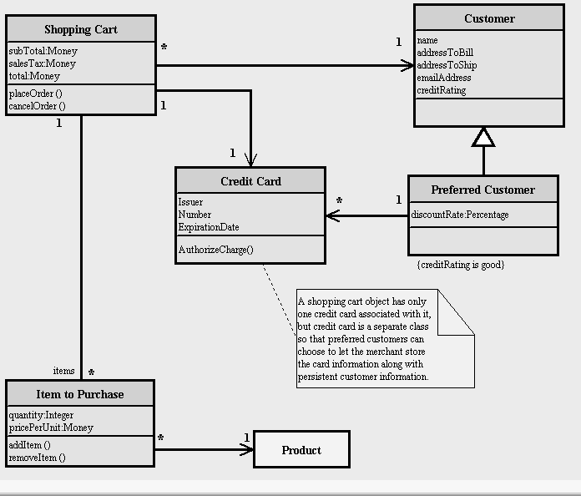
Examples
Reference: www.smartdraw.com

Slide 15
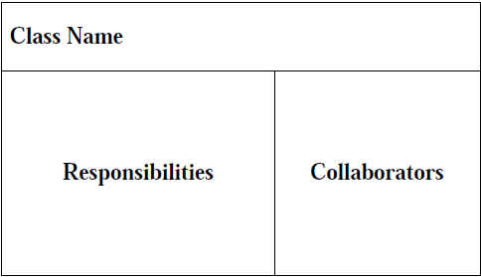
CRC Cards
A CRC card is divided into three sections (Beck & Cunningham, 1989; Ambler, 1995)

Slide 16
Responsibilities and Collaborations
A responsibility is anything that a class knows or does.
Sometimes a class will have a responsibility to fulfill, but will not have enough information to do it. When this happens it has to collaborate with other classes to get the job done.

Slide 17
CRC Model
A CRC model is a collection of CRC cards that represent whole or part of an application or problem domain.
The most common use for CRC models is to gather and define the user requirements for an object-oriented application.
Collaborating cards are placed close to each other

Slide 18
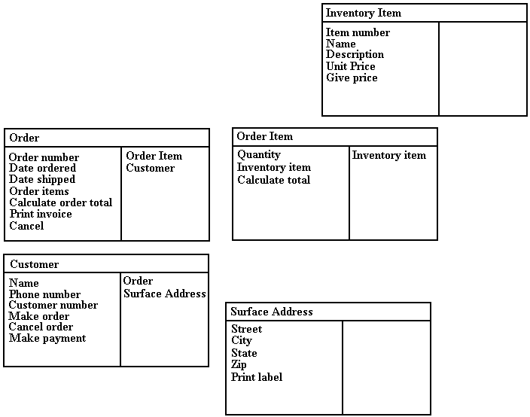

Slide 19
Creating CRC Model
Put together the CRC modeling team.
Organize the modeling room.
Do some brainstorming.
Explain the CRC modeling technique.
Iteratively perform the steps of CRC modeling.
Perform use-case scenario testing.

Slide 20
CRC Team
Business Domain Experts (BDEs).
Facilitator.
Scribe(s).
Observers.

Slide 21
Room preparation
Reserve a meeting room that has something write on.
Bring CRC modeling supplies.
Have a modeling table
Have chairs and desks for the scribe(s).
Have chairs for the BDEs.
Have chairs for the observers

Slide 22
Brainstorming
Set of questions:
Who is this system for?
What will they do with the system?
Why do we do this?
Why do we do this the way that we do?
What business needs does this system support?
What do/will our customers want/demand from us?
How is the business changing?
What is our competition doing? Why? How can we do it better?
Do we even need to do this?
If we were starting from scratch, how would we do this?
Just because we were successful in the past doing this, will we be successful in the future?

Slide 23
Brainstorming (cont…)
Can we combine several jobs into one? Do we want to?
How will people’s jobs be affected? Are we empowering or disempowering them?
What information will people need to do their jobs?
Is work being performed where it makes the most sense?
Are there any trivial tasks that we can automate?
Are people performing only the complex tasks that the system can’t handle?
Will the system pay for itself?
Does the system support teamwork, or does it hinder it?
Do our users have the skills/education necessary to use this system? What training will they need?
What are our organization’s strategic goals and objectives? Does this system support them?
How can we do this faster?
How can we do this cheaper?
How can we do this better?

Slide 24
Explain the CRC Modeling Technique
Facilitator should describe the CRC modeling process. This usually takes between ten and fifteen minutes and will often include the creation of several example CRC cards.
Lead BDEs through creation of example CRC cards

Slide 25
Perform The Iterative Steps of CRC Modeling
Find classes
  Look for anything that interacts with the system, or is part of the system
  Ask yourself “Is there a customer?”
  Follow the money
  Look for reports generated by the system
  Look for any screens used in the system
  Immediately prototype interface and report classes
  Look for the three to five main classes right away
  Create a new card for a class immediately
  Use one or two words to describe the class
  Class names are singular

Slide 26
Find responsibilities
  Ask yourself what the class knows
  Ask yourself what the class does
  If you’ve identified a responsibility, ask yourself what class it "belongs" to
  Sometimes get responsibilities that we won’t implement, and that’s OK
  Classes will collaborate to fulfill many of their responsibilities
Define collaborators
  Collaboration occurs when a class needs information that it doesn’t have
  Collaboration occurs when a class needs to modify information that it doesn’t have
  There will always be at least one initiator of any given collaboration
  Sometimes the collaborator does the bulk of the work
  Don’t pass the buck
  New responsibilities may be created to fulfill the collaboration

Slide 27
Define use-cases
  The BDEs will identify them as responsibilities of actor classes
  Do some brainstorming
  Transcribe the scenarios onto cards
Arrange the cards on the table
  Cards that collaborate with each other should be close to one another on the desk
  The more that two cards collaborate, the closer that they should be on the desk
  Expect to be moving the cards around a lot at the beginning
  Put "busy" cards towards the center of the table
  Actually move them around
  People will identify relationships/associations between classes as they move them around

Slide 28
Perform Use-Case Scenario Testing
Call out a new scenario
Determine which card should handle the responsibility
Update the cards whenever necessary
Describe the processing logic
Collaborate if necessary
Pass the ball back when done

Slide 29
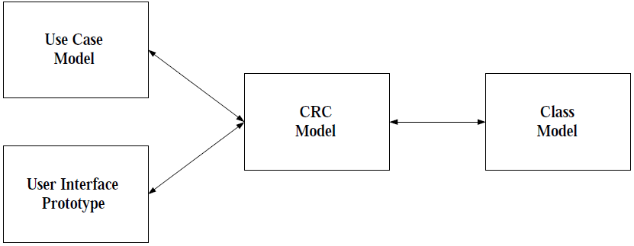
How CRC Modeling Fits in?

Slide 30
CRC Modeling Tips and Techniques
Send ahead an agenda a few days before the modeling session
Prominently display the CRC definitions
Use their terminology
Keep it low tech
Expect to prototype
Expect to take a few days
Get management support
Include CRC modeling in your system development life cycle
Do CRC modeling with front-line staff only

Slide 31
Advantages of CRC Modeling
The experts do the analysis
User participation increased
Breaks down communication barriers
It’s simple and straightforward
It’s non-threatening to users
It’s inexpensive and portable
It goes hand-in-hand with prototyping
It leads directly into class diagramming

Slide 32
Disadvantages of CRC Modeling
It’s threatening to some developers
It’s hard to get users together
CRC cards are limited

Slide 33
Summary
Class Diagrams
CRC Modeling

Slide 34
Reference
Ambler, S.W., (1998) CRC Modelling: Bridging the Communication Gap Between Developers and Users, An AmbySoft Inc. White Paper

