Slide 1
Activity Diagrams

Slide 2
Recap
Activity Diagrams
  When to use?
  Where?
  Nodes
  Edges
  More to come ….

Slide 3

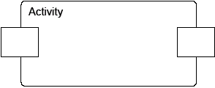
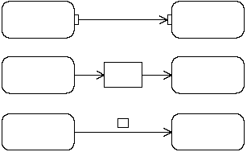



Object nodes
Hold data temporarily while they wait to move through the graph
Specify the type of values they can hold (if no type is specified, they can hold values of any type)
Can also specify the state of the held objects
There are four kinds of object nodes:
Central Buffer Nodes
Data Store Nodes
Activity Parameter Nodes
Pins
(three differents notations)

Slide 4

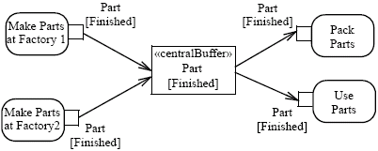
Object nodes – CentralBuffer
A central buffer node is an object node that manages flows from multiple sources and destinations (as opposed to pins and parameters)
Acts as a buffer for multiple input flows and output flows
Is not tied to an action like pins, or to an activity like activity parameter nodes
The centralBuffer node collects the object Parts, and each Part can be used or packet (but not both)

Slide 5
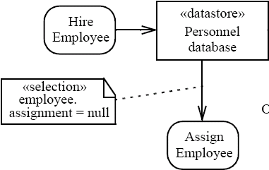

Object nodes – Datastore
Is a specific central buffer node which stores objects persistently
Keeps all tokens that enter into it
Tokens chosen to move downstream are copied so that tokens never leave the data store
If arrives a token containing an object already present in the data store, this replaces the old one
Tokens in a data store node cannot be removed (they are removed when the activity is terminated)
Notes:
Hire = assumere

Slide 6

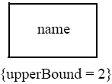
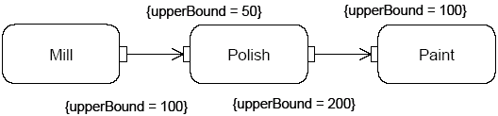
Object nodes - Multiplicities and upper Bound
Multiplicities: specify the minimum (≥0) and maximum number of values each pin accepts or provides at each invocation of the action:
  when is available the minimum number of values, the action can start
  if there is more values than the maximum, the action takes only the first maximum value
UpperBound: shows the maximum number of values that an object node can hold: at runtime, when the upper bound has been reached, the flow is stopped (buffering)

Slide 7
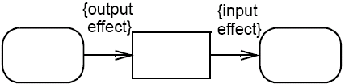


Object nodes – Effect and ordering
Effect: pins can be notated with the effect that their actions have on objects that move through the pin
The effects can be: ‘create’ (only on output pins), ‘read’, ‘update’ or ‘delete’ (only on input pins)
Ordering: specifies the order in which the tokens of an object node are offered to the outgoing edges (FIFO, LIFO or modeler-defined ordering)

Slide 8




Activity edges – Presentation options
An edge can also be notated using a connector
Every connector with a given label must be paired with exactly one other with the same label on the same activity diagram
is equivalent to
To reduce clutter in complex diagrams, object nodes may be elided
is equivalent to

Slide 9

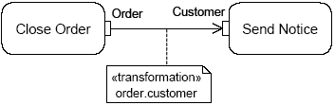

Activity edges - Transformation
It is possible to apply a transformation of tokens as they move across an object flow edge (each order is passed to the transformation behaviour and replaced with the result)
<<transformation>>
transformation specification
In this example, the transformation gets the value of the attribute Customer of the Order object

Slide 10
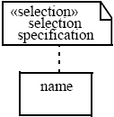
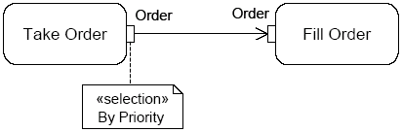
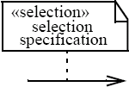
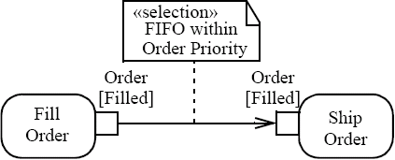
Selection
Specifies the order (FIFO, LIFO or modeler-defined ordering) in which tokens in the node are offered to the outgoing edges
Can be applied to:
  Object node - specifies the object node ordering, choosing what token offers to the outgoing edge whenever it asks a token
  Edge - chooses the order on which tokens are offered from the source object node to the edge (overrides any selection present on the object node, that is object node ordering)

Slide 11
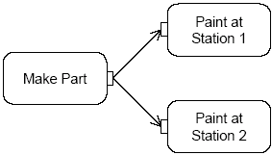
Token competition
A parameter node or pin may have multiple edges coming out of it, whereupon there will be competition for its tokens, because object nodes cannot duplicate tokens while forks can
Then there is indeterminacy in the movement of data in the graph
If the input pin of Paint at Station 1 is full, the token remains at the output of Make Part until the traversal can be completed to one of the input pins

Slide 12
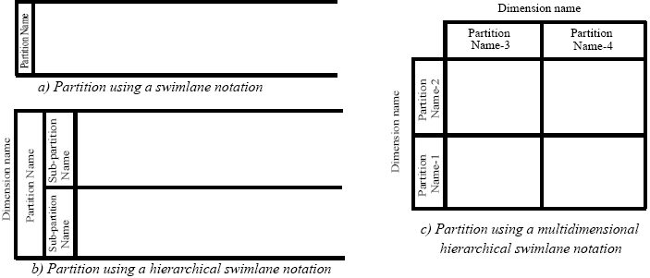
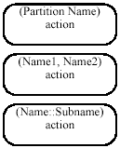

ActivityPartition (1)
Partitions divide the nodes and edges for identifying actions that have some characteristics in common
They often correspond to organizational units in a business model
Partitions can be hierarchical and multidimensional
Additional notation is provided: placing the partition name in parenthesis above the activity name

Slide 13
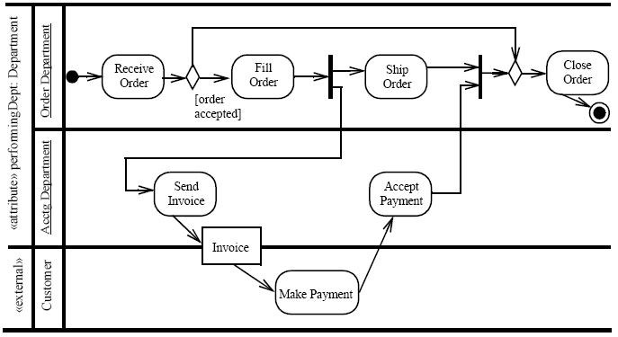
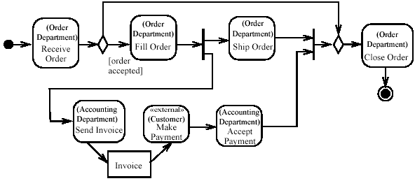
ActivityPartition (2)
Partition notated to occur outside the primary concern of the model

Slide 14
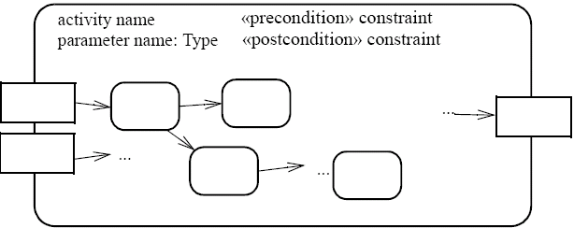
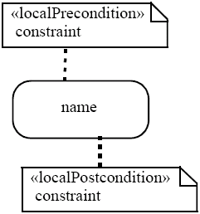
Pre & post condition (1)
Can be referred to an activity or to an action (local condition)
UML intentionally does not specify when or whether pre/post conditions are tested (design time, runtime, etc.)
UML also does not define what the runtime effect of a failed pre/post condition should be (error that stops execution, warning, no action)

Slide 15
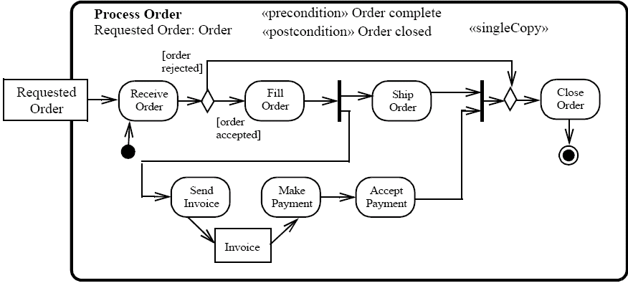
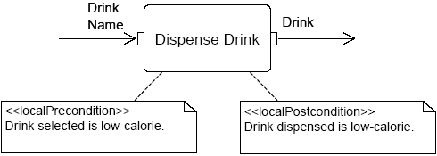
Pre & post condition (2)

Slide 16

SendSignalAction
Creates a signal instance from its inputs, and transmits it to the target object (local or remote)
A signal is an asynchronous stimulus that triggers a reaction in the receiver in an asynchronous way and without a reply
Any reply message is ignored

Slide 17
Time triggers and Time events
A Time trigger is a trigger that specifies when a time event will be generated
Time events occur at the instant when a specified point in time has transpired
This time may be relative or absolute
  Relative time trigger: is specified with the keyword ‘after’ followed by an expression that evaluates to a time value
  Absolute time trigger: is specified as an expression that evaluates to a time value
after (5 seconds)
Jan, 1, 2000, Noon
Relative time trigger
Absolute time trigger

Slide 18

AcceptEventAction
Waits for the occurrence of an event meeting specified conditions
Two kinds of AcceptEventAction:
  Accept event action – accepts signal
    events generated by a SendSignalAction
  Wait time action – accepts time events
Accept event action
Wait time action

Slide 19

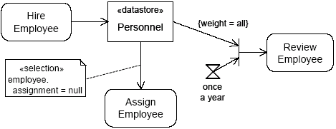
The objects stored in Personnel are only retrieved when the join succeeds (only once a year)

Slide 20
InterruptibleActivityRegion
Is an activity group (sets of nodes and edges) that supports termination of tokens flowing into it
When a token leaves an interruptible region via interrupting edges, all tokens and behaviours in the region are terminated
Token transfer is still atomic: a token transition is never partial; it is either complete or it does not happen at all (also for internal stream)

Slide 21
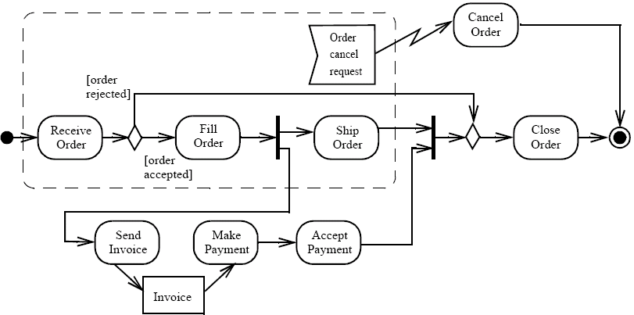

InterruptibleActivityRegion
Interrupting edge

Slide 22
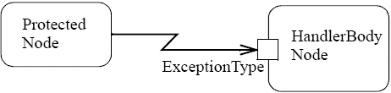
Exceptions (1)
Exception handler - specifies the code to be executed when the specified exception occurs during the execution of the protected node
When an exception occurs the set of execution handlers on the action is examined to look for a handler that matches (catches) the exception
If the exception is not caught, it is propagated to the enclosing protected node, if one exists
If the exception propagates to the topmost level of the system and is not caught, the behaviour of the system is unspecified; profiles may specify what happens in such cases

Slide 23
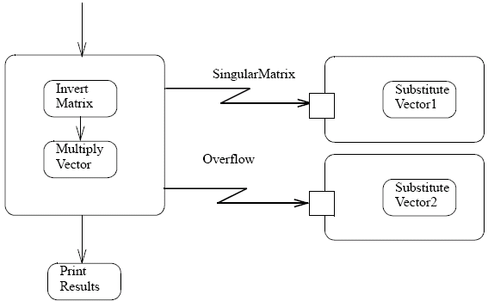
Exceptions (2)
When an exception is caught, is executed the exception body instead of the protected node, and then the token is passed to all the edges that go out from that protected node
The exception body has no explicit input or output edges
Exception body can resolve the problems that have caused the exception or can abort the program
We can put any activities nested in a protected node (in UML 2.0, nesting activities is allowed)
Protected node with two nested activities
HandlerBody node
Successful end

Slide 24
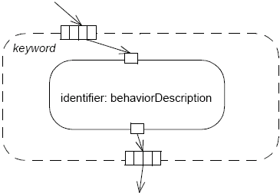
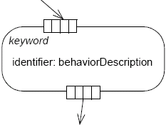
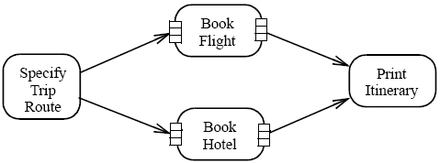
ExpansionRegion (1)
Nested region of an activity in which each input is a collection of values
The expansion region is executed once for each element (or position) in the input collection
On each execution of the region, an output value from the region is inserted into an output collection at the same position as the input elements

Slide 25
ExpansionRegion (2)
There are three ways of interaction between the executions:
  Parallel (concurrent): all the interactions are independent
  Iterative: the interactions occur in the order of the elements (the executions of the region must happen in sequence, with one finishing before another can begin)
  Stream (streaming): there is a single execution of the region, where the values in the input collection are extracted and placed into the execution of the expansion region as a stream (in order if the collection is ordered)

Slide 26
Swim Lane
Activity diagrams describe the activities of a class. These diagrams are similar to state chart diagrams and use similar conventions, but activity diagrams describe the behavior of a class in response to internal processing rather than external events as in state chart diagram.
Swim lanes, which represent responsibilities of one or more objects for actions within an overall activity; that is, they divide the activity states into groups and assign these groups to objects that must perform the activities.

Slide 27
Activity Diagrams: Swim lanes
Actions may be grouped into swim lanes to denote the object or subsystem that implements the actions.
Allocate
Dispatcher
Resources
Open
Coordinate
Archive
Incident
Resources
Incident
FieldOfficer
Document
Incident

Slide 28
Finance
Order
Processing
Stock
Manager
Receive Order
Receive Supply
*for each
order item
Choose Outstanding Order Items
Authorize Payment
Check Order
Item
vertical lines
are used to separate
“swimlanes”
to show which
activities are handled
by which part of the
system
* for each
chosen
order item
[in stock]
[failed]
Assign to Order
Assign to Order
[succeeded]
Cancel Order
[need to reorder]
Reorder
item
[all outstanding order
items filled]
[stock assigned to all order items
and payment authorized]
Add Remainder
to Stock
Dispatch
Order

Slide 29
Summary
Object Nodes
  Activity Parameter, Pins, Central Buffer, Data Stores
  Multiplicities, upper bound, effect, ordering
Activity Edges
  Labels, transformations, selection
Activity partitioning
Pre/Post conditions
Event actions
  SendSignalAction, AcceptEventAction, WaitTimeAction, Time trigger and time events
Interruptible activity region
Expansion region
Swim lane diagrams

