Slide 1
Use Case Diagram

Slide 2
Recap
Requirement Engineering
  Inception
  Elicitation
  Elaboration
  Negotiation
  Specification
  Validation
  Requirements Management

Slide 3
Outline
Use Case Diagrams
  Formal introduction
  UML notation
  Examples

Slide 4
A use case diagram presents interactions between the system and other systems or with the system’s users, who are called actors
Actors represent roles which may include human users, external hardware or other systems.
It describes who will use the system and the ways in which a user will interact with the system to achieve a certain goal.
Usually, the diagram is accompanied by a narrative description, which details, in a structured manner, the steps of each interaction

Slide 5
The use case technique enables creating an initial description of the users’ needs, so that later on the system’s behavior can be defined by using other means, for example, sequence or collaboration diagrams

Slide 6
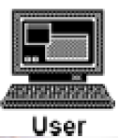
Components of a Use Case Diagram
An actor may also be shown as a class rectangle with the keyword «actor», with the usual notation for all compartments.
Other icons that convey the kind of actor may also be used to denote an actor, actor such as using a separate icon for non-human actors.
«actor»
Customer

Slide 7
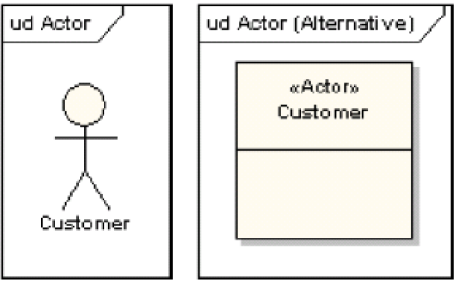
Actor: Use Case Diagram

Slide 8
Use Case
A use case is a single unit of meaningful work
It provides a high-level view of behavior observable to someone or something outside the system
The notation for a use case is an ellipse
ud use case
Use case

Slide 9

Relationship
The notation for using a use case is a connecting line with an optional arrowhead showing the direction of control
The following diagram indicates that the actor “Patient” uses the “make appointment” use case
make appointment
patient

Slide 10
System Boundary
It is usual to display use cases as being inside the system and actors as being outside the system
make appointment
Patient

Slide 11

Relationship
A relationship from an extending use case to an extended use case that specifies how and when the behavior defined in the extending use case can be inserted into the behavior defined in the extended use case.
Registration use case is meaningful on its own. It could be extended with optional Get Help On Registration use case
The point at which an extending use case is added can be defined by means of an extension point

Slide 12
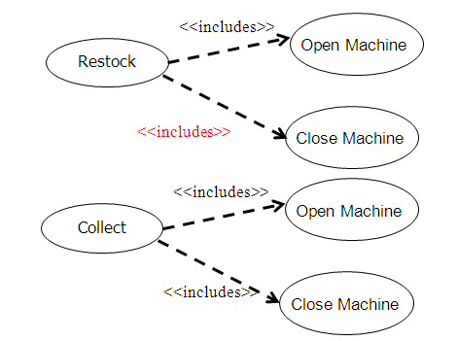
Relationship
An include relationship defines that a use case contains the behavior defined in another use case.

Slide 13
ud Include
withdraw
Card identification
<<include>>
ud Extend
patientmodify
Modify Order
Get Approval
<<extend>>

Slide 14
Relationship: Use Case Connector
The uses connector can optionally have multiplicity values at each end, as in the
following diagram
which shows that a customer may only have one withdrawal session at a time, but a bank may have any number of customers making withdrawals concurrently
ud Multiplicity
Withdraw
1
1
0..1
0..*
Customer
Bank

Slide 15
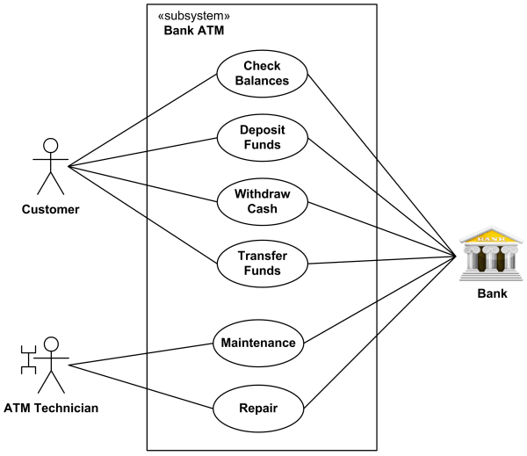
An example of use case diagram for Bank ATM subsystem
Ref: http://www.uml-diagrams.org/use-case-diagrams-examples.html#atm

Slide 16
Node Type | Notation
Actor(default)
Actor (optional user-defined icon)
Extend
Extend (with Condition)
Customer
<<extend>>
Extension point Selection
Extended (use case)
Extending (use case)
Condition: [Customer selected HELP]
extension point: Selection
<<extend>>

Slide 17
Node Type | Notation
Include
Use case
withdraw
<<include>>
Card identification
Including use case
Included use case
withdraw
On-Line Help
Extension point Selection

Slide 18
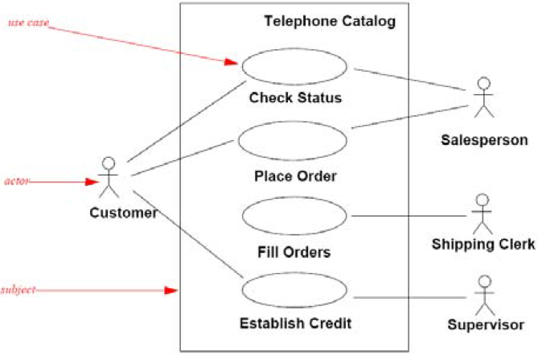
Use Case
Actor
Subject
Use case diagram with rectangle representing the boundary of the subject

Slide 19
Components of a Use Case Diagram
Notation | Meaning
 | Use case: An Ellipse represents a single Use Case. The name of the use case is written inside ellipse.
Actor | Actor: Represents every element which interact with the system. It may be a user a another system which interact with the system described in the use case.
 | Ordinary Relationship: Represents a connection that is a channel for the transfer of information between a use case and an actor or between use cases.
System boundary | System Boundary: A square represents the boundary of the system. Inside the system are the use cases and outside the square are the actors who interact with the system.
Use Case

Slide 20
Format of a Use Case Description
Use Case Name | In this field we write the name of the use case.
Actors | List of the actors who take part in the use case.
Description | A short verbal description of the use case.
References | Links to a requirements document and require use cases.
Typical Course of event | This is the main part of the use case description. Its purpose is to describe the sequence of the use case’s activities.
Alternate course | This part describe the special course of action.
Precondition | List preconditions that must be fulfilled the use case can take place.
Post conditions | Lists events that have to occur after the use case is completed.
Assumptions | Basic assumptions and other remarks.

Slide 21
Example: Bank ATM

Slide 22
Example: Bank ATM

Slide 23
Example: Student Teacher Information System

Slide 24
Example: Student Teacher Information System

Slide 25
Summary
Use Case Diagrams
UML notations for use case
How to write a use case?
Examples

Slide 26
References
Roger S. Pressman, Software Engineering, A Practitioner’s Approach, Sixth Edition, 20005.Engineering
http://www.uml.org
http://www.sciencedirect.com/

