Slide 1
CSC271 Database Systems
Lecture # 27

Slide 2
Summary: Previous Lecture
Remaining activities/steps in building conceptual data model
Logical database design
  Build and validate logical database design
    Derive relations for logical data model
    Validate relations using normalization

Slide 3
Normalization
Chapter 13

Slide 4
Purpose of Normalization
Normalization is a technique for producing a set of suitable relations that support the data requirements of an enterprise

Slide 5
Characteristic of Suitable Relations
The characteristics of a suitable set of relations include the following:
  The minimal number of attributes necessary to support the data requirements of the enterprise
  Attributes with a close logical relationship (described as functional dependency) are found in the same relation
  Minimal redundancy with each attribute represented only once with the important exception of attributes that form all or part of foreign keys, which are essential for the joining of related relations

Slide 6
Benefits of DB with Suitable Relations
The beneﬁts of using a database that has a suitable set of relations are:
  Easier for the user to access and maintain the data
  Take up minimal storage space on computer

Slide 7
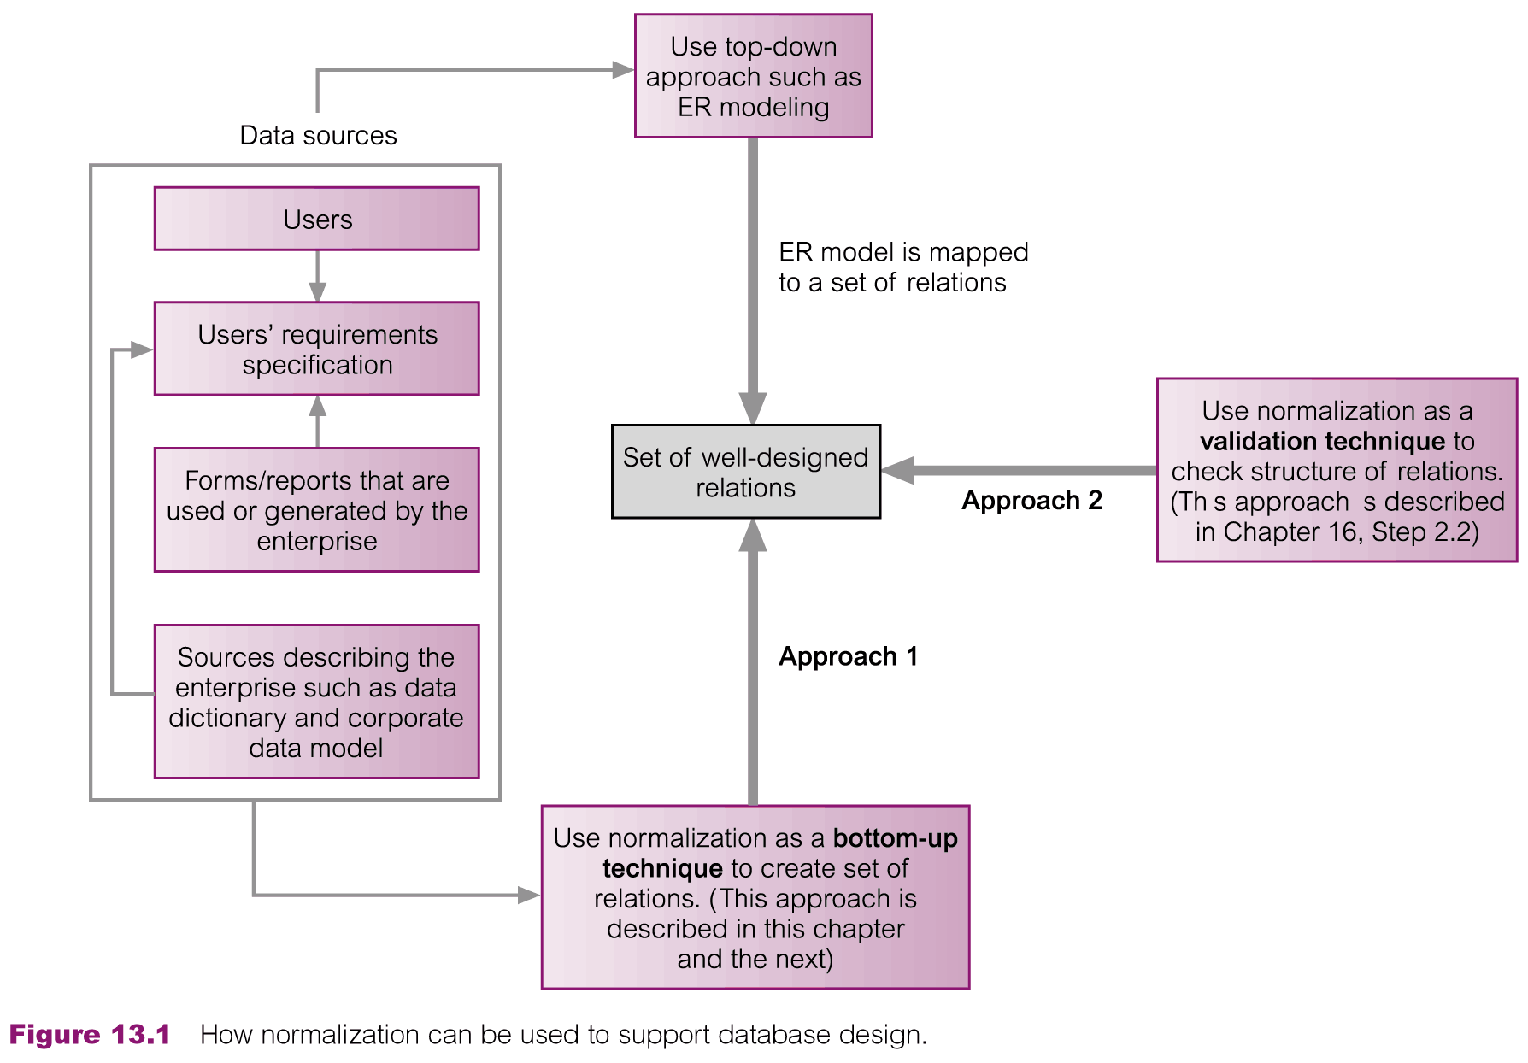
Normalization Supporting DB Design

Slide 8
Data Redundancy & Update Anomalies
Major aim of relational database design is to group attributes into relations to minimize data redundancy
If this aim is achieved, the potential beneﬁts for the implemented database include the following:
  Updates to the data stored in the database are achieved with a minimal number of operations thus reducing the opportunities for data inconsistencies occurring in the database
  Reduction in the ﬁle storage space required by the base relations thus minimizing costs

Slide 9
Data Redundancy & Update Anomalies
Problems associated with data redundancy are illustrated by comparing the Staff and Branch relations with the StaffBranch relation
The StaffBranch relation is an alternative format of the Staff and Branch relations
Staff (staffNo, sName, position, salary, branchNo)
Branch (branchNo, bAddress)
StaffBranch (staffNo, sName, position, salary, branchNo, bAddress)

Slide 10
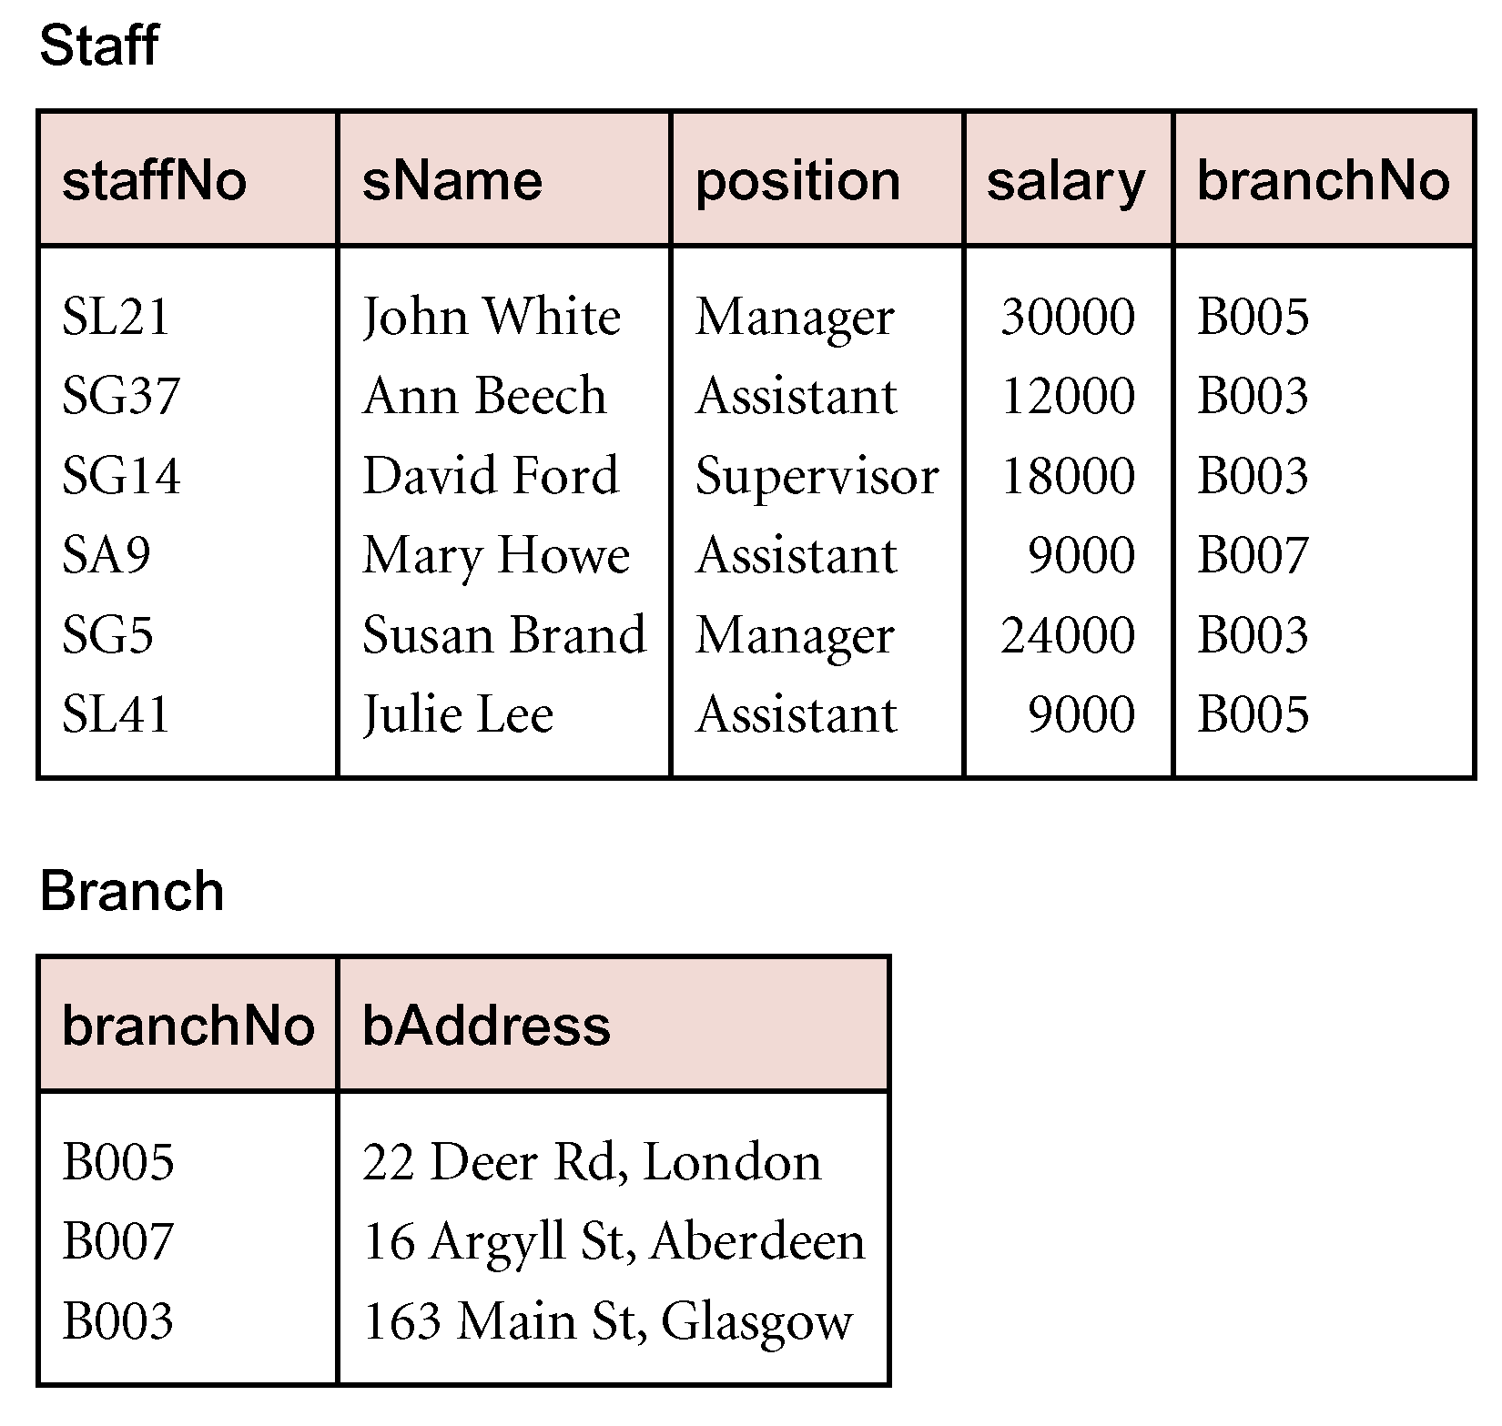
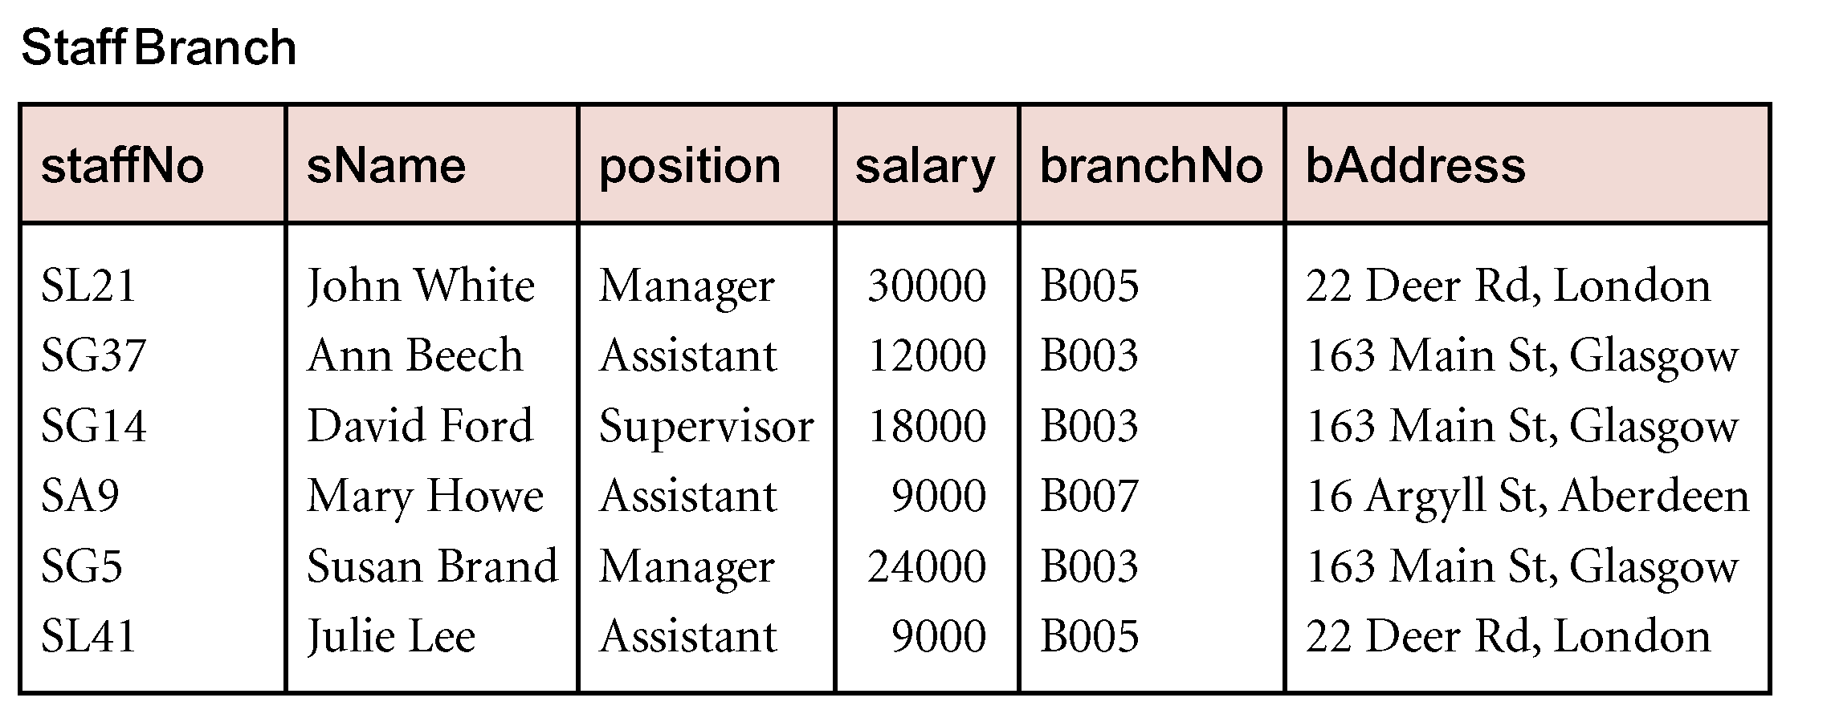
Data Redundancy & Update Anomalies

Slide 11
Data Redundancy & Update Anomalies
Relations that contain redundant information may potentially suffer from update anomalies
Types of update anomalies include:
  Insertion
    Insert new staff/branch in StaffBranch relation
  Deletion
    Delete SA9 from StaffBranch relation
  Modification
    Update the address for branch number B003

Slide 12
Decomposition
We can avoid these anomalies by decomposing the original relation into the Staff and Branch relations
There are two important properties associated with decomposition of a larger relation into smaller relations:
  The lossless-join property ensures that any instance of the original relation can be identiﬁed from corresponding instances in the smaller relations
  The dependency preservation property ensures that a constraint on the original relation can be maintained by simply enforcing some constraint on each of the smaller relations. In other words, we do not need to perform joins on the smaller relations to check whether a constraint on the original relation is violated

Slide 13
Functional Dependencies
Important concept associated with normalization
Functional dependency (FD) describes relationship between attributes and could be defined as:
  For example, if A and B are attributes of relation R, B is functionally dependent on A (denoted A → B), if each value of A in R is associated with exactly one value of B in R
  Functional dependency is a property of the meaning or semantics of the attributes in a relation
  An alternative way to describe the relationship between attributes A and B is to say that ‘A functionally determines B’

Slide 14
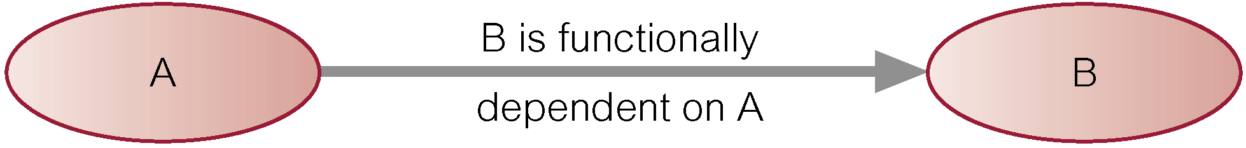
Determinant
The determinant of a functional dependency refers to the attribute or group of attributes on the left-hand side of the arrow

Slide 15
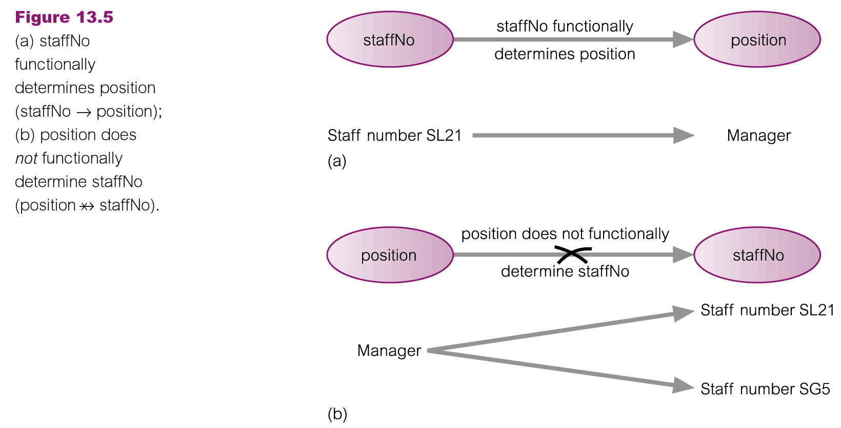
An Example Functional Dependency

Slide 16
Observations: Example FD
The relationship between staffNo and position is one-to-one (1:1): for each staff number there is only one position
On the other hand, the relationship between position and staffNo is one-to-many (1:*): there are several staff numbers associated with a given position
For the purposes of normalization we are interested in identifying functional dependencies between attributes of a relation that have a one-to-one relationship
A functional dependency is a property of a relational schema (intension) and not a property of a particular instance of the schema (extension)

Slide 17
Example: FD for all Time
Consider the values shown in staffNo and sName attributes of the Staff relation
Based on sample data, the following functional dependencies appear to hold
  staffNo → sName (holds for all time)
  sName → staffNo (holds for the current insatnce)

Slide 18
Full Functional Dependency
Determinants should have the minimal number of attributes necessary to maintain the functional dependency with the attribute(s) on the right hand-side
Full functional dependency indicates that if A and B are attributes of a relation, B is fully functionally dependent on A, if B is functionally dependent on A, but not on any proper subset of A
A functional dependency A→ B is a full functional dependency if removal of any attribute from A results in the dependency no longer existing
  staffNo → branchNo

Slide 19
Partial Functional Dependency
Partial functional dependency indicates that if A and B are attributes of a relation, B is partially functionally dependent on A, if B is functionally dependent any proper subset of A
A functional dependency A→ B is a partially dependency if there is some attribute that can be removed from A and yet the dependency still holds
  staffNo, sName → branchNo

Slide 20
Functional Dependency
In summary, the functional dependencies that we use in normalization have the following characteristics:
  There is a one-to-one relationship between the attribute(s) on the left-hand side (determinant) and those on the right-hand side of a functional dependency (opposite direction, can have a one-to-one relationship or one-to-many relationship)
  They hold for all time
  The determinant has the minimal number of attributes necessary to maintain the dependency with the attribute(s) on the right-hand side (full functional dependency)

Slide 21
Transitive Dependency
There is an additional type of functional dependency called a transitive dependency that we need to recognize because its existence in a relation can potentially cause the types of update anomaly
Transitive dependency describes a condition where A, B, and C are attributes of a relation such that if A → B and B → C, then C is transitively dependent on A via B (provided that A is not functionally dependent on B or C)

Slide 22
Example: Transitive Dependency
Consider functional dependencies in the StaffBranch relation
staffNo → sName, position, salary, branchNo, bAddress
branchNo → bAddress
Transitive dependency, branchNo → bAddress exists on staffNo via branchNo

Slide 23
Identifying Functional Dependencies
Identifying all functional dependencies between a set of attributes is relatively simple if the meaning of each attribute and the relationships between the attributes are well understood
This information should be provided by the enterprise in the form of discussions with users and/or documentation such as the users’ requirements specification
What if the users are unavailable for consultation and/or the documentation is incomplete?
  Database designer should use their common sense and/or experience to provide the missing information

Slide 24
Identifying FDs: StaffBranch Relation
Examine semantics of attributes in StaffBranch relation, assume that position held and branch determine a member of staff’s salary
  staffNo → sName, position, salary, branchNo, bAddress
  branchNo → bAddress
  bAddress → branchNo
  branchNo, position → salary
  bAddress, position → salary

Slide 25
Identifying FDs: Using Sample Data
Consider the data for attributes denoted A, B, C, D, and E in the Sample relation
Important to establish that sample data values shown in relation are representative of all possible values that can be held by attributes A, B, C, D, and E
Assume that this is true despite the relatively small amount of data shown in this relation

Slide 26
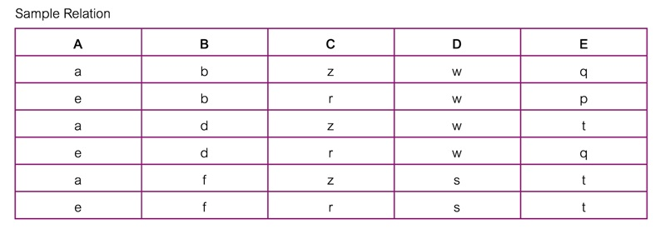
Identifying FDs: Using Sample Data

Slide 27
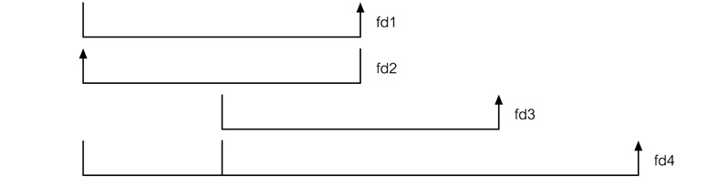
Identifying FDs: Using Sample Data

Slide 28
Identifying FDs: Using Sample Data
Functional dependencies between attributes A to E in the Sample relation
  A → C (fd1)
  C → A (fd2)
  B → D (fd3)
  A, B → E (fd4)

Slide 29
Identifying PKs Using FDs
Main purpose of identifying a set of functional dependencies for a relation is to specify the set of integrity constraints that must hold on a relation
An important integrity constraint to consider first is the identification of candidate keys, one of which is selected to be the primary key for the relation

Slide 30
Identifying PKs Using FDs
StaffBranch relation has five functional dependencies
The determinants are staffNo, branchNo, bAddress, (branchNo, position), and (bAddress, position)
To identify all candidate key(s), identify the attribute (or group of attributes) that uniquely identifies each tuple in this relation
All attributes that are not part of a candidate key should be functionally dependent on the key
The only candidate key and therefore primary key for StaffBranch relation, is staffNo, as all other attributes of the relation are functionally dependent on staffNo
Although branchNo, bAddress, (branchNo, position), and (bAddress, position) are determinants in this relation, they are not candidate keys for the relation

Slide 31
Identifying PKs Using FDs
Sample relation has four FDs and the determinants in the Sample relation are A, B, C, and (A, B)
However, the only determinant that functionally determines all the other attributes of the relation is (A, B), hence identified as the primary key for this relation
In particular, A functionally determines C, B functionally determines D, and (A, B) functionally determines E
In other words, the attributes that make up the determinant (A, B) can determine all the other attributes in the relation either separately as A or B or together as (A, B)
An essential characteristic for a candidate key of a relation is that the attributes of a determinant either individually or working together must be able to functionally determine all the other attributes in the relation

Slide 32
Summary
Purpose of normalization
Data redundancy and update anomalies
Functional Dependencies
  Partial, full, transitive
  Identifying functional dependencies
  Identifying primary keys using functional dependencies

Slide 33
References
All the material (slides, diagrams etc.) presented in this lecture is taken (with modifications) from the Pearson Education website :
  http://www.booksites.net/connbegg

