Slide 1
CSC271 Database Systems
Lecture # 26

Slide 2
Summary: Previous Lecture
Enhanced Entity-Relationship (EER) model
  Specialization/Generalization
  Specialization/Generalization constraints
  Aggregation
  Composition
  Application of EER concepts to DreamHome

Slide 3
Building Conceptual Data Model
The tasks involved in building conceptual data model are:
  Identify entity types
  Identify relationship types
  Identify and associate attributes with entity or relationship types
  Determine attribute domains
  Determine candidate, primary, and alternate key attributes
  Consider use of enhanced modeling concepts (optional step)
  Check model for redundancy
  Validate conceptual model against user transactions
  Review conceptual data model with user

Slide 4
Building Conceptual Data Model..
  Identify relationship types
  Use Entity–Relationship (ER) diagrams
  Determine the multiplicity constraints of relationship types
  Used to check and maintain data quality
  Results in better representation of the data requirements of the enterprise
  Check for fan and chasm traps
  Document relationship types

Slide 5
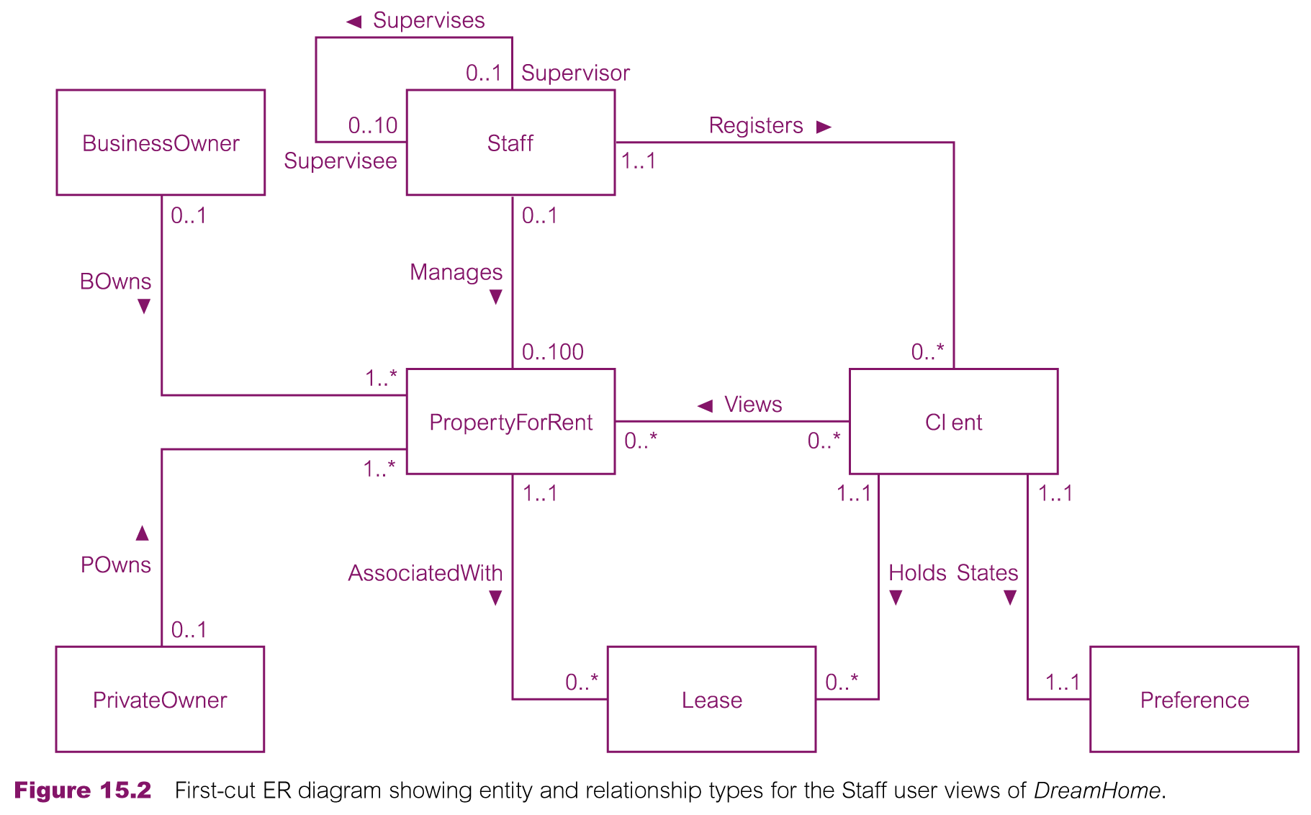
Staff User View

Slide 6
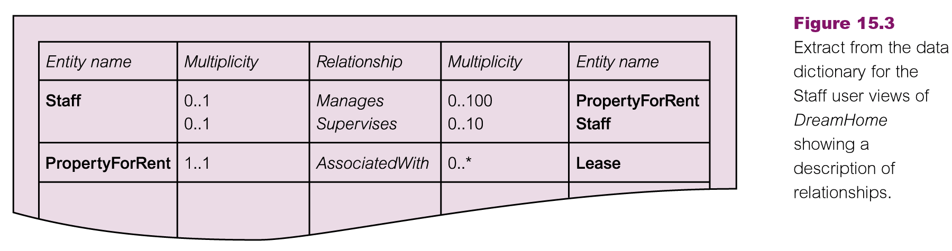
Identify Relationship Types

Slide 7
Building Conceptual Data Model..
Identify and associate attributes with entity or relationship types
  Simple/composite attributes
  Single/multi-valued attributes
    Two approaches, separate entity or as a multi-valued
  Derived attribute
  Document attributes

Slide 8
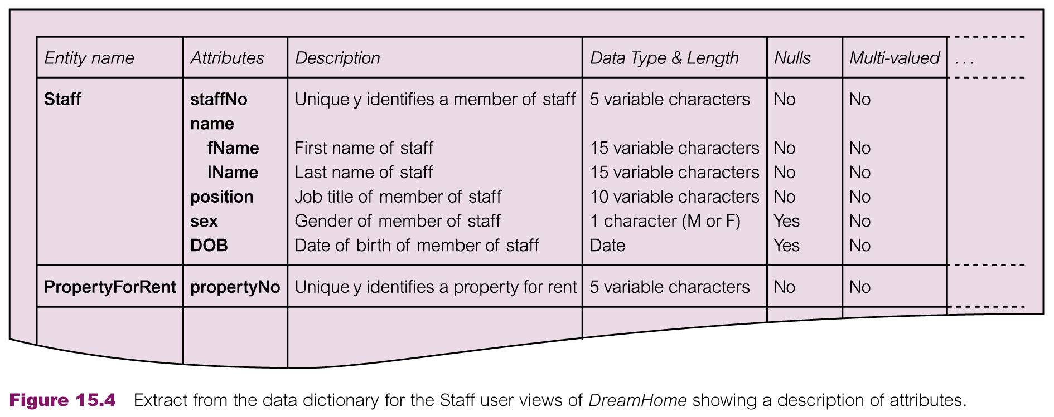
Building Conceptual Data Model..

Slide 9
DreamHome Entities/Attributes
  Staff staffNo, name (composite: fName, lName), position, sex, DOB
  PropertyForRent propertyNo, address (composite: street, city, postcode), type, rooms, rent
  PrivateOwner ownerNo, name (composite: fName, lName), address, telNo
  BusinessOwner ownerNo, bName, bType, address, telNo, contactName
  Client clientNo, name (composite: fName, lName), telNo Preference prefType, maxRent
  Lease leaseNo, paymentMethod, deposit (derived as PropertyForRent.rent*2), depositPaid, rentStart, rentFinish, duration (derived as rentFinish – rentStart)

Slide 10
Building Conceptual Data Model..
Determine attribute domains
  A domain is a pool of values from which one or more attributes draw their values e.g. staffNo, sex etc.
  Document attribute domains

Slide 11
Building Conceptual Data Model..
Determine candidate, primary, and alternate key attributes
Primary key guidelines
  The CK with the minimal set of attributes
  The CK that is least likely to have its values changed
  The CK with fewest characters (strings)
  The CK with smallest maximum value (numerical )
  The CK that is easiest to use from the users’ point of view
Strong and weak entities
Document PK and AKs

Slide 12
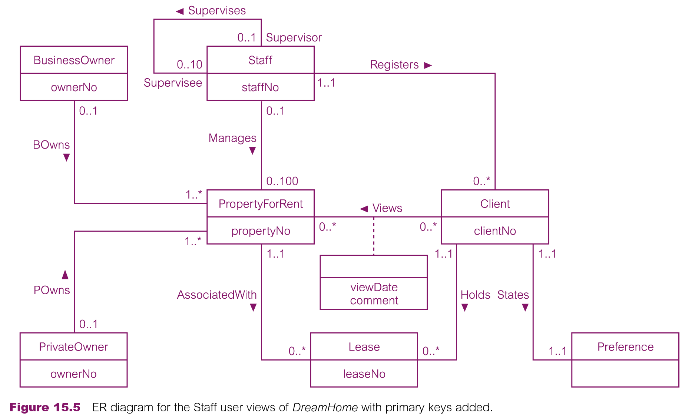
Building Conceptual Data Model..

Slide 13
Building Conceptual Data Model..
Consider use of enhanced modeling concepts (optional step)
  As a useful ‘rule of thumb’ when considering the use of these concepts, always attempt to represent the important entities and their relationships as clearly as possible in the ER diagram
  Therefore, the use of advanced modeling concepts should be guided by the readability of the ER diagram and the clarity by which it models the important entities and relationships

Slide 14
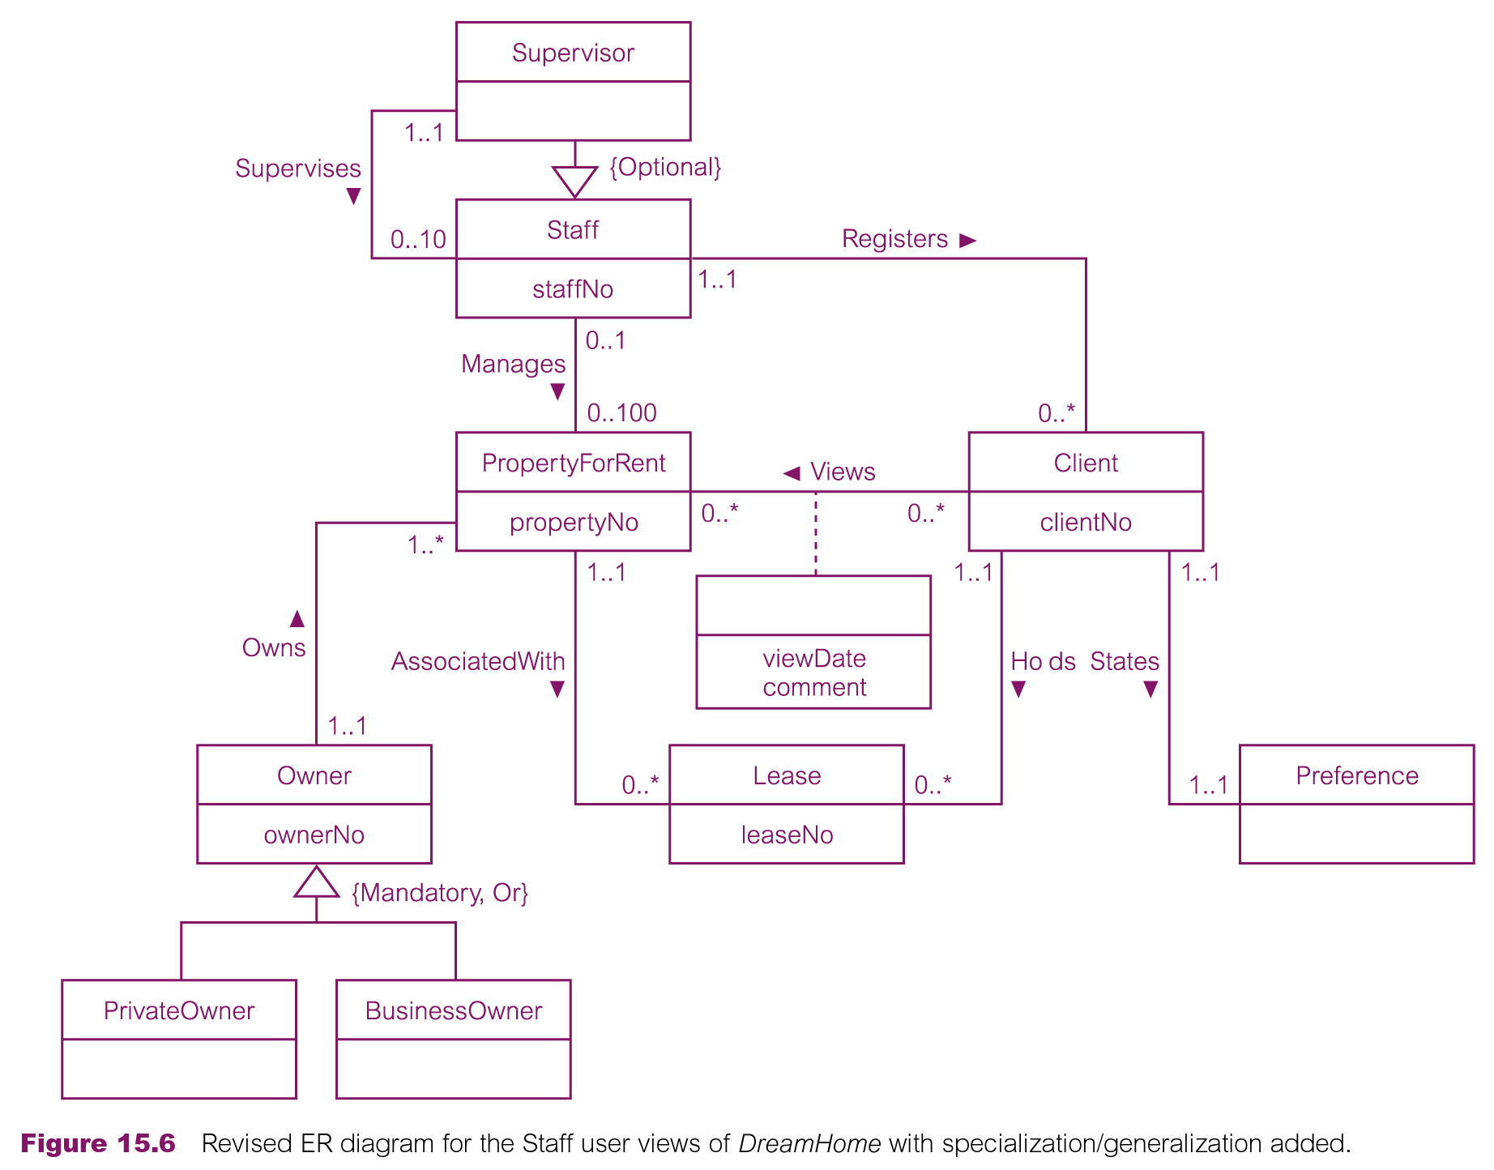
Building Conceptual Data Model..

Slide 15
Building Conceptual Data Model..
Check model for redundancy
  Re-examine one-to-one (1:1) relationships
    For example, Client and Renter entities
  Remove redundant relationships
  Consider time dimension

Slide 16
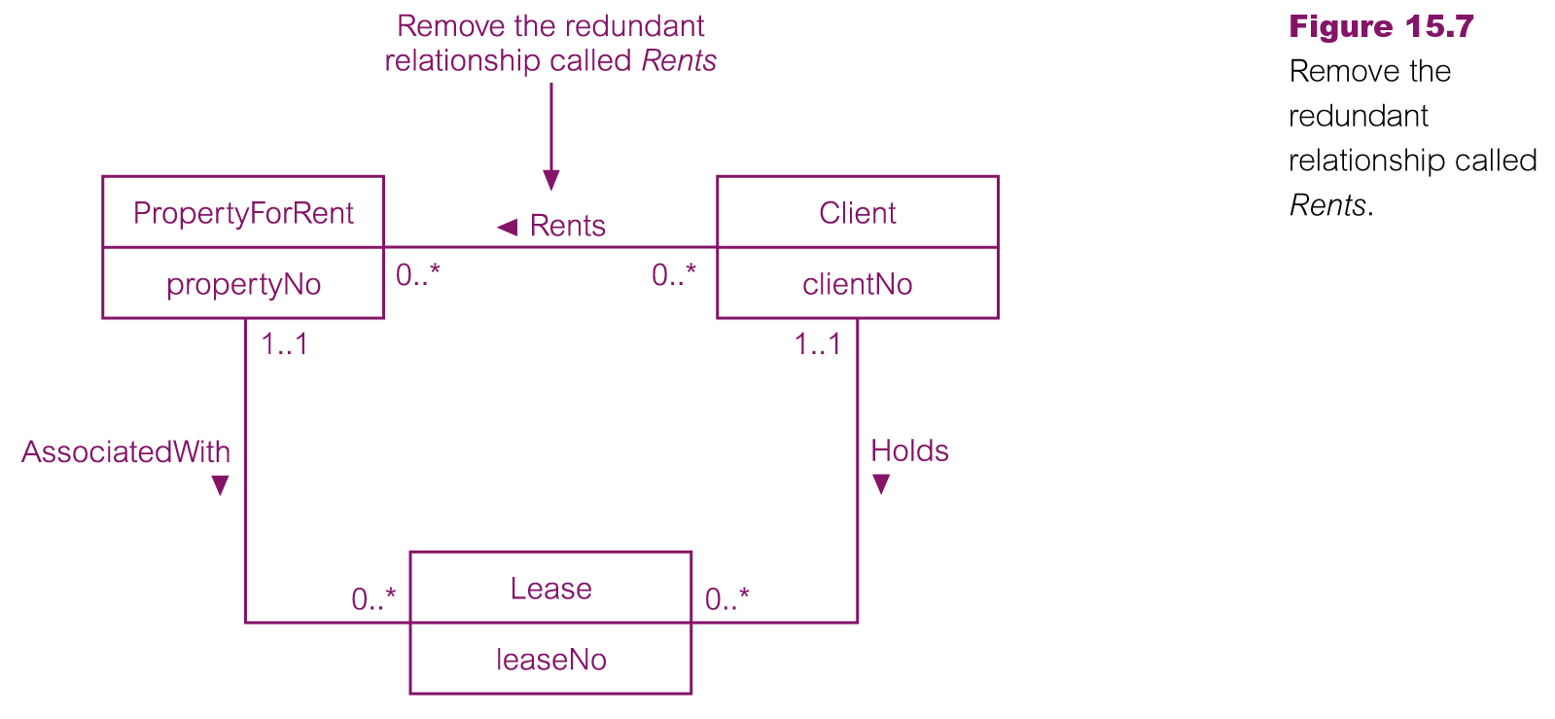
Building Conceptual Data Model..

Slide 17
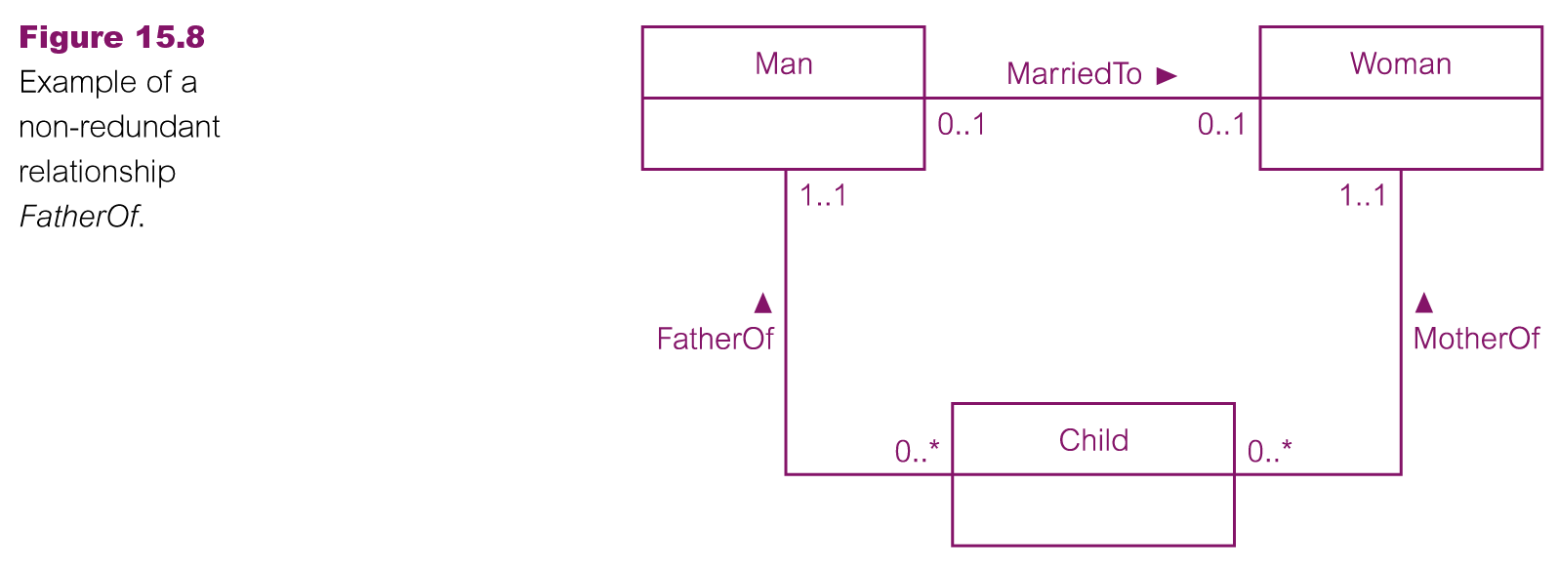
Building Conceptual Data Model..

Slide 18
Building Conceptual Data Model..
Validate conceptual model against user transactions
  We examine two possible approaches to ensuring that the conceptual data model supports the required transactions:
  Describing the transactions
    List the details of properties managed by a named member of staff at the branch
  Using transaction pathways

Slide 19
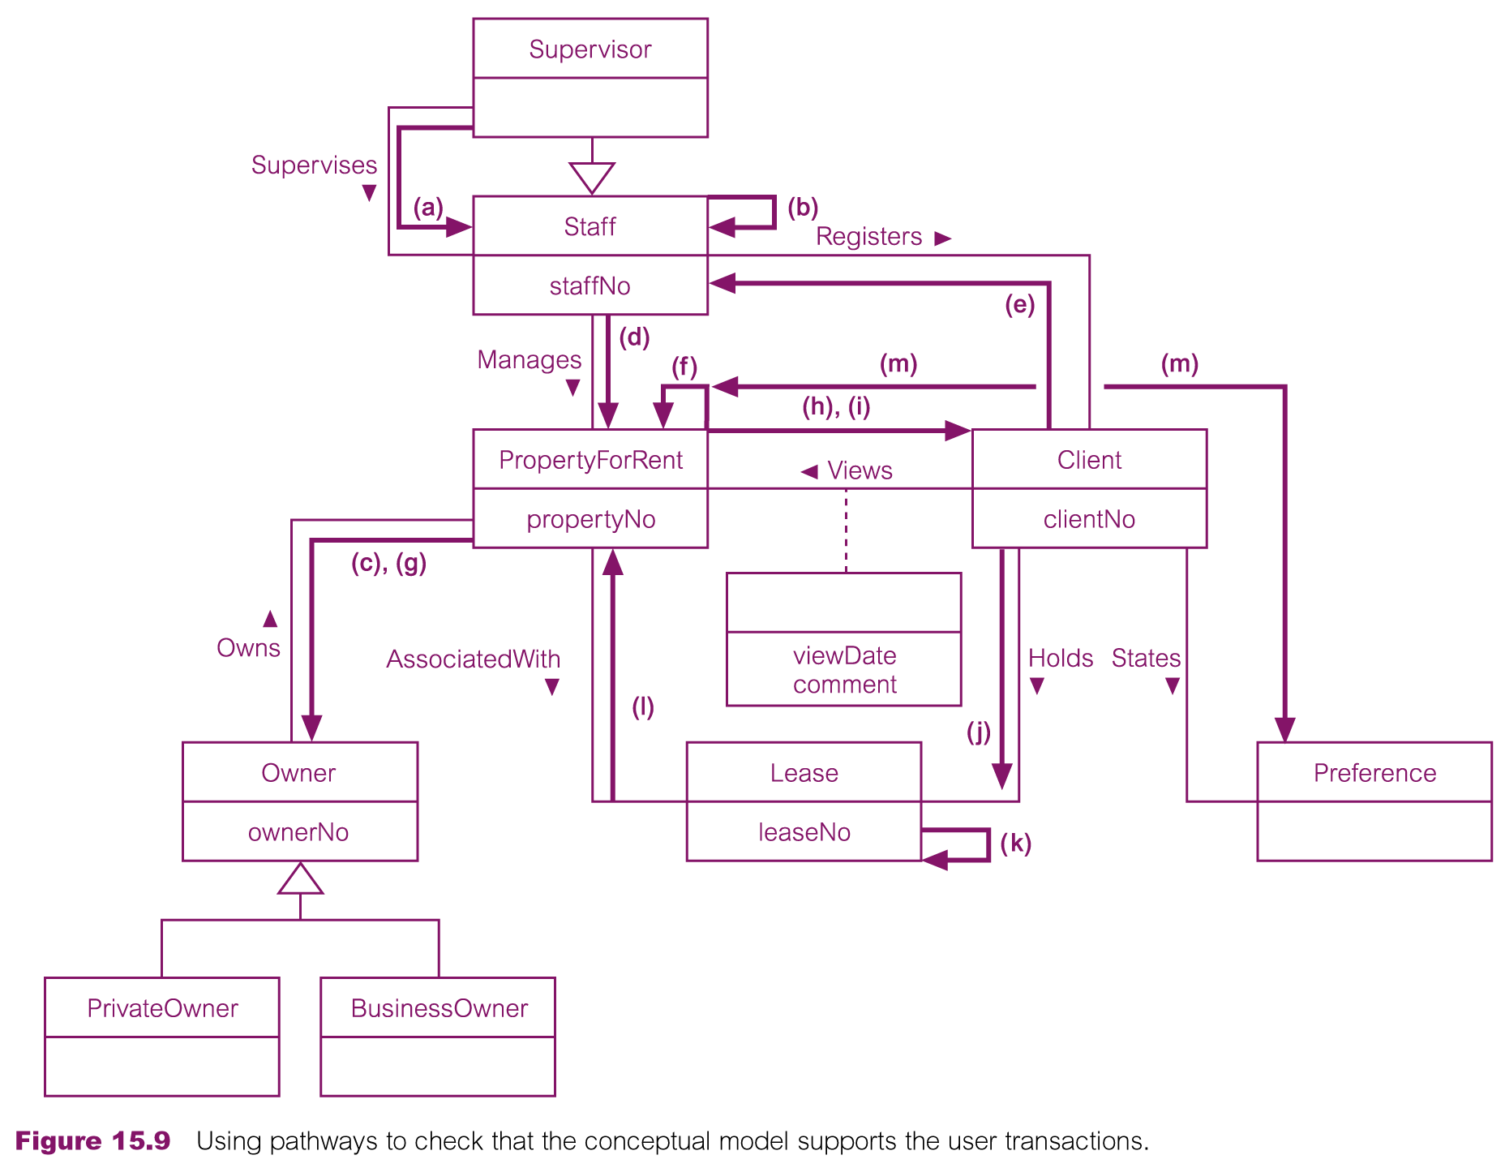
Building Conceptual Data Model..

Slide 20
Building Conceptual Data Model..
Review conceptual data model with user
  To review the conceptual data model with the users to ensure that they consider the model to be a ‘true’ representation of the data requirements of the enterprise
  If any anomalies are present in the data model, we must make the appropriate changes, which may require repeating the previous step
  We repeat this process until the user is prepared to ‘sign off’ the model as being a ‘true’ representation of the part of the enterprise that we are modeling

Slide 21
Logical Database Design (RDM)
Chapter 16

Slide 22
Building Logical Data Model
Build and validate logical data model
  To translate the conceptual data model into a logical data model and then to validate this model to check that it is structurally correct and able to support the required transactions

Slide 23
Building Logical Data Model
Activities included in building logical data model are:
  Derive relations for logical data model
  Validate relations using normalization
  Validate relations against user transactions
  Check integrity constraints
  Review logical data model with user
  Merge logical data models into global model (optional)
  Check for future growth

Slide 24
Building Logical Data Model
Derive relations for logical data model
  To create relations for the logical data model to represent the entities, relationships, and attributes that have been identiﬁed
  Database Deﬁnition Language (DBDL) for relational databases
  Relation name followed by a list of the relation’s attributes enclosed in brackets
  Identification of PK, AKs and FKs
  Placement of FKs (parent/child)

Slide 25
Building Logical Data Model
Relations are derived for the following structures that may occur in a conceptual data model:
  Strong entity types
  Weak entity types
  One-to-many (1:*) binary relationship types
  One-to-one (1:1) binary relationship types
  One-to-one (1:1) recursive relationship types
  Superclass/subclass relationship types
  Many-to-many (*:*) binary relationship types
  Complex relationship types
  Multi-valued attributes

Slide 26
Building Logical Data Model
Strong entity types
  For each strong entity in the data model, create a relation that includes all the simple attributes of that entity
  For composite attributes, include only the constituent simple attributes
  Staff (staffNo, fName, lName, position, sex, DOB)
  Primary Key staffNo

Slide 27
Building Logical Data Model
Weak entity types
  For each weak entity in the data model, create a relation that includes all the simple attributes of that entity
  The primary key of a weak entity is partially or fully derived from each owner entity and so the identification of the primary key of a weak entity cannot be made until after all the relationships with the owner entities have been mapped
    Preference (prefType, maxRent)
    Primary Key None (at present)

Slide 28
Building Logical Data Model
Weak entity types
  For each weak entity in the data model, create a relation that includes all the simple attributes of that entity
  The primary key of a weak entity is partially or fully derived from each owner entity and so the identification of the primary key of a weak entity cannot be made until after all the relationships with the owner entities have been mapped
    Preference (prefType, maxRent)
    Primary Key None (at present)

Slide 29
Building Logical Data Model
One-to-many (1:*) binary relationship types
  For each 1:* binary relationship, the entity on the ‘one side’ of the relationship is designated as the parent entity and the entity on the ‘many side’ is designated as the child entity
  To represent this relationship, post a copy of the primary key attribute(s) of parent entity into the relation representing the child entity, to act as a foreign key e.g. Staff , Client relationship etc.
  In the case where a 1:* relationship has one or more attributes, these attributes should follow the posting of the primary key to the child relation e.g. attribute called dateRegister etc.

Slide 30
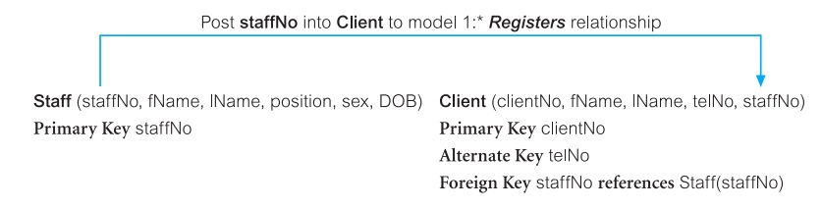
Building Logical Data Model
One-to-many (1:*) binary relationship types

Slide 31
Building Logical Data Model
One-to-one (1:1) binary relationship types
  Creating relations to represent a 1:1 relationship is more complex as the cardinality cannot be used to identify the parent and child entities in a relationship
  Instead, the participation constraints are used to decide whether it is best to represent the relationship by combining the entities involved into one relation or by creating two relations and posting a copy of the primary key from one relation to the other, consider the following:
    Mandatory participation on both sides of 1:1 relationship
    Mandatory participation on one side of 1:1 relationship
    Optional participation on both sides of 1:1 relationship

Slide 32
Building Logical Data Model
One-to-one (1:1) binary relationship types
  Mandatory participation on both sides of 1:1 relationship
    Combine entities involved into one relation and choose one of the primary keys of original entities to be primary key of the new relation, while the other (if one exists) is used as an alternate key
    Client States Preference relationship is an example of a 1:1 relationship with mandatory participation on both sides
    Client (clientNo, fName, lName, telNo, prefType, maxRent, staffNo)
    Primary Key clientNo
    Foreign Key staffNo references Staff(staffNo)
    In the case where a 1:1 relationship with mandatory participation on both sides has one or more attributes, these attributes should also be included in the merged relation e.g. States relationship had an attribute called dateStated etc.

Slide 33
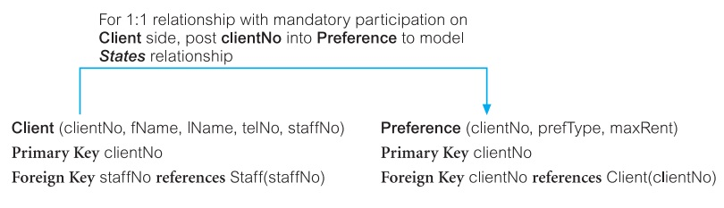
Building Logical Data Model
One-to-one (1:1) binary relationship types
  Mandatory participation on one side of a 1:1 relationship
    Identify parent and child entities using participation constraints
    Entity with optional participation in relationship is designated as parent entity, and entity with mandatory participation is designated as child entity
    A copy of primary key of the parent entity is placed in the relation representing the child entity
    If the relationship has one or more attributes, these attributes should follow the posting of the primary key to the child relation

Slide 34
Building Logical Data Model
One-to-one (1:1) binary relationship types
  Optional participation on both sides of a 1:1 relationship
    In this case, the designation of the parent and child entities is arbitrary unless we can find out more about the relationship that can help a decision to be made one way or the other
    However, assume that the majority of cars, but not all, are used by staff and only a minority of staff use cars
    The Car entity in ‘Staff Uses Car’ relationship, although optional, is closer to being mandatory than the Staff entity
    We therefore designate Staff as the parent entity and Car as the child entity, and post a copy of the primary key of the Staff entity (staffNo) into the Car relation

Slide 35
Building Logical Data Model
One-to-one (1:1) recursive relationship types
  For a 1:1 recursive relationship, follow the rules for participation as described above for a 1:1 relationship
  Mandatory participation on both sides, represent the recursive relationship as a single relation with two copies of the primary key
  Mandatory participation on only one side, option to create a single relation with two copies of the primary key, or to create a new relation to represent the relationship, the new relation would only have two attributes, both copies of the primary key
  As before, the copies of the primary keys act as foreign keys and have to be renamed to indicate the purpose of each in the relation
  Optional participation on both sides, again create a new relation as described above

Slide 36
Building Logical Data Model
Superclass/subclass relationship types
  Identify superclass entity as parent entity and subclass entity as the child entity
  There are various options on how to represent such a relationship as one or more relations
  The selection of the most appropriate option is dependent on a number of factors such as the disjointness and participation constraints on the superclass/subclass relationship, whether the subclasses are involved in distinct relationships, and the number of participants in the superclass/subclass relationship

Slide 37
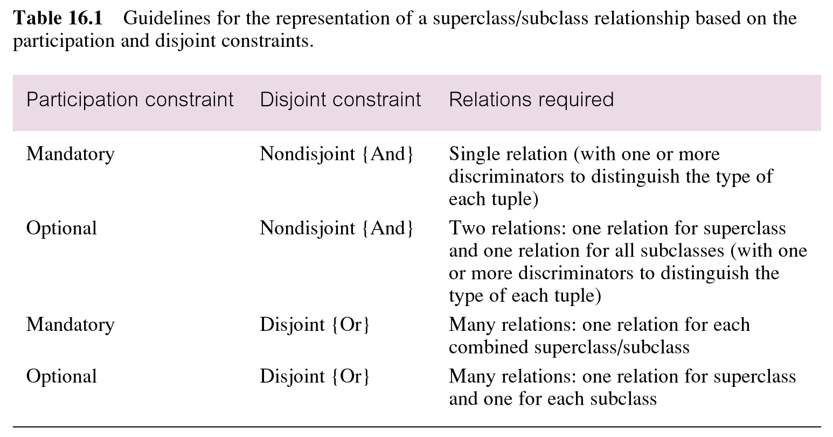
Building Logical Data Model
Superclass/subclass relationship types

Slide 38
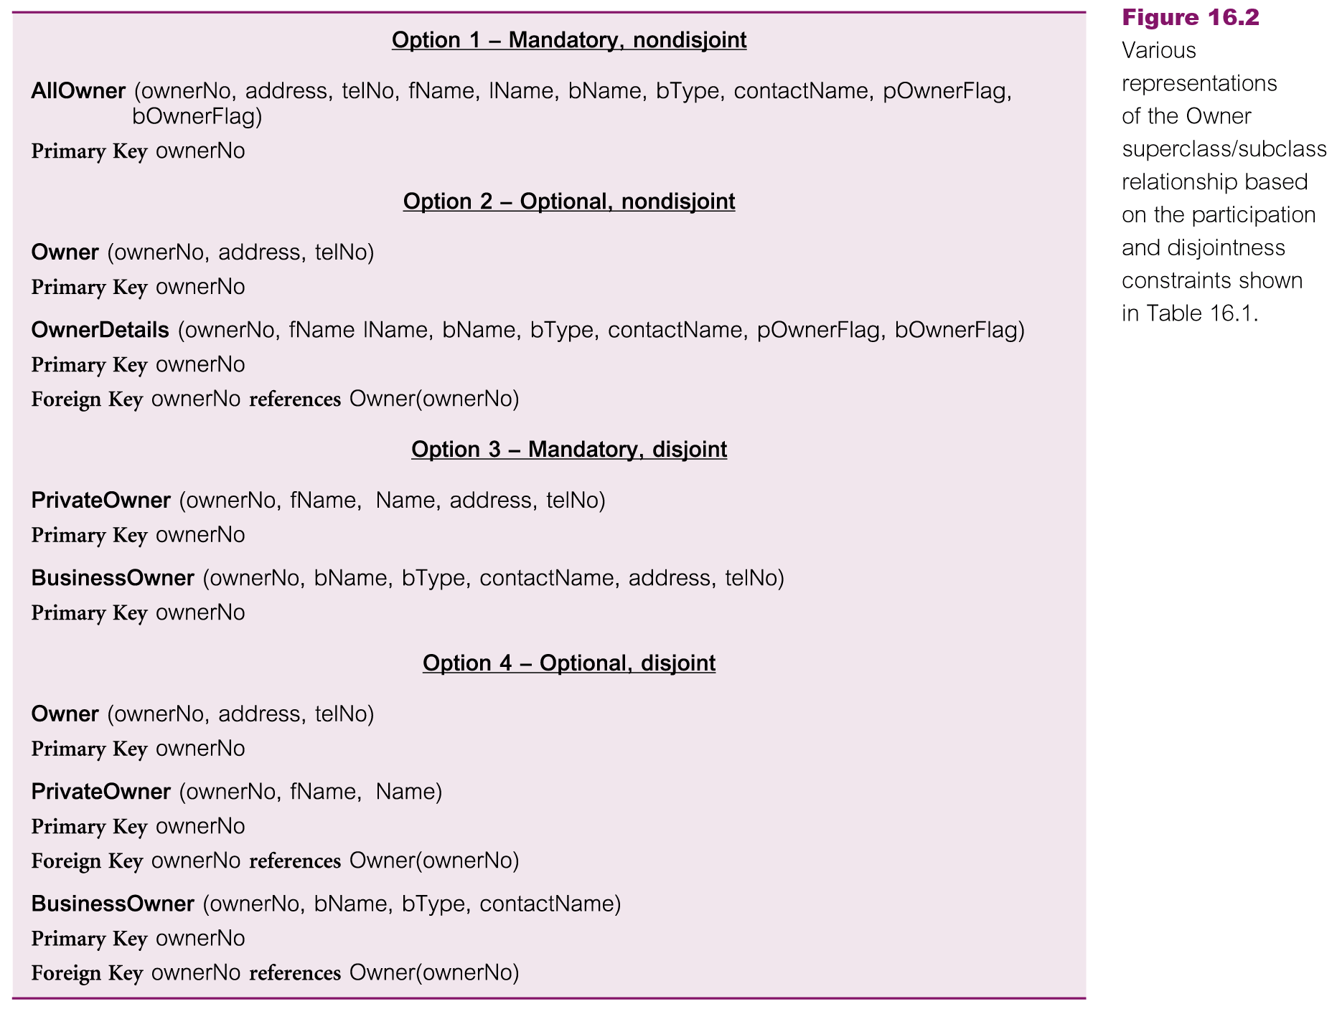
Building Logical Data Model

Slide 39
Building Logical Data Model
Many-to-many (*:*) binary relationship types
  Create a relation to represent the relationship and include any attributes that are part of the relationship
  We post a copy of the primary key attribute(s) of the entities that participate in the relationship into the new relation, to act as foreign keys
  These foreign keys will also form the primary key of the new relation, possibly in combination with some of the attributes of the relationship

Slide 40
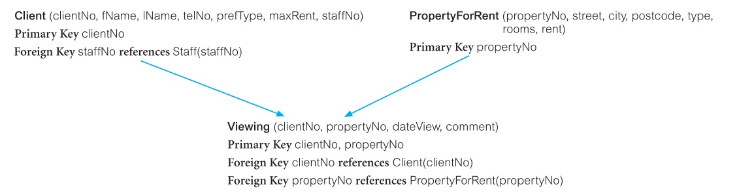
Building Logical Data Model
Many-to-many (*:*) binary relationship types

Slide 41
Building Logical Data Model
Complex relationship types
  Create a relation to represent the relationship and include any attributes that are part of the relationship
  Post a copy of the primary key attribute(s) of the entities that participate in the complex relationship into the new relation, to act as foreign keys
  Any foreign keys that represent a ‘many’ relationship (for example, 1..*, 0..*) generally will also form the primary key of this new relation, possibly in combination with some of the attributes of the relationship

Slide 42
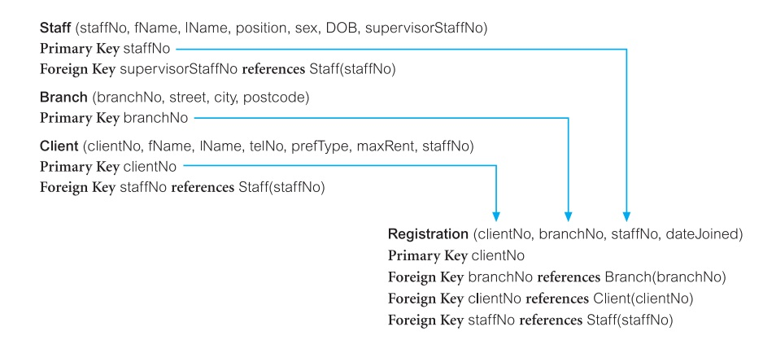
Building Logical Data Model
Complex relationship types

Slide 43
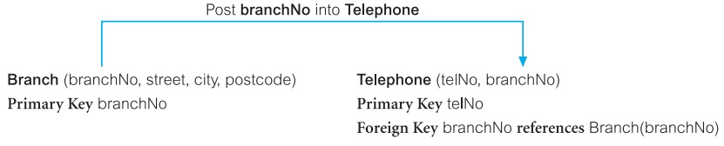
Building Logical Data Model
Multi-valued attributes
  Create a new relation to represent multi-valued attribute and include primary key of entity in new relation, to act as a foreign key
  Unless the multi-valued attribute is itself an alternate key of the entity, the primary key of the new relation is the combination of the multi-valued attribute and the primary key of the entity

Slide 44
Building Logical Data Model
Multi-valued attributes
  Create a new relation to represent multi-valued attribute and include primary key of entity in new relation, to act as a foreign key
  Unless the multi-valued attribute is itself an alternate key of the entity, the primary key of the new relation is the combination of the multi-valued attribute and the primary key of the entity

Slide 45
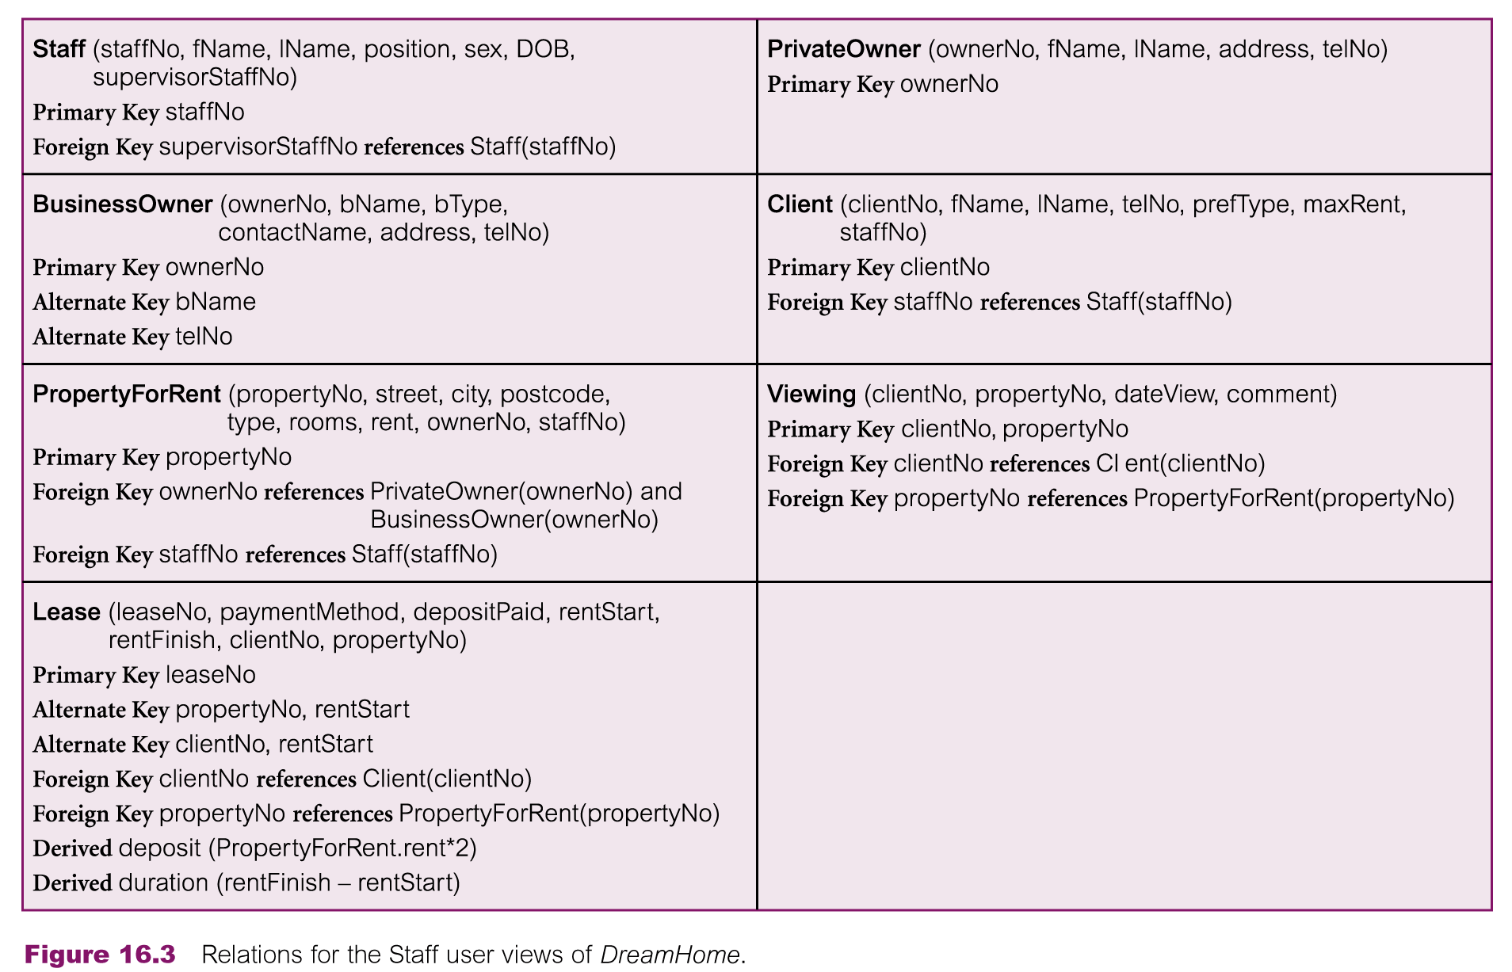
Relations: Staff User View

Slide 46
Building Logical Data Model
Document relations and FK attributes
Validate relations using normalization
  To validate the relations in the logical data model using normalization

Slide 47
Summary
Remaining activities/steps in building conceptual data model
Logical database design
  Build and validate logical database design
    Derive relations for logical data model
    Validate relations using normalization

Slide 48
References
All the material (slides, diagrams etc.) presented in this lecture is taken (with modifications) from the Pearson Education website :
  http://www.booksites.net/connbegg

