Slide 1
CSC241: Object Oriented Programming
Lecture No 06

Slide 2
Previous Lecture
Reference variable
Why object pass to a function by reference
const object
this pointer
  Type of this pointer
  Cascading function calls
Dynamic memory allocation

Slide 3
Today’s Lecture
static class member
Information hiding
Abstract data type (ADT)
Container classes
Proxy classes

Slide 4
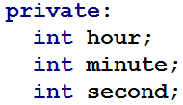
Object’s data member
Each object of a class has its own copy of all the data members of the class
noon
hours
12
minutes
0
seconds
0
wakeup
hours
5
minutes
50
seconds
0

Slide 5
static Data Members
In certain cases, only one copy of a variable can be shared by all objects of a class
A static data member is used
If a data item in a class is declared as static, only one such item is created for the entire class, no matter how many objects are created
static data
0
Object 1
Object 2
Object 3
data1
2
data1
4
data1
9
data2
4
data2
15
data2
3

Slide 6
Cont.
A member static variable is visible only within the class, but its lifetime is the entire program
They seems like global variables
It continues to exist even if there are no objects of the class
A static data item is useful when all objects of the same class must share a common item of information

Slide 7
Uses of static data member
Suppose an object needed to know how many other objects of its class were in the program
For example, in road-racing game a car might want to know how many other cars are still in the race
In this case a static variable count could be included as a member of the class
All the objects would have access to this variable

Slide 8
Example – Race class
class Race
{
private:
static int count;
int carNo;
public:
Race()
{ count++; carNo=0; }
void setCarNo(int no)
{ carNo = no; }
void printData() {
cout<<“Total car = ”<< count;
cout<<“,Car No. = ”<<carNo<<endl;
}
};
int Race::count = 0;
main()
{
  Race c1, c2, c3; //create three objects
  c1.setCarNo(10); c2.setCarNo(11);
  c3.setCarNo(12);
  c1.printData();
  c2.printData(); c3.printData();
}
count
0
2
1
3
c1
c2
0
11
carNo
10
carNo
0
c3
12
carNo
0
Total car = 3, Car No. 10
Total car = 3, Car No. 11
Total car = 3, Car No. 12

Slide 9
Cont.
class Race
{
private:
static int count;
int carNo;
public:
Race()
{ count++; carNo=0; }
void setCarNo(int no)
{ carNo = no; }
void printData() {
cout<<“Total car = ”<< count;
cout<<“,Car No. = ”<<carNo<<endl;
}
};
int Race::count = 0;
main()
{
  Race c1, c2; //create three objects
  c1.setCarNo(10); c2.setCarNo(11);
  c1.printData();
  c2.printData();
  Race c3; c3.setCarNo(12); c3.printData();
}
count
0
2
1
3
c1
c2
10
0
0
carNo
carNo
11
c3
12
carNo
0
Total car = 2, Car No. 10
Total car = 2, Car No. 11
Total car = 3, Car No. 12

Slide 10
Static data member – access
A public static data member can be access using any object of the class or class name
  [Object Name].[name of static variable]
    e1.count;
  [Class Name] :: [name of static variable]
    Employee ::count;
A private static member can be access using a public member function
  [objectName].[public member function]
    e1.getCount();
  [Class name]::[public member function]
    Employee::getCount();

Slide 11
static member function
A function should be static if it only access static member of class
A call to a static function does not need an object as handler, it needs a class name
A static function
  cannot access non static member function
  does not have a this pointer

Slide 12
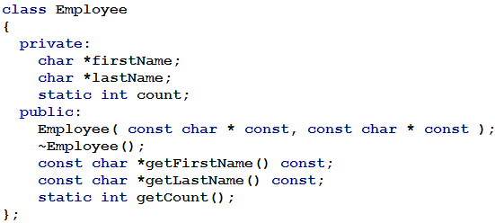
Example – Employee class

Slide 13
Cont
char *
  A pointer to a character
const char *
  Pointer to a constant character
f
c
705
705
*p
874
m
874
f
c
705
705
*p
874
m
874

Slide 14
Cont
char * const
  Constant pointer to a character
const char * const
  Constant pointer to a constant character
f
c
*p
705
705
705
874
m
874
c
f
*p
705
705
705
874
m
874

Slide 15

const char * as return type
But return type of getFirstName() and getLastName() are const char *
If return type char * is non constant pointer mean one can change the content
const char * means content cannot be changed
Ahmad
Ali
6000
Go to program

Slide 16
Information hiding
A class normally hides its implementation details from its clients
For example,
  a library contains classes, compile form is given to users
  Users includes header file in cpp file contain main function and set library path
  Compile the file and use library
Go to program

