Slide 1
CSC241: Object Oriented Programming
Lecture No 28

Slide 2
Previous Lecture
Exception
Exception handling
  Why exception handling ?
try , catch and throw block
  Program skeleton
  Example program stack ( class Range { }; )
Multiple exceptions
  class Full { };
  class Empty { };

Slide 3
Today’s Lecture
Exception in Distance class
Re-throwing an exception
Exception with arguments
bad_alloc class
set_new_handler function

Slide 4
Exceptions with the Distance Class
class Distance {
private:
int feet; float inches;
public:
  class InchesEx { };
  Distance() { feet = 0; inches = 0.0; }
  Distance(int ft, float in) {
    if(in >= 12.0)
    throw InchesEx();
    feet = ft; inches = in;
  }
  void getdist() {
    cout << “\nEnter feet: “; cin >> feet;
    cout << “Enter inches: “; cin >> inches;
    if(inches >= 12.0)
    throw InchesEx();
  }
};
Go to program

Slide 5
Re-throwing an Exception
An exception handler (catch block) when receive an exception may decide that
  It cannot process that exception or
  It can process the exception only partially
It might re-throw an exception to another exception handler via throw statement
Go to program

Slide 6
Exceptions with Arguments
What happens if the application needs more information about what caused an exception?
For example
  In the Distance example, it is useful to display what the bad inches value actually was
  If the same exception is thrown different member functions, it be useful to display which function causes that exception to be thrown
Two things happened when an exception is thrown
  transferring control to the handler (catch block)
  creating an object of the exception class by calling its constructor
throw Full();
throw Empty();

Slide 7
Exceptions with Arguments-Distance class
class Distance {
private:
int feet; float inches;
public:
    class InchesEx {
    public:
    string origin;
    float iValue;
    InchesEx(string or, float in) {
    origin = or;
    iValue = in;
    }
    };
    Distance()
    { feet = 0; inches = 0.0; }
  . . .
main()
{
  try{
  Distance dist1(17, 3.5);
  Distance dist2;
  . . . .
  }
  catch(Distance::InchesEx ix)
  {
cout << “Error in “
<< ix.origin
<< “Inches value of “
<<xi.Value << “ is too large.”;
}
}
Go to program

Slide 8
Specifying Data in an Exception Class
Data in an exception class is public so it can be accessed directly by the exception handler
Exception class data member can be private
class InchesEx {
public:
string origin;
float iValue;
InchesEx(string or, float in)
{
origin = or;
iValue = in;
}
};

Slide 9
Initializing an Exception Object
two-argument constructor for the Stack class
in the getdist() member function
throw InchesEx(“2-arg constructor”, in);
throw InchesEx(“getdist() function”, inches);

Slide 10
Extracting Data from the Exception Object
catch(Distance::InchesEx ix)
{
//access ‘ix.origin’ and ‘ix.iValue’ directly
}
Enter feet: 7
Enter inches: 13.5
Initialization error in getdist() function
Inches value of 13.5 is too large
Distance dist1(17, 22.25);
the resulting exception will cause this error message:
Initialization error in 2-arg constructor.
Inches value of 22.25 is too large.

Slide 11
Constructors, Destructors and Exception Handling
What happens when an error is detected in a constructor?
How should an object's constructor respond when new fails to allocate memory
Constructor return no value so alternative mechanism is use to indicate an error
Mechanisms are
  Global variable
  A construct must throw an exception

Slide 12
Cont.
Exceptions thrown by a constructor cause destructors to be called
If an object has member objects,
  an exception is thrown before the outer object is fully constructed
  then destructors will be executed for the member objects that have been constructed prior to the occurrence of the exception
  In case of array of objects, only destructors for the constructed objects in the array will be called

Slide 13
The bad_alloc Class
Standard C++ contains several built-in exception classes.
The most commonly used is bad_alloc, which is thrown if an error occurs when attempting to allocate memory with new
This exception was called xalloc in earlier versions of C++.
Go to program

Slide 14
set_new_handler function
It is an additional feature for handling new failures
It takes as argument a pointer to a function with
  with no arguments
  returns void
  set_new_handles( functionName );
This function will be called if new fails
This provides a method to handling all new failure with a uniform approach

Slide 15
Cont.
If new allocates memory successfully, it returns a pointer to that memory
If new fails to allocate memory, then
  If set_new_handler did not register a new-handler function, new throws a bad_alloc exception
  If a new-handler function has been registered, the new-handler function is called

Slide 16
Task performed by handler-function
Make more memory available by deleting other dynamically allocated memory and return to operator new to attempt to allocate memory again.
Throw an exception of type bad_alloc.
Call function abort or exit to terminate the program

Slide 17
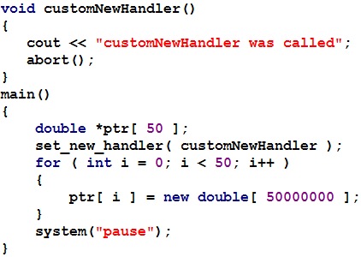
Example

Slide 18
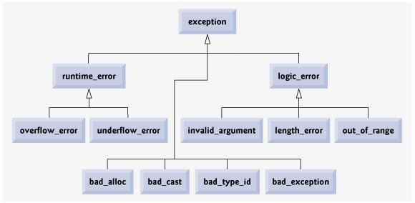
Standard Library Exception Hierarchy

Slide 19
Summary
An exception is an indication of a problem that occurs during a program's execution
Exception handling enables programmers to create programs that can resolve problems that occur at execution
Exception handling enables the programmer to remove error-handling code
try block define a block of code in which exceptions might occur
At least one catch handler must immediately follow a try block

Slide 20
Cont.
catch handler specifies an exception parameter that represents the type of exception the catch handler can process
Point in the program at which an exception occurs is called the throw point
When a try block terminates, local variables defined in the block go out of scope
Common examples of exceptions are
  out-of-range array subscripts,
  arithmetic overflow,
  division by zero,
  invalid function parameters and
  unsuccessful memory allocations

Slide 21
Cont.
Destructors are called for every object constructed in a try block before an exception is thrown
If an array of objects has been partially constructed when an exception occurs, only the destructors for the constructed array element objects will be called.

Slide 22
Exercise program
A queue is a data-storage device. It’s like a stack, except that, instead of being last-infirst-out, it’s first-in-first-out, like the line at a bank teller’s window.
Write a class template for a queue class. Also check if the queue is full or empty and throw an exception if it is
Go to program

