Slide 1
CSC241: Object Oriented Programming
Lecture No 25

Slide 2
Previous Lecture
Example programs
  Publication company
    Two derived classes
      Book and Tape
    Polymorphic behavior: Virtual function
  Distance class
    Overloaded * operator
    Friend version of member function required one more argument

Slide 3
Today’s Lecture
Intro to Generic Programming
  Template
    Function template
    Class template

Slide 4
Generic programming
There are situations where same algorithms works for different data type
  Suppose a function that returns the maximum of two numbers
    Same algorithm (to find the max number) works with integers and real numbers
  Until now we have to write two separate function
    int max (int, int);
    float max (float, float);
  Through generic programming we can have just one function to find max of int or float or any other type of values

Slide 5
Cont.
Generic programming is a style of computer programming in which algorithms are written in terms of to-be-specified-later types that are then instantiated when needed for specific types provided as parameter
So if max() function is called with int parameter, max function with int parameter is created
In C++ generic programming is implemented with “templates

Slide 6
Benefit of generic programming
Value Max (Value1, Value2) {
if( Value1 > Value2 )
return Value1;
else
return Value2;
}
Reusability
y= Max(15, 67);
y= Max(15.45, 67.45);
int Max (int arg1, int arg2) {
if( 15 > 67 )
return arg1;
else
return arg2;
}
int Max (float arg1, float arg2) {
if( 15 > 67 )
return arg1;
else
return arg2;
}

Slide 7
Templates
Templates make it possible to use one function or class to handle many different data types
The template concept can be used in two different ways:
  with functions and
  with classes

Slide 8
A simple function template
Suppose we want to write a function that returns the absolute value of two numbers
absolute value of a number is its value without regard to its sign:
  absolute value of 3 is 3
  absolute value of –3 is also 3
  absolute value of 4.5 is 4.5
  absolute value of -4.5 is 4.5

Slide 9
Why Template
int abs(int n) {
return (n<0) ? (-1*n) : n;
}
long abs(long n) {
return (n<0) ? (-1*n) n;
}
float abs(float n) {
return (n<0) ? (-1*n) : n;
}
Observations:
Same algorithm: body of function is same in each case
But they are completely different functions because they handle different types of arguments and return values
Time-consuming and wastes space
Using template you need to write such a function just once, and it works for many different data types

Slide 10
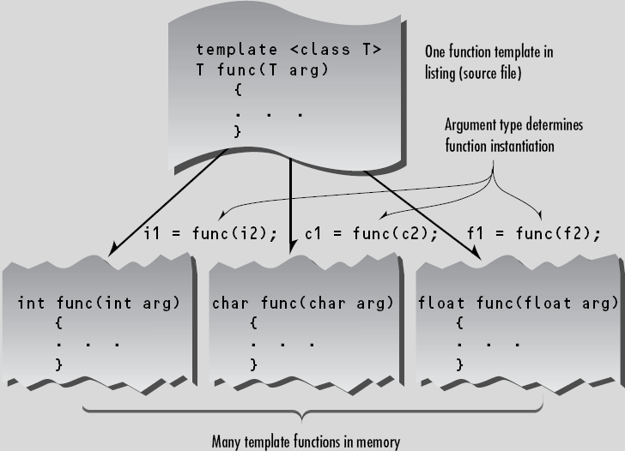

Slide 11
Template version of abs function
template <class T>
T abs(T n) {
return (n<0) ? -1*n : n;
}
function template
Key feature: represent the data type used by the function i.e. T. It is also called template argument
keyword class might just be called type, as user define class also represent new type

Slide 12
What the Compiler Does
At compile time:
  Compiler do nothing for template function
  It cannot generate code as it don’t know type
  It remember template function for future reference
Code generation of template function take place when that function is invoked
Now compiler know that type is int
So it generates a specific version of the abs() function for type int
int x=-3, y;
y = abs (x);

Slide 13
Example Program – abs function
template <class T>
T abs(T n) {
return (n < 0) ? (-1*n) : n;
}
main() {
int int1 = 5, int2 = -6;
long lon1= 70000, lon2 = -80000,
double dub1 = 9.95, dub2 = -10.15;
}
Program Output
5
6
70000
80000
9.95
10.15
int abs(int n) {
return (n<0) ? (-1*n) : n;
}
cout << abs(int1);
cout << abs(int2);
cout << abs(lon1);
long abs(long n) {
return (n<0) ? (-1*n) n;
}
cout << abs(lon2);
cout << abs(dub1);
cout << abs(dub2);
Go to program
double abs(double n) {
return (n<0) ? (-1*n) : n;
}

Slide 14
Simplifying source file
Amount of RAM used is same
  whether template approach is used or
  actually write three separate functions
Template approaches simply saves from having three separate functions into the source file
This makes the source file shorter and easier to understand
For any change in function, the change should be make in only one place in the source file instead of three places

Slide 15
Example program 2
Write a program that can sort int, float, double, character and etc type of array in ascending order and then display it.
Write a program

Slide 16
Function Templates – Multiple Arguments
Suppose a function to search an array for a specific value
This function takes three arguments:
  two that are template arguments
  one of a basic type
Function returns the array index for that value if it finds it, or –1 if it can’t find it

Slide 17
template <class atype>
int find(atype* array, atype value, int size)
{
for(int j=0; j<size; j++)
if(array[j]==value)
return j;
return -1;
}
char chrArr[] = {‘a’, ‘b’, ‘c’, ‘d’, ‘e’, ‘f’};
char ch = ‘d’;
int intArr[] = {1, 3, 5, 9, 11, 13};
int in = 6;
long lonArr[] = {1, 3, 5, 9, 11, 13};
long lo = 11;
double dubArr[] = {1.0, 3.0, 5.0, 9.0, 11.0, 13.0};
double db = 4.5;
main() {
cout << “\n d in chrArray: index=” << find(chrArr, ch, 6);
cout << “\n 6 in intArray: index=” << find(intArr, in, 6);
cout << “\n11 in lonArray: index=” << find(lonArr, lo, 6);
cout << “\n 4 in dubArray: index=” << find(dubArr, db, 6);
}
Program Output
d in chrArray: index=3
6 in intArray: index=-1
11 in lonArray: index=4
4 in dubArray: index=-1
Go to program

Slide 18
Template Arguments Must Match
When a template function is invoked, all instances of the same template argument must be of the same type.
For example, in find(), if the array name is of type int, the value to search for must also be of type int.
Following code give and error message
  int intarray[] = {1, 3, 5, 7};
  float f1 = 5.0;
  int value = find(intarray, f1, 4);
because the compiler expects all instances of atype to be the same type. It can generate a function
    find( int*, int, int);
    but it can’t generate
    find( int*, float, int);

Slide 19
More Than One Template Argument
template <class atype, class btype>
btype find( atype * array, atype value, btype size)
{
for(btype j=0; j<size; j++) //note use of btype
{
if(array[j]==value)
return j;
}
return (btype)(-1);
}
int a[5] = {4, 3, 2, 6, 7}, y, b=3;
y = find (a, b, 5);
int a[5] = {4, 3, 2, 6, 7}, y;
float b=3.5;
y = find (a, b, 5);

Slide 20
Why not marcos?
Macros can be used to create different versions of a function for different data types.
#define abs(n) ( (n<0) ? (-1*n) : (n) )
It performs a simple text substitution and can thus work with any type
Problem:
  macros don’t perform any type checking
  Compiler wouldn’t check if several argument of marcos are of same type or not
  Return value type is not specified

Slide 21
What type works?
How to determine that a template function can be instantiated for a particular data type?
E.g. can find function works with c-strings type

