Slide 1
CSC241: Object Oriented Programming
Lecture No 23

Slide 2
Previous Lecture
Example program
  Copy initialization
  Assignment operator overloaded
Memory efficient string class

Slide 3
Today’s Lecture
Efficient string class
  Resolve problem while deleting String objects
Dynamic Type Information

Slide 4
Cont.
It’s more efficient to create a new class to store the count
Each object of this class, which we call strCount, contains a count and also a pointer to the string

Slide 5
Cont.
main() {
}
void operator = (String& S) {
if(psc->count==1)
delete psc;
else,
(psc->count)--;
psc = S.psc;
(psc->count)++;
}
String(String& S) {
psc = S.psc;
(psc->count)++;
}
String(char* s) {
psc = new strCount(s); }
String()
{ psc = new strCount(“\0”); }
String s3 = “hello world.”;
~strCount()
{ delete[] str; }
cout << “\ns3=”; s3.display();
strCount(char* s) {
int length = strlen(s);
str = new char[length+1]; strcpy(str, s);
count=1;
}
String s1;
s1 = s3;
Go to program
cout << “\ns1=”; s1.display();
String s2(s3);
S3
S1
S2
cout << “\ns2=”; s2.display();
*psc:
*psc:
*psc:
7550
:strcount
:strcount
Program Output
count:
count:
1
2
3
1
s3= hello world. addr=7550
*str:
*str:
s1= hello world. addr=7550
hello world
\0
s2= hello world. addr=7550

Slide 6
Note
Why must the assignment operator in String worry about deletion?
S2
S1
S3
7550
8750
8750
*psc:
*psc:
*psc:
7550
7550
7550
:strcount
8750
:strcount
count:
count:
1
1
2
1
0
650
975
*str:
*str:
650
hello world
975
Good morning
S1 = S2;
S3 = S1;

Slide 7
Cont.
String object on the left of the equal sign (s1=s2) was pointing at some strCount object (call it oldStrCnt) before the assignment.
After the assignment s1 will be pointing to the object on the right of the equal sign.
If there are now no String objects pointing to oldStrCnt, it should be deleted.

Slide 8
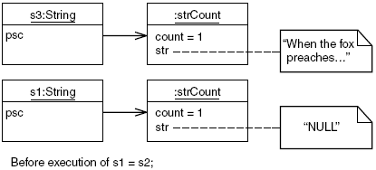
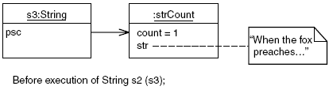
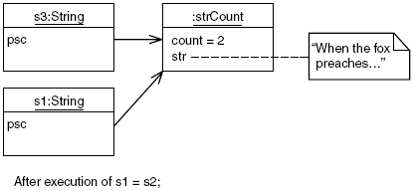
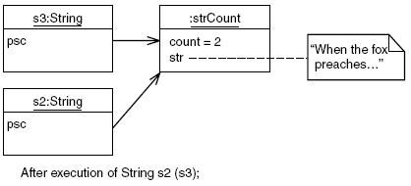
Assignment operator
Copy constructor

Slide 9
this Pointer
The member functions of every object have access to a sort of magic pointer named this, which points to the object itself.
Thus any member function can find out the address of the object of which it is a member

Slide 10
Example
class where {
private:
char charray[10];
public:
void reveal()
{ cout << “\nMy object’s address is “ << this; }
};
main() {
where w1, w2, w3;
w1.reveal();
w2.reveal();
w3.reveal();
cout << endl;
}
Program Output
My object’s address is 0x8f4effec
My object’s address is 0x8f4effe2
My object’s address is 0x8f4effd8

Slide 11
Accessing Member Data with this
class what {
private:
int alpha;
public:
void tester() {
this->alpha = 11; //same as alpha = 11;
cout << this->alpha; //same as cout << alpha;
}
};
main() {
what w;
w.tester();
cout << endl;
}

Slide 12
Using this for Returning Values
class alpha {
private:
int data;
public:
alpha() { }
alpha(int d) { data = d; }
void display()
{ cout << data; }
alpha& operator = (alpha& a) {
data = a.data;
cout << “\nAssignment operator
invoked”;
return *this;
}
};
main() {
alpha a1(37);
alpha a2, a3;
a3 = a2 = a1;
cout << “\na2=”; a2.display();
cout << “\na3=”; a3.display();
}

Slide 13
Beware of Self-Assignment
Murphy’s Law states that whatever is possible, someone will eventually do.
This is certainly true in programming, so you can expect that if you have overloaded the = operator, someone will use it to set an object equal to itself
s1 = s1;
Problem
the code for the assignment operator deletes the strCount object if it thinks the object that called it is the only object using the strCount.

Slide 14
Cont.
S1
7550
*psc:
S1 = S1;
7550
:strcount
count:
1
650
*str:
650
hello world
To fix this, self-assignment should be checked at the start of any overloaded assignment operator.
if(this == &S)
return *this;
Go to program

Slide 15
Dynamic Type Information
It’s possible to find out below information at run time about
  an object’s class and
  even change the class of an object
Such capabilities are used in situations where a variety of classes are descended from a base class
For dynamic casts to work, the base class must be polymorphic

Slide 16
Cont.
To achieve such capabilities, we will see two mechanisms
  the dynamic_cast operator,
  the typeid operator

Slide 17
Checking class type using dynamic_cast
Suppose some other program sends your program an object
It’s supposed to be a certain type of object, but you want to check it to be sure
How can you tell if an object is a certain type?
  dynamic_cast operator provides a way,
  Condition: classes whose objects you want to check are all descended from a common ancestor.

Slide 18
Example
class Base {
virtual void vertFunc() { }
};
class Derv1 : public Base { };
class Derv2 : public Base { };
bool isDerv1(Base* pUnknown) {
Derv1* pDerv1;
if( pDerv1 = dynamic_cast<Derv1*>(pUnknown) )
return true;
else
return false;
}
Go to program

Slide 19
Changing Pointer Types with dynamic_cast
dynamic_cast operator allows you to cast upward and downward in the inheritance tree
class Base {
protected:
int ba;
public:
Base() : ba(0) { }
Base(int b) : ba(b) { }
virtual void vertFunc() { }
void show() {
cout << “Base:ba=” << ba;
}
};
class Derv : public Base {
private:
int da;
public:
Derv(int b, int d) : da(d) {
ba = b;
}
void show() {
cout << "Derv: ba=" << ba
<< ", da=" << da ;
}
};

Slide 20
Cont.
main() {
Base* pBase = new Base(10);
Derv* pDerv = new Derv(21, 22);
}
*pDerv
ba
31
pBase = dynamic_cast<Base*>(pDerv);
pBase->show();
da
32
*pBase
pBase = new Derv(31, 32);
ba
21
pDerv = dynamic_cast<Derv*>(pBase);
pDerv->show();
da
22
ba
10
Go to program
Program output
void show() {
cout << "Derv: ba=" << ba
<< ", da=" << da ;
}
void show() {
cout << “Base:ba=” << ba;
}
base: ba = 21
Derv: ba = 31, da = 32

Slide 21
typeid Operator
typeid operator is used to get more information about an object than just a simple verification
Go to program

