Slide 1
CSC241: Object Oriented Programming
Lecture No 18

Slide 2
Previous lecture
Example program – inheritance
Relationship between class
  Association
  Aggregation
  Composition
c
e
name
ali
ID
6
*emp
name
ali
house
rooms[2]
0
1
name
Name
Name
Length
Length
Width
Width

Slide 3
Today’s Lecture
Default copy constructor
Memory management
  String class using new operator
  Pointer to object
  Array of pointers to objects
Polymorphism

Slide 4
Default Copy constructor
Two ways to initialize objects.
  no-argument constructor
  Distance d1;
  multi-argument constructor
  Distance d2(4, 5,76);
An object can be initialize with another object of the same type
  Distance d1 = d2;
A default copy constructor will be called
  One argument constructor whose argument is an object of same class

Slide 5
Cont.
If no copy constructor define in class then complier adds default copy constructor
When default copy constructor is invoked
  When object is pass as an argument to a function
  Distance d1, d2, d3;
  …
  d3.add_dist(d1, d2);
  When an object is return by value
  Prototype : Distance add_dist(Distance d);
  Function call: d3 = d2.add_dist(d1);

Slide 6
Copy constructor—Function Arguments
The copy constructor is invoked when an object is passed by value to a function.
It creates the copy that the function operates on.
Thus if the function
  void func(alpha a);
called by the statement
  func(a1);
then the copy constructor would be invoked to create a copy of the a1 object for use by func().
Copy constructor is not invoked if the argument is pass by reference or by pointer. In these case no copy is created

Slide 7
Copy constructor—Function Return Values
The copy constructor also creates a temporary object when a value (an object) is returned from a function.
Suppose there was a function
  alpha func();
and this function was called by the statement
  a2 = func();
The copy constructor would be invoked to create a copy of the value returned by func(), and
this value would be assigned to a2

Slide 8
Memory management
It is an act of managing computer memory
It provides ways to dynamically allocate memory to programs at their request, and freeing it for reuse when no longer needed
In c++ new and delete operator are use to dynamically allocate and deallocate memory for C++ program

Slide 9
A String Class Using new
class String {
private:
char* str;
public:
String(char* s) {
int length = strlen(s);
str = new char[length+1];
strcpy(str, s);
}
~String() {
cout << “Deleting str.\n”;
delete[ ] str;
}
void display() {
cout << str << endl;
}
};
main() {
String s1 = “Information Technology.”;
cout << “s1=”; //display string
s1.display();
}
Program Output
s1=Information Technology.
Deleting str
S1
*str
Information Technology.

Slide 10
A problem with String class
If you copy one String object to another, say with a statement like s2 = s1,
Both objects now point to the same string in memory.
But if you delete one string, the destructor will delete the char* string, leaving the other object with an invalid pointer
S1
*str
Information Technology.
S2
*str
S1
*str
S2
*str
Go to program

Slide 11
Pointer to Objects
A pointer can point to objects as well as to simple data types and array
main() {
Distance dist;
dist.getdist();
dist.showdist();
}
dist1
0
feet
5
inches
6.5
0.0
Distance* distptr;
*distptr
distptr = new Distance;
distptr->getdist();
8
distptr->showdist();
feet
0
inches
0.0
8.56

Slide 12
An Array of Pointers to Objects
4 bytes
main() {
Distance* d[3];
}
0
1
2
d[0] = new Distance;
*d[3]
d[1] = new Distance;
d[2] = new Distance;
d[0] -> setdist(7, 5.6);
feet
0
d[0] -> showdist();
inches
0.0
0
feet
7
inches
0.0
5.6
feet
0
inches
0.0

Slide 13
Polymorphism

Slide 14
Polymorphism
It enables to write programs that process objects of classes (that are part of the same class hierarchy) as if they are all objects of the hierarchy's base class.
base class
D1 class
D2 class
D3 class

Slide 15
Polymorphism – Example 1
Program that simulates the movement of several types of animals for a biological study
  Classes Fish, Frog and Bird
  Each of these classes inherits from base class Animal
    contains a function move and maintains an animal's current location
  Each derived class implements function move
  Program maintains an array of pointers to objects of the various derived classes (Fish, Frog and Bird )
  To simulate the animal’s movements, the program sends each object the same message, move()

Slide 16
Cont.
  Each object knows how to modify its location appropriately for its specific type of movement
  Relying on each object to know how to "do the right thing" in response to the same function call is the key concept of polymorphism
animal
fish
frog
bird

Slide 17
Polymorphism – Example 2
  Suppose you have a objects of different classes
    All are inherited from a base class
    you want to put them all in an array
    perform a particular operation on them using the same function call.
Shape
Circle
Square
Triangle

Slide 18
Cont.
0
1
2
3
*ptrArray
shape* ptrArray[4];
ptrArray[0] = new Circle;
ptrArray[1] = new Triangle;
ptrArray[0] = new Circle;
ptrArray[0] = new Square;
for(int j=0; j<4; j++)
ptrarr[j]->draw();
circle
square
triangle
circle

Slide 19
Cont.
This is an amazing capability:
  Completely different functions are executed by the same function call.
  If the pointer in ptrarray points to a circle, the function that draws a circle is called
  if it points to a triangle, the triangle-drawing function is called.
  This is called polymorphism, which means different forms

Slide 20
Condition for polymorphism
Following condition must be meet in order to achieve polymorphic behaviour
  First, all the different classes of shapes, such as circle and triangles, must be inherited from a single base class
  Second, the draw() function must be declared to be virtual in the base class.
Shape
draw()
ptrarr[j]->draw();
Circle
draw()
Square
draw()
Triangle
draw()

Slide 21
Example programs
Normal Member Functions Accessed with Pointers
Virtual Member Functions Accessed with Pointers

Slide 22
Normal Member Functions Accessed
class Base {
  public:
  void show()
  { cout << “Base\n”; }
};
main() {
}
*ptr
  Derv1 dv1;
  Derv2 dv2;
  Base* ptr;
  ptr = &dv1;
dv1
dv2
class Derv1 : public Base {
public:
void show()
{ cout << “Derv1\n”; }
};
  ptr->show();
  ptr = &dv2;
Program Output
  ptr->show();
Base
Base
Go to program
class Derv2 : public Base {
public:
void show()
{ cout << “Derv2\n”; }
};
Note: Compiler ignores the contents of the pointer ptr and chooses the member function that matches the type of the pointer

Slide 23
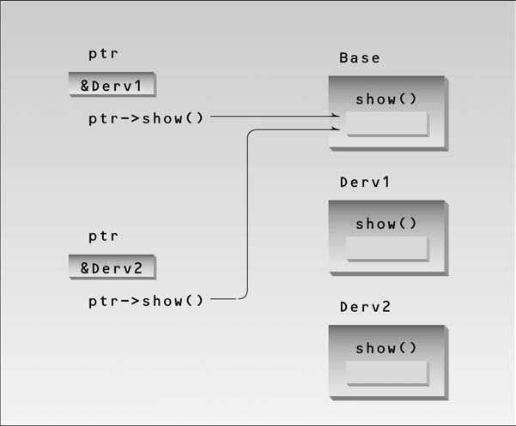
Non-virtual pointer access.

Slide 24
Virtual Member Functions Accessed
class Base {
  public:
  virtual void show()
  { cout << “Base\n”; }
};
main() {
}
*ptr
  Derv1 dv1;
  Derv2 dv2;
  Base* ptr;
  ptr = &dv1;
dv1
dv2
class Derv1 : public Base {
public:
void show()
{ cout << “Derv1\n”; }
};
  ptr->show();
  ptr = &dv2;
Program Output
  ptr->show();
Derv1
Derv2
Go to program
class Derv2 : public Base {
public:
void show()
{ cout << “Derv2\n”; }
};
Note: Compiler selects the function based on the contents of the pointer ptr, not on the type of the pointer

Slide 25
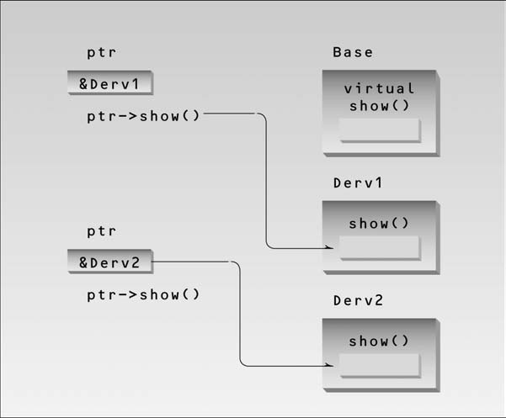
Virtual pointer access

