Slide 1
CSC241: Object Oriented Programming
Lecture No 13

Slide 2
Previous Lecture
  Implicit conversion
Explicit constructor
Overloading
  Stream insertion <<
  Stream extraction >>
Inheritance

Slide 3
Today’s Lecture
Inheritance
Protected members
Constructor in derived class
Function overriding

Slide 4
Inheritance
Base class
Derive class
  A derived class represents a more specialized group of objects
  Inherit behaviors of base class and can customize the inherited behavior
Direct base class is the base class from which a derived class explicitly inherits
Indirect base class is inherited from two or more levels up in the class hierarchy
single inheritance and multiple inheritance

Slide 5
protected Members
Access specifiers
  public: accessible within the body of base class and anywhere that the program
  private: accessible only within the body of base class and the friends of base class
A base class's protected members can be accessed within
  the body of that base class,
  by members and friends of that base class, and
  by members and friends of any classes derived from that base class

Slide 6
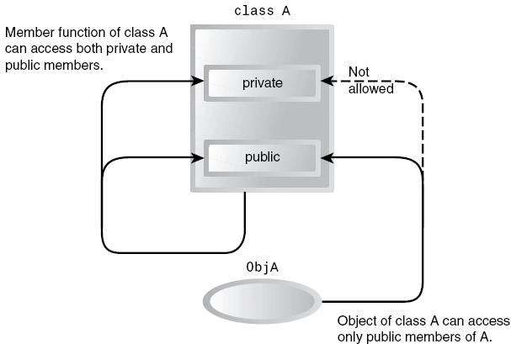
Generalization in UML Class Diagrams

Slide 7
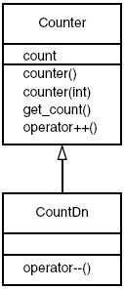
Generalization in UML Class Diagrams

Slide 8
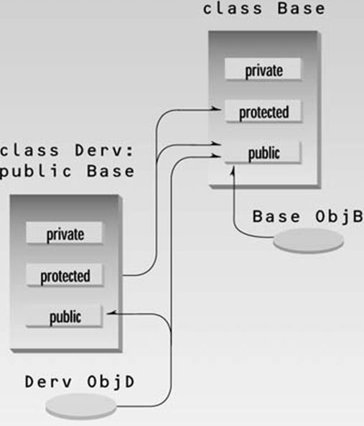
Cont.

Slide 9
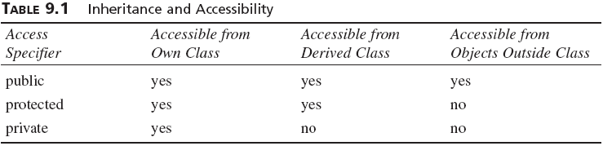
Cont.

Slide 10
Inheritance – Example program
class Counter {
protected:
    unsigned int count;
    public:
    Counter() : count(0)
    { }
    int get_count()
    { return count; }
    Counter operator ++ () {
      return Counter(++count);
      }
};
class CountDn : public Counter {
public:
Counter operator -- () {
return Counter(--count);
}
};
main() {
CountDn c1;
cout << “\nc1=” << c1.get_count();
++c1; ++c1; ++c1;
cout << “\nc1=” << c1.get_count();
--c1; --c1;
cout << “\nc1=” << c1.get_count();
}
Go to program

Slide 11
Base Class Unchanged
Inheritance doesn’t work in reverse
If other classes have been derived from base class, the base class remains unchanged
Counter c2;
The base class and its objects don’t know anything about any classes derived from the base class
Objects of class Counter, such as c2, can’t use the operator--() function in CountDn

Slide 12
Dangers of protected Access Specifier
Suppose you’ve written a class library, which you’re distributing to the public
Any programmer who buys this library can access protected members of your classes simply by deriving other classes from them
This makes protected members considerably less secure than private members
To avoid corrupted data, it’s often safer to force derived classes to access data in the base class using only public functions in the base class

Slide 13
Derived class constructor
Instantiating a derived-class object begins a chain of constructor calls,
  invokes its direct base class's constructor
  either explicitly or implicitly
  Then derived class constructor is
  executed
class A
A() { }
A()
{..}
A()
{..}
A()
{..}
A a1;
class B
B() { }
B()
{..}
B()
{..}
B b1;
class C
C() { }
C()
{..}
C c1;

Slide 14
Derived Class Constructors
class Counter {
protected:
    unsigned int count;
  public:
    Counter() : count(0)
    { }
Counter(int c) : count(c)
{ }
    int get_count(){
    return count;
    }
    Counter operator ++ (){
      return Counter(++count);
      }
};
class CountDn : public Counter {
public:
CountDn() : Counter()
{ }
CountDn(int c) : Counter(c)
{ }
Counter operator -- (){
return Counter(--count);
}
};
CountDn c1;
CountDn c2(100);
Go to program

Slide 15
Derived class destructor
When a derived-class object is destroyed, the chain of calling destructor begins in reverse order as that of constructor
  derived-class destructor performs
  its task,
  then invokes the destructor of the
  next base class up the hierarchy
class A
~A() { }
~A()
{..}
class B
~B() { }
~B()
{..}
C *c1 = new C;
…
delete c1;
class C
~C() { }
~C()
{..}
Go to program

Slide 16
Overriding Member Functions
Member functions in a derived class can be override, i.e. have the same name as those in the base class
Stack, a simple data storage medium. It allowed you to push integers onto the stack and pop them off
class A
abc(int x) { }
class B
abc(int x) { }

Slide 17
Example - stack
class Stack {
  protected:
      int st[3];
      int top;
  public:
    Stack()
    { top = -1; }
    void push(int var) {
    st[++top] = var;
    }
    int pop() {
    return st[top--];
    }
  };
class Stack2 : public Stack{
  public:
  void push(int var1){
    if(top >= 3 -1){
    cout << “\nError: stack is full”;
    exit(1);
    }
    Stack::push(var);
  }
  int pop() {
    if(top < 0) {
    cout << “\nError: stack is empty”;
    exit(1);
    }
    return Stack::pop();
  }
};
S1
top
-1
0
2
1
st[3]
  Stack2 s1;
  s1.push(11); s1.push(22);
  s1.push(33);
13
  cout <<s1.pop();
  cout <<s1.pop();
  cout <<s1.pop();
12
11
Go to program
  cout <<s1.pop();

Slide 18
Which function is called?
s1.push(11); Which function is executed? Derive or Base class
Rule: When the same function exists in both the base class and the derived class, the function in the derived class will be executed
This is true of objects of the derived class
Objects of the base class don’t know anything about the derived class and will always use the base class functions

Slide 19
Scope Resolution with Overridden Functions
How do push() and pop() in Stack2 access push() and pop() in Stack?
They use the scope resolution operator, ::, in the statements
Stack::push(var);
and
return Stack::pop();
Without the scope resolution operator, the compiler would think the push() and pop() functions in Stack2 were calling themselves

Slide 20
Inheritance in the Distance Class
enum DSign { pos, neg }; //for sign in DistSign
class Distance
{
  protected:
  int feet;
  float inches;
  public:
  Distance() : feet(0), inches(0.0)
  { }
  Distance(int ft, float in) : feet(ft), inches(in)
  { }
  void getdist() //get length from user
  {
  cout << “\nEnter feet: “; cin >> feet;
  cout << “Enter inches: “; cin >> inches;
  }
  void showdist() const //display distance
  {
  cout << feet << “ : ” << inches ;
  }
};
class DistSign : public Distance //adds sign to Distance
{
  private:
  DSign sign; //sign is pos or neg
  public:
  DistSign() : Distance() //call base constructor
  { sign = pos; }
  // 2 or 3 argument constructor
  DistSign(int ft, float in, DSign sg=pos) :
  Distance(ft, in) //call base constructor
  {
  sign = sg;
  } //set the sign
  void getdist() //get length from user
  {
    Distance::getdist(); //call base getdist()
    char ch; //get sign from user
    cout << “Enter sign (+ or -): “; cin >> ch;
    sign = (ch==’+’) ? pos : neg;
  }
  void showdist() const //display distance
  {
  //show sign
  cout << ( (sign==pos) ? “(+)” : “(-)” );
  Distance::showdist(); //ft and in
  }
};

Slide 21
Cont.
int main()
{
  DistSign alpha; //no-arg constructor
  alpha.getdist(); //get alpha from user
  DistSign beta(11, 6.25); //2-arg constructor
  DistSign gamma(100, 5.5, neg); //3-arg constructor
  //display all distances
  cout << “\nalpha = “; alpha.showdist();
  cout << “\nbeta = “; beta.showdist();
  cout << “\ngamma = “; gamma.showdist();
  cout << endl;
  return 0;
}
Program Output
Enter feet: 6
Enter inches: 2.5
Enter sign (+ or -): -
alpha = (-)6 : 2.5
beta = (+)11 : 6.25
gamma = (-)100 : 5.5

