Slide 1
CSC241: Object Oriented Programming
Lecture No 12

Slide 2
Previous Lecture
Data conversion
  one-argument constructor
  conversion function
Overloading stream operators
  Stream insertion
  Stream extraction

Slide 3
Data conversion summary
Kilometers km1 = 2.5;
  One argument constructor Kilometers (float)
Km1 = 3.5
  Overloaded function void operator=(float) or
  One argument constructor Kilometers (float)
Miles m1 = km1; Miles m1(km1)
  One argument constructor Miles(Kilometers kilometers) or
  Conversion function in Kilometers class operator Miles()

Slide 4
Cont.
m1 = km1;
  Overloaded function void operator=(Kilometers) in Miles class or
  Conversion function in Kilometers class operator Miles() or
  One argument constructor in miles class Miles(Kilometers km)
float f = km1;
  Conversion function in Kilometers class operator float()
Go to program

Slide 5
Today’s Lecture
  Implicit conversion
Explicit constructor
Overloading
  Stream insertion <<
  Stream extraction >>
Inheritance

Slide 6
Implicit conversion: one argument constructor
Any single-argument constructor can be used by the compiler to perform an implicit conversion
  Miles(float m) : miles(m) { }
  Miles m1 = 3.75;
  m1 = 4.55;
Conversion is automatic/implicit
Miles(float m)
Miles(float m)

Slide 7
Explicit constructor
Implicit conversions are undesirable or having chances of errors
Making a single argument constructor explicit will avoid implicit conversion
Distance (float m) { …. }
explicit Distance(float m) { …. }
Go to program

Slide 8
Overloading Stream Insertion and Stream Extraction
Distance dist1;
dist1.getValue();
dist1.showValue();
Distance dist1;
cin >> dist1
cout << dist1;
Enter feet:
4
Enter inches:
3.75
4 : 3.75
friend istream& operator >> (istream& s, Distance& d);
friend ostream& operator << (ostream& s, Distance& d);

Slide 9
Cont.
istream& operator >> (istream& s, Distance& d)
{
cout << “\nEnter feet: “; s >> d.feet;
cout << “Enter inches: “; s >> d.inches;
return s;
}
ostream& operator << (ostream& s, Distance& d)
{
s << d.feet << “ : ” << d.inches <<endl;
return s;
}
Go to program

Slide 10
Inheritance
Inheritance is the process of creating new classes, called derived classes, from existing or base classes
The derived class inherits all the capabilities of the base class but can add refinements of its own
The base class is unchanged by this process

Slide 11
Example of inheritance
Base class | Derived classes
Student | GraduateStudent, UndergraduateStudent
Shape | Circle, Triangle, Rectangle, Sphere, Cube
Loan | CarLoan, HomeImprovementLoan,
Employee | Faculty, Staff
Account | CheckingAccount, SavingsAccount

Slide 12
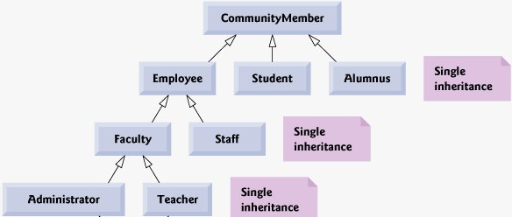

Inheritance hierarchy for university

Slide 13
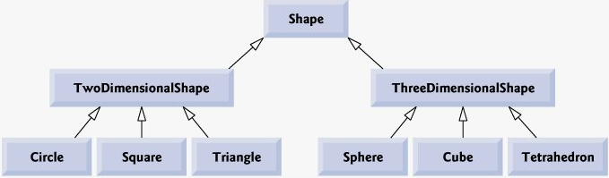
Inheritance hierarchy for Shapes
class TwoDimensionalShape : public Shape

Slide 14
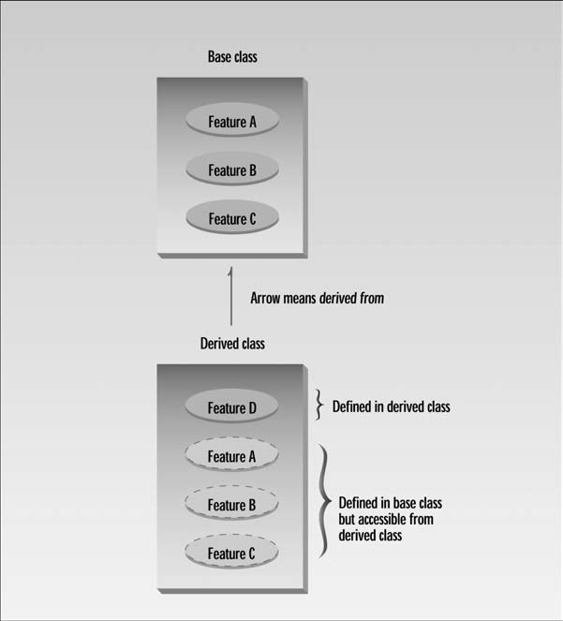

Slide 15
Relationship
Inheritance represents “is-a relationship”
In an is-a relationship, an object of a derived class also can be treated as an object of its base class
for example, a car is a vehicle
Properties and behaviors of a vehicle are also properties of a car

Slide 16
Cont.
Inheritance big payoff is that it permits code reusability
Once a base class is written and debugged, it need not be touched again, but, using inheritance it can be adapted to work in different situations.
Reusing existing code saves time and money and increases a program’s reliability.

Slide 17
Derived Class and Base Class
class Counter {
protected:
    unsigned int count;
    public:
    Counter() : count(0)
    { }
    int get_count()
    { return count; }
    Counter operator ++ () {
      return Counter(++count);
      }
};
class CountDn : public Counter {
public:
Counter operator -- () {
return Counter(--count);
}
};
main() {
CountDn c1;
cout << “\nc1=” << c1.get_count();
++c1; ++c1; ++c1;
cout << “\nc1=” << c1.get_count();
--c1; --c1;
cout << “\nc1=” << c1.get_count();
}
Go to program

