Slide 1
CSC241: Object Oriented Programming
Lecture No 01

Slide 2
Aim of the course
This course provides
  motivation of object oriented programming language
  in depth knowledge of the various concepts of object oriented programming and its implementation in C++

Slide 3
Course book
Text book
  C++ How to program by Deitel and Deitel
Reference books
  Waite Group’s Object oriented programming in C++, Robert Lafore

Slide 4
Course outline
Classes, Objects, Member functions, Objects as data types, Constructors and destructors, Overloaded constructor
The default copy constructor, Returning objects from functions, objects and memory, Static class data, Constant member functions, Constant objects
Base classes and derived classes, Derived class constructors, Overloading member functions, Scope resolution, Abstract classes, Public and private inheritance, Levels of inheritance, Multiple inheritance, Aggregation and composition
New and delete operators, Pointers to objects, Virtual functions and late binding, Abstract classes and pure virtual functions, Virtual destructors, Virtual base classes, Friend functions and friend classes, Static functions, this pointer, Dynamic type information
Motivation for exception handling, Try-catch block, Throwing an exception, Catching multiple exceptions
Streams and files, Templates

Slide 5
Marks distribution
Assignments: 10%
Quizzes: 15%
Sessional exam 01: 10%
Sessional exam 02: 15%
Terminal Exam: 50%

Slide 6
Introduction
Five concepts in object oriented programming are:
  Object
  Classes
  Encapsulation
  Inheritance
  Polymorphism

Slide 7
Simple analogy
You are driving a car
You can pressing accelerator pedal
Someone has design it and built it
Engineering drawings → car
Drawings also includes design for accelerator pedal to make car go faster
We can say, pedal “hides” complex mechanism that make the car go faster

Slide 8
Cont.
Brake pedal “hides” the mechanism that slow the car
Steering wheel “hides” the mechanism that turn the car and so on
Simple “interfaces” like accelerator and brake pedal, steering wheel, transmission shift and etc. allow driver to interact car’s complex internal mechanisms

Slide 9
Points to be noted
You cannot drive the engineering design of a car
Before you can drive a car, it must be built according to engineering design
The car will not accelerator on its own, a driver must press the accelerator pedal

Slide 10
Object oriented programming concepts
Function hides from user the complex task it performs
Same as accelerator pedal hides complex mechanism of making the car go faster
C++ makes a program unit called class that houses various functions
Same as car engineering design houses the mechanism of accelerator pedal

Slide 11
Cont.
In C++, a class can have various functions that are design to perform a class tasks
For example, a class representing bank account might contain functions
  Deposit money
  Withdraw money
  Current balance

Slide 12
Car example
Real world
Engineering drawing cannot be drive
A car is build from that drawing
Pressing accelerator pedal sends a message to car to perform task (go faster)
C++ programming
An object of a class must be create to get a program to perform the tasks the class describes
Message can be sent to object by calling a member functions

Slide 13
Cont.
Car analogy is used to introduce
  Class
  Objects
  Member functions
In addition to capabilities of car, it has many attributes
    Color, No. of doors, amount of gas in tank, total miles driven and etc
Attributes are part of car engineering drawing

Slide 14
Cont.
These attribute are always associated with the car
Every car maintains its own attribute
Example 1: each car knows how much gas in its own tank but do not know how much is in the tanks of other cars
Example 2: a bank account object has a balance attribute. Each bank account object knows the balance in its account not the others

Slide 15
Object
Look around right now and you'll find many examples of real-world objects:
your dog, your desk, your television set, your bicycle.
Real-world objects share two characteristics: They all have
  State and
  Behavior

Slide 16
Object example
A dog x has state (name, color, breed, hungry) and behavior (barking, fetching, wagging tail).
Your bicycle also have state (current gear, current pedal cadence, current speed) and behavior (changing gear, changing pedal cadence, applying brakes).

Slide 17
Cont.
For each object that you see, ask yourself two questions:
  "What possible states can this object be in?" and
  "What possible behavior can this object perform?"

Slide 18
Real world objects
Real-world objects vary in complexity
  your desktop lamp may have only two possible states (on and off) and two possible behaviors (turn on, turn off),
  but your desktop radio might have additional states (on, off, current volume, current station) and behavior (turn on, turn off, increase volume, decrease volume, seek, scan, and tune).

Slide 19
Cont..
You may also notice that some objects, in turn, will also contain other objects.
These real-world observations all translate into the world of object-oriented programming

Slide 20
Class
In the real world, you'll often find many individual objects all of the same kind
There may be thousands of other bicycles in existence, all of the same make and model.
Each bicycle was built from the same engineering design and contains the same components.
In object-oriented terms, we say that your bicycle is an instance of the class of objects known as bicycles.

Slide 21
Software Object
Software objects are conceptually similar to real-world objects: they too consist of state and related behavior. An object stores its state in
  fields (variables in some programming languages)
and exposes its behavior through
  methods (functions in some programming languages). A Software Object

Slide 22
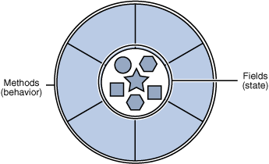
Cont.
Methods operate on an object's internal state and serve as the primary mechanism for object-to-object communication.

Slide 23
Class vs. Object
Class is a blue print of an object, which is non-live entity.
Object is instance of class, which is a live entity.
Example:
  Employee is a class
  Fruit is a class
  I am an object
  apple is an object

Slide 24
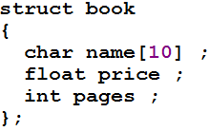
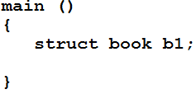
Points to remember
A class is not a living entity, it is just a engineering design that how an object of this class look like
Object are living entities

Slide 25
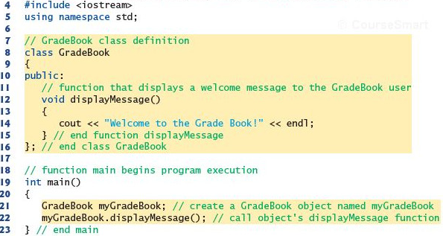
Defining a class with member function

Slide 26
Cont.
Class definition
Access specifier – Public
Class’s body is enclosed in a pair of { }
Class definition ends at semi colon
Member function
Class object
Dot operator

Slide 27
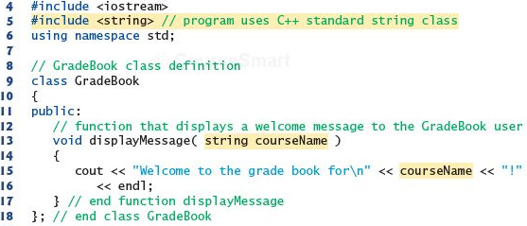
Member function with parameter
Write a program

Slide 28
#include <iostream.h>
#include <string.h>
class book{
private:
char name[25];
int pages;
float price;
public:
void changeName(char *n){
strcpy(name, n);
}
void changePages(int p){
pages = p;
}
void changePrice(float p){
price = p;
}
void display(){
cout<<"name = "<<name<<" pages = "<<pages<<" price = "<<price<<endl;
}
};
  Book Class
Simple program

Slide 29
Class data
The class book contain three data items
  char name[15];
  int pages;
  float price;
There can be any number of data members in a class just as in structure
There data member lie under keyword private, so they can be accessed from within the class, but not outside

Slide 30
Member function
These functions are included in a class
There are four member functions in class book
  changeName(char *n)
  changePages(int p)
  changePrice(float p)
  display()
There functions are followed by a keyword public, so they can be accessed outside the class

Slide 31
Class data and member function
Access specifier label public and private
Function are public and data is private
Data is hidden so that it can be safe from accidental manipulation
Functions operates on data are public so they can be accessed from outside the class

Slide 32
Defining Objects
void main()
{
book b1;
b1.changeName("Operating System");
b1.changePages(500);
b1.changePrice(150.56);
b1.display();
}
b1
Name
Operating system
Pages
500
Price
150.56

Slide 33
Cont.
Defining an object is similar to defining a variable of any data type: Space is set aside for it in memory e.g. int x;
Defining objects in this way (book b1;) means creating them, also called instantiating them
An object is an instance (that is, a specific example) of a class. Objects are sometimes called instance variables.

Slide 34
Calling Member Functions
The next four statements in main() call the member function
  b1.changeName("Operating System");
  b1.changePages(500);
  b1.changePrice(150.56);
  b1.display();
don’t look like normal function calls
This syntax is used to call a member function that is associated with a specific object
It doesn’t make sense to say
  changeName("Operating System");
because a member function is always called to act on a specific object, not on the class in general

Slide 35
Cont.
To use a member function, the dot operator (the period) connects the object name and the member function.
The syntax is similar to the way we refer to structure members, but the parentheses signal that we’re executing a member function rather than referring to a data item.
The dot operator is also called the class member access operator.

Slide 36
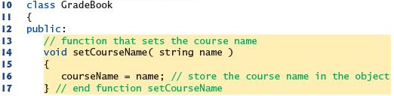

Data members, set and get functions

Slide 37
Example program – Distance class
Data members
  Feet
  Inches
Member functions
  void setdist(int ft, float in);
  void getdist();
  void initialize();
  void showdist();
Go to program

Slide 38
Constructors
The Distance example shows two ways that member functions can be used to give values to the data items in an object
It is convenient if an object can initialize itself when it’s first created, without requiring a separate call to a member function
Automatic initialization is carried out using a special member function called a constructor.
A constructor is a member function that is executed automatically whenever an object is created.

Slide 39
A counter example
Data member
  Count
Member function
  Constructor
  void inc_count()
  int get_count()
Go to program

