Slide 1
CSC 221
Computer Organization and Assembly Language
Lecture 27:
2-Dimensional Arrays +
Structures

Slide 2
Lecture 26: Review
Assembly Implementation of:
Stack Parameters
  INVOKE Directive
  PROC Directive
  PROTO Directive
  Passing by Value or by Reference
  Example: Exchanging Two Integers

Slide 3
Lecture 26: Review
(cont.)
Assembly Implementation of:
Stack Frames
  Explicit Access to Stack Parameters
  Passing Arguments by Reference

Slide 4
Lecture Outline
Two Dimensional Arrays
  Basic Concept
  2-D Array Representation
  Base-Index Operands
    Row-Sum Example
  Base-Index Displacement
      Bubble Sort Algorithm
Structures

Slide 5
Two-Dimensional Arrays
Basic Concept
Base-Index Operands
Base-Index Displacement

Slide 6
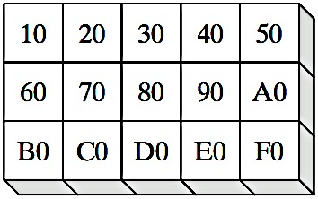
Basic Concepts
From an assembly language programmer’s perspective, a two-dimensional array is a high-level abstraction of a one-dimensional array.
One of two methods of arranging the rows and columns in memory: row-major order and column-major order.
Logical
Arrangement
Order
Row-major:
(Most Common)
Col.-major:

Slide 7
Base-Index Operand
A base-index operand adds the values of two registers (called base and index), producing an effective address.
[base + index]
The square brackets are required.
In 32-bit mode, any two 32-bit general-purpose registers may be used as base and index registers.
In 16-bit mode, the base register must be BX or BP, and the index register must be SI or DI.

Slide 8
Base-Index Operand
The following are examples of various combinations of base and index operands in 32-bit mode:
.data
array WORD 1000h,2000h,3000h
.code
mov ebx,OFFSET array
mov esi,2
mov ax,[ebx+esi] ; AX = 2000h
mov edi,OFFSET array
mov ecx,4
mov ax,[edi+ecx] ; AX = 3000h
mov ebp,OFFSET array
mov esi,0
mov ax,[ebp+esi] ; AX = 1000h

Slide 9
Structure Application
Base-index operands are great for accessing arrays of structures. (A structure groups together data under a single name.)
A common application of base-index addressing has to do with addressing arrays of structures.
The following defines a structure named COORD containing X and Y screen coordinates:
COORD STRUCT
X WORD ? ; offset 00
Y WORD ? ; offset 02
COORD ENDS
Then we can define an array of COORD objects:
.data
setOfCoordinates COORD 10 DUP(<>)

Slide 10
Structure Application
The following code loops through the array and displays each Y-coordinate:
mov ebx,OFFSET setOfCoordinates
mov esi,2 ; offset of Y value
mov eax,0
L1:mov ax,[ebx+esi]
invoke dwtoa, eax, addr DispDec
invoke StdOut, addr DispDec
add ebx,SIZEOF COORD
loop L1

Slide 11
Two-Dimensional Array Example
Imagine a table with three rows and five columns. The data can be arranged in any format on the page:
table BYTE 10h, 20h, 30h, 40h, 50h
BYTE 60h, 70h, 80h, 90h, 0A0h
BYTE 0B0h, 0C0h, 0D0h, 0E0h, 0F0h
NumCols = 5
Alternative format:
table BYTE 10h,20h,30h,40h,50h,60h,70h,
80h,90h,0A0h,
0B0h,0C0h,0D0h,
0E0h,0F0h
NumCols = 5

Slide 12
Accessing Two-Dimensional Array
Accessing a two-dimensional array in row-major order:
Row offset is held in the base register
Column offset is in the index register.
Example: Following Table has 3 rows and 5 columns:
tableB BYTE 10h, 20h, 30h, 40h, 50h
BYTE 60h, 70h, 80h, 90h, 0A0h
BYTE 0B0h, 0C0h, 0D0h, 0E0h, 0F0h
Rowsize = 5

Slide 13
Two-Dimensional Array
(cont.)
In row-major order: Rowsize is calculated by the assembler as the number of bytes in each table row.
Access: Element at Row 1 and Column 2: tableB(1,2)
EBX = table’s offset +
Row Offset = EBX + (Rowsize * row_index)
ESI = Column index
row_index = 1
column_index = 2
mov ebx,OFFSET tableB ; table offset
add ebx,RowSize * row_index ; row offset
mov esi,column_index
mov al,[ebx + esi] ; AL = 80h

Slide 14
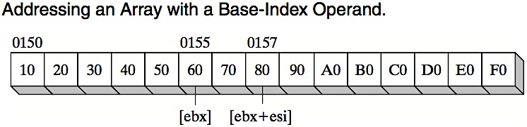
Two-Dimensional Array
(cont.)
row_index = 1
column_index = 2
mov ebx,OFFSET tableB ; table offset
add ebx,RowSize * row_index ; row offset
mov esi,column_index
mov al,[ebx + esi] ; AL = 80h
^{tableB OFFSET}

Slide 15
Calculating Row-Sum
.data
tableB BYTE 10h, 20h, 30h, 40h, 50h
BYTE 60h, 70h, 80h, 90h, 0A0h
BYTE 0B0h, 0C0h, 0D0h, 0E0h, 0F0h
RowSize = 5
Disp1 BYTE 20 DUP(?)
msg2 BYTE "The sum is: ",0
.code
start:
mov edx,1 ; Row number
mov ebx,OFFSET tableB
mov ecx,RowSize
call calc_row_sum ; EAX = sum
invoke StdOut, addr msg2 ; "The sum is:”
invoke dwtoa, eax, addr Disp1
invoke StdOut, addr Disp1
……

Slide 16
Calculating Row-Sum
;---------------------------------------------------------
calc_row_sum PROC uses ebx ecx edx esi
;
; Calculates the sum of a row in a byte matrix.
; Receives: EBX = table offset, EAX = row index,
; ECX = row size, in bytes.
; Returns: EAX holds the sum.
;---------------------------------------------------------
mul ecx ; row index * row size
add ebx,eax ; row offset
mov eax,0 ; accumulator
mov esi,0 ; column index
L1: movzx edx,BYTE PTR[ebx + esi] ; get a byte
add eax,edx ; add to accumulator
inc esi ; next byte in row
loop L1
ret
calc_row_sum ENDP

Slide 17
Base-Index-Displacement Operand
A base-index-displacement operand adds base and index registers to a constant, producing an effective address. Displacement can be the name of a variable or a constant expression.
Any two 32-bit general-purpose registers may be used.
Common formats:
[ base + index + displacement ]
displacement [ base + index ]

Slide 18
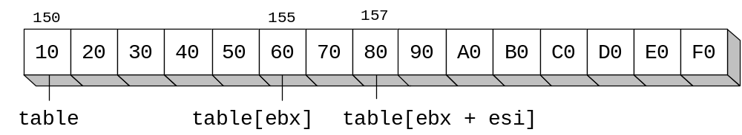
Two-Dimensional Table Example
The following code loads the table element stored in row 1, column 2:
RowNumber = 1
ColumnNumber = 2
mov ebx,NumCols * RowNumber
mov esi,ColumnNumber
mov al,table[ebx + esi]

Slide 19
Sorting Integer Arrays
Bubble Sort
  A simple sorting algorithm that works well for small arrays

Slide 20
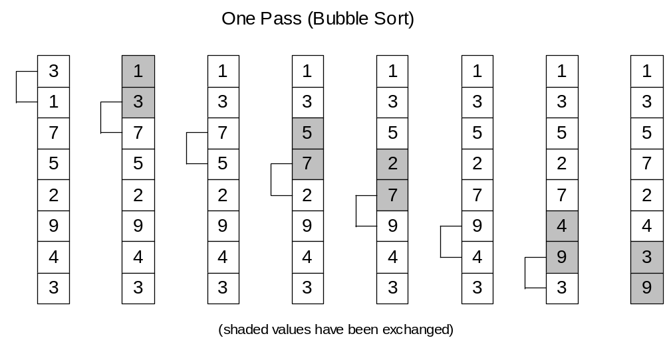
Bubble Sort
Each pair of adjacent values is compared, and exchanged if the values are not ordered correctly:

Slide 21
Bubble Sort Pseudocode
N = array size, cx1 = outer loop counter, cx2 = inner loop counter:
cx1 = N - 1
while( cx1 > 0 )
{
esi = addr(array)
cx2 = cx1
while( cx2 > 0 )
{
if( array[esi] < array[esi+4] )
exchange( array[esi], array[esi+4] )
add esi,4
dec cx2
}
dec cx1
}

Slide 22
Bubble Sort Implementation
BubbleSort PROC USES eax ecx esi,
pArray:PTR DWORD,Count:DWORD
mov ecx,Count
dec ecx ; decrement count by 1
L1: push ecx ; save outer loop count
mov esi,pArray ; point to first value
L2: mov eax,[esi] ; get array value
cmp [esi+4],eax ; compare a pair of values
jge L3 ; if [esi] <= [edi], skip
xchg eax,[esi+4] ; else exchange the pair
mov [esi],eax
L3: add esi,4 ; move both pointers forward
loop L2 ; inner loop
pop ecx ; retrieve outer loop count
loop L1 ; else repeat outer loop
L4: ret
BubbleSort ENDP

Slide 23
Structures - Overview
Defining Structures
Declaring Structure Variables
Referencing Structure Variables

Slide 24
Structure
A template or pattern given to a logically related group of variables.
field - structure member containing data
Program access to a structure:
  entire structure as a complete unit
  individual fields
Useful way to pass multiple related arguments to a procedure
  example: file directory information

Slide 25
Using a Structure
Using a structure involves three sequential steps:
  1. Define the structure.
  2. Declare one or more variables of the structure type, called structure variables.
  3. Write runtime instructions that access the structure.

Slide 26
Structure Definition Syntax
name STRUCT
field-declarations
name ENDS
Field-declarations are identical to variable declarations

Slide 27
COORD Structure
The COORD structure used by the MS-Windows programming library identifies X and Y screen coordinates
COORD STRUCT
X WORD ? ; offset 00
Y WORD ? ; offset 02
COORD ENDS

Slide 28
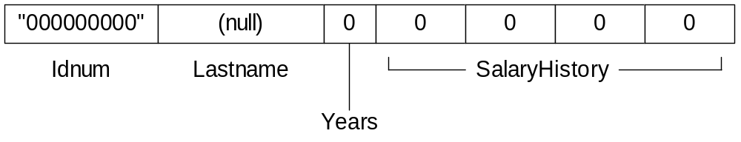
Employee Structure
A structure is ideal for combining fields of different types:
Employee STRUCT
  IdNum BYTE "000000000"
  LastName BYTE 30 DUP(0)
  Years WORD 0
  SalaryHistory DWORD 0,0,0,0
Employee ENDS

Slide 29
Declaring Structure Variables
Structure name is a user-defined type
Insert replacement initializers between brackets:
    < . . . >
Empty brackets <> retain the structure's default field initializers
Examples:
.data
point1 COORD <5,10>
point2 COORD <>
worker Employee <>

Slide 30
Initializing Array Fields
Use the DUP operator to initialize one or more elements of an array field:
.data
emp Employee <,,,2 DUP(20000)>

Slide 31
Array of Structures
An array of structure objects can be defined using the DUP operator.
Initializers can be used
NumPoints = 3
AllPoints COORD NumPoints DUP(<0,0>)
RD_Dept Employee 20 DUP(<>)
accounting Employee 10 DUP(<,,,4 DUP(20000) >)

Slide 32
Referencing Structure Variables
Employee STRUCT ; bytes
  IdNum BYTE "000000000" ; 9
  LastName BYTE 30 DUP(0) ; 30
  Years WORD 0 ; 2
  SalaryHistory DWORD 0,0,0,0 ; 16
Employee ENDS ; 57
.data
worker Employee <>
mov eax,TYPE Employee ; 57
mov eax,SIZEOF Employee ; 57
mov eax,SIZEOF worker ; 57
mov eax,TYPE Employee.SalaryHistory ; 4
mov eax,LENGTHOF Employee.SalaryHistory ; 4
mov eax,SIZEOF Employee.SalaryHistory ; 16

Slide 33
. . . continued
mov dx,worker.Years
mov worker.SalaryHistory,20000 ; first salary
mov worker.SalaryHistory+4,30000 ; second salary
mov edx,OFFSET worker.LastName
mov esi,OFFSET worker
mov ax,(Employee PTR [esi]).Years
mov ax,[esi].Years ; invalid operand (ambiguous)

Slide 34
Looping Through an Array of Points
Sets the X and Y coordinates of the AllPoints array to sequentially increasing values (1,1), (2,2), ...
.data
NumPoints = 3
AllPoints COORD NumPoints DUP(<0,0>)
.code
mov edi,0 ; array index
mov ecx,NumPoints ; loop counter
mov ax,1 ; starting X, Y values
L1:
mov (COORD PTR AllPoints[edi]).X,ax
mov (COORD PTR AllPoints[edi]).Y,ax
add edi,TYPE COORD
inc ax
Loop L1

Slide 36
Summary
Two Dimensional Arrays
  Basic Concept
  2-D Array Representation
  Base-Index Operands
    Row-Sum Example
  Base-Index Displacement
  Bubble Sort Algorithm
Structures

Slide 37
Reference
Most of the Slides are taken from Presentation:
Chapter 9 & 10
Assembly Language for Intel-Based Computers, 4th Edition
Kip R. Irvine
(c) Pearson Education, 2002. All rights reserved. You may modify and copy this slide show for your personal use, or for use in the classroom, as long as this copyright statement, the author's name, and the title are not changed.

