Slide 1
CSC 221
Computer Organization and Assembly Language
Lecture 14:
Flow Control Instructions in Assembly Language

Slide 2
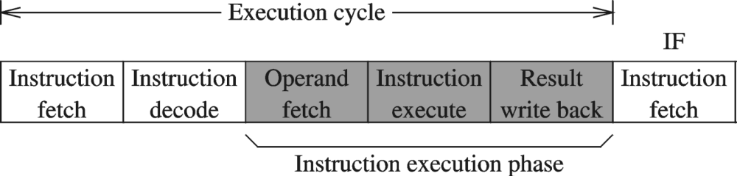
Lecture 13: Review
Clock Cycle
Instruction Cycle
JMP Instruction
JMP is an unconditional jump to a label that is usually within the same procedure.
Syntax: JMP target
Logic: EIP ← target
Example:
top:
.
.
jmp top

Slide 3
Lecture 13: Review
(cont.)
LOOP Instruction
The LOOP instruction creates a counting loop
Syntax: LOOP target
Logic:
  ECX ← ECX – 1
  if ECX != 0, jump to target
offset machine code source code
00000000 66 B8 0000 mov ax,0
00000004 B9 00000005 mov ecx,5
00000009 66 03 C1 L1: add ax,cx
0000000C E2 FB loop L1
0000000E

Slide 4
Lecture 13: Review
(cont.)
Nested Loops
.data
count DWORD ?
.code
mov ecx,100 ; set outer loop count
L1:
mov count,ecx ; save outer loop count
mov ecx,20 ; set inner loop count
L2: .
  .
  loop L2 ; repeat the inner loop
mov ecx,count ; restore outer loop count
loop L1 ; repeat the outer loop

Slide 5
Lecture Outline
Assembly Language Examples:
Control Flow
  JMP Instruction
  LOOP Instruction
  LOOP Example
  Summing an Integer Array

Slide 6
Let’s Enjoy
ASSEMBLY LANGUAGE

Slide 7
Summary
Instruction Execution
FLOW CONTROL Instruction Examples
JMP Instruction
LOOP Instruction

Slide 8
Reference
Most of the Slides are taken from Presentation:
Chapter 4 and 5
Assembly Language for Intel-Based Computers, 4th Edition
Kip R. Irvine
(c) Pearson Education, 2002. All rights reserved. You may modify and copy this slide show for your personal use, or for use in the classroom, as long as this copyright statement, the author's name, and the title are not changed.

