Slide 1
CSC 221
Computer Organization and Assembly Language
Lecture 04:
Microprocessor Architecture

Slide 2
Review
Data Representation
  Decimal Representation
  Binary Representation
  Two’s Complement
  Hexadecimal Representation
  Binary Addition
  Binary Multiplication
  Floating Point Representation

Slide 3
Lecture Outline
Intel Microprocessors
Intel Microprocessor Architecture
Components of a Microprocessor:
  Registers
    General Purpose
    Special Purpose

Slide 4
Intel Microprocessors

Slide 5
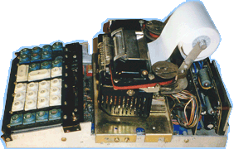
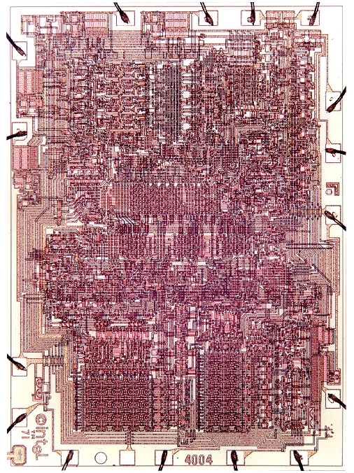
1971: 4004 Microprocessor
Intel's first microprocessor.
It powered the Busicom calculator.
It paved the way for embedding intelligence in inanimate objects as well as the Personal computer.
Source: http://www.computerhistory.org/exhibits/highlights/busicom.shtml

Slide 6
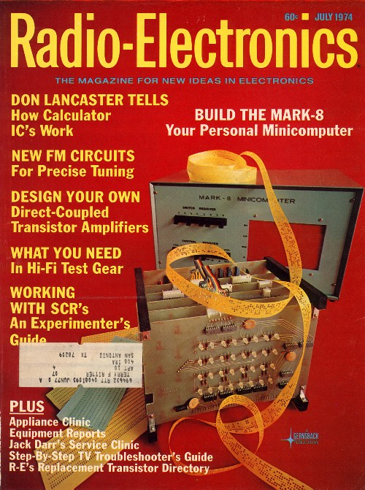
1972: 8008 Microprocessor
Twice as powerful as the 4004.
A 1974 article in Radio Electronics referred to a device called the Mark-8 which used the 8008.
The Mark-8 is known as one of the first Computers for the home --one that by today's standards was difficult to build, maintain and operate.
Source: www.ciphersbyritter.com/ MARK8/MAGCOV5.JPG

Slide 7
1972: 8008 Microprocessor
Data Word: 8-bit
Clock: 800KHz
Address Space: 16 KB
Instructions: 48
Registers: 15
Addressing modes
  Register
  Register direct
  Immediate

Slide 8
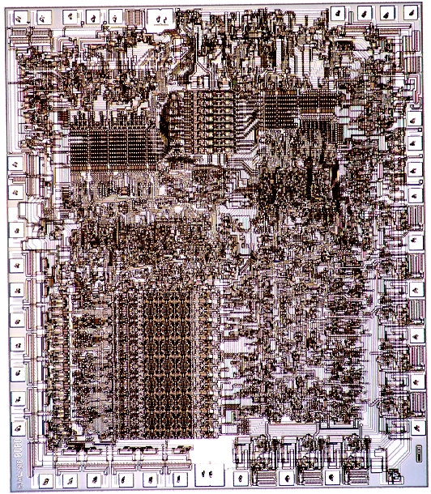
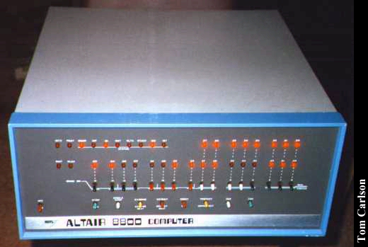
1974: 8080 Microprocessor
Brain of the first Personal Computer--The Altair¹.
The Altair Kit was sold for $395.
It sold tens of thousands, within months.
¹Destination of the Starship Enterprise from the Star Trek television show.
Source: http://www.obsoletecomputermuseum.org/altair/altair3.jpg

Slide 9
Microporcessor | 8008 | 8080
Data Word | 8-Bit | 8-Bit
Clock | 800KHz | ~2MHz
Address Space | 16 KB | 64 KB
Instructions | 48 | 48
Addressing Modes | Register Reg. Direct Immediate | Register Reg. Direct Immediate

Slide 10
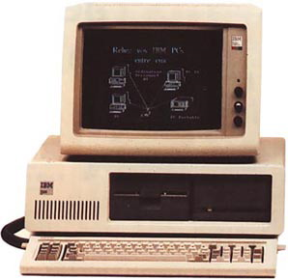
1978: 8086-8088 Microprocessor
The 8088 became the brains of IBM's new hit product--the IBM PC.
Fortune magazine named the company one of the "Business Triumphs of the Seventies."
Source: http://accad.osu.edu/~waynec/history/images/small/ibm_pc_xt.jpg

Slide 11
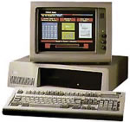
1982: 286 Microprocessor
The Intel 286 (originally 80286) was the first Intel processor that could run all the software written for its predecessor.
This software compatibility remains a hallmark of Intel's family of microprocessors.
Within 6 years of its release, an estimated 15 million 286-based personal computers were installed around the world.

Slide 12
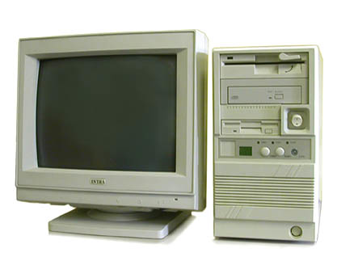
1985: Intel386™ Microprocessor
275,000 transistors--more than 100times as many as the original 4004.
32-bit chip.
"multi tasking" --run multiple programs at the same time.
Source: http://www.frontier-electronics.co.za/early_computers.htm

Slide 13
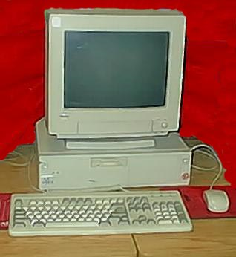
1989: Intel486™ DX CPU Microprocessor
"I could have a color computer for the first time and do desktop publishing at a significant speed," recalls technology historian David K. Allison of the Smithsonian's National Museum of American History.
First to offer a built-in math coprocessor, which speeds up computing because it offloads complex math functions from the central processor.
Source: http://www.100megspopup.com/redawa/Graphics/Icon486.jpg

Slide 14
Processor | Clock | Intro Date(s) | Trans. | Addressable Memory | Cache | Typical Use
 | Speed(s)
Intel486™ SL | 20~33MHz | Nov-92 | 1.4 mil. | 4 MB | 8 kB | First CPU specifically designed for Notebook PCs
Intel486™ SX | 16~33 MHz | Sep-91 | 1.2 mil. | 4 GB | 8 kB | Low-cost, entry-level desktops
Intel386™ SL | 20~25 MHz | Oct-90 | 0.8 mil. | 4 GB | None | First CPU designed specifically for portables
Intel486™ DX | 25~50 MHz | Apr-89 | 1.2 mil. | 4 GB | 8 kB | Desktops and servers.
Intel386™ SX | 16 ~33MHz | Jun-88 | 275,000 | 16 MB | None | Entry-level desktop and portable computing
Intel386™ DX | 16 ~33MHz | Oct-85 | 275,000 | 4 GB | None | Desktops
80286 | 6~12MHz | Feb-82 | 134,000 | 16 MB | None | Desktops (standard CPU for all IBM PCs clones at the time)
8088 | 4.77~8MHz | Jun-79 | 29,000 | 64 kB | None | Desktops (standard CPU for all IBM PCs and PC clones at the time)
8086 | 4.77~10 MHz | Jun-78 | 29,000 | 1 MB | None | Portable computing
8085 | 2 MHz | Mar-76 | 6,500 | 64 KB | None | High level of integration, operating for first time on a single 5-volt power supply (down from 12 volts).
8080 | 2 MHz | Apr-74 | 6,000 | 64 KB | None | Traffic light controller, Altair computer (first PC).
8008 | 200 KHz | Apr-72 | 3,500 | 16 KB | None | Dumb terminals, general calculators, bottling machines, data/character manipulation
4004 | 108 KHz | Nov-71 | 2,300 | 640 Bytes | None | Busicom calculator, arithmetic manipulation.
Source: http://www.intel.com/pressroom/kits/quickref.htm

Slide 15
1993: Intel® Pentium® Processor
1995: Intel® Pentium® Pro Processor
The Intel Pentium® processor allowed computers to more easily incorporate "real world" data: Speech, Sound, Handwriting and Photographic images.
Designed to fuel 32-bit server and workstation applications, enabling fast CAD, Mechanical Engineering and Scientific Computation.
Packaged together with a second speed-enhancing cache memory chip.
5.5 million transistors.
This made possible the advanced 3D visualization and interactive capabilities.

Slide 16
^{Intel® Pentium® II processor}
Intel® Pentium II Xeon® processor
^{Introduced: 1997}
^{Initial clock speed: 300 MHz}
Number of transistors: 7,500,000
^{Intel® Pentium® III processor}
Intel® Pentium III Xeon® processor
^{Introduced: 1999}
^{Initial clock speed: 500 MHz}
Number of transistors: 9,500,000
The seamless combination of the P6 microarchitecture and Intel MMX media enhancement technology.
It executed Internet Streaming SIMD Extensions, extended the concept of processor identification and utilized multiple low-power states to conserve power during idle times.
^{Intel® Pentium® 4 processor}
^{Intel® Xeon® processor}
^{Introduced: 2001}
^{Initial clock speed: 1.5 GHz}
Number of transistors: 42,000,000
^{Intel® Pentium® D processor}
^{Introduced: 2005}
^{Initial clock speed: 3.5 GHz}
^{Number of transistor:} ^{291,000,000}
The Intel® Pentium® 4 processor ushers in the advent of the nanotechnology age.
It features the first desktop duel-core design with two complete processor cores, that each run at the same speed, in one physical package.
Source: http://www.intel.com/pressroom/kits/quickref.htm

Slide 17
Internal Microprocessor Architecture
Before a program is written or instruction investigated, internal configuration of the microprocessor must be known.
In a multiple core microprocessor each core contains the same programming model.
Each core runs a separate task or thread simultaneously.

Slide 18
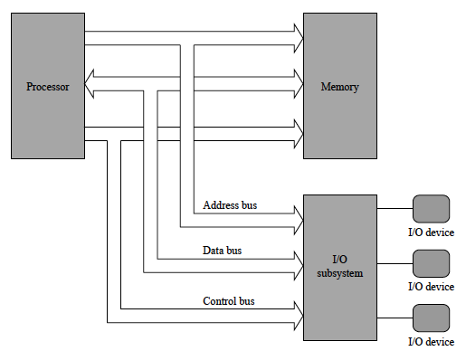
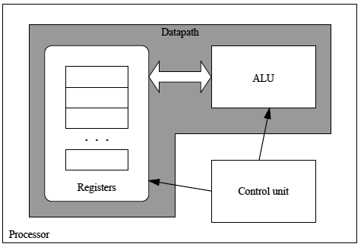
Internal Microprocessor Architecture

Slide 19
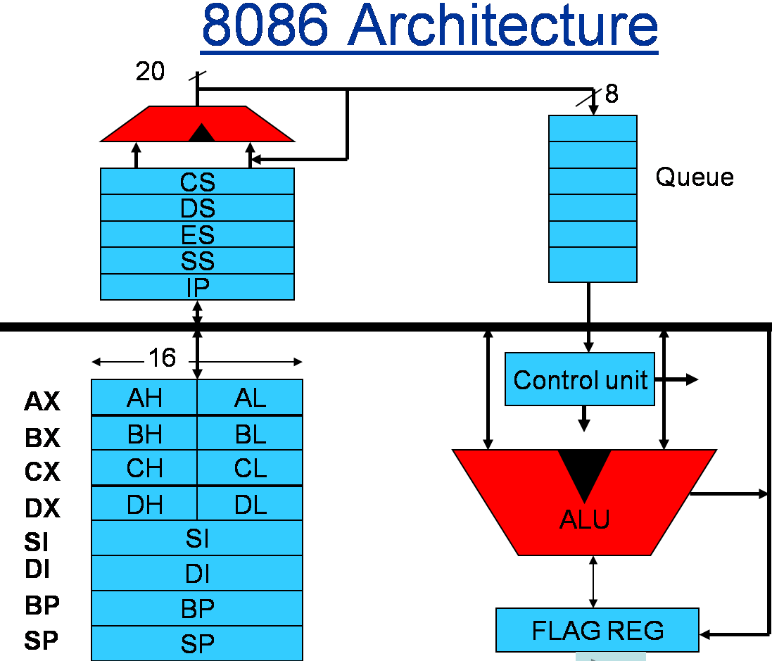

Slide 20
Why Choose the Intel 8086?
8086 is first x86 microprocessor.
The term x86 refers to a family of instruction set architectures based on the Intel 8086 CPU.
The 8086 was launched in 1978 as a fully 16-bit extension of Intel's early 8-bit based microprocessors and also introduced segmentation to overcome the 16-bit addressing barrier of earlier chips.
The term x86 derived from the fact that early successors to the 8086 also had names ending in "86".
Many additions and extensions have been added to the x86 instruction set over the years, almost consistently with full backward compatibility.
The architecture has been implemented in processors from Intel, Cyrix, AMD, VIA, and many others.

Slide 21
Current x86 processors
x86-32: EP80579 · Intel CE · Atom
x86-64: Atom (some) · Celeron · Pentium (Dual-Core) · Core (i3 · i5 · i7) · Xeon
Other: IOP · Itanium
x86 Assemblers: A86/A386 · FASM · GAS · HLA · MASM · NASM · TASM · WASM · YASM
Source: http://en.wikipedia.org/wiki/8086
http://en.wikipedia.org/wiki/X86_architecture

Slide 22
8086 microprocessor
Address Bus – 20 lines – A₁₉ – A₀
Add
Bus
Data Bus – 16 lines – D₁₅ – D₀
Data
Bus
Microprocessor
8086
16 bit- microprocessor ?
16-bits data bus?
Control
signals

Slide 23
20 bits address bus?
It can address any one of 1,048,576 (=2²⁰ ) memory locations/addresses.
Each memory location is one byte wide.
To store a word of 16 bit 2 memory locations are required.
If the first byte of the word is at even address 8086 can read the entire word in one operation.
If the first byte of the word is at an odd address, the 8086 will read the first byte with one bus operation and the second byte with another bus operation.
A₁₉……………A₀
0……………….0
00000H
1……………….1
FFFFFH
00000H
Memory
Address
Space
FFFFFH

Slide 24
BIU and EU
BIU (bus interface unit) sends out addresses, fetches instructions from memory, reads data from ports and memory, and writes data to ports and memory. In other words, the BIU handles all transfers of data and addresses on the buses for the execution unit.
EU (execution unit) of the 8086 tells the BIU where to fetch instructions or data from, decodes instructions, and executes instructions.

Slide 25
The Programming Model
8086 through Core2 considered program visible.
  registers are used during programming and are specified by the instructions
Other registers considered to be program invisible.
  not addressable directly during applications programming

Slide 26
The Programming Model
80286 and above contain program-invisible registers to control and operate protected memory.
  and other features of the microprocessor
80386 through Core2 microprocessors contain full 32-bit internal architectures.
8086 through the 80286 are fully upward-compatible to the 80386 through Core2.
the programming model 8086 through Core2 microprocessor.
  including the 64-bit extensions

Slide 27
The programming model of the 8086 through the Core2 microprocessor including the 64-bit extensions.
16 bit Names
164 bit Names
32 bit Names
8 bit Names
RAX
RBX
RCX
RDX
RBP
RSI
RDI
RSP
EAX
AX AH
AL
EBX
BX BH
BL
ECX
CX CH
CL
EDX
DX DH
DL
EBP
BP
ESI
SI
EDI
DI
ESP
SP
64 bits
32 bits
16 bits
8 bits

Slide 28
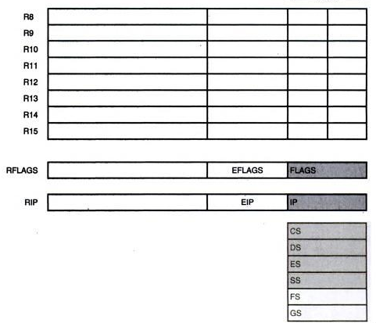
The programming model of the 8086 through the Core2 microprocessor including the 64-bit extensions.

Slide 29
Multipurpose Registers
RAX - a 64-bit register (RAX), a 32-bit register (accumulator) (EAX), a 16-bit register (AX), or as either of two 8-bit registers (AH and AL).
The accumulator is used for instructions such as multiplication, division, and some of the adjustment instructions.
Intel plans to expand the address bus to 52 bits to address 4P (peta) bytes of memory.

Slide 30
RBX, addressable as RBX, EBX, BX, BH, BL.
  BX register (base index) sometimes holds offset address of a location in the memory system in all versions of the microprocessor
RCX, as RCX, ECX, CX, CH, or CL.
  a (count) general-purpose register that also holds the count for various instructions
RDX, as RDX, EDX, DX, DH, or DL.
  a (data) general-purpose register
  holds a part of the result from a multiplication
  or part of dividend before a division

Slide 31
RBP, as RBP, EBP, or BP.
  points to a memory (base pointer) location
  for memory data transfers
RDI addressable as RDI, EDI, or DI.
  often addresses (destination index) string destination data for the string instructions
RSI used as RSI, ESI, or SI.
  the (source index) register addresses source string data for the string instructions
  like RDI, RSI also functions as a general-
  purpose register

Slide 32
R8 - R15 found in the Pentium 4 and Core2 if 64-bit extensions are enabled.
  data are addressed as 64-, 32-, 16-, or 8-bit
  sizes and are of general purpose
Most applications will not use these registers until 64-bit processors are common.
  the 8-bit portion is the rightmost 8-bit only
  bits 8 to 15 are not directly addressable as
  a byte

Slide 33
Special-Purpose Registers
Include RIP, RSP, and RFLAGS
  segment registers include CS, DS, ES, SS, FS, and GS
RIP addresses the next instruction in a section of memory.
  defined as (instruction pointer) a code segment
RSP addresses an area of memory called
the stack.
  the (stack pointer) stores data through this pointer

Slide 34
RFLAGS indicate the condition of the microprocessor and control its operation.
The flag registers of all versions of the microprocessor is shown in Next Slide.
Flags are upward-compatible from the 8086/8088 through Core2 .
The rightmost five and the overflow flag are changed by most arithmetic and logic operations.
  although data transfers do not affect them

Slide 35
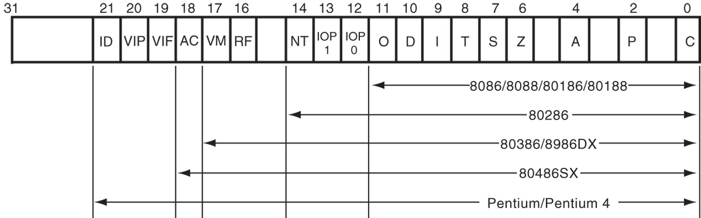
Figure 2–2 The EFLAG and FLAG register counts for the entire 8086 and Pentium microprocessor family.
Flags never change for any data transfer or program control operation.
Some of the flags are also used to control features found in the microprocessor.

Slide 36
Flag bits, with a brief description of function.
C (carry) holds the carry after addition or borrow after subtraction.
  also indicates error conditions
P (parity) is the count of ones in a number expressed as even or odd. Logic 0 for odd parity; logic 1 for even parity.
  if a number contains three binary one bits, it has odd parity
  if a number contains no one bits, it has even parity

Slide 37
Description of Each Flag bit
C (carry) holds the carry after addition or borrow after subtraction.
  also indicates error conditions
P (parity) is the count of ones in a number expressed as even or odd. Logic 0 for odd parity; logic 1 for even parity.
  if a number contains three binary one bits, it has odd parity; If a number contains no one bits, it
  has even parity

Slide 38
A (auxiliary carry) holds the carry (half-carry) after addition or the borrow after subtraction between bit positions 3 and 4 of the result.
Z (zero) shows that the result of an arithmetic or logic operation is zero.
S (sign) flag holds the arithmetic sign of the result after an arithmetic or logic instruction executes.
T (trap) The trap flag enables trapping through an on-chip debugging feature.

Slide 39
I (interrupt) controls operation of the INTR (interrupt request) input pin.
D (direction) selects increment or decrement mode for the DI and/or SI registers.
O (overflow) occurs when signed numbers are added or subtracted.
  an overflow indicates the result has exceeded
  the capacity of the machine

Slide 40
IOPL used in protected mode operation
to select the privilege level for I/O devices.
NT (nested task) flag indicates the current task is nested within another task in protected mode operation.
RF (resume) used with debugging to control resumption of execution after the next instruction.
VM (virtual mode) flag bit selects virtual mode operation in a protected mode system.

Slide 41
AC, (alignment check) flag bit activates if a word or doubleword is addressed on a non-word or non-doubleword boundary.
VIF is a copy of the interrupt flag bit available to the Pentium 4–(virtual interrupt)
VIP (virtual) provides information about a virtual mode interrupt for (interrupt pending) Pentium.
  used in multitasking environments to provide virtual interrupt flags

Slide 42
ID (identification) flag indicates that the Pentium microprocessors support the CPUID instruction.
  CPUID instruction provides the system with information about the Pentium microprocessor

Slide 43
Segment Registers
Generate memory addresses when combined with other registers in the microprocessor.
Four or six segment registers in various versions of the microprocessor.
A segment register functions differently in real mode than in protected mode.
Following is a list of each segment register, along with its function in the system.

Slide 44
CS (code) segment holds code (programs and procedures) used by the microprocessor.
DS (data) contains most data used by a program.
  Data are accessed by an offset address or contents of other registers that hold the offset address
ES (extra) an additional data segment used by some instructions to hold destination data.

Slide 45
SS (stack) defines the area of memory used for the stack.
  stack entry point is determined by the stack segment and stack pointer registers
  the BP register also addresses data within
  the stack segment

Slide 46
FS and GS segments are supplemental segment registers available in 80386–Core2 microprocessors.
  allow two additional memory segments for access by programs
Windows uses these segments for internal operations, but no definition of their usageis available.

Slide 47
Summary
Brief Intel Microprocessor History
General Microprocessor Architecture
Registers
  General Purpose
  Segment Register
  Flag Register

