Slide 1
CSC 221
Computer Organization and Assembly Language
Lecture 02: Data Representation

Slide 2
Lecture 01
Anatomy of a Computer: Detailed Block Diagram ..
Processor (CPU)
Control Unit
Common Bus (address, data & control)
Datapath
Arithmetic Logic Unit (ALU)
Registers
Memory
Program Storage
Data Storage
Output Units
Input Units

Slide 3
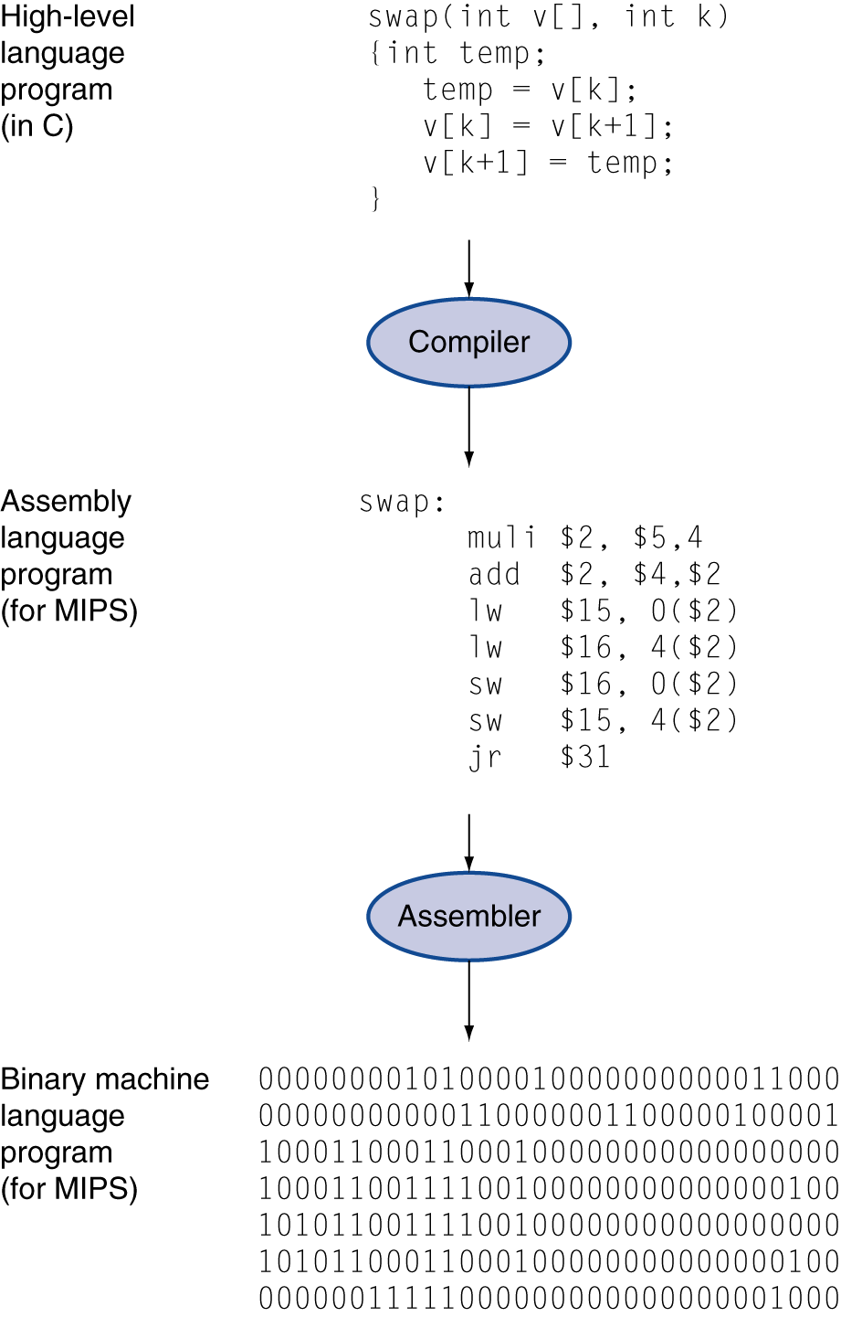
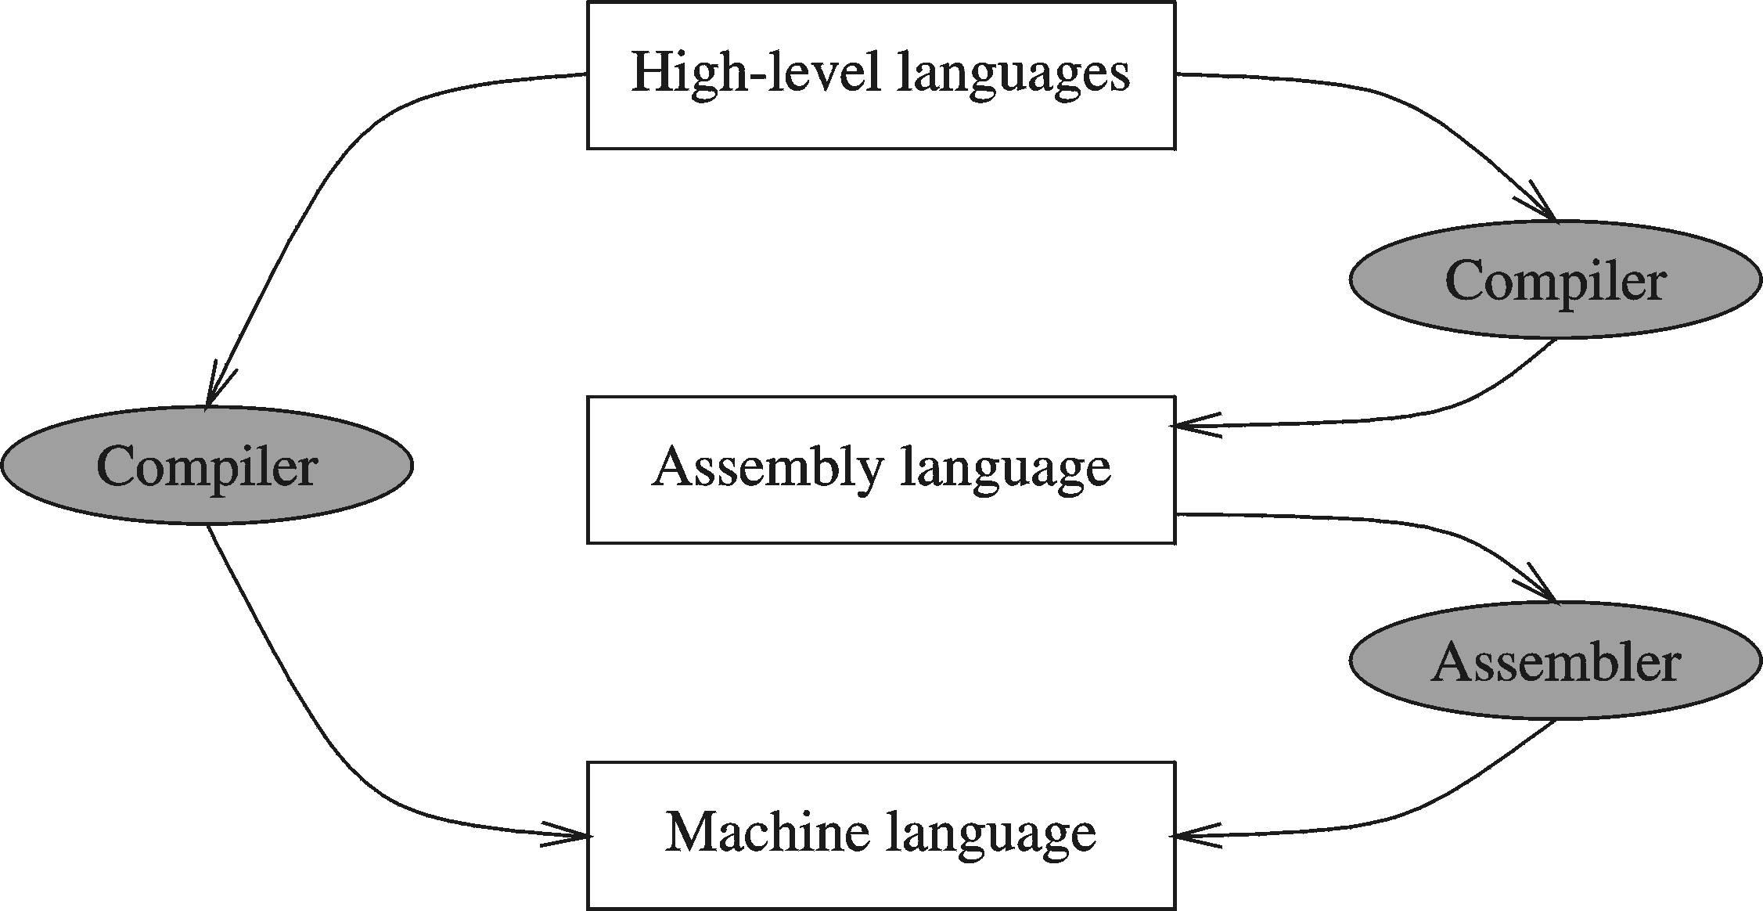
Lecture 01
Levels of Program Code
Compilers and Assemblers

Slide 4
Lecture Outline
Data Representation
  Decimal Representation
  Binary Representation
  Two’s Complement
  Hexadecimal Representation
  Floating Point Representation

Slide 5
Introduction
A bit is the most basic unit of information in a computer.
  It is a state of “on” or “off” in a digital circuit.
  Or “high” or “low” voltage instead of “on” or “off.”
A byte is a group of eight bits.
  A byte is the smallest possible addressable unit of computer storage.
A word is a contiguous group of bytes
  Word sizes of 16, 32, or 64 bits are most common.
  Usually a word represents a number or instruction.
5

Slide 6
Numbering Systems
Numbering systems are characterized by their base number.
In general a numbering system with a base r will have r different digits (including the 0) in its number set. These digits will range from 0 to r-1
The most widely used numbering systems are listed in the table below:
  Decimal
  Binary
  Hexadecimal
  Octal

Slide 7
Number Systems and Bases
Number’s Base “B”
⇒ B unique values per digit.
DECIMAL NUMBER SYSTEM
Base 10: {0, 1, 2, 3, 4, 5, 6, 7, 8, 9}
BINARY NUMBER SYSTEM
Base 2: {0, 1}
HEXADECIMAL NUMBER SYSTEM
Base 16: {0, 1, 2, 3, 4, 5, 6, 7, 8, 9, A, B, C, D, E, F}

Slide 8
Base 10 (Decimal)
Digits: 0, 1, 2, 3, 4, 5, 6, 7, 8, 9 (10 of them)
Example:
  3217 = (3×10³) + (2×10²) + (1×10¹) + (7×10⁰)
  A shorthand form we’ll also use:
    10³ 10² 10¹ 10⁰
    3 2 1 7

Slide 9
Binary Numbers (Base 2)
Digits: 0, 1 (2 of them)
“Binary digit” = “Bit”
Example:
  11010₂ = (1×2⁴) + (1×2³) + (0×2²) + (1×2¹) + (0×2⁰)
  = 16 + 8 + 0 + 2 + 0 = 26₁₀
Choice for machine implementation!
  1 = ON / HIGH / TRUE, 0 = OFF / LOW / FALSE

Slide 10
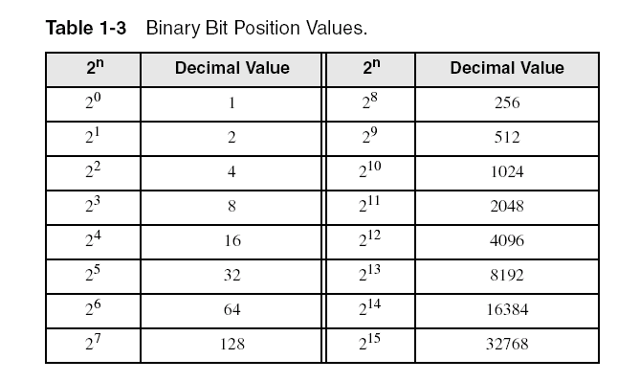
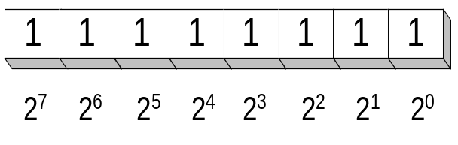
Binary Numbers (Base 2)
Each digit (bit) is either 1 or 0
Each bit represents a power of 2
Every binary number is a sum of powers of 2

Slide 11
Converting Binary to Decimal
Weighted positional notation shows how to calculate the decimal value of each binary bit:
Decimal = (b_{n-1} × 2^{n-1}) + (b_{n-2} × 2^{n-2}) + ... + (b₁ × 2¹) + (b₀ × 2⁰)
b = binary digit
binary 10101001 = decimal 169:
(1 × 2⁷) + (1 × 2⁵) + (1 × 2³) + (1 × 2⁰) = 128+32+8+1=169

Slide 12
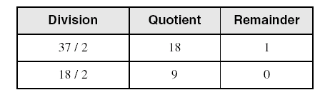
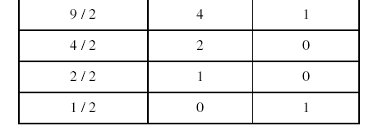
Convert Unsigned Decimal to Binary
Repeatedly divide the Decimal Integer by 2. Each remainder is a binary digit in the translated value:
least significant bit
most significant bit
37₁₀ = 100101₂
stop when quotient is zero

Slide 13
Another Procedure for Converting from Decimal to Binary
Start with a binary representation of all 0’s
Determine the highest possible power of two that is less or equal to the number.
Put a 1 in the bit position corresponding to the highest power of two found above.
Subtract the highest power of two found above from the number.
Repeat the process for the remaining number

Slide 14
Another Procedure for Converting from Decimal to Binary
Example: Converting 76_{d} or 76₁₀ to Binary
  The highest power of 2 less or equal to 76 is 64, hence the seventh (MSB) bit is 1
  Subtracting 64 from 76 we get 12.
  The highest power of 2 less or equal to 12 is 8, hence the fourth bit position is 1
  We subtract 8 from 12 and get 4.
  The highest power of 2 less or equal to 4 is 4, hence the third bit position is 1
  Subtracting 4 from 4 yield a zero, hence all the left bits are set to 0 to yield the final answer

Slide 15
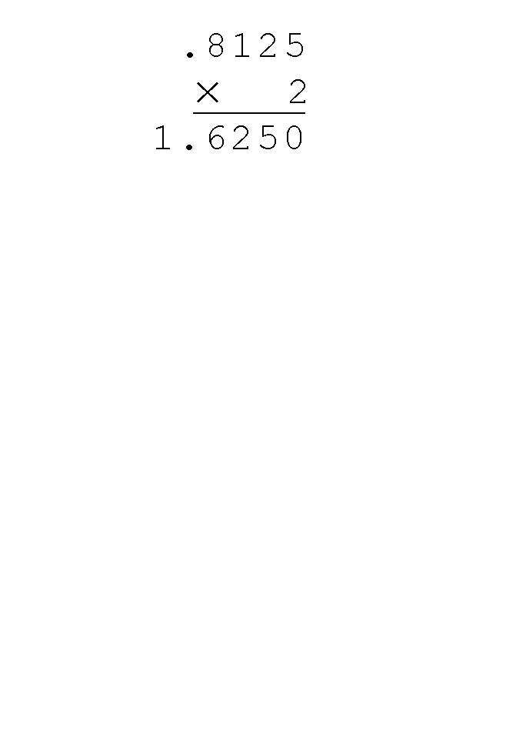
Converting from Decimal fractions to Binary
Using the multiplication method to convert the decimal 0.8125 to binary, we multiply by the radix 2.
  The first product carries into the units place.

Slide 16
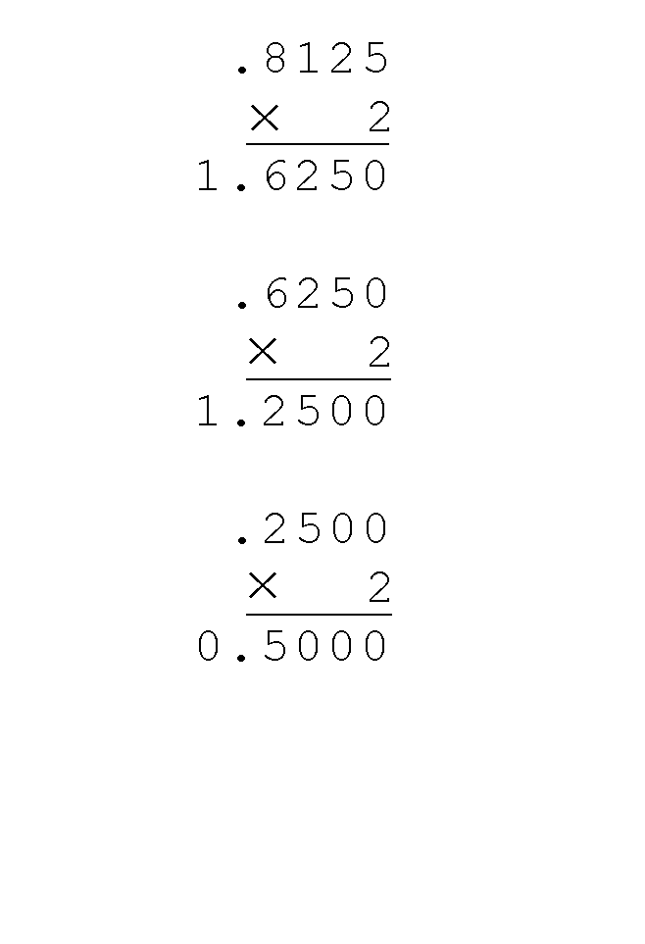
Converting from Decimal fractions to Binary
Converting 0.8125 to binary . . .
  Ignoring the value in the units place at each step, continue multiplying each fractional part by the radix.

Slide 17
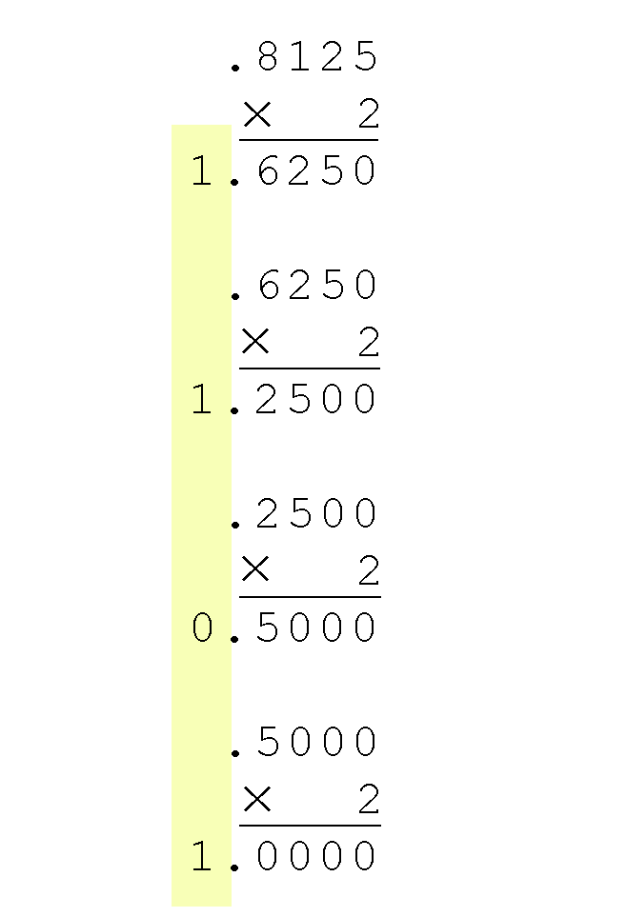
Converting from Decimal fractions to Binary
Converting 0.8125 to binary . . .
  You are finished when the product is zero, or until you have reached the desired number of binary places.
  Our result, reading from top to bottom is:
  0.8125₁₀ = 0.1101₂
  This method also works with any base. Just use the target radix as the multiplier.

Slide 18
Hexadecimal Numbers (Base 16)
Digits: 0,1,2,3,4,5,6,7,8,9,A,B,C,D,E,F (16 of them)
Example: 1A₁₆ or 1A_{h} or 0x1A
Binary values are represented in hexadecimal.
Binary | Decimal | Hexadecimal | Binary | Decimal | Hexadecimal
0000 | 0 | 0 | 1000 | 8 | 8
0001 | 1 | 1 | 1001 | 9 | 9
0010 | 2 | 2 | 1010 | 10 | A
0011 | 3 | 3 | 1011 | 11 | B
0100 | 4 | 4 | 1100 | 12 | C
0101 | 5 | 5 | 1101 | 13 | D
0110 | 6 | 6 | 1110 | 14 | E
0111 | 7 | 7 | 1111 | 15 | F

Slide 19
Numbers inside Computer
Actual machine code is in binary
  0, 1 are High and LOW signals to hardware
Hex (base 16) is often used by humans (code, simulator, manuals, …) because:
16 is a power of 2 (while 10 is not); mapping between hex and binary is easy
It’s more compact than binary
We can write, e.g., 0x90000008 in programs rather than 10010000000000000000000000001000

Slide 20

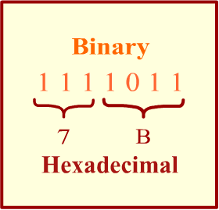
Converting Binary to Hexadecimal
Each hexadecimal digit corresponds to 4 binary bits.
Example: Translate the binary integer 000101101010011110010100 to hexadecimal

Slide 21
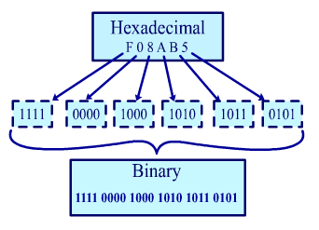
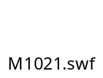
Converting Hexadecimal to Binary
Each Hexadecimal digit can be replaced by its 4-bit binary number to form the binary equivalent.

Slide 22
Converting Hexadecimal to Decimal
Multiply each digit by its corresponding power of 16:
Decimal = (h_{n-1} × 16^{n-1}) + (h_{n-2} × 16^{n-2}) +…+ (h₁ × 16¹) + (h₀ × 16⁰)
h = hexadecimal digit
Examples:
  Hex 1234 = (1 × 16³) + (2 × 16²) + (3 × 16¹) + (4 × 16⁰) =
  Decimal 4,660
  Hex 3BA4 = (3 × 16³) + (11 * 16²) + (10 × 16¹) + (4 × 16⁰) = Decimal 15,268

Slide 23
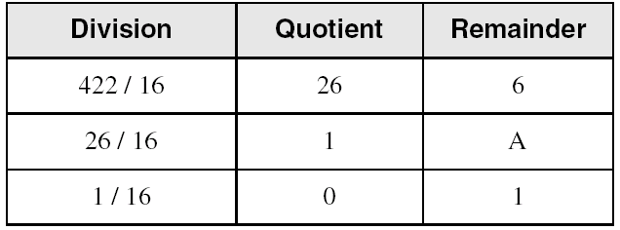
Converting Decimal to Hexadecimal
Repeatedly divide the decimal integer by 16. Each remainder is a hex digit in the translated value:
least significant digit
most significant digit
stop when quotient is zero
Decimal 422 = 1A6 hexadecimal

Slide 24
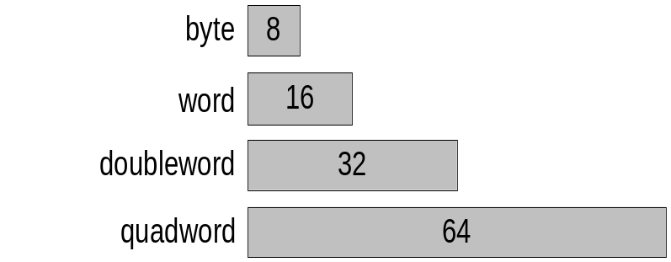
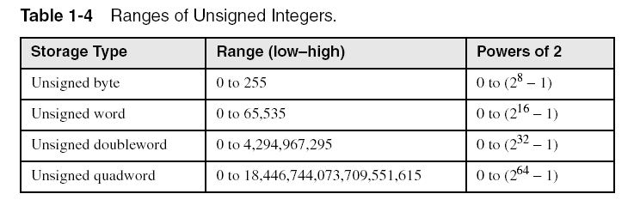
Integer Storage Sizes
Standard sizes:
What is the largest unsigned integer that may be stored in 20 bits?

Slide 25
Binary Addition
Start with the least significant bit (rightmost bit)
Add each pair of bits
Include the carry in the addition, if present
carry:
1
0
0
0
0
0
1
0
0
(4)
+
0
0
0
0
0
1
1
1
(7)
0
0
0
0
1
0
1
1
(11)
bit position:
7
6
5
4
3
2
1
0

Slide 26
Hexadecimal Addition
Start adding Hex. Digits from right to left.
If sum of two Hex. Digits is greater than 15, then divide the sum by Hex. base (16). The quotient becomes the carry value, and the remainder is the sum digit.
1
1
36 28 28 6A
+ 42 45 58 4B
78 6D 80 B5
21 / 16 = 1, remainder 5
Important skill: Programmers frequently add and subtract the addresses of variables and instructions.

Slide 27
Signed Integer Representation
There are three ways in which signed binary numbers may be expressed:
  Signed magnitude,
  One’s complement and
  Two’s complement.
In an 8-bit word, signed magnitude representation places the absolute value of the number in the 7 bits to the right of the sign bit.

Slide 28
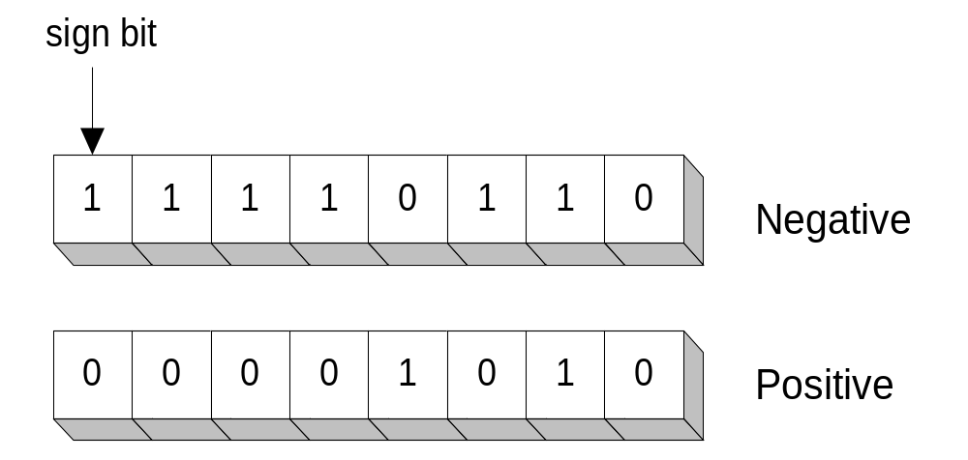
Sign Bit
Highest bit indicates the sign. 1 = negative, 0 = positive
If highest digit of a hexadecimal is > 7, the value is negative
Examples: 8A and C5 are negative bytes
A21F and 9D03 are negative words
B1C42A00 is a negative double-word

Slide 29
Signed Integer Representation
For example, in 8-bit signed magnitude:
+3 is: 00000011
-3 is: 10000011
Computers perform arithmetic operations on signed magnitude numbers in much the same way as humans carry out pencil and paper arithmetic.
  Humans often ignore the signs of the operands while performing a calculation, applying the appropriate sign after the calculation is complete.

Slide 30
Signed Integer Representation
Binary addition is as easy as it gets. You need to know only four rules:
  0 + 0 = 0 0 + 1 = 1
  1 + 0 = 1 1 + 1 = 10
The simplicity of this system makes it possible for digital circuits to carry out arithmetic operations.
  We will describe these circuits in Chapter 3.
Let’s see how the addition rules work with signed magnitude numbers . . .

Slide 31
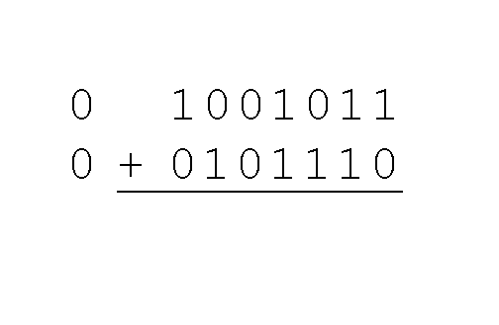
Signed Integer Representation
Example:
  Using signed magnitude binary arithmetic, find the sum of 75 and 46.
First, convert 75 and 46 to binary, and arrange as a sum, but separate the (positive) sign bits from the magnitude bits.

Slide 32
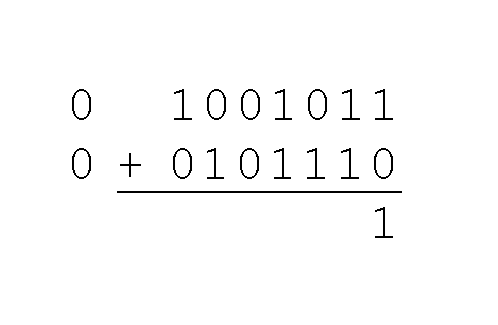
Signed Integer Representation
Example:
  Using signed magnitude binary arithmetic, find the sum of 75 and 46.
Just as in decimal arithmetic, we find the sum starting with the rightmost bit and work left.

Slide 33
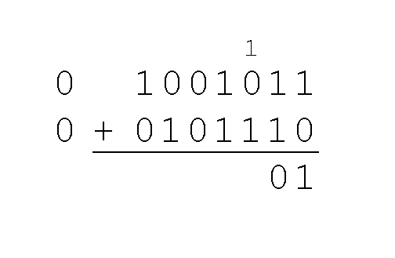
Signed Integer Representation
Example:
  Using signed magnitude binary arithmetic, find the sum of 75 and 46.
In the second bit, we have a carry, so we note it above the third bit.

Slide 34
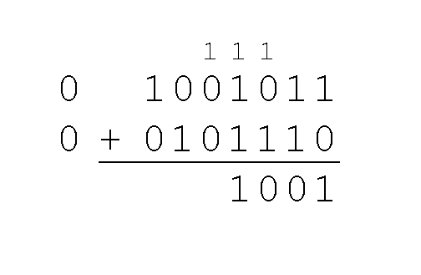
Signed Integer Representation
Example:
  Using signed magnitude binary arithmetic, find the sum of 75 and 46.
The third and fourth bits also give us carries.

Slide 35
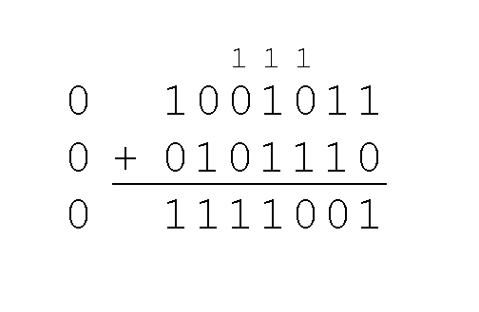
Signed Integer Representation
Example:
  Using signed magnitude binary arithmetic, find the sum of 75 and 46.
Once we have worked our way through all eight bits, we are done.
In this example, we were careful careful to pick two values whose sum would fit into seven bits. If that is not the case, we have a problem.

Slide 36
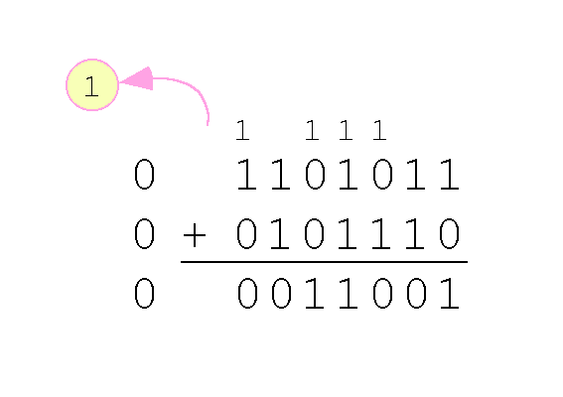
Signed Integer Representation
Example:
  Using signed magnitude binary arithmetic, find the sum of 107 and 46.
We see that the carry from the seventh bit overflows and is discarded, giving us the erroneous result:
107 + 46 = 25.

Slide 37
Signed Integer Representation
Signed magnitude representation is easy for people to understand, but it requires complicated computer hardware.
Another disadvantage of signed magnitude is that it allows two different representations for zero: positive zero and negative zero.
For these reasons (among others) computers systems employ complement systems for numeric value representation.

Slide 38
Signed Integer Representation
In complement systems, negative values are represented by some difference between a number and its base.
In diminished radix complement systems, a negative value is given by the difference between the absolute value of a number and one less than its base.
In the binary system, this gives us one’s complement. It amounts to little more than flipping the bits of a binary number.

Slide 39
Signed Integer Representation
For example, in 8-bit one’s complement;
+ 3 is: 00000011
- 3 is: 11111100
  In one’s complement, as with signed magnitude, negative values are indicated by a 1 in the high order bit.
Complement systems are useful because they eliminate the need for special circuitry for subtraction. The difference of two values is found by adding the minuend to the complement of the subtrahend.

Slide 40
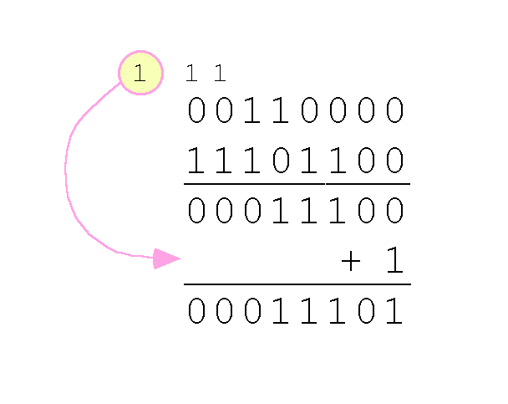
Signed Integer Representation
With one’s complement addition, the carry bit is “carried around” and added to the sum.
  Example: Using one’s complement binary arithmetic, find the sum of 48 and - 19
  We note that 19 in one’s complement is 00010011,
  so -19 in one’s complement is: 11101100.

Slide 41
Signed Integer Representation
Although the “end carry around” adds some complexity, one’s complement is simpler to implement than signed magnitude.
But it still has the disadvantage of having two different representations for zero: positive zero and negative zero.
Two’s complement solves this problem.
Two’s complement is the radix complement of the binary numbering system.

Slide 42
Signed Integer Representation
To express a value in two’s complement:
  If the number is positive, just convert it to binary and you’re done.
  If the number is negative, find the one’s complement of the number and then add 1.
Example:
  In 8-bit one’s complement, positive 3 is: 0 0 0 0 0 0 1 1
  Negative 3 in one’s complement is: 1 1 1 1 1 1 0 0
  Adding 1 gives us -3 in two’s complement form: 11111101.

Slide 43
Forming the Two's Complement
starting value | 00100100 = +36
step1: reverse the bits (1's complement) | 11011011
step 2: add 1 to the value from step 1 | + 1
sum = 2's complement representation | 11011100 = -36
Sum of an integer and its 2's complement must be zero:
00100100 + 11011100 = 00000000 (8-bit sum) ⇒ Ignore Carry
The easiest way to obtain the 2's complement of a binary number is by starting at the LSB, leaving all the 0s unchanged, look for the first occurrence of a 1. Leave this 1 unchanged and complement all the bits after it.

Slide 44
Two's Complement Representation
Positive numbers
  Signed value = Unsigned value
Negative numbers
  Signed value = Unsigned value – 2^{n}
      n = number of bits
Negative weight for MSB
  Another way to obtain the signed value is to assign a negative weight to most-significant bit
  = -128 + 32 + 16 + 4 = -76
8-bit Binary value | Unsigned value | Signed value
00000000 | 0 | 0
00000001 | 1 | +1
00000010 | 2 | +2
. . . | . . . | . . .
01111110 | 126 | +126
01111111 | 127 | +127
10000000 | 128 | -128
10000001 | 129 | -127
. . . | . . . | . . .
11111110 | 254 | -2
11111111 | 255 | -1
1
0
1
1
0
1
0
0
-128
64
32
16
8
4
2
1

Slide 45
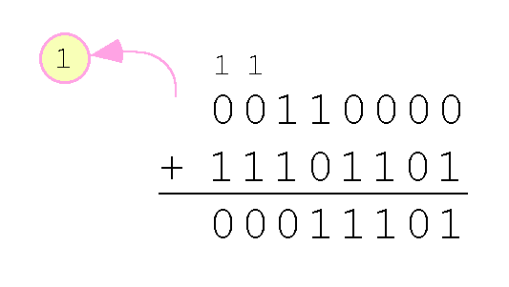
Signed Integer Representation
With two’s complement arithmetic, all we do is add our two binary numbers. Just discard any carries emitting from the high order bit.
Example: Using one’s complement binary arithmetic, find the sum of 48 and - 19.
  We note that 19 in one’s complement is: 00010011,
  so -19 in one’s complement is: 11101100,
  and -19 in two’s complement is: 11101101.

Slide 46
Signed Integer Representation
When we use any finite number of bits to represent a number, we always run the risk of the result of our calculations becoming too large to be stored in the computer.
While we can’t always prevent overflow, we can always detect overflow.
In complement arithmetic, an overflow condition is easy to detect.

Slide 47
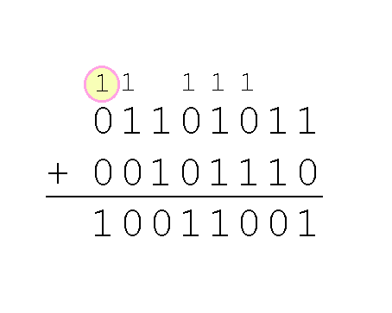
Signed Integer Representation
Example:
  Using two’s complement binary arithmetic, find the sum of 107 and 46.
We see that the nonzero carry from the seventh bit overflows into the sign bit, giving us the erroneous result: 107 + 46 = -103.
Rule for detecting two’s complement overflow: When the “carry in” and the “carry out” of the sign bit differ, overflow has occurred.

Slide 48
Sign Extension
Step 1: Move the number into the lower-significant bits
Step 2: Fill all the remaining higher bits with the sign bit
This will ensure that both magnitude and sign are correct
Examples
  Sign-Extend 10110011 to 16 bits
  Sign-Extend 01100010 to 16 bits
Infinite 0s can be added to the left of a positive number
Infinite 1s can be added to the left of a negative number
10110011 = -77
11111111 10110011 = -77
01100010 = +98
00000000 01100010 = +98
Sign Extension→Required when manipulating signed values of variable lengths (converting 8-bit signed 2’s comp value to 16-bit)

Slide 49
Two's Complement of a Hexadecimal
To form the two's complement of a hexadecimal
  Subtract each hexadecimal digit from 15
  Add 1
Examples:
  2's complement of 6A3D = 95C3
  2's complement of 92F0 = 6D10
  2's complement of FFFF = 0001
No need to convert hexadecimal to binary

Slide 50
Two's Complement of a Hexadecimal
Start at the least significant digit, leaving all the 0s unchanged, look for the first occurrence of a non-zero digit.
Subtract this digit from 16.
Then subtract all remaining digits from 15.
Examples:
  2's complement of 6A3D = 95C3
  2's complement of 92F0 = 6D10
  2's complement of FFFF = 0001
F F F 16
6 A 3 D
--------------
9 5 C 3
F F 16
9 2 F 0
--------------
6 D 1 0

Slide 51
Binary Subtraction
When subtracting A – B, convert B to its 2's complement
Add A to (–B)
0 0 0 0 1 1 0 0 0 0 0 0 1 1 0 0
0 0 0 0 0 0 1 0 1 1 1 1 1 1 1 0 (2's complement)
0 0 0 0 1 0 1 0 0 0 0 0 1 0 1 0 (same result)
Carry is ignored, because
  Negative number is sign-extended with 1's
  You can imagine infinite 1's to the left of a negative number
  Adding the carry to the extended 1's produces extended zeros
–
+
Practice: Subtract 00100101 from 01101001.

Slide 52
Hexadecimal Subtraction
When a borrow is required from the digit to the left, add 16 (decimal) to the current digit's value
Last Carry is ignored
16 + 5 = 21
-1
1
1
C675
A247
242E
C675
5DB9 (2's complement)
242E (same result)
-
+
Practice: The address of var1 is 00400B20. The address of the next variable after var1 is 0040A06C. How many bytes are used by var1?

Slide 53
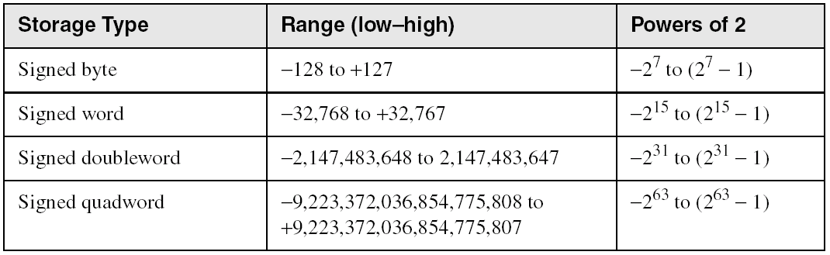
Ranges of Signed Integers
The unsigned range is divided into two signed ranges for positive and negative numbers
Practice: What is the range of signed values that may be stored in 20 bits?

Slide 54
Carry and Overflow
Carry is important when …
  Adding or subtracting unsigned integers
  Indicates that the unsigned sum is out of range
  Either < 0 or > maximum unsigned n-bit value
Overflow is important when …
  Adding or subtracting signed integers
  Indicates that the signed sum is out of range
Overflow occurs when
  Adding two positive numbers and the sum is negative
  Adding two negative numbers and the sum is positive
  Can happen because of the fixed number of sum bits

Slide 55
Carry and Overflow Examples
We can have carry without overflow and vice-versa
Four cases are possible
1
1
1
1
1
1
0
0
0
0
1
1
1
1
15
0
0
0
0
1
1
1
1
15
+
+
0
0
0
0
1
0
0
0
8
1
1
1
1
1
0
0
0
245 (-8)
0
0
0
1
0
1
1
1
23
0
0
0
0
0
1
1
1
7
Carry = 0 Overflow = 0
Carry = 1 Overflow = 0
1
1
1
1
0
1
0
0
1
1
1
1
79
1
1
0
1
1
0
1
0
218 (-38)
+
+
0
1
0
0
0
0
0
0
64
1
0
0
1
1
1
0
1
157 (-99)
1
0
0
0
1
1
1
1
143
(-113)
0
1
1
1
0
1
1
1
119
Carry = 0 Overflow = 1
Carry = 1 Overflow = 1

Slide 56
Summary
Understand the fundamentals of numerical data representation and manipulation in digital computers.
Binary Representation of Numbers
Decimal and Hexadecimal Representation of Numbers
Addition and subtraction of Binary and Hexadecimal Numbers

Slide 57
Floating-Point Representation
The signed magnitude, one’s complement, and two’s complement representation that we have just presented deal with integer values only.
Without modification, these formats are not useful in scientific or business applications that deal with real number values.
Floating-point representation solves this problem.

Slide 58
Floating-Point Representation
If we are clever programmers, we can perform floating-point calculations using any integer format.
This is called floating-point emulation, because floating point values aren’t stored as such, we just create programs that make it seem as if floating-point values are being used.
Most of today’s computers are equipped with specialized hardware that performs floating-point arithmetic with no special programming required.

Slide 59
Floating-Point Representation
Floating-point numbers allow an arbitrary number of decimal places to the right of the decimal point.
  For example: 0.5 × 0.25 = 0.125
They are often expressed in scientific notation.
  For example:
    0.125 = 1.25 × 10⁻¹
    5,000,000 = 5.0 × 10⁶

Slide 60
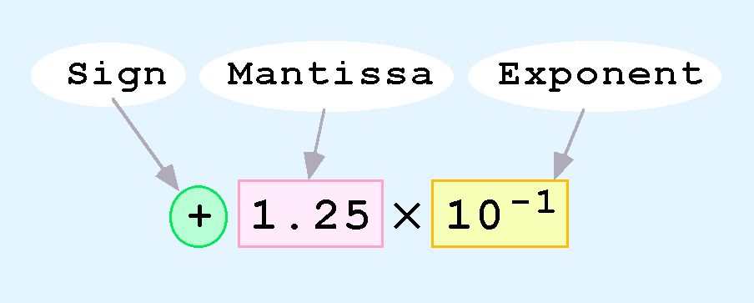
Floating-Point Representation
Computers use a form of scientific notation for floating-point representation
Numbers written in scientific notation have three components:

Slide 61
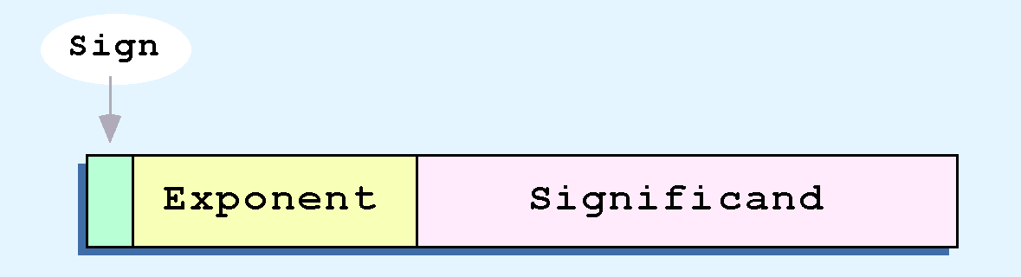
Floating-Point Representation
Computer representation of a floating-point number consists of three fixed-size fields:
This is the standard arrangement of these fields.

Slide 62
Floating-Point Representation
The one-bit sign field is the sign of the stored value.
The size of the exponent field, determines the range of values that can be represented.
The size of the significand determines the precision of the representation.

Slide 63
Floating-Point Representation
The IEEE-754 single precision floating point standard uses an 8-bit exponent and a 23-bit significand.
The IEEE-754 double precision standard uses an 11-bit exponent and a 52-bit significand.
For illustrative purposes, we will use a 14-bit model with a 5-bit exponent and an 8-bit significand.

Slide 64
Floating-Point Representation
The significand of a floating-point number is always preceded by an implied binary point.
Thus, the significand always contains a fractional binary value.
The exponent indicates the power of 2 to which the significand is raised.

Slide 65
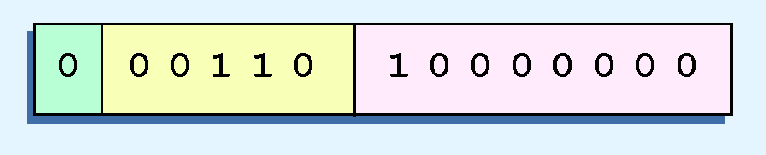
Floating-Point Representation
Example:
  Express 32₁₀ in the simplified 14-bit floating-point model.
We know that 32 is 2⁵. So in (binary) scientific notation 32 = 1.0 x 2⁵ = 0.1 x 2⁶.
Using this information, we put 110 (= 6₁₀) in the exponent field and 1 in the significand as shown.

Slide 66
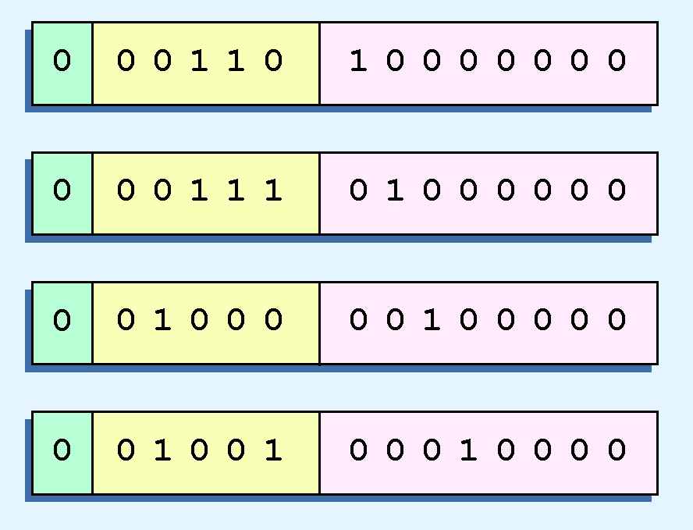
Floating-Point Representation
The illustrations shown at the right are all equivalent representations for 32 using our simplified model.
Not only do these synonymous representations waste space, but they can also cause confusion.

Slide 67
Floating-Point Representation
Another problem with our system is that we have made no allowances for negative exponents. We have no way to express 0.5 (=2 ⁻¹)! (Notice that there is no sign in the exponent field!)
All of these problems can be fixed with no changes to our basic model.

Slide 68
Floating-Point Representation
To resolve the problem of synonymous forms, we will establish a rule that the first digit of the significand must be 1. This results in a unique pattern for each floating-point number.
  In the IEEE-754 standard, this 1 is implied meaning that a 1 is assumed after the binary point.
  By using an implied 1, we increase the precision of the representation by a power of two. (Why?)
In our simple instructional model, we will use no implied bits.

Slide 69
Floating-Point Representation
To provide for negative exponents, we will use a biased exponent.
A bias is a number that is approximately midway in the range of values expressible by the exponent. We subtract the bias from the value in the exponent to determine its true value.
  In our case, we have a 5-bit exponent. We will use 16 for our bias. This is called excess-16 representation.
In our model, exponent values less than 16 are negative, representing fractional numbers.

Slide 70
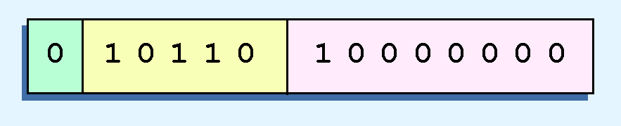
Floating-Point Representation
Example:
  Express 32₁₀ in the revised 14-bit floating-point model.
We know that 32 = 1.0 x 2⁵ = 0.1 x 2⁶.
To use our excess 16 biased exponent, we add 16 to 6, giving 22₁₀ (=10110₂).
Graphically:

Slide 71

Floating-Point Representation
Example:
  Express 0.0625₁₀ in the revised 14-bit floating-point model.
We know that 0.0625 is 2⁻⁴. So in (binary) scientific notation 0.0625 = 1.0 x 2⁻⁴ = 0.1 x 2 ⁻³.
To use our excess 16 biased exponent, we add 16 to -3, giving 13₁₀ (=01101₂).

Slide 72

Floating-Point Representation
Example:
  Express -26.625₁₀ in the revised 14-bit floating-point model.
We find 26.625₁₀ = 11010.101₂. Normalizing, we have: 26.625₁₀ = 0.11010101 x 2 ⁵.
To use our excess 16 biased exponent, we add 16 to 5, giving 21₁₀ (=10101₂). We also need a 1 in the sign bit.

Slide 73
Floating-Point Representation
The IEEE-754 single precision floating point standard uses bias of 127 over its 8-bit exponent.
  An exponent of 255 indicates a special value.
    If the significand is zero, the value is ± infinity.
    If the significand is nonzero, the value is NaN, “not a number,” often used to flag an error condition.
The double precision standard has a bias of 1023 over its 11-bit exponent.
  The “special” exponent value for a double precision number is 2047, instead of the 255 used by the single precision standard.

Slide 74
Floating-Point Representation
Both the 14-bit model that we have presented and the IEEE-754 floating point standard allow two representations for zero.
  Zero is indicated by all zeros in the exponent and the significand, but the sign bit can be either 0 or 1.
This is why programmers should avoid testing a floating-point value for equality to zero.
  Negative zero does not equal positive zero.

Slide 75
Floating-Point Representation
Floating-point addition and subtraction are done using methods analogous to how we perform calculations using pencil and paper.
The first thing that we do is express both operands in the same exponential power, then add the numbers, preserving the exponent in the sum.
If the exponent requires adjustment, we do so at the end of the calculation.

Slide 76
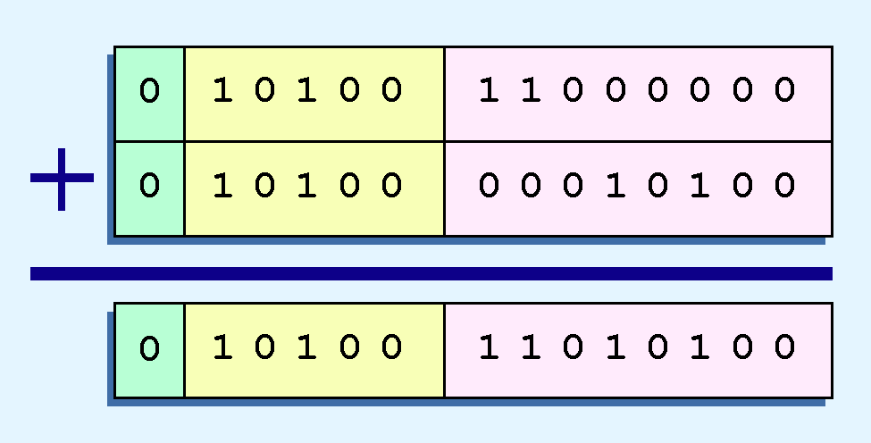
Floating-Point Representation
Example:
  Find the sum of 12₁₀ and 1.25₁₀ using the 14-bit floating-point model.
We find 12₁₀ = 0.1100 x 2 ⁴. And 1.25₁₀ = 0.101 x 2 ¹ = 0.000101 x 2 ⁴.
Thus, our sum is 0.110101 x 2 4.

Slide 77
Floating-Point Representation
Floating-point multiplication is also carried out in a manner akin to how we perform multiplication using pencil and paper.
We multiply the two operands and add their exponents.
If the exponent requires adjustment, we do so at the end of the calculation.

Slide 78
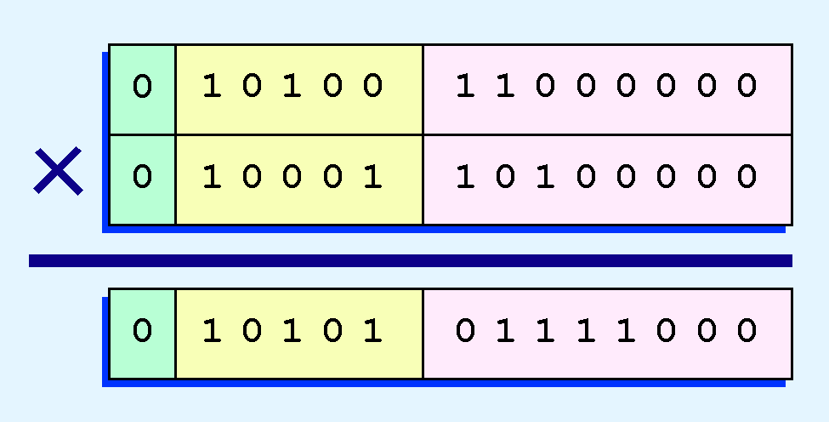
Floating-Point Representation
Example:
  Find the product of 12₁₀ and 1.25₁₀ using the 14-bit floating-point model.
We find 12₁₀ = 0.1100 x 2 ⁴. And 1.25₁₀ = 0.101 x 2 ¹.
Thus, our product is 0.0111100 x 2 5 = 0.1111 x 2 4.
The normalized product requires an exponent of 20₁₀ = 10110₂.

Slide 79
Floating-Point Representation
No matter how many bits we use in a floating-point representation, our model must be finite.
The real number system is, of course, infinite, so our models can give nothing more than an approximation of a real value.
At some point, every model breaks down, introducing errors into our calculations.
By using a greater number of bits in our model, we can reduce these errors, but we can never totally eliminate them.

Slide 80
Floating-Point Representation
Our job becomes one of reducing error, or at least being aware of the possible magnitude of error in our calculations.
We must also be aware that errors can compound through repetitive arithmetic operations.
For example, our 14-bit model cannot exactly represent the decimal value 128.5. In binary, it is 9 bits wide:
  10000000.1₂ = 128.5₁₀

